Slide 1
Chapter 8
Anthropogenic and Natural Radiative Forcing
David I. Duncan
Jianbo Liu
Oct 20, 2014

Slide 2
Table of Contents
8.1 Radiative Forcing
8.2 Atmospheric Chemistry
8.3 Present-Day Anthropogenic Radiative Forcing
8.4 Natural Forcing Changes: Solar and Volcanic
8.5 Synthesis of Global Mean Radiative Forcing, Past and Future
8.6 Geographic Distribution of Radiative Forcing
8.7 Emission Metrics

Slide 3
Roadmap for the First Half
Radiative Forcing (RF) ⬅ Section 8.1
  RF, instantaneous RF, and effective RF
RFs by Individual Chemical Species ⬅ Section 8.2 & 8.3
  Ozone
  Stratospheric Water Vapor
  WMGHG: CO₂, CH₄, N₂O
  Aerosols
  Land Surface Changes
Natural Forcing Changes ⬅ Section 8.4
  Solar Irradiance
  Volcanic Eruptions

Slide 4
IT’S ALL ABOUT RF…
RF (stratospherically adjusted RF, inherited from AR4)
  Change in the net (down minus up) downward radiative flux (SW+LW) at the tropopause
  Allow stratospheric temperature to readjust
  Surface tropospheric temperatures and state variables fixed
Instantaneous RF
  Change in the net flux at TOA or climatological tropopause
  Temperature fixed everywhere
  In response to the imposed forcing alone
  Counteractions by the climate system are excluded
Effective RF
  Change in the net flux at TOA
  Allow atmospheric temperatures, water vapor and clouds to adjust, and partially fix surface temperature
  Including the forcing agent and the rapid adjustments
A combination of RF and ERF will be used in this chapter
  In most cases, RF and ERF only differ by a few percent
  Pre-Industrial Value (1750), Present Value (2011), Projected Value (2100)

Slide 5
Instantaneous RF
Stratospherically adjusted RF
ERF
#1
ERF
#2
ERF
#3

Slide 6
Tropospheric ozone RF is largely attributed to anthropogenic emissions of methane, nitrogen oxides, carbon monoxide and non-methane volatile organic compounds
Stratospheric ozone RF results primarily from ozone depletion by halocarbons
Tropospheric Ozone
Burden

Slide 7
The total RF estimated from modeled ozone changes is 0.35 W m-2, with RF due to tropospheric ozone changes of 0.4 Wm-2 and due to stratospheric ozone changes of -0.05 Wm-2
Ozone is not emitted directly into the atmosphere, but formed by photochemical reactions
There is robust evidence that tropospheric ozone has a detrimental impact on vegetation physiology, and therefore on its CO2 uptake, but here is low confidence on quantitative estimates of the RF owing to this indirect effect

Slide 8
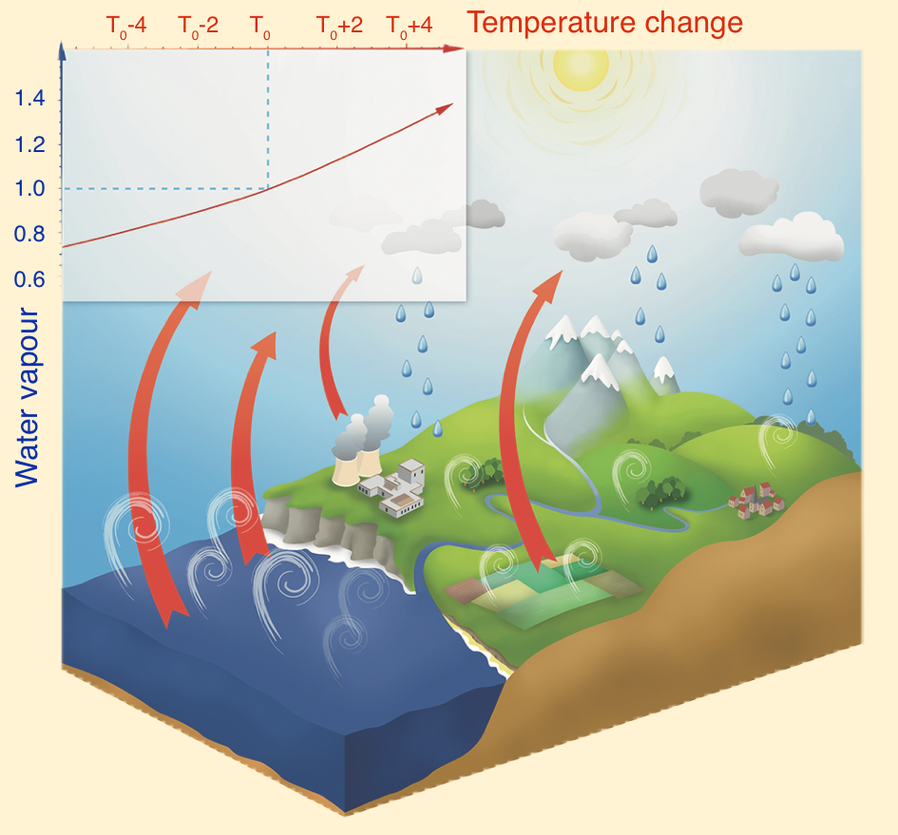
Stratospheric water vapor abundance increased by an average of 1.0±0.2 ppm during 1980-2010, with CH₄ oxidation explaining approximately 25% of this increase, or approximately 0.07 Wm⁻²
RF contributed from civilian aircraft in 2005 is around 0.0009 Wm⁻², with high confidence in the upper limit
Contrails and contrail-induced cirrus give a 0.05 Wm⁻² ERF estimate
Sources for Stratospheric Water Vapor
Free exchange at the tropopause
Direction injection by volcanoes and aircrafts
Chemical reactions, e.g. oxidation of CH₄

Slide 9
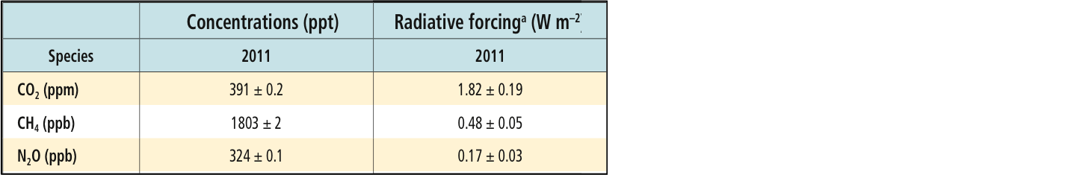
Due to the increased concentrations, RF from WMGHGs has increased by 0.20 (now 2.83) Wm⁻² since the AR4 estimate for the year of 2005
There is high confidence that the overall growth rate in the RF from all WMGHG is smaller over the last decade than in the 1970s and 1980s owing to a reduced rate of increase in the combined non-CO₂ RF
Notes:
Due to the increased concentrations, RF from WMGHGs has increased by 0.20 Wm-2 (0.-18 to 0.22, 8%) since the AR4 estimate for the year of 2005.2. here is high confidence that the overall growth rate in the RF from all WMGHG is small er over the last decade than in the 1970s and 1980s owing to a reduced rate of increase in the combined non-CO2 RF.

Slide 10
Despite the large uncertainty range, there is a high confidence that aerosols have offset a substantial portion of the WMGHG global mean forcing.

Slide 11
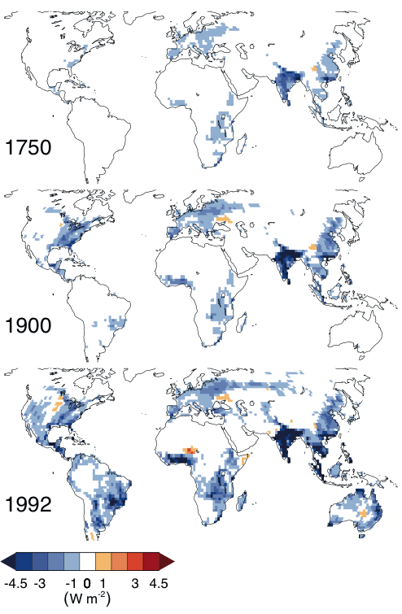
There is low agreement on the sign of the net change in global mean temperature as a result of land use change
There is very likely that anthropogenic land use change has increased the land surface albedo, which leads to an RF of -0.15±0.10 Wm⁻²
Notes:
There is low agreement on the sign of the net change in global mean temperature as a result of land use change.
there is robust evidence that anthropogenic land use change has increased the land surface albedo, which leads to an RF of -0.15±0.10 Wm⁻²

Slide 12
There is a very low confidence concerning the future solar forcing estimates (from 1745 to 2008, 0.05 Wm⁻², medium confidence)
There is a high confidence that the TSI RF variation will be much smaller than the projected increased forcing due to the GHG during the forthcoming decades
Notes:
There is very low confidence concerning the future solar forcing estimates, but there is high confidence that the TSI RF variation will be much smaller than the projected increased forcing due to the GHG during the forthcoming decades.

Slide 13
The RF of volcanic aerosols is well understood and is greatest for a short period (~2 years) following volcanic eruptions
There is very high confidence that industrial-era natural forcing is a small fraction of the anthropogenic forcing except for brief periods following large volcanic eruptions.

Slide 14
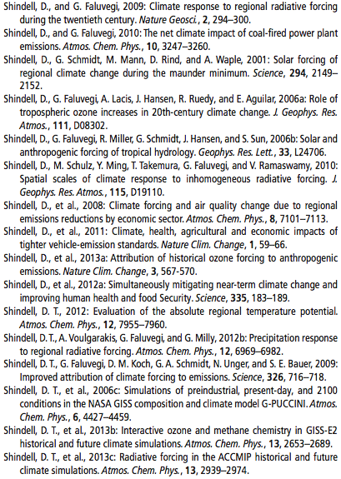
Sections 8.5, (8.6, 8.7)
At the risk of coming across glibly... Here’s the
SDS (Summary for Disinterested Students):
Aerosol people need to try harder
Shindell et al. ad nauseam (16 lead author self-citations!)
People like bar graphs
Not well written

Slide 15
Section 8.5
Synthesis of global mean radiative forcing, past and future

Slide 16
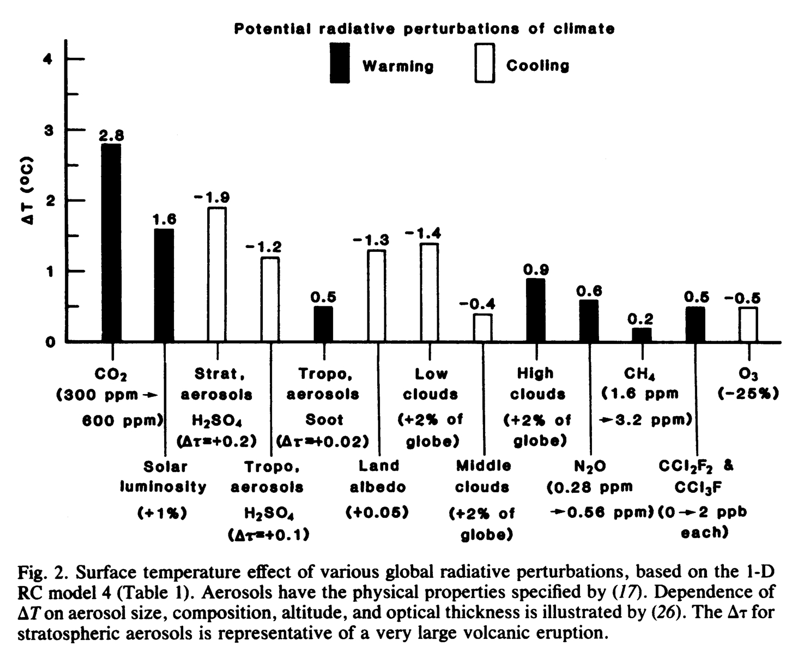
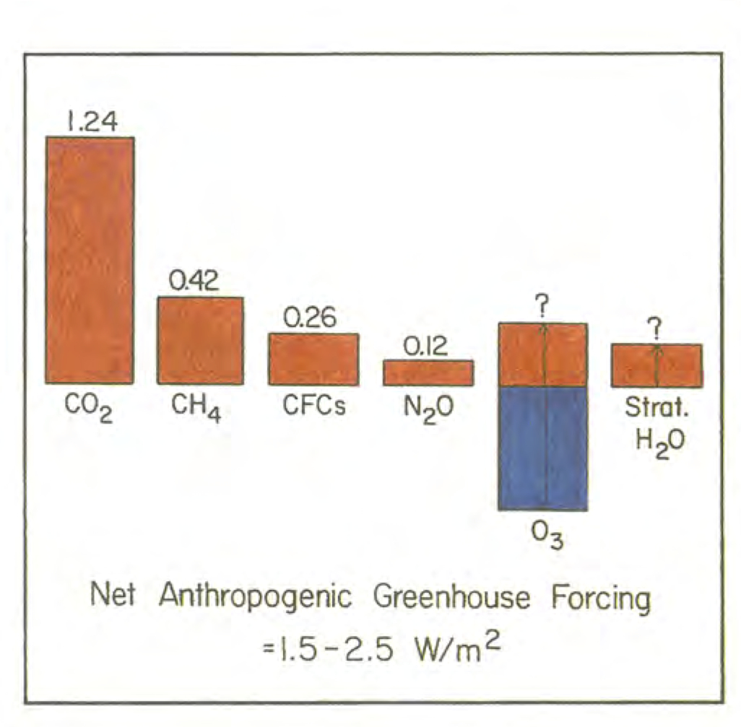
Some historical context
(http://www.realclimate.org/index.php/archives/2013/10/the-evolution-of-radiative-forcing-bar-charts/):
Hansen et al (1981)
Equilibrium response? Temperature units.
Hansen et al (1993)
Against 1850 reference, now in W/m²

Slide 17
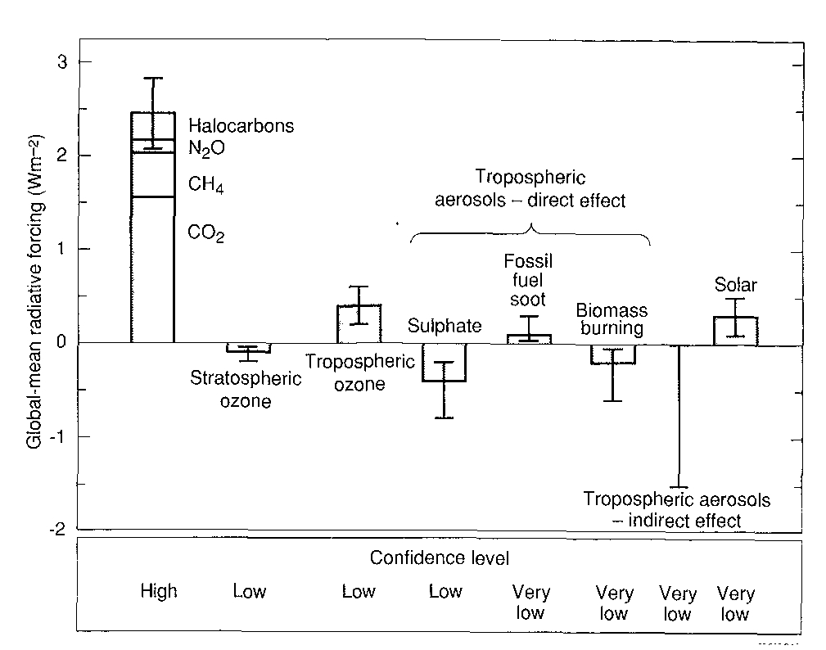
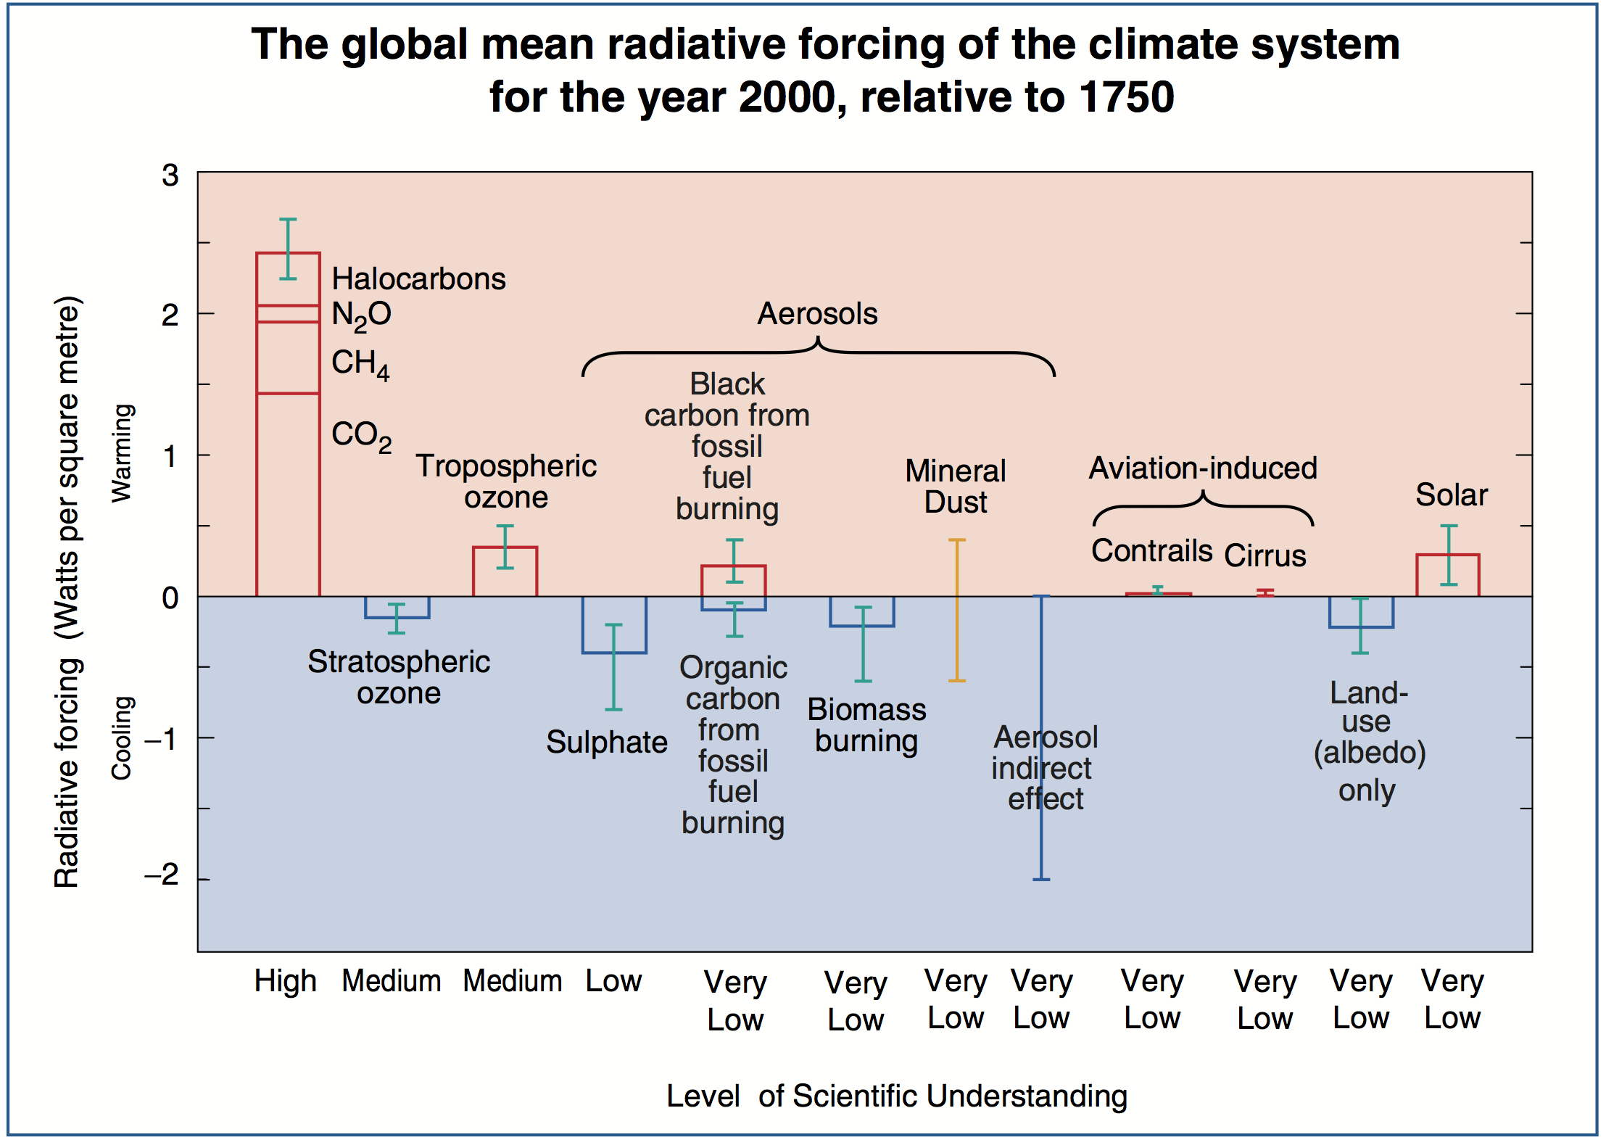
SAR (1995)
Confidence levels, aerosol prominence
TAR (2001)
More aerosols! Add land-use, BC/OC.
Lots of ‘very low’ LOSU

Slide 18
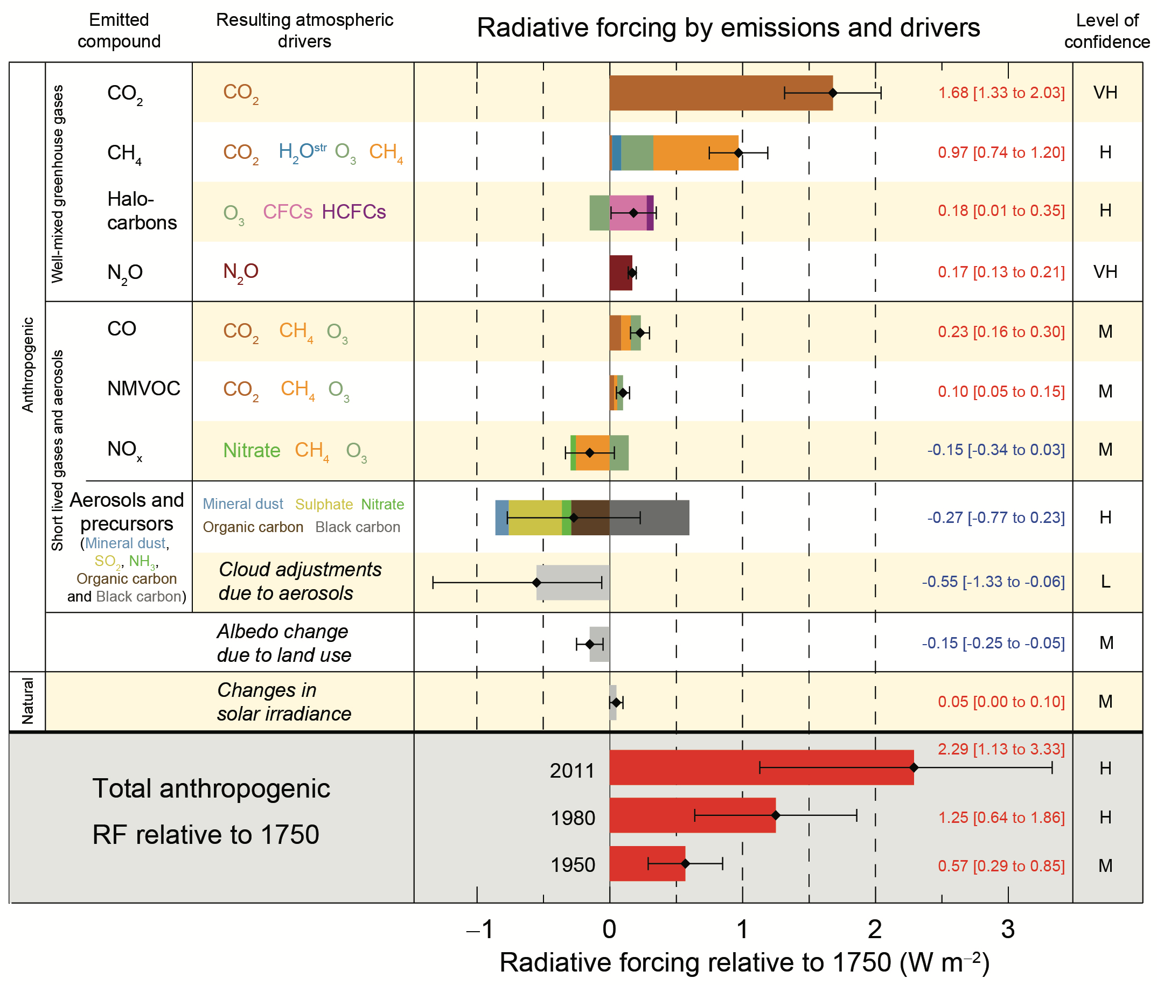
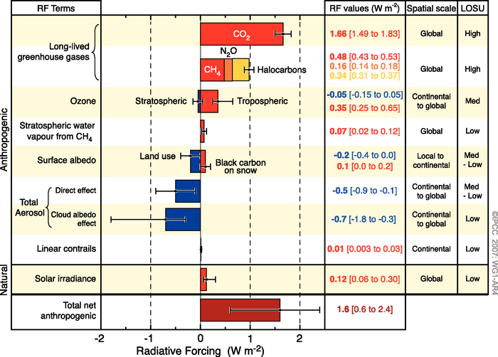
AR4 (2007)
Turn it 90°! Add color!
BC on snow, stratospheric WV
AR5 SPM (2013)
Separated by compound
Compare historically

Slide 19
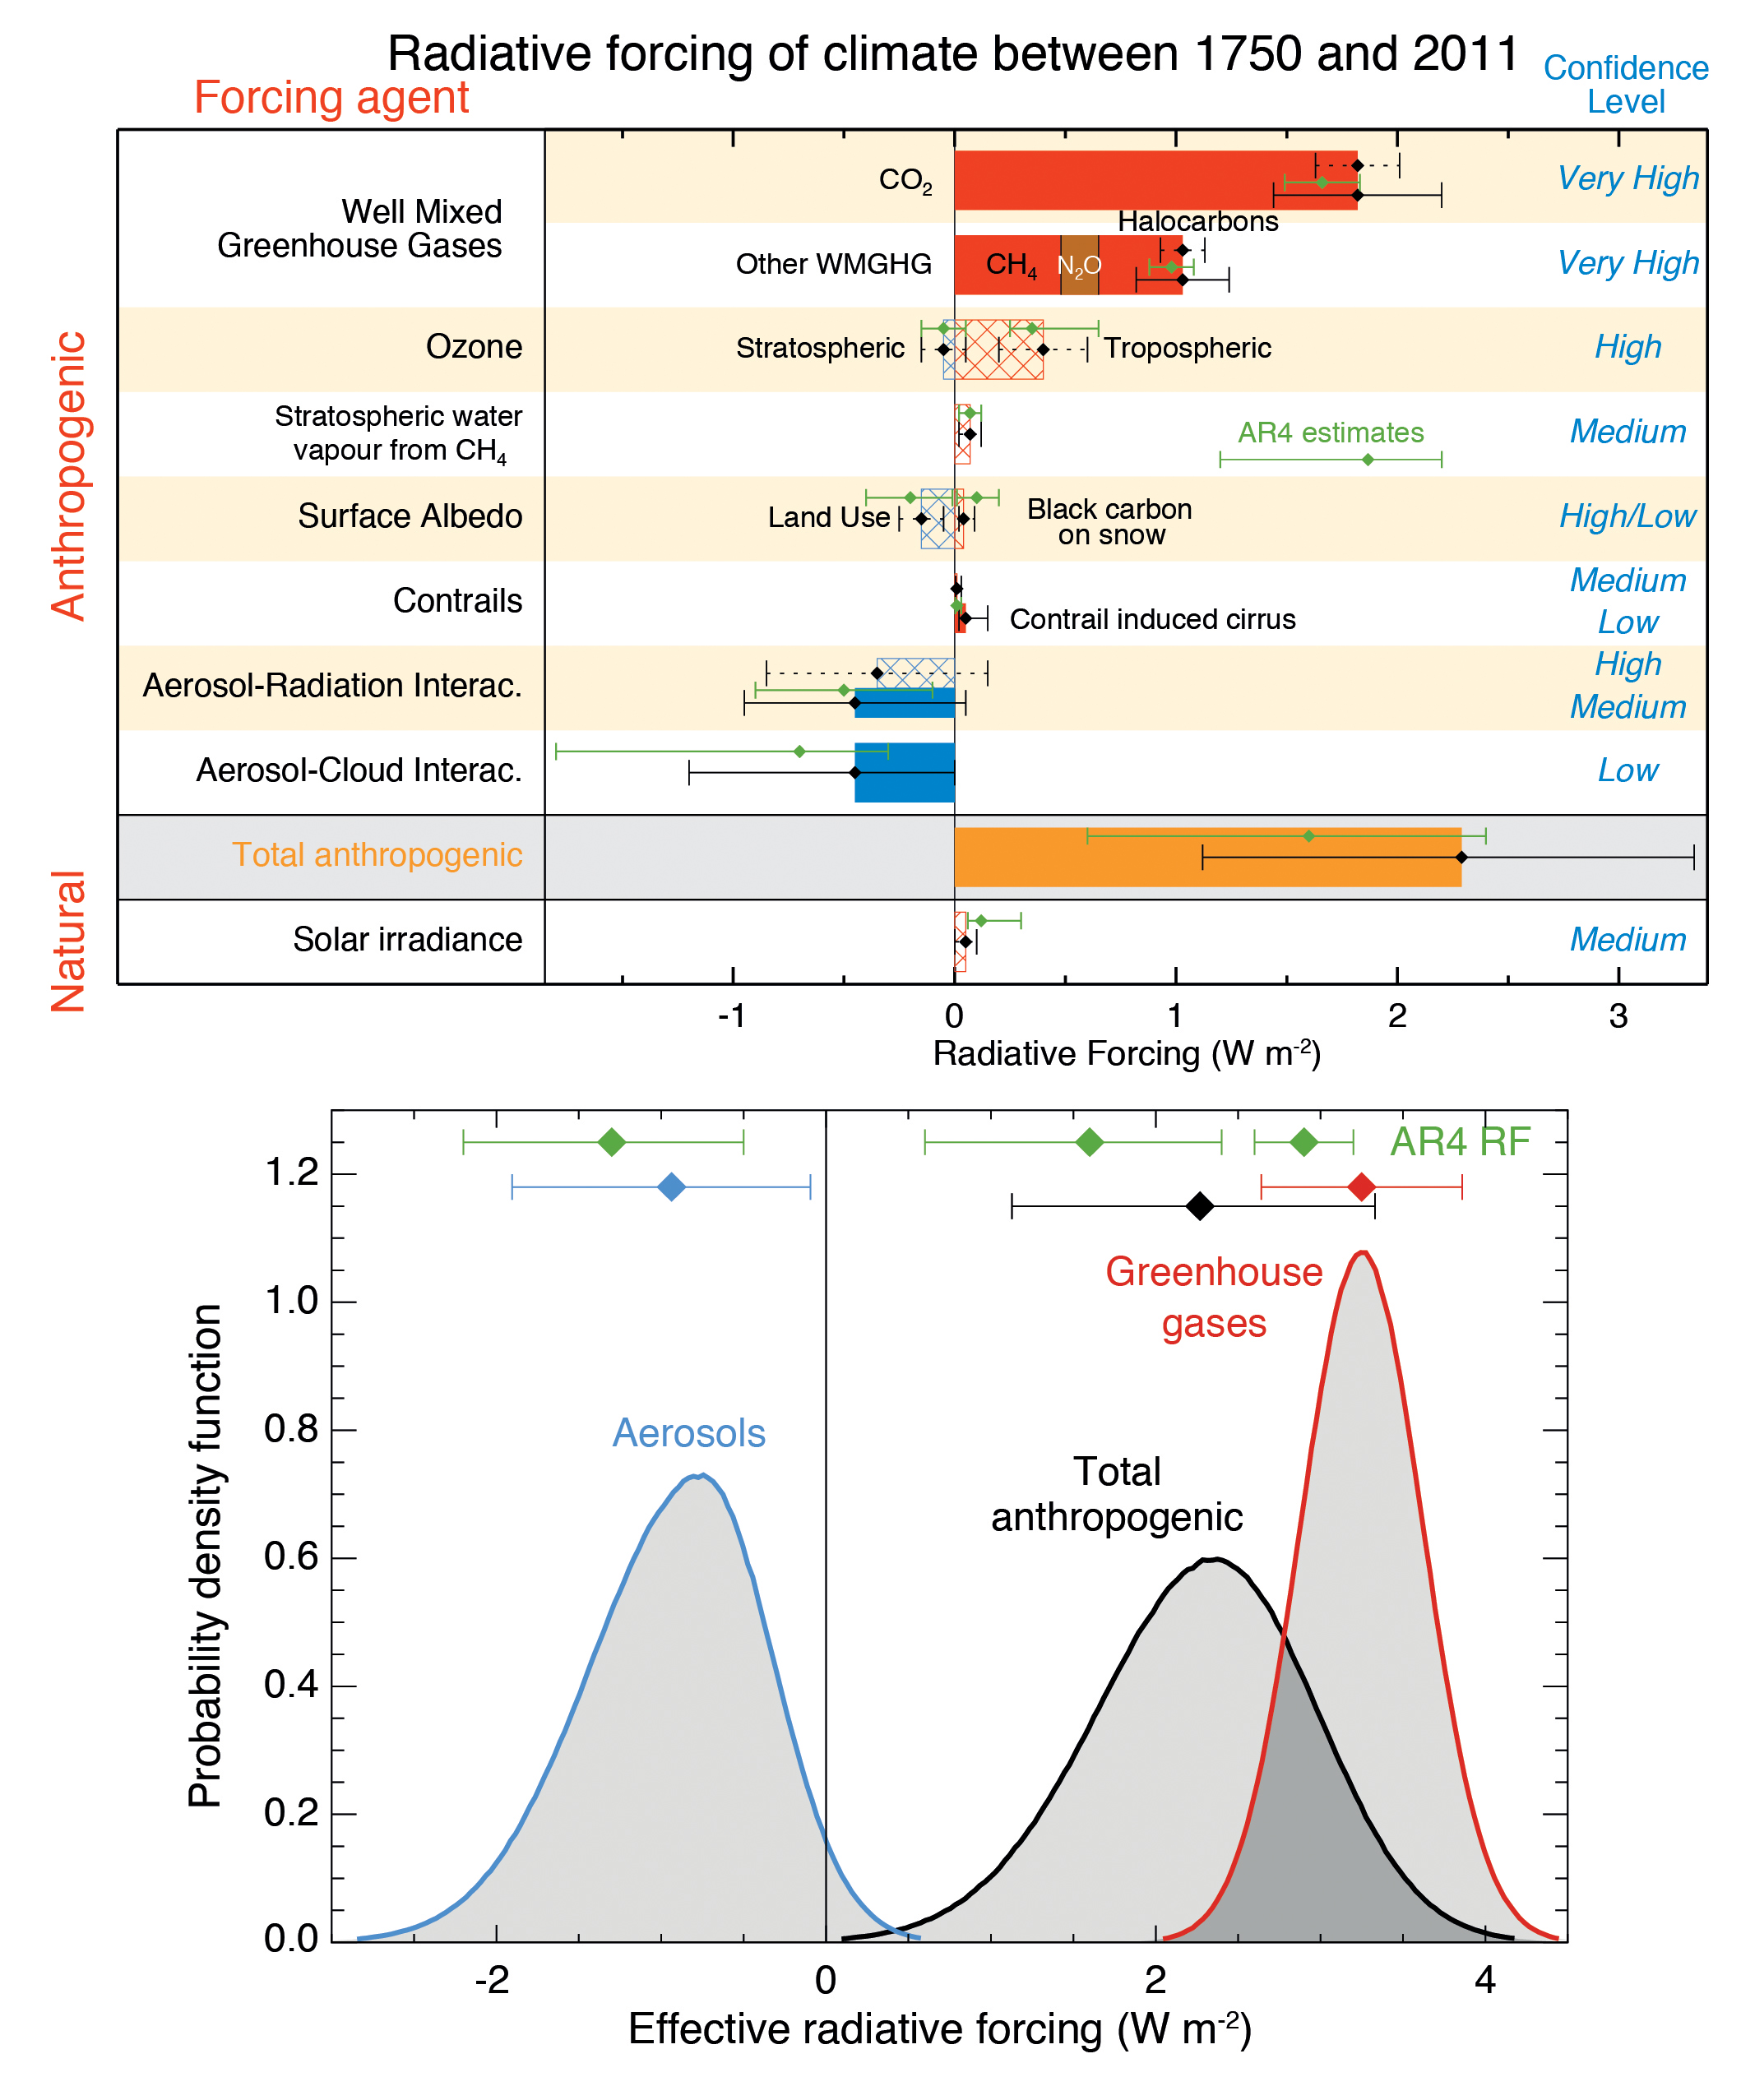
RF (hatched)
ERF (solid)
AR5 TS (2013)
Give me a PDF!
No numbers

Slide 20
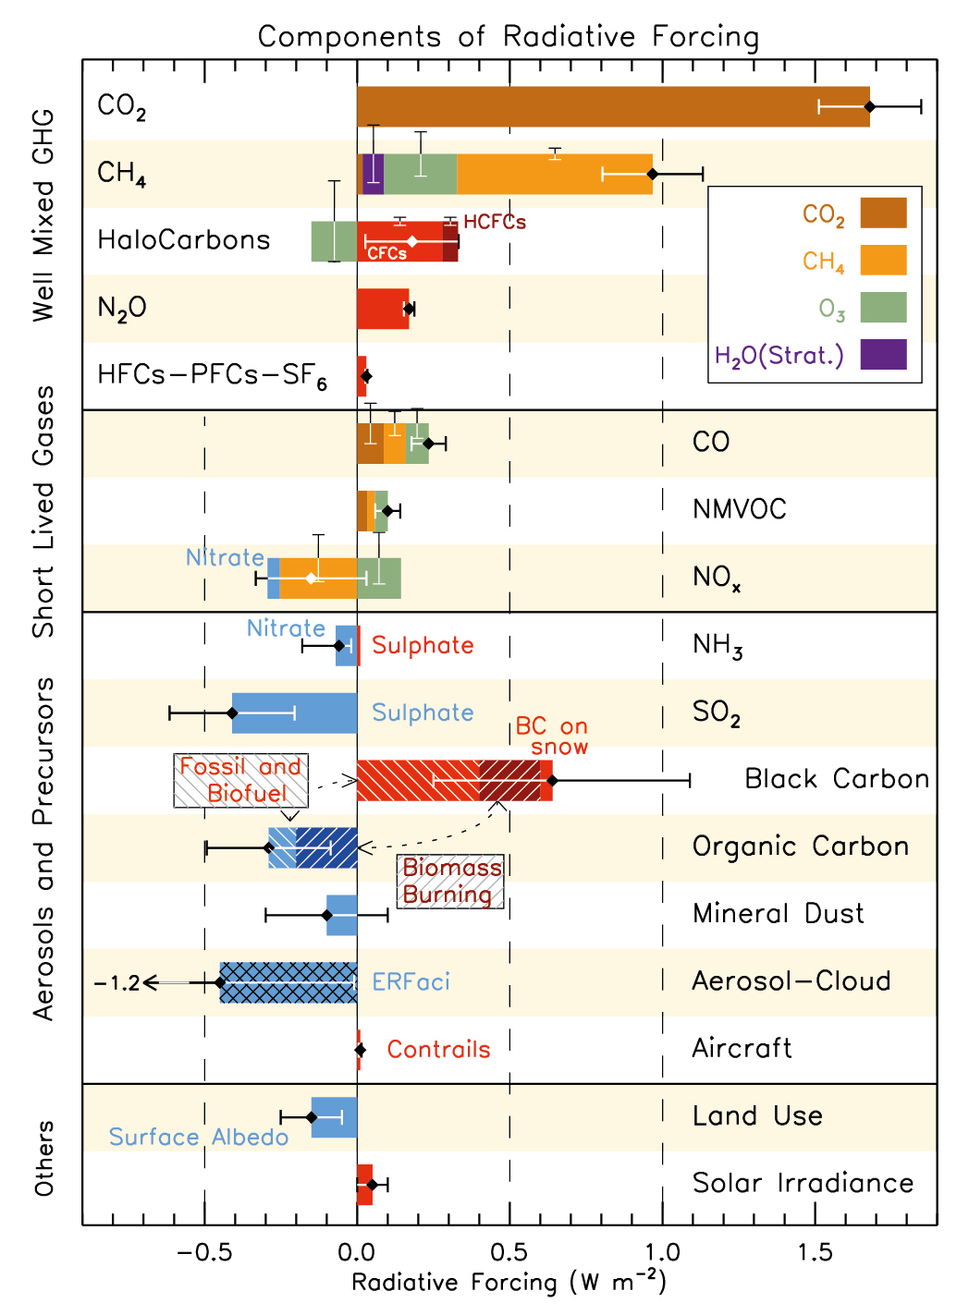
AR5 ch8 (2013)
Give me a more
complicated graphic!
And combined effects!
And secondary effects!
But not SOA...

Slide 21
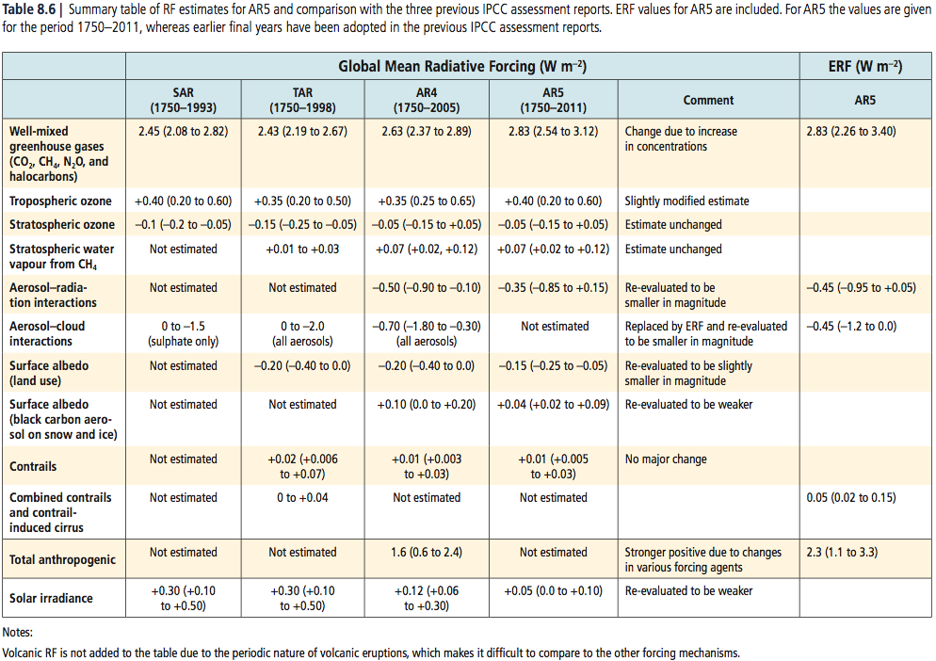
Comparison to AR4
“The best estimates for RF due to aerosol-radiation interactions, BC on snow and solar irradiance are all substantially decreased in magnitude compared to AR4; otherwise the modifications to the best estimates are rather small. For the RF due to aerosol-radiation interaction and BC on snow the changes in the estimates are based on additional new studies since AR4”

Slide 22
Quick summary
“...the large uncertainty in the aerosol forcing is the main cause of the large uncertainty in the total anthropogenic ERF.”
“The total anthropogenic forcing is virtually certain to be positive with the probability for a negative value less than 0.1%.”
Anthropogenic ERF increased 43% from AR4 to AR5 due to higher GHG concentrations and weaker ERF estimates of aerosol forcings
“Additionally indirect effects from sulphate on atmospheric compounds are not included here as models typically simulate a small effect...”

Slide 23
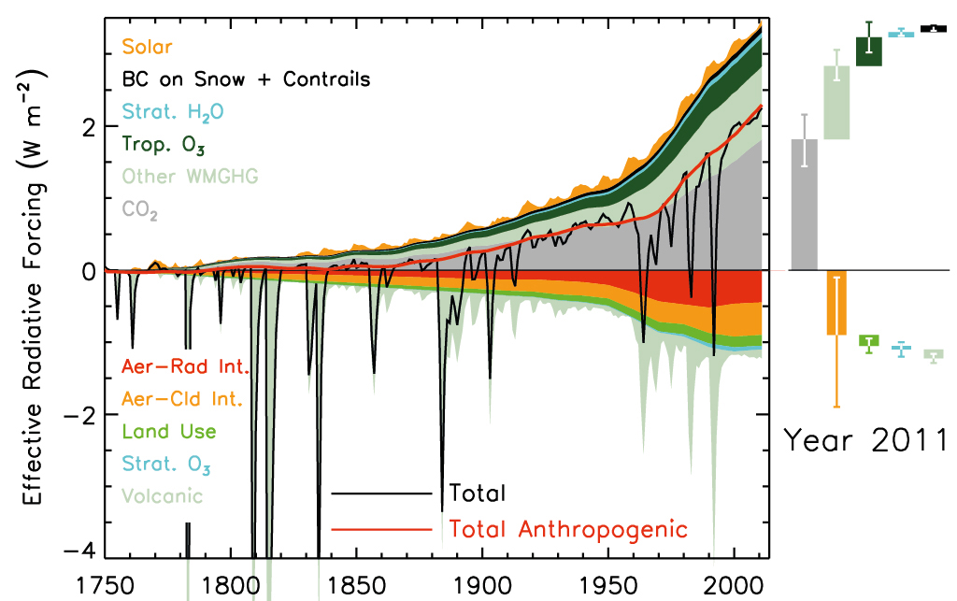
AR5 ch8 (2013)
Historical Perspectives
“Similar to the results for 1970-2011 in Figure 8.19, Box 13.1 shows that the global energy budget is dominated by anthropogenic forcing compared to the natural forcing, except for the two major volcanic eruption in the period as can be easily seen in Figure 8.18”
Even though most of the data in this is necessarily quite contrived, it’s still my favorite graphic of the chapter. Simple, colorful, present day with historical record, positive vs. negative forcings...

Slide 24
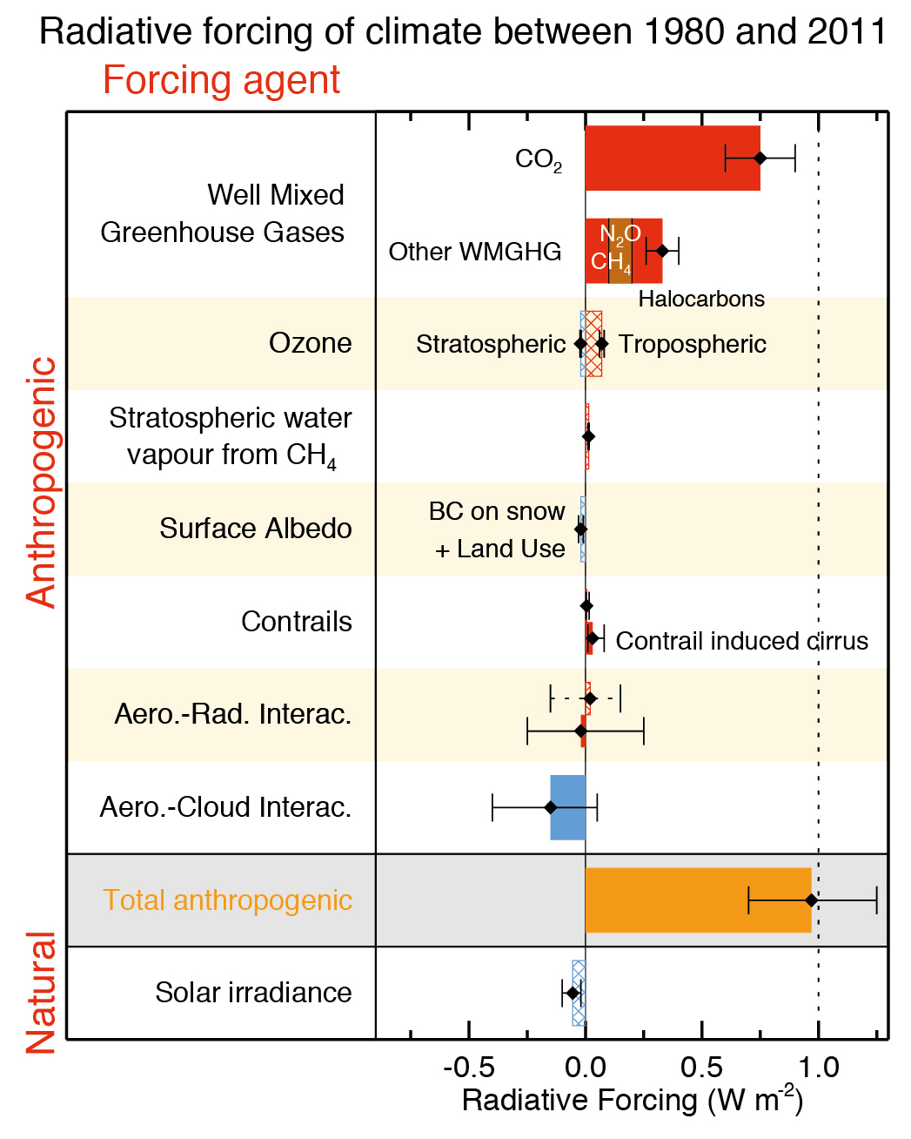
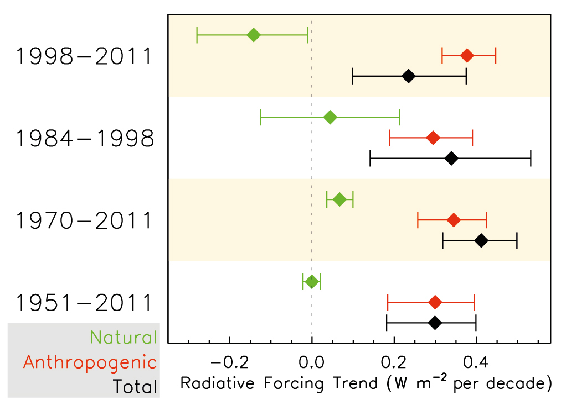
AR5 ch8 (2013)
Historical Perspectives
Trends!
Weird year ranges
Explaining slowdown of warming?

Slide 25
Quick summary
“There is very low confidence for the trend in the total aerosol forcing during the past two to three decades, even the sign; however, there is high confidence that the offset from aerosol forcing to WMGHG forcing during this period was much smaller than over the 1950-1980 period.”
“For the 1998-2011 period the natural forcing is very likely negative and has offset 2-89% of the anthropogenic forcing. It is likely that the natural forcing change has offset at least 30% of the anthropogenic forcing increase and very likely that it has offset at least 10% of the anthropogenic increase.”

Slide 26
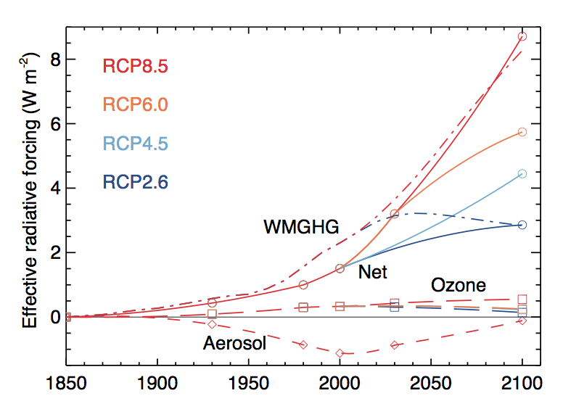
Future Forcing?
“Of course the projections of drastic reduction in primary aerosol as well as aerosol and ozone precursor emissions may be overly optimistic as they assume virtually all nations in the world become wealthy and that emissions reductions are directly dependent on wealth.”
“Natural forcings will also change in the future. The magnitudes cannot be reliably project, but are likely to be small...”

Slide 27
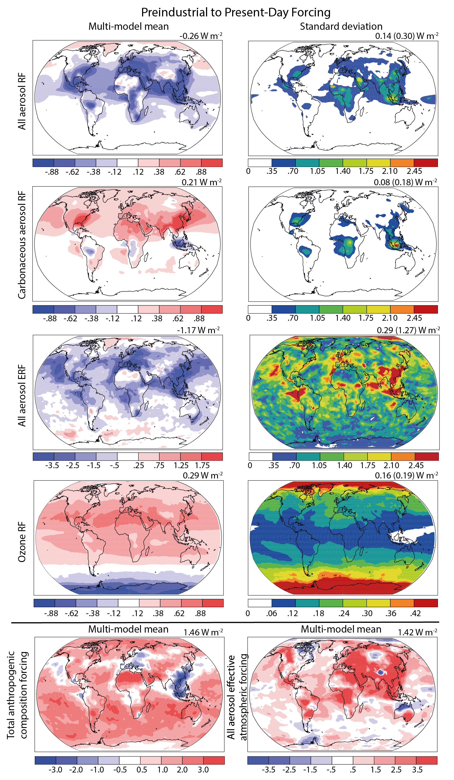
Section 8.6
Geographic distribution of radiative forcing
*
*
*

Slide 28
Section 8.6
Regional Forcing and Climate Response
“Detection and attribution methods have had limited success in discerning statistically significant regional climate signals from regional forcing, due to large internal climate variability at regional scales, uncertainty in model process and sparse regional observational records”
Significant regional cooling and hydrological shifts in eastern USA and Eastern Asia attributed to local aerosols
Increased aerosol loading and subsequent reduction in NH surface energy fluxes have “been implicated in the observed southward shift of the ITCZ...”
Aerosols “are more effective than an equivalent WMGHG forcing for shifting precipitation...”
However, confidence in attributing human influence to shifts in zonal precipitation is only medium.

Slide 29
Section 8.7
Emission metrics
GWP – Global Warming Potential: the time-integrated RF due to a pulse emission of a given component, relative to a pulse emission of an equal mass of CO₂
GWP is the default metric for translating emissions of gases to a common scale, often called ‘CO₂ equivalent emissions’
Name is misleading, ‘relative cumulative forcing index’ is maybe better
GTP – Global Temperature change Potential: the change in global mean surface temperature at a chosen point in time in response to an emission pulse, relative to that of CO₂
GTP can be misleading due to dependence on the timeframe chosen
GTP implicitly accounts for the climate sensitivity and exchange of heat between atmosphere and ocean
“As metrics use parameters further down the cause effect chain the metrics become in general more policy relevant, but at the same time the uncertainties increase”

Slide 30
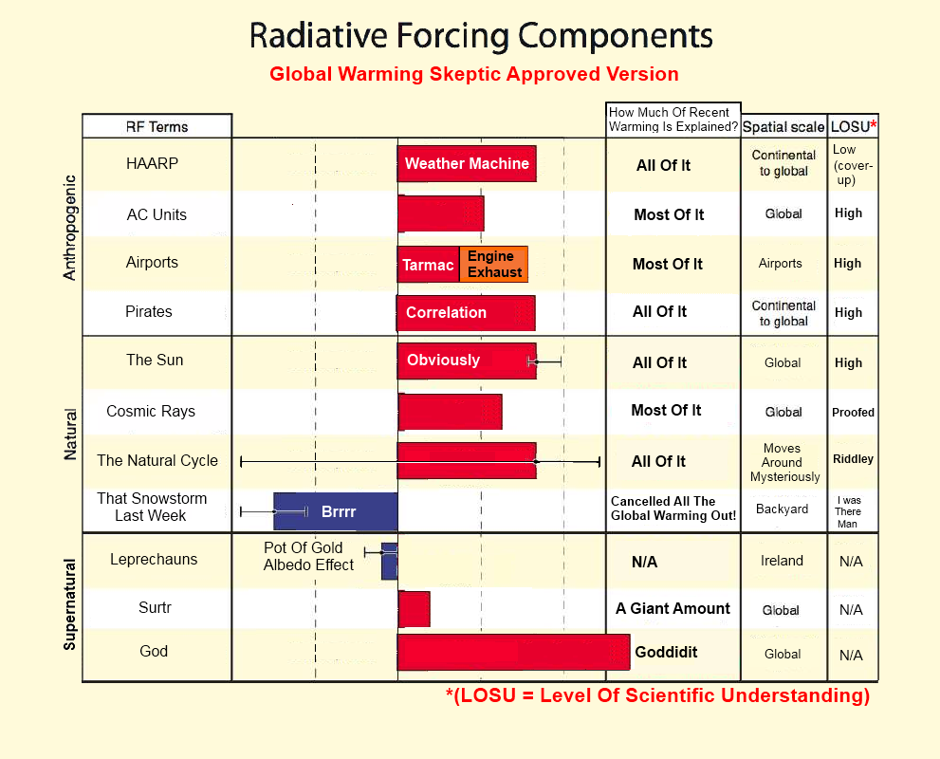
A joke slide

