Slide 1
Chapter 5 Paleoclimate Archives
Brody Fuchs
Zitely Tzompa

Slide 2
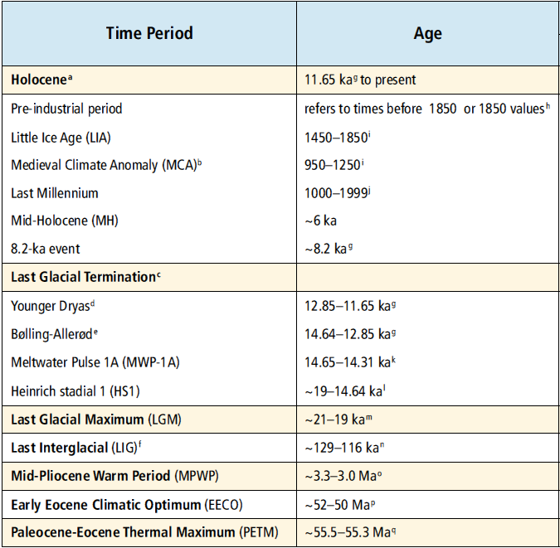
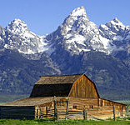
Rockies & Alps
Homo habilis
1st mammals

Slide 3
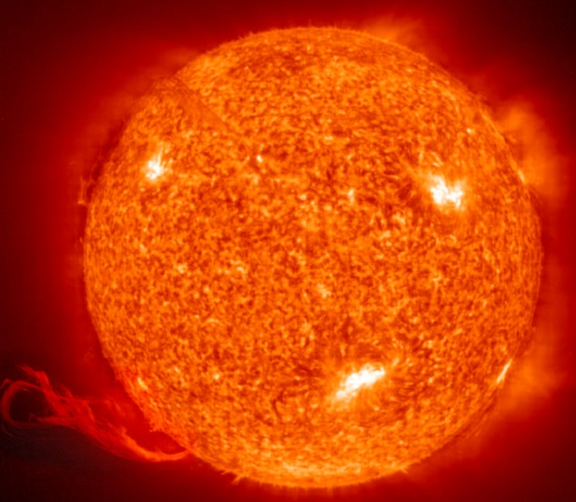
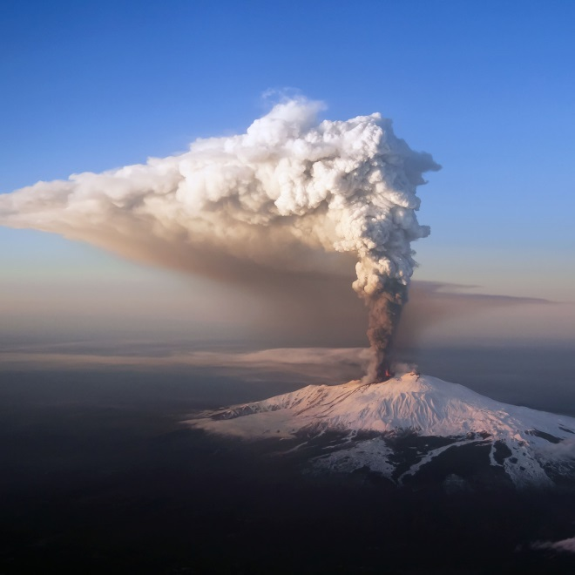
Pre-Industrial Radiative Forcing Factors
Solar Forcing
Volcanic Forcing
Typical changes
11-year solar cycle
0.1% TSI
~30% UV of SSI
sunspots
cosmogenic
radionuclides
Reconstructions
¹⁰Be
¹⁴C
sulphate aerosols
Increase in Earth’s albedo
Sulphate deposition
Greenland
Antartica
Reconstructions
aerosol distribution
optical depth
Modelling
Notes:
Total solar irradiance (TSI) & Spectral solar irradiance (SSI - wavelength dependent)
Typical changes measured over an 11-year solar cycle are 0.1% for TSI and up to several percent for the ultraviolet (UV) part of SSI.
From 8.4: in the past 30 years indicated that UV variations account for about 30% of the SC TSI variations, while about 70% were produced within the visible and infrared
The extension of TSI and SSI into the pre-satellite period poses two main challenges.
First, the satellite period (since 1978) used to calibrate the solar irradiance models does not show any significant long-term trend.
Second, information about the various magnetic features at the solar surface decreases back in time and must be deduced from proxies such as sunspot counts for the last 400 years and cosmogenic radionuclides (10Be and 14C) for the past millennium and Holocene.
10Be and 14C records reflect not only solar activity, but also the geomagnetic field intensity and effects of their respective geochemical cycles and transport pathways.
Volcanic activity affects global climate through the radiative impacts of atmospheric sulphate aerosols injected by volcanic eruptions.
Reconstructions of past volcanic forcing are based on sulphate deposition from multiple ice cores from Greenland and Antarctica, combined with atmospheric modelling of aerosol distribution and optical depth.

Slide 4
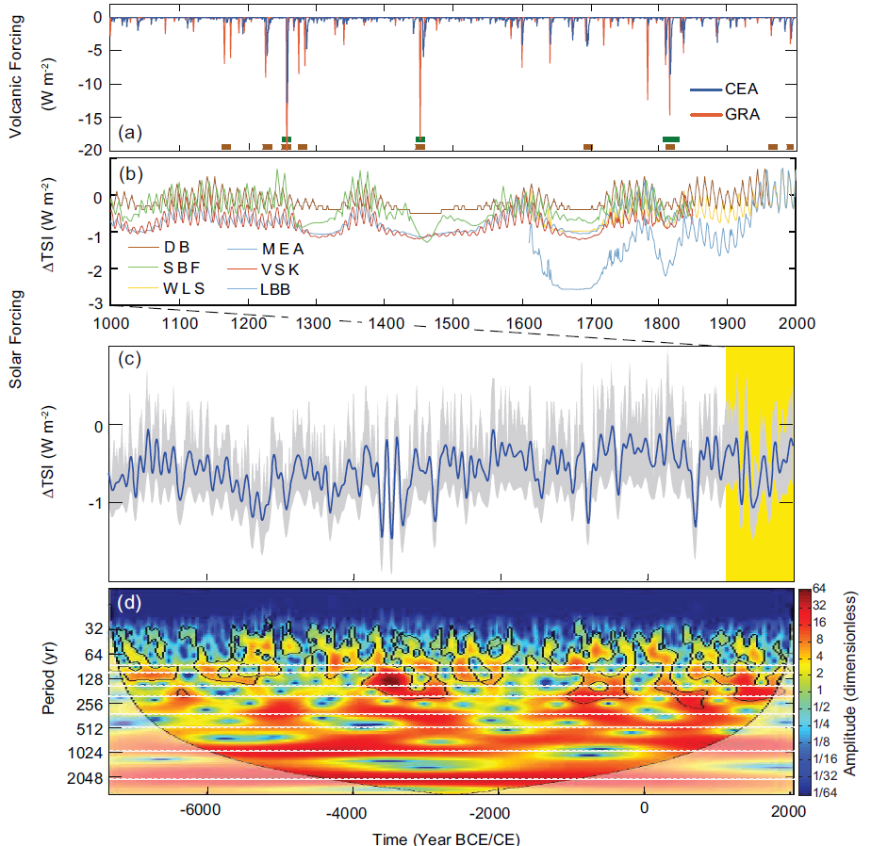
Medieval Climate
Anomaly
Little Ice Age
Present day ∆TSI (2011)
don’t explain global sfc. temp. increases
~ 3200 – 1000 BC
Notes:
Two reconstructions of volcanic forcing for the past 1000 years derived from ice core sulphate. Boxes: green: Greenland; brown: Antarctica; volcanic sulphate peaks identified from their isotopic composition as originating from the stratosphere.
Proxies of solar activity (e.g., sunspots, 10Be) are used to estimate the parameters of the models or directly TSI. For the years prior to 1600, the 11-year cycle has been added artificially to the original data with an amplitude proportional to the mean level of TSI.
Reconstructed TSI anomalies (100-year low-pass filtered; grey shading: 1 standard deviation uncertainty range) for the past 9300 years (Steinhilber et al., 2009). The reconstruction is based on 10Be and calibrated using the relationship between instrumental data of the open magnetic field, which modulates the production of 10Be, and TSI for the past four solar minima. Anomalies are relative to the 1976–2006 mean value (1366.14 W m–2) of Wang et al. (2005).
Wavelet analysis (Torrence and Compo, 1998) of TSI anomalies from (c) with dashed white lines highlighting significant periodicities (Stuiver and Braziunas, 1993).

Slide 5
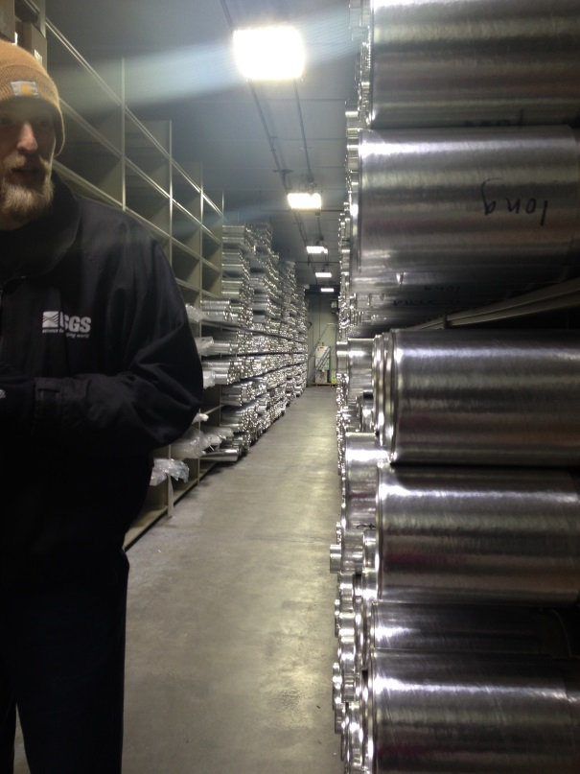
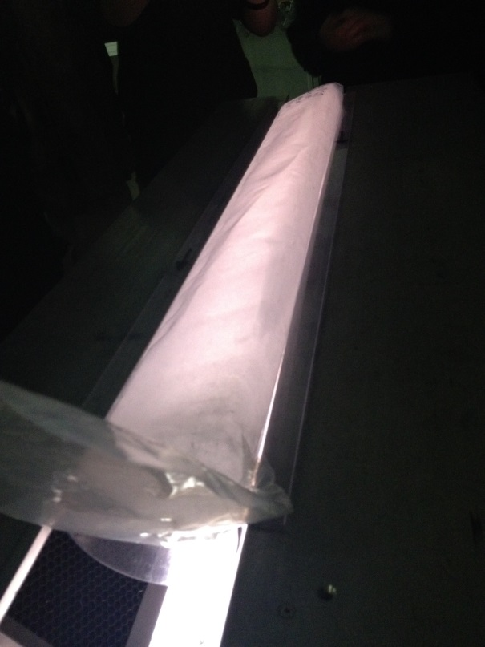
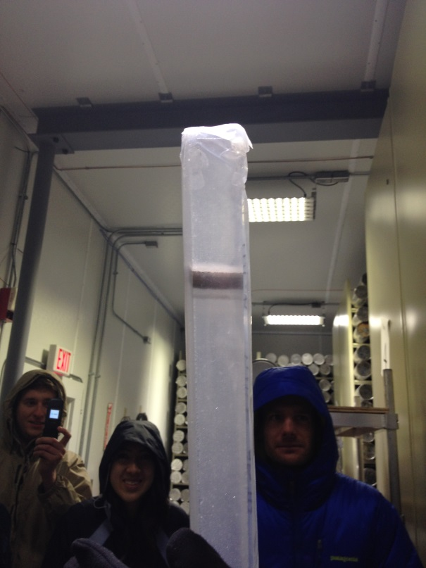
Air bubbles
(e.g. CO2 conc)
Ash deposit
(e.g. sulphure isotopes)

Slide 6
Radiative Perturbations from GHG and Dust
Present-day (2011) concentrations of CO2 (390.5 ppm), CH4 (1803 ppb) and N2O (324 ppm) (Annex II) exceed the range of concentrations recorded in the ice core records during the past 800 ka.
Geological proxies provide indirect information on atmospheric CO2 concentrations for time intervals older than those covered by ice core records.
CO2 reconstructions for the Pliocene based on marine proxies have produced consistent estimates mostly in the range 350 ppm to 450 ppm.

Slide 7
Radiative Perturbations from GHG and Dust
We conclude that there is medium confidence that CO2 levels were above pre-industrial interglacial concentration (~280 ppm) and did not exceed ~450 ppm during the Pliocene, with interglacial values in the upper part of that range between 350 and 450 ppm.
Past changes in mineral dust aerosol (MDA) are important for estimates of climate sensitivity and for its supply of nutrients, especially iron to the Southern Ocean.
MDA concentration is controlled by variations in dust sources, and by changes in atmospheric circulation patterns acting on its transport and lifetime.
Since AR4, new records of past MDA flux have been obtained from deep-sea sediment and ice cores.

Slide 8
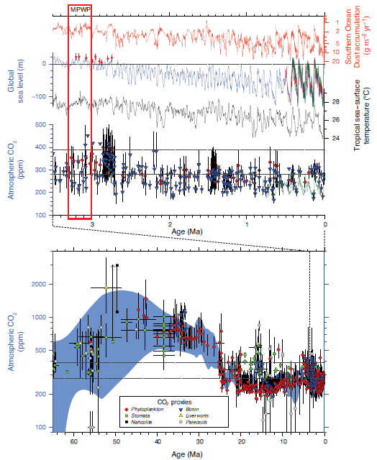
Atlantic sector of the Southern Ocean
Blue: stacked ¹⁸O proxy for ice vol & ocean temp. Green: coral shorelines
-black line: CO2 from ice cores.
-blue triangles: CO 2 from boron isotopes in marine sediments.
-red: phytoplankton Alkenone from carbon isotope proxies
- CO2 concentrations reconstructed from marine and terrestrial proxies.
- Different colors are individual proxy methods.
- Cenozoic (last 65 Ma) geological archives provide examples of natural climate states globally warmer than the present, which are associated with atmospheric CO 2 concentrations above pre-industrial levels.
Notes:
(Top) Orbital-scale Earth system responses to radiative forcings and perturbations from 3.5 Ma to present.
MPWP = Mid-Pliocene Warm Period (Homo habilis times)
The light blue shading is a 1-standard deviation uncertainty band

Slide 9
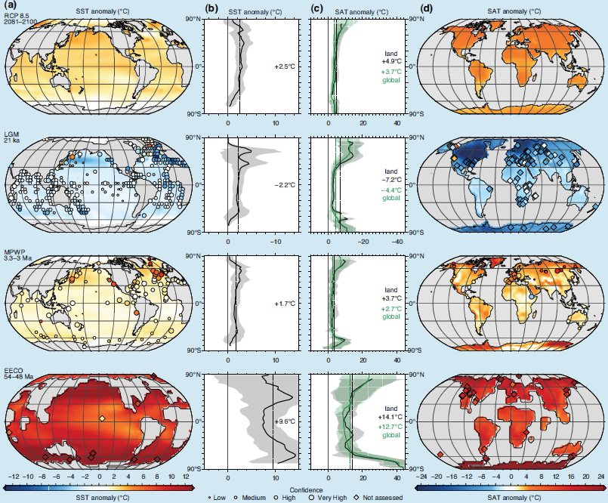
Anomalies relative to the pre-industrial value
Notes:
Comparison of data and multi-model mean (MMM) simulations, for four periods of time, showing (a) sea surface temperature (SST) anomalies, (b) zonally averaged SST anomalies, (c) zonally averaged global (green) and land (grey) surface air temperature (SAT) nomalies and (d) land SAT anomalies.
The time periods are 2081–2100 for the Representative Concentration Pathway (RCP) 8.5 (top row), Last Glacial Maximum (LGM, second row), mid-Pliocene Warm Period (MPWP, third row) and Early Eocene Climatic Optimum (EECO, bottom row). Model temperature anomalies are calculated relative to the pre-industrial value of each model in the ensemble prior to calculating the MMM anomaly (a, d; colour shading). Zonal MMM gradients (b, c) are plotted with a shaded band indicating 2 standard deviations.

Slide 10
Pre-Industrial Radiative Forcing Factors
External Forcings: Orbital Forcing
ICE AGES CAUSED BY COLD NH SUMMERS
Incoming solar
radiation changes
Explains the
multi-millennial
trends
Temperature
Arctic sea ice
glaciers
current interglacial period and specifically the last 2,000 years.
Notes:
Orbital forcing are the changes in incoming solar radiation from variations in the Earth’s orbital and in its axial tilt (described by the Milankovitch cycles).
Multi-millennial trends of temperature, Arctic sea ice and glaciers during the current interglacial period, and specifically the last 2000 years, HAVE BEEN RELATED TO ORBITAL FORCING!

Slide 11
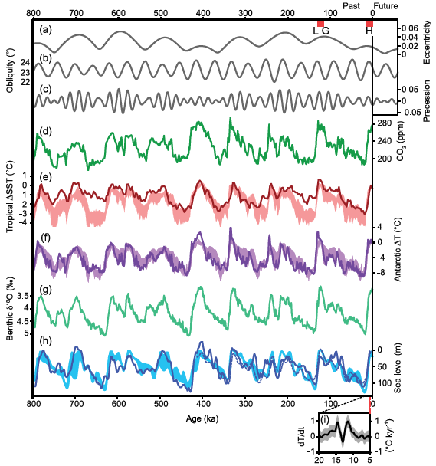
** high confidence that orbital forcing is the primary external driver of glacial cycles
Ice cores

Slide 12
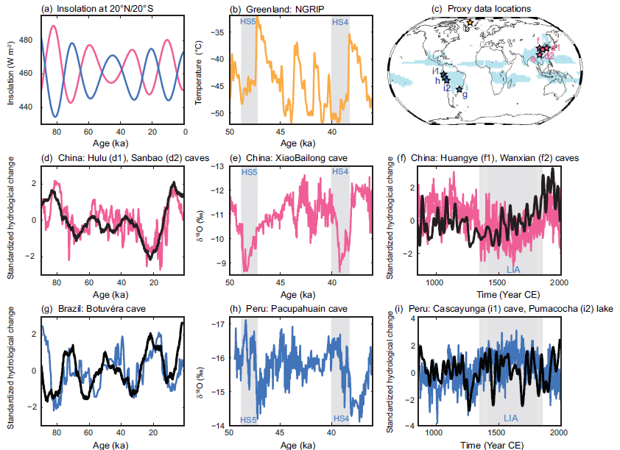
???
MONSOON SYSTEMS
Increasing boreal summer insolation can generate a strong inter-hemispheric surface temperature gradient that leads to large-scale decreases in precip in the SH summer monsoon systems and increased precip in the NH tropics.
High confidence that orbital forcing induces inter-hemispheric rainfall variability.
Notes:
High confidence that orbital forcing induces inter-hemispheric rainfall variability.
???

Slide 13
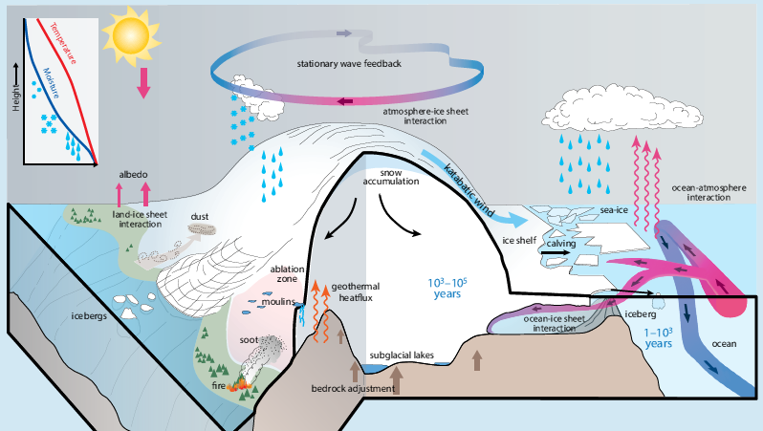
Climate-Ice Sheet Interactions
WARMER
SIDE
ADVECTION OF WARMER WATERS
Notes:
Large glacial ice sheets also deflect the path of the extratropical NH westerly winds, generating anticyclonic circulation anomalies which tend to warm the western side of the ice sheet and cool the remainder.
Furthermore, the orographic effects of ice sheets lead to reorganizations of the global atmosphere circulation by changing the major stationary wave patterns (e.g., Abe-Ouchi et al., 2007; Yin et al., 2008) and trade wind systems (Timmermann et al., 2004). This allows for a fast transmission of ice sheet signals to remote regions.
Advection of warmer waters below ice shelves can cause ice shelf instabilities, reduced buttressing, accelerated ice stream flow (De Angelis and Skvarca, 2003) and grounding line retreat in regions with retrograde bedrock slopes (Schoof, 2012), such as West Antarctica.

Slide 14
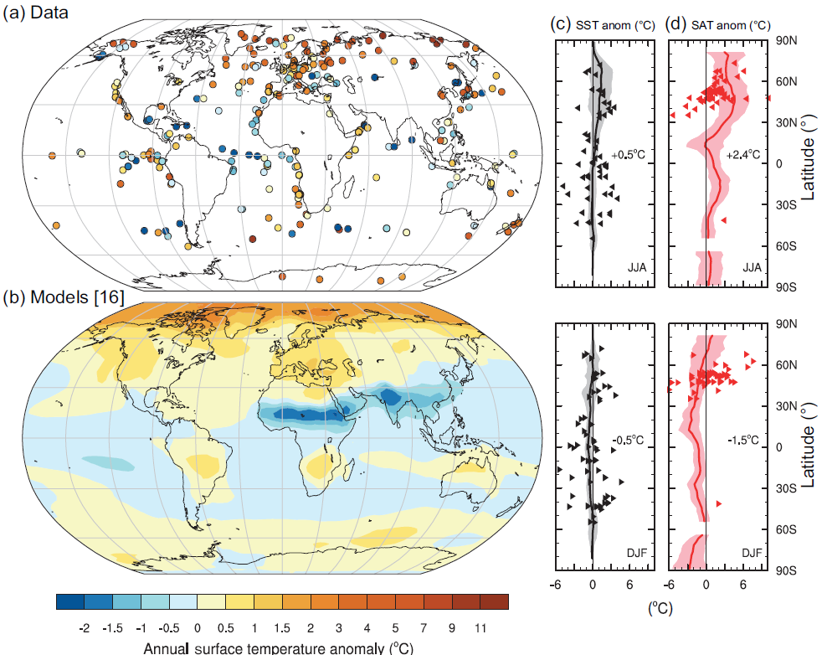
Changes in SST & SAT for the Last Interglacial (LIG)
Medium confidence that LIG global mean annual surface temperature is estimated to be ~1°C to 2°C warmer than pre-industrial
Notes:
From data synthesis, the LIG global mean annual surface temperature is estimated to be ~1°C to 2°C warmer than pre-industrial (medium confidence)
Error bars on temperature reconstructions vary significantly between methods and regions, due to the effects of seasonality and resolution.

Slide 15
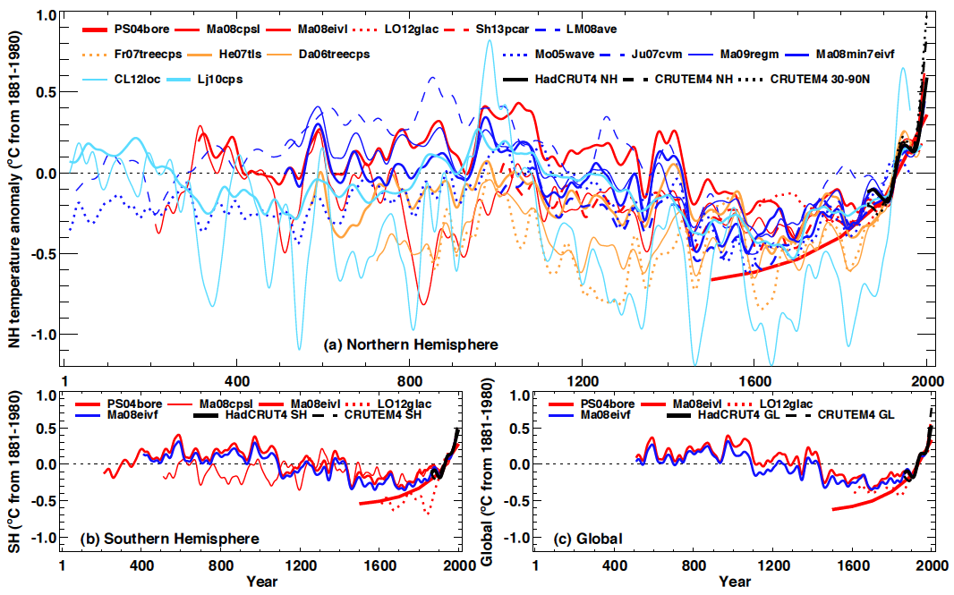
Temperature Variations During the Last 2000 Years
Low High
High confidence that the mean NH temperature of the last 30 or 50 years very likely exceeded any previous 30- or 50-year mean during the past 800 years.
Notes:
Based on multiple lines of evidence (using different statistical methods or different compilations of proxy records indicate, with high confidence, that the mean NH temperature of the last 30 or 50 years very likely exceeded any previous 30- or 50-year mean during the past 800 years.

Slide 16
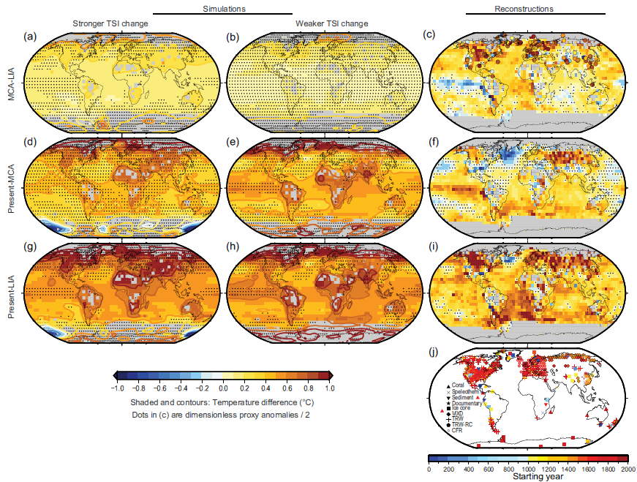
Temperature changes for key periods in the last millennium
Notes:
Simulated and reconstructed temperature changes for key periods in the last millennium. Annual temperature differences for: (a) to (c) Medieval Climate Anomaly (MCA, 950–1250) minus Little Ice Age (LIA, 1450–1850); (d) to (f) present (1950–2000) minus MCA; (g) to (i) present minus LIA.
TSI = Total solar irradiance

Slide 17
Amplitude of interannual SST anomalies in the Niño 3.4 region (average over 5°S to 5°N and 170°W to 120°W)
Currently ENSO variance reconstructions for the LGM are too uncertain to help constrain the simulated responses of the annual cycle and ENSO to LGM boundary conditions.
GCMs show that a reduced AMOC very likely induces intensification of ENSO amplitude and for the majority of climate models also a reduction of the amplitude of the SST annual cycle in the eastern equatorial Pacific.
Notes:
time-slice experiments and for freshwater perturbation experiments (Hosing) that lead to a weakening of the ENSO SST by more than 50%.
Bars encompass the 25 and 75 percentiles, with the red horizontal lines indicating the median in the respective multi-model ensemble, red crosses are values in the upper and lower quartile of the distribution.
Atlantic Ocean meridional overturning circulation (AMOC)

Slide 18
Sea Level
Global mean sea level sensitive to surface temperatures
Due to deglaciation of GIS, WAIS, EAIS, sea level < 20 meters higher than present during Mid-Pliocene Warm Period (MPWP; ~ 3 Ma) with high confidence
Uncertainties associated with isolating temperature component in benthic δ¹⁸O
CO2 ~ 350-450 ppm during MPWP, warmer surface temperatures than today
During LIG (~120 ka), sea level 5-10 meters higher than today. Similar temperatures to present
120 meters below current sea levels at last glacial max (LGM; ~ 20 ka)

Slide 19
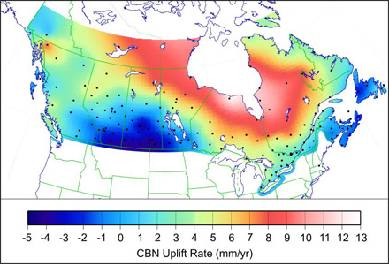
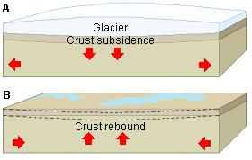
Isostatic Rebound
Enormous weight under glaciers and ice sheets depress crust
As ice melts and water flows away, crust rebounds back to equilibrium
Substantial relative sea level changes
Suggested that Hudson Bay wont be around in ~10,000 years
isostacy.wikispaces.org

Slide 20
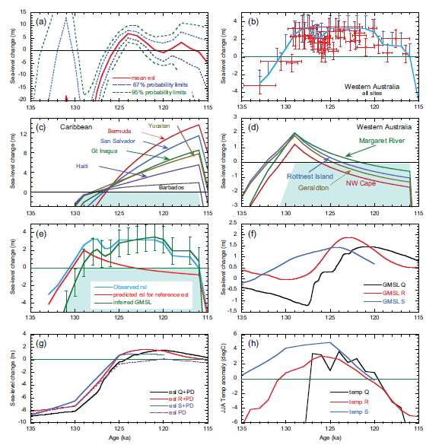
Last Interglacial sea level
Increases in sea level around 125-115 ka
Regionally dependent
Glacial isostasy
Also tectonics
Greenland Ice Sheet contribution
GIS temp anomaly

Slide 21
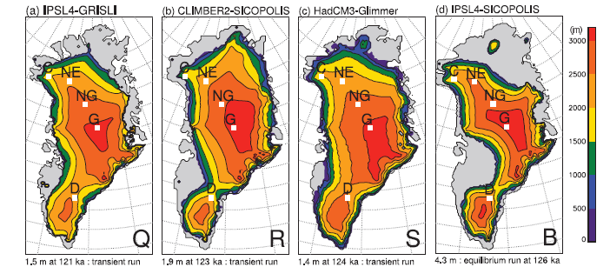
Ice sheet models showing GIS
GIS very likely contributed 1.4 – 4.3 meters sea level rise last interglacial
Sediments show Greenland not ice-free during LIG
Medium confidence on contribution from Antarctic ice sheet, little data available (5 m sea level higher)

Slide 22
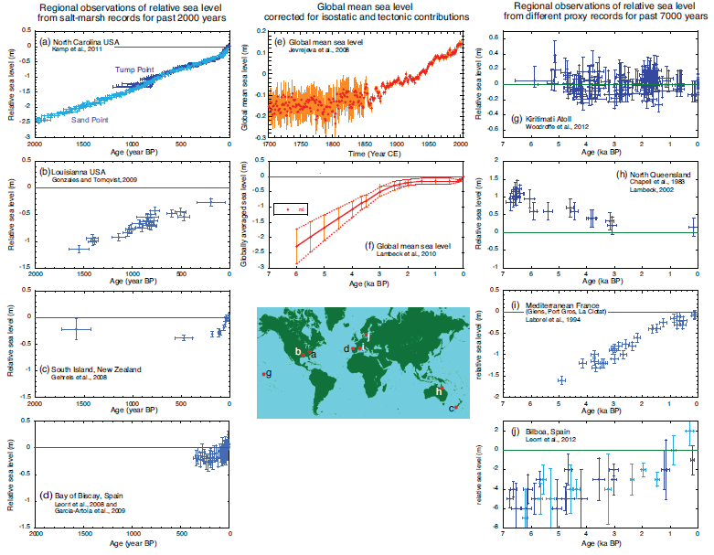
Last glacial termination

Slide 23
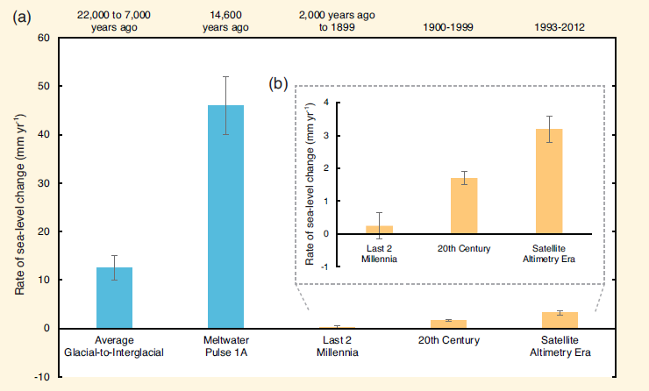
Current sea level change context
Current change ~ 3 mm/yr global average
Unusually high in the context of the last two millennia (medium confidence)
Has been accelerating since ~ 1900
Local areas can be drastically different due to tectonics
Much lower than glacial termination periods
Sea level rose ~ 15 meters in 500 years!!!
Evidence of rapid ice sheet melting and sea level rise ~ 130 meters in 13 kyr

Slide 24
Abrupt Past Climate Changes
Temperature (and other quantities) based on δ¹⁸O records of ocean sediments, ice cores and corals
Theorized to be possibly both from external forcings and internal dynamics
Nonlinearities and/or thresholds in underlying climate dynamics
Order of 10 – 100 years
Dansegaard-Oeschger (DO) events and Heinrich events (last ice age)
Past repeating itself?

Slide 25
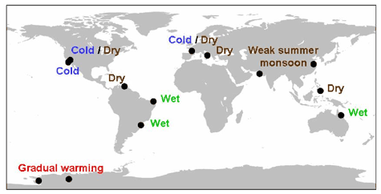
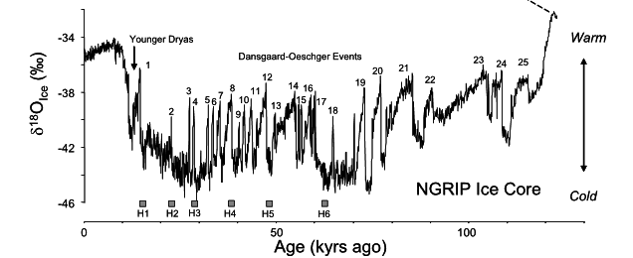
Dansgaard–Oeschger (DO) events
Conditions between DO events
Much stronger response in Greenland than Antarctica
☹
25 observed events during last glacial period
Occur on multiples of 1470 years(?)
Rapid North Atlantic warming followed by gradual cooling
Up to 16 °C warming within decades in Greenland(!)
Physical explanation lacking (AMOC? Ice feedbacks? Not solar)
Ncdc.noaa.gov; Clement and Peterson (2008)

Slide 26
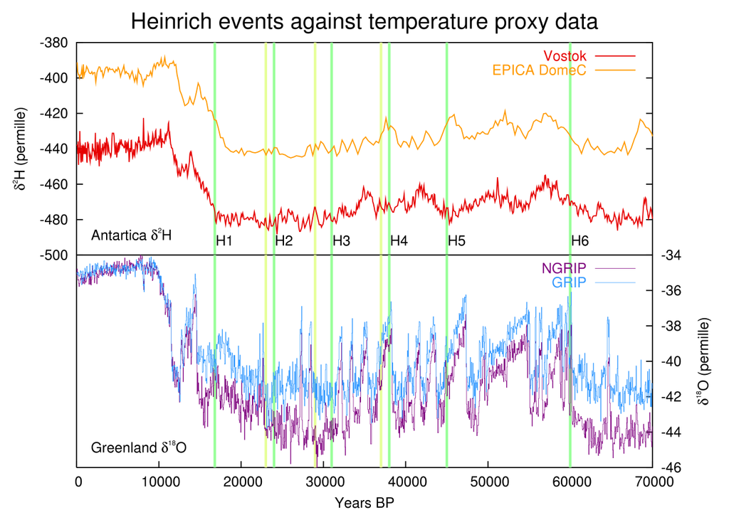
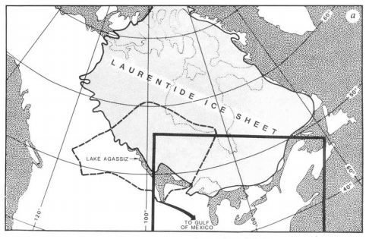
Heinrich Events/ Younger Dryas
Cold events lasting ~ 1000 years
Large chunks of ice break off continental ice sheet
Carry “ice rafted debris” – high proportions of continental rocks
Related to DO events, or at least constrain timing
Binge-purge model, solar forcing
Evidence
Drop in ocean salinity
Decreased proxy temperatures
Tree-type changes (pollen)
Increase in wind and ocean currents (by proxies)
Mayewski et al. (1994); Broecker et al. (1991)

Slide 27
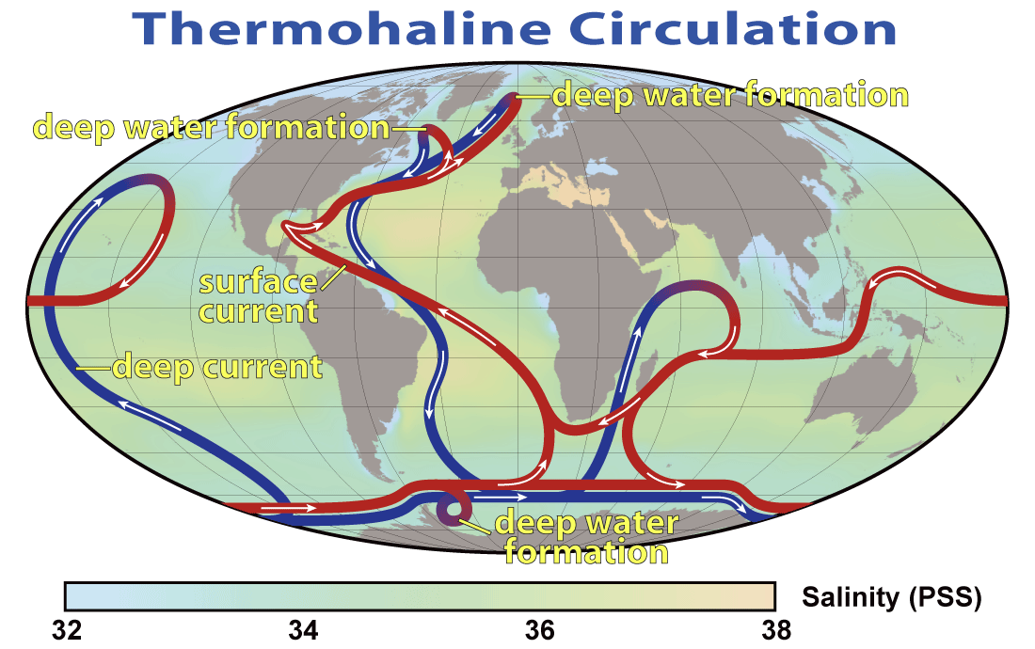
DO events and AMOC
Warming of Greenland ice sheet -> discharge of freshwater
Global sea level rises ~ 20 meters
Since AR4, climate models (high confidence) that AMOC/THC changes may explain abrupt climate changes
Release of GIS fresh water can shut down THC
Widespread north Atlantic cooling affects global circulations
Drying in northern South America, equatorial Africa, parts of Asia, Australia and Maritime continent
Wetter in SW North America, southern South America
Also may explain North Pacific temp variations
Why?
www.wikipedia.org

Slide 28
Bipolar seesaw concept
Equatorial temperature anomalies out of phase on millennial scales
Dependent on deep water current from north to south Atlantic
Antarctic warming coincident with North Atlantic cooling
Weaker AMOC, less heat transport across the equator from south to north (Atlantic Heat Piracy)
Finally the AABW slows down due to warming, then NADW, Gulf Stream recover

Slide 29
Irreversability in Climate – Ice sheets
Modeling studies suggest multiple equilibrium states for ice sheets with respect to
T
CO2
Orbital forcing
Implies possibility of irreversability in past and future
Hysterisis shown in ice sheet models for Antarctic ice sheets – EAIS glaciated when CO2 dropped to 600-900 ppm but deglaciation above 1200 ppm
May be responsible for abrupt ice volume ~ 33 Ma and coincident CO2 decrease
WAIS may be more sensitive and may be lost (medium confidence) if CO2 stays above 350 ppm
feedbacks
GIS may have several equilibrium states under present climate state ☹

Slide 30
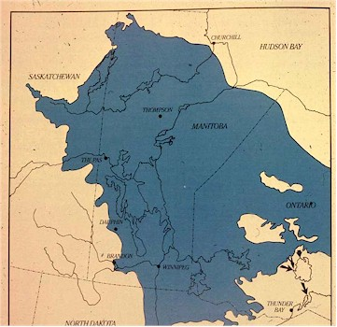
Irreversability – Ocean circulation
Ocean circulations big deal for climate
THC/AMOC recovery time from considerable freshwater input from Lake Agassiz
Study freshwater input from ~ 8.2 ka into North Atlantic (as short as 6 months, long as 200 years)
~ 10¹⁴ m³ of freshwater
Resulted in > 100 yr cool period
Reconstructions and models show THC recovery time ~200 years, depending on details of freshwater release
www.gov.mb.ca

Slide 31
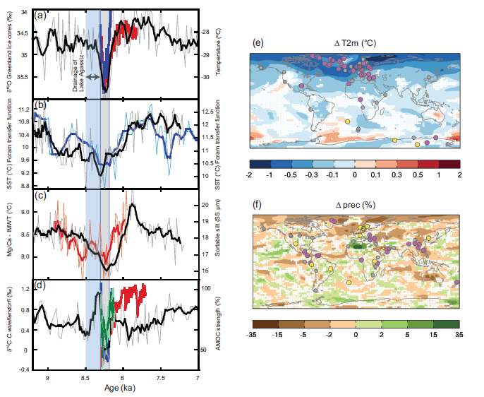
Purple = cold anomaly
Yellow = warm anomaly
Purple = dry anomaly
Yellow = wet anomaly

Slide 32
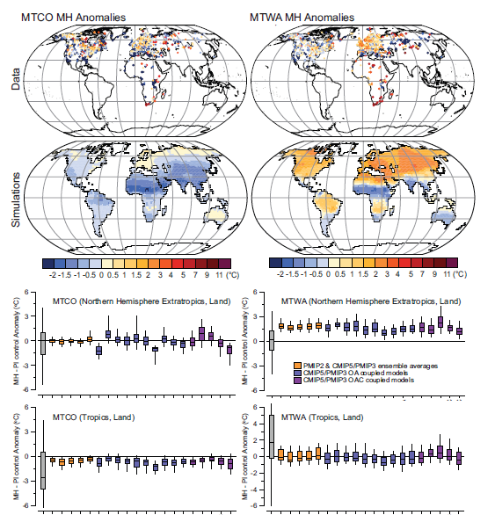
Holocene - Temperature
Mid-holocene (~6ka) summer temps higher than present (minimum glacier extents)
Solar forcing (high NH summer insolation)
High confidence that surface warming trends have reversed long-term cooling trends of past 5000 yrs

Slide 33
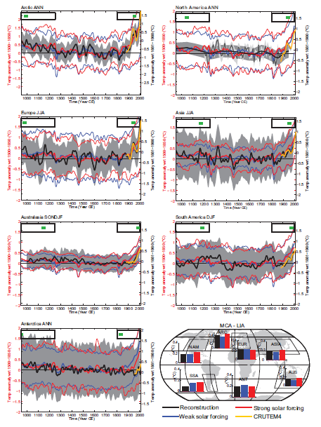
Medieval climate anomaly
(900 – 1200)
Anomalously high SSTs in North Atlantic and Norweigan sea
Coincident with Norse colonization of Americas
Not as warm as present day
Different temp max’s at different times
Temperature anomalies with respect to LIA

Slide 34
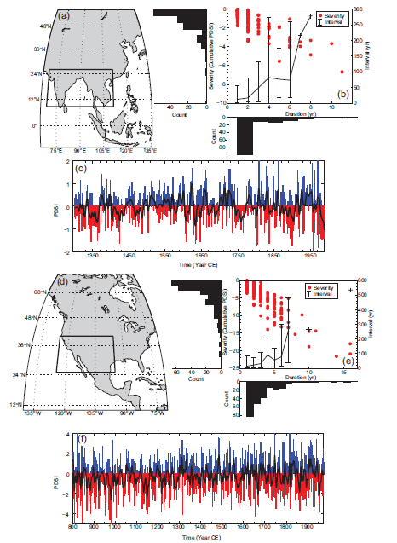
Holocene – Droughts and Floods
Longer and more severe droughts during last millennium than today
Regionally dependent
High confidence historical floods worse than present in Europe, Mediterranian, east Asia
Medium confidence present floods are comparable to last 500 years in India, central North America, Near East

Slide 35
Next glacial inception – Ice Age
Ice ages forced by orbital/solar variations
Also dependent on CO2 concentrations
If CO2 were at pre-industrial level, glaciation would be possible soon
Wont see glaciation for 50 kyr if CO2 stays constant
Simulations show anthropogenic CO2 has multi-millenial lifetime in atmosphere
CO2 wouldn’t fall to 300 ppm until year 3000 for lowest RCP 2.6 scenario
Virtually certain orbital forcing will not trigger glacial inception for at least a millenium

