Slide 1
IPCC WG1 AR5 Chapter 2
Observations: Atmosphere and Surface
Rob Nelson, Andy Manaster
09/08/2014

Slide 2
Authors
Coordinating Lead Authors:
  Dennis L. Hartmann (USA), Albert M.G. Klein Tank (Netherlands), Matilde Rusticucci (Argentina)
Lead Authors:
  Lisa V. Alexander (Australia), Stefan Brönnimann (Switzerland), Yassine Abdul-Rahman Charabi (Oman), Frank J. Dentener (EU/Netherlands), Edward J. Dlugokencky (USA), David R. Easterling (USA), Alexey Kaplan (USA), Brian J. Soden (USA), Peter W. Thorne (USA/Norway/UK), Martin Wild (Switzerland), Panmao Zhai (China)

Slide 3
Contents of Chapter 2
  2.1 - Introduction
Changes in…
  2.2 - Atmospheric Composition
  2.3 - Radiation Budgets
  2.4 - Temperature
  2.5 - Hydrological Cycle
  2.6 - Extreme Events
  2.7 - Atmospheric Circulation and Patterns of Variability

Slide 4
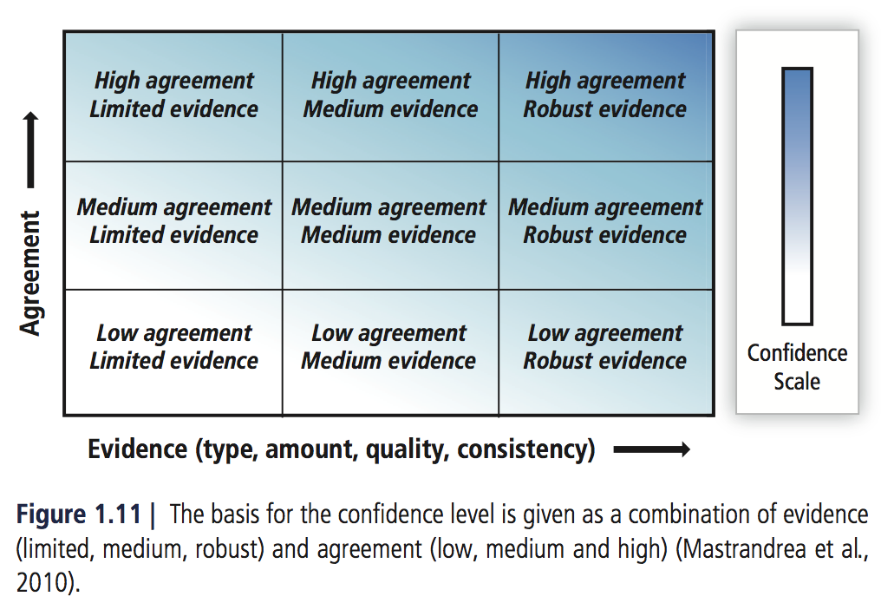
Confidence

Slide 5
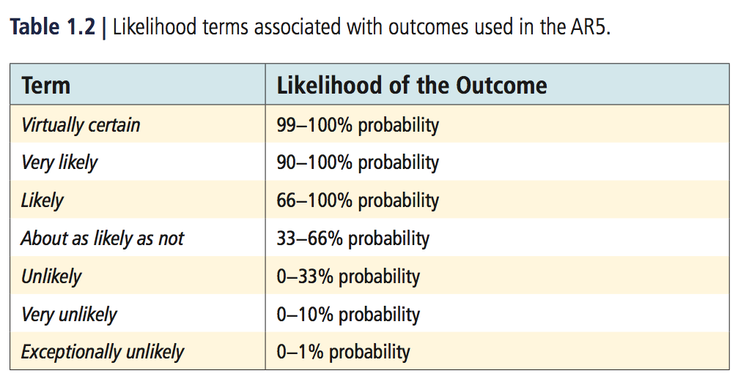
Likelihood

Slide 6
2.2 Changes in Atmospheric Composition

Slide 7

certain
It is that atmospheric burdens of the well-mixed greenhouse gases (GHGs) targeted by the Kyoto Protocol _________ from 2005 to 2011.
increased
  CO₂ (Carbon Dioxide)
  CH₄ (Methane)
  N₂O (Nitrous Oxide)
  HFCs (Hydrofluorocarbons)
  … and more!

Slide 8
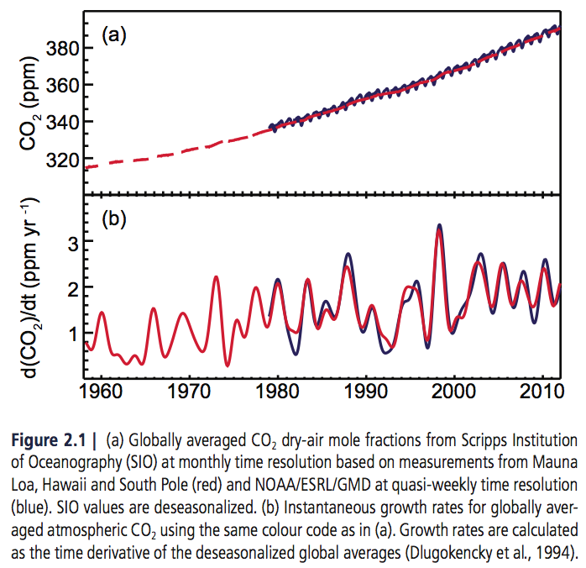
Carbon Dioxide (CO₂)
1750 = 278 ± 2 ppm
2011 = 390.5 ppm
40% increase

Slide 9
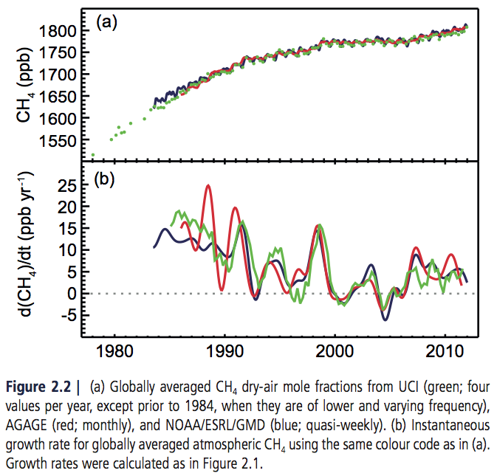
Methane (CH₄)
1750 = 722 ± 25 ppb
2011 = 1803 ± 2 ppb
150% increase!
Warm arctic in ‘07
Rainy tropics ‘07-‘08
Not wetlands or shallow sub-sea CH₄ clathrates

Slide 10
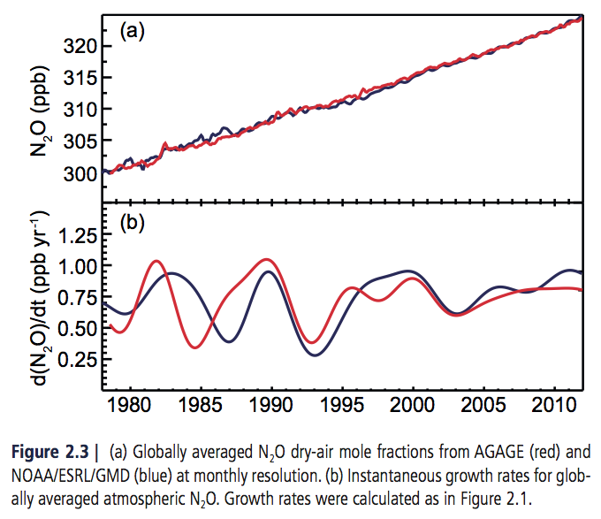
Nitrous Oxide (N₂O)
1750 = 270 ± 7 ppb
2011 = 324.2 ppb
20% increase
Soils treated with nitrogen fertilizer
Third most important well-mixed GHG! (CFC-12 has decreased)

Slide 11
For ozone-depleting substances (Montreal Protocol gases), it is ________ that the global mean abundances of major chlorofluorocarbons (CFCs) are __________ and HCFCs are _________.
certain
  CFCs (Chlorofluorocarbons)
  HCFCs (Hydrochlorofluorocarbons)
  HFCs (Hydrofluorocarbons)
decreasing
increasing

Slide 12
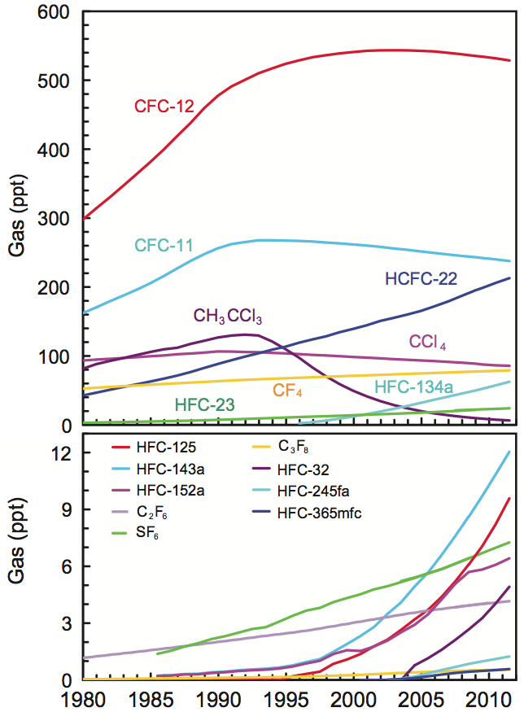
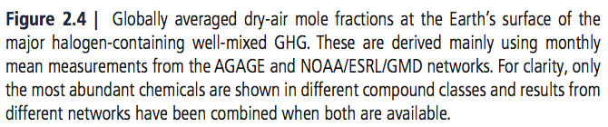
CFCs/HFCs/HCFCs/etc.
Many CFCs replaced (via Montreal Protocol) by HCFCs/HFCs
  Success!
HCFCs are “transitional substitutes”
Growing GHGs: <1% contribution to RF

Slide 13
Because of large variability and relatively short data records, confidence in stratospheric H₂O vapour trends is ________.
low

Slide 14
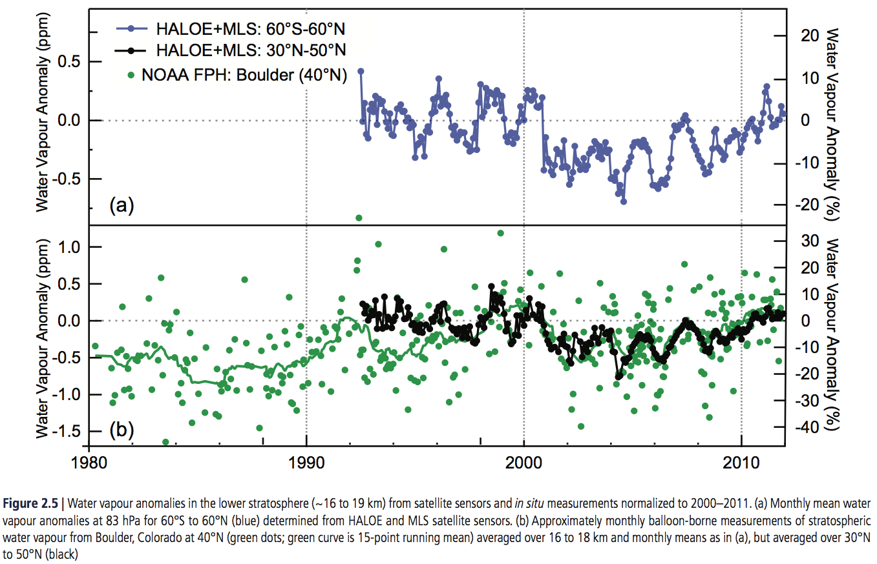
Stratospheric H₂O Vapo[u]r
In situ, Boulder; Satellites (SAGE II, HALOE, Aura MLS, Envisat MIPAS)
High variability, no trend

Slide 15
certain
It is _________ that global stratospheric ozone has _________ from pre-1980 values.
declined

Slide 16
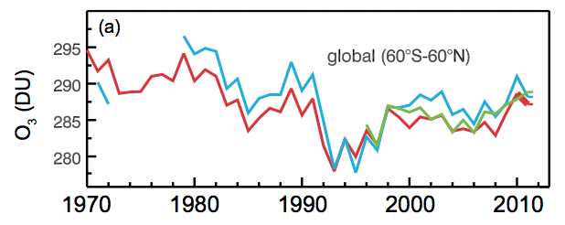
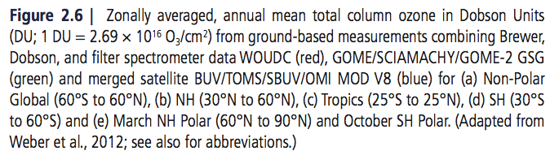
Stratospheric Ozone
Decrease in 1980s
Constant now

Slide 17
medium
Confidence is ________ in large-scale _________ of tropospheric ozone across the Northern Hemisphere (NH) since the 1970s.
Confidence is _______ in ozone changes across the Southern Hemisphere (SH) owing to limited measurements.
increases
low

Slide 18
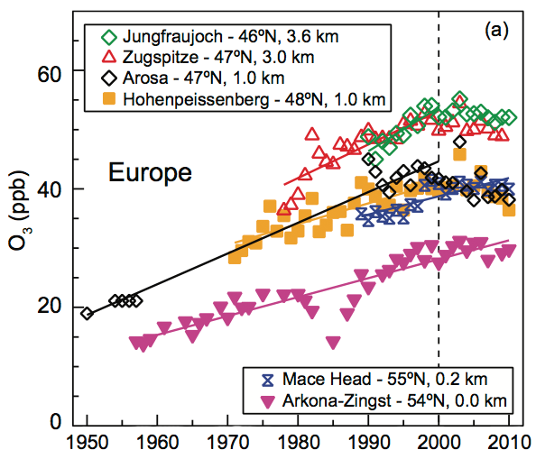
Tropospheric Ozone
Short-lived, high regional variable
Constant or decreased in N. America and W. Europe
Strong increase in East Asia

Slide 19
likely
decreased
NO₂ has _______ _________ by 30 to 50% in Europe and North America and _________ by more than a factor of 2 in Asia since the mid-1990s.
increased

Slide 20
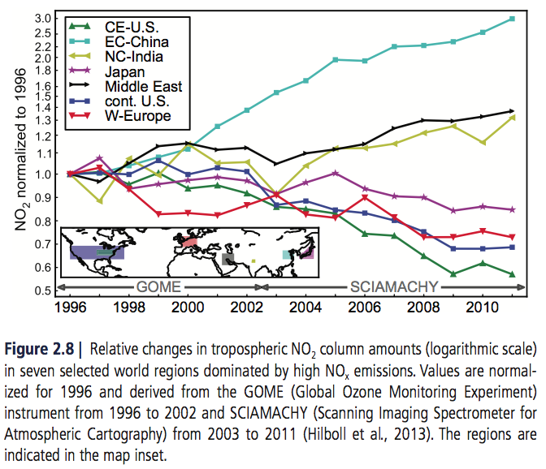
NO₂
Satellite column measurements
NO_{X} emission reductions

Slide 21
It is _________ that aerosol column amounts have _________ over Europe and the eastern USA since the mid 1990s and _________ over eastern and southern Asia since 2000.
very likely
declined
increased

Slide 22
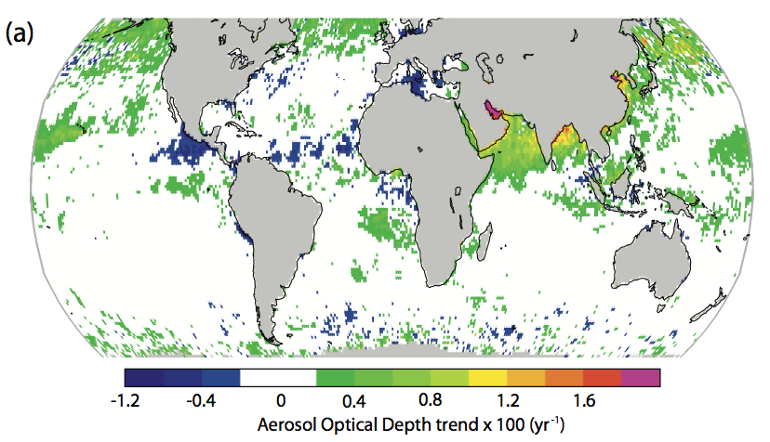
Sun photometers (AERONET); visibility; satellites (MODIS, AVHRR, SeaWiFS)
Strong regional variance

Slide 23
2.3 Changes in Radiation Budgets

Slide 24
Satellite records of top of the atmosphere radiation fluxes have been substantially extended since AR4, and it is _________ that significant trends exist in global and tropical radiation budgets since 2000.
unlikely

Slide 25
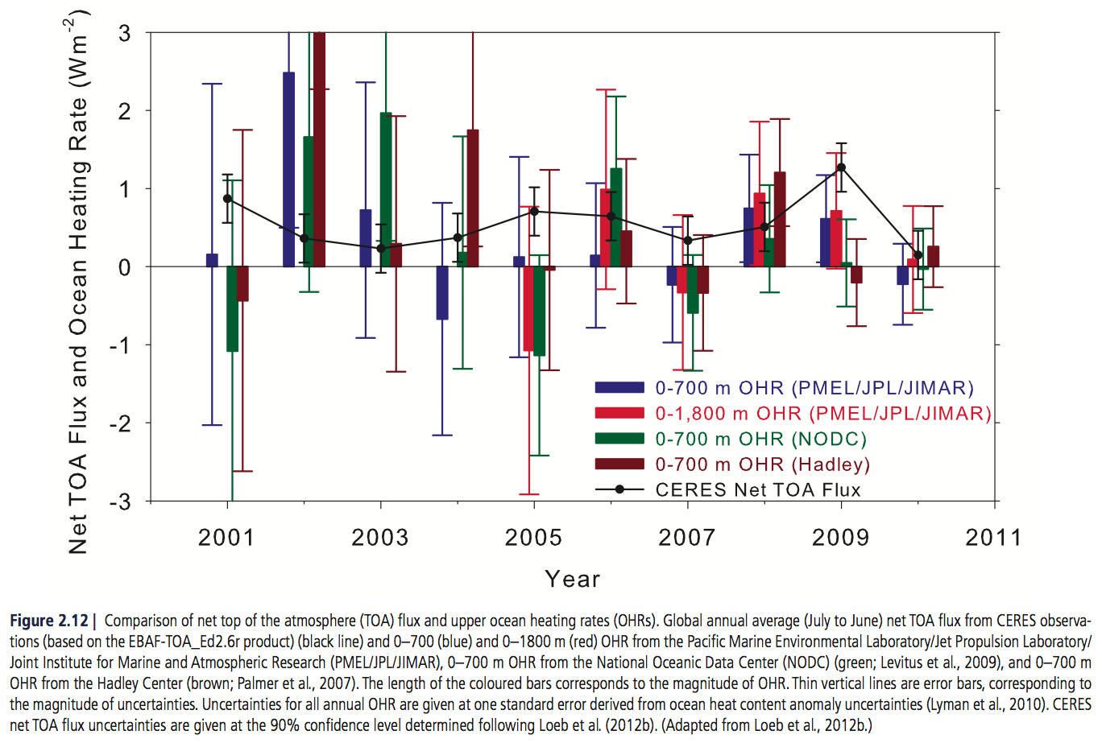
TOA Radiation Budget
ERBS, CIRES
No trend

Slide 26
likely
Surface solar radiation _______ underwent widespread decadal changes after 1950, with _________ (‘dimming’) until the 1980s and subsequent ________ (‘brightening’) observed at many land-based sites.
decreases
increases

Slide 27
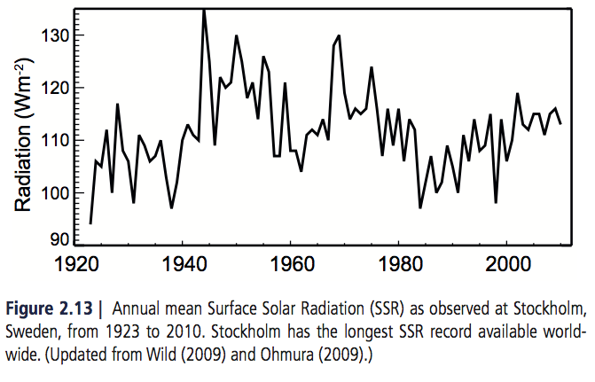
Surface Solar Radiation
Related to…
  Sunshine duration
  DTR (Diurnal Temperature
  Range)
  Hydrological quantities
  Aerosol emission patterns

Slide 28
2.4 Changes in Temperature

Slide 29
It is _______ that Global Mean Surface Temperature has _________ since the late 19th century. Each of the past three decades has been successively _______ at the Earth’s surface than all the previous decades in the instrumental record, and the first decade of the 21st century has been the ________.
certain
increased
warmer
warmest

Slide 30
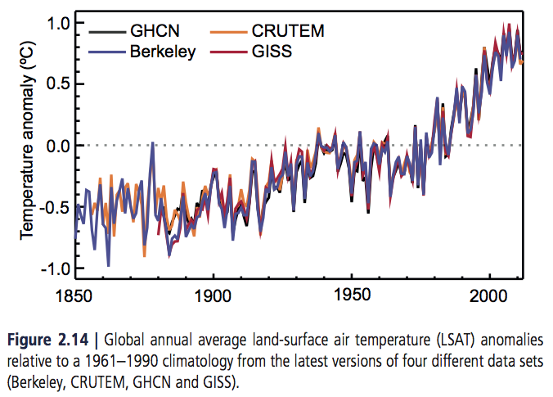
Land Surface Air Temperature
Several independent
datasets
Especially since 1970s
Short term trends very
sensitive to start/end dates

Slide 31
unlikely
It is ________ that any uncorrected urban heat-island effects and land use change effects have raised the estimated centennial globally averaged LSAT trends by more than 10% of the reported trend.
  Regional trends may differ
medium
decreases
Confidence is ________ in reported _________ in observed global diurnal temperature range (DTR), noted as a key uncertainty in the AR4.
  Changes in DTR much less than changes in average maximum/minimum temperature

Slide 32
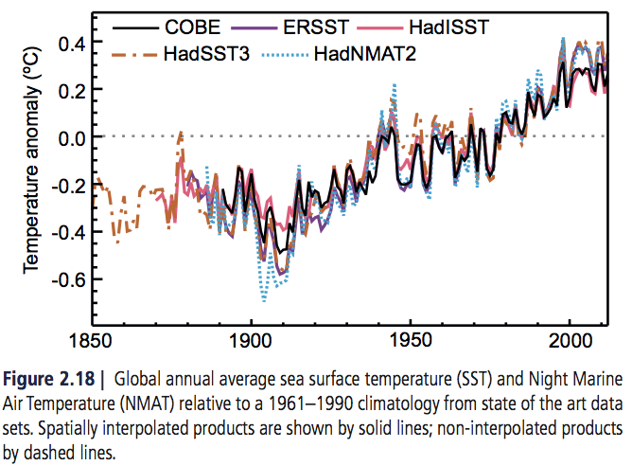
Sea Surface Temperature
Many data sources…
  Canvas/wooden buckets
  Engine room intake
  Hull contact sensors
  Buoys
  Satellites (AVHRR, AATSR)

Slide 33
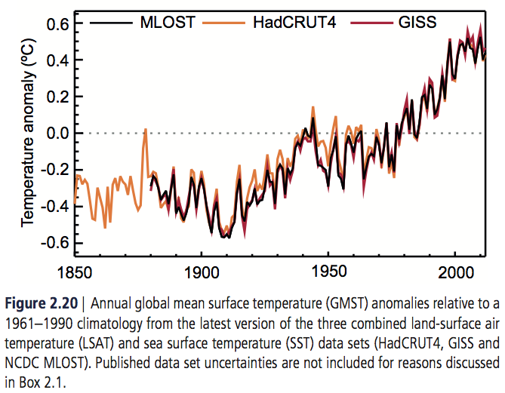
Global Combined Land and Sea Surface Temperature
“GMST had increased, with the last 50 years 1880s increasing at almost double the rate of the last 100 years.”
“All ten of the warmest years have occurred since 1997”

Slide 34
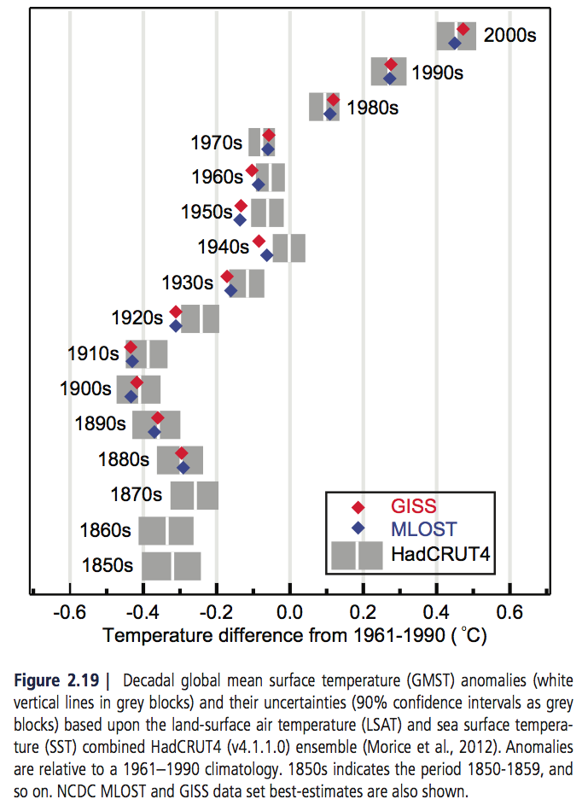
“Each of the past three decades has been warmer than all the previous decades in the instrumental record”
Increase of 0.85 [0.65 to 1.06] °C from 1880-2012

Slide 35
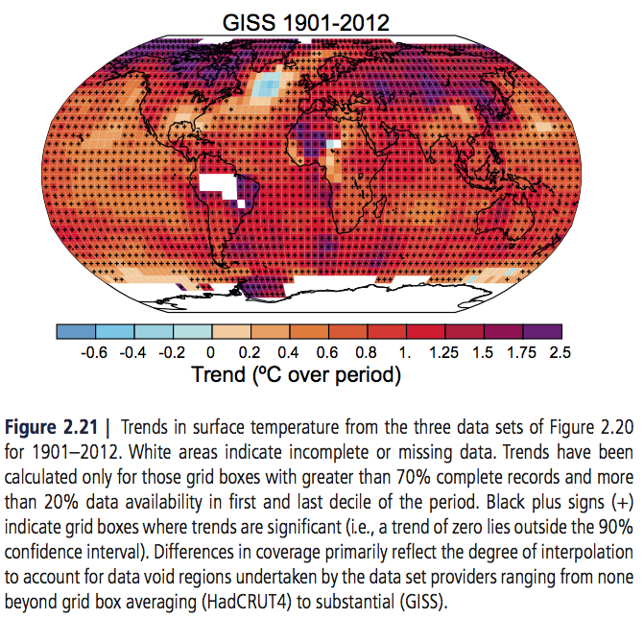

Slide 36
Based on multiple independent analyses of measurements from radiosondes and satellite sensors it is _______________ that globally the troposphere has ________ and the stratosphere has _______ since the mid-20th century.
virtually certain
warmed
cooled

Slide 37
Tropospheric and Stratospheric Temperatures
Radiosondes (since 1958)
Satellites (MSU, 1978; AMSU, 1998)
New methods
  GPS radio occultation
  Thermal winds

Slide 38
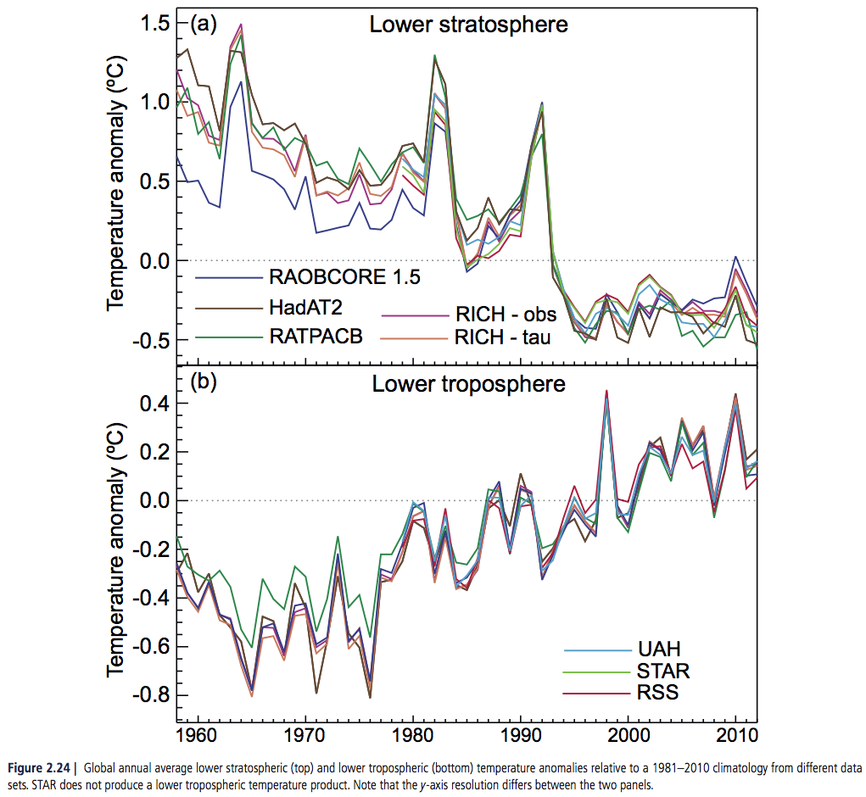

Slide 39
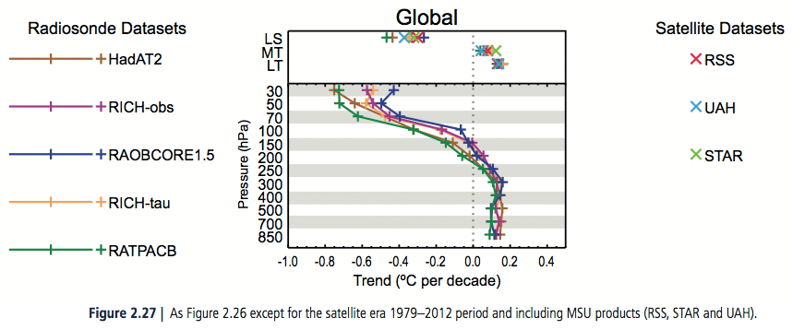
Disagreement on rate of temperature change, especially outside of the NH extratropical troposphere

Slide 40
2.5 Changes in Hydrological Cycle

Slide 41
Confidence in precipitation change averaged over global land areas since 1901 is _______ for years prior to 1951 and ________ afterwards. Averaged over the mid-latitude land areas of the Northern Hemisphere, precipitation has ______ increased since 1901 (________ confidence before and _______ confidence after 1951).
low
medium
likely
medium
high
For all other areas data sparsity, quality, or lack of agreement yields low confidence in characterizing long term precipitation trends

Slide 42
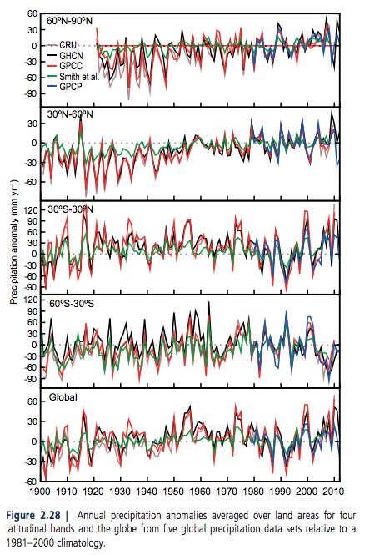
Large Scale Changes in Precipitation
Precipitation over tropical areas increased in last decade reversing the drying trend seen since mid 1970’s
Positive trend in Northern Mid-latitudes
Almost no trend in Southern Mid-latitudes

Slide 43
very likely
It is __________ that global near surface and tropospheric air specific humidity have increased since the 1970s

Slide 44
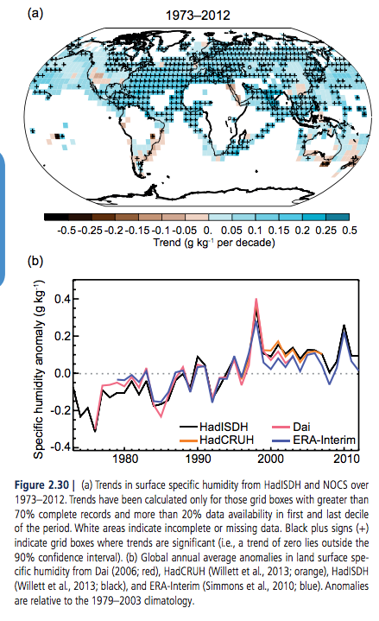
Surface Humidity
Increases in specific humidity strongly correlated with average land surface temps over the period from 1973-1999
Shows increases of ~7%/deg C (predicted by Clausius-Clayperon)
Notes:
Maybe say how it has abated in recent years – seen in a decrease in RH over land – land temps continue to warm
Possibly linked to greater warming over land than oceans

Slide 45
While trends of cloud cover are consistent between independent data sets in certain regions, substantial ambiguity and therefore ________ confidence remains in the observations of global-scale cloud variability and trends.
low
Especially in satellite observations

Slide 46
Clouds
Satellite cloud observations “require careful efforts to identify and correct for temporal discontinuities in the data sets associated with orbital drift, sensor degradation, and inter-satellite calibration differences.”
Downward trend in ISCCP cloud cover data set – inconsistent with PATMOS-x and surface obs
Recent work confirmed this trend to be spurious – artifact of changes in satellite viewing geometry
Stubenrauch et al. 2013 looked at long-term variations in global-mean cloud amount in 9 different satellite data sets
  Found differences in data sets on the same order of magnitude as interannual variability

Slide 47
2.6 Changes in Extreme Events

Slide 48
very likely
It is _________ that the numbers of cold days and nights have __________ and the numbers of warm days and nights have _________ globally since about 1950.
decreased
increased

Slide 49
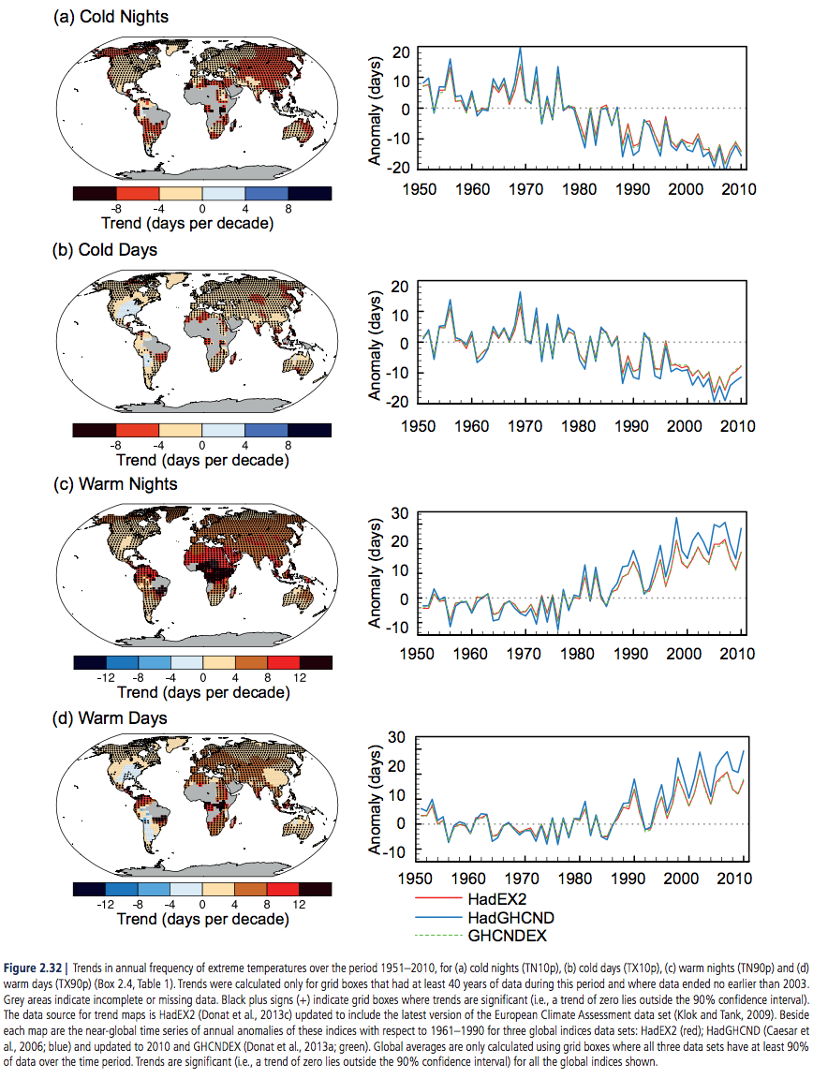
Notes:
Insert figure 2.32

Slide 50
likely
It is _______ that since about 1950 the number of heavy precipitation events over land has _________ in more regions than it has _________.
increased
decreased
Notes:
Don’t animate “likely”

Slide 51
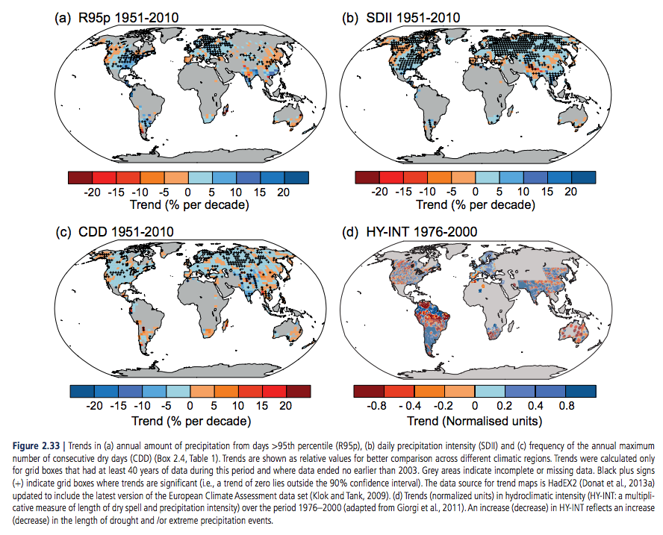
Precipitation Extremes
Ratio of annual total precipitation to the number of wet days (SDII) increasing more than decreasing
Amount of precipitation from the wettest 5% of days (R95p), increasing more than decreasing
Consecutive dry days decreasing more than increasing

Slide 52
low
Confidence is ________ for a global-scale observed trend in drought or dryness (lack of rainfall) since the middle of the 20th century, owing to lack of direct observations, methodological uncertainties and geographical inconsistencies in the trends.
Notes:
Don’t animate “likely”

Slide 53
Droughts
AR5 concludes that AR4’s conclusions of droughts increasing globally were “likely overstated”
AR5 does, however, conclude that is likely drought frequency and intensity has increased in the Mediterranean and West Africa and decreased in central North American and north-west Australia since 1950

Slide 54
low
Confidence remains ________ for long-term (centennial) changes in tropical cyclone activity, after accounting for past changes in observing capabilities.

Slide 55
Tropical Storms
Differences in observing capabilities
Different methods for estimating undercounts in earlier records
Changing technology/methodology
Notes:
Maybe mention how since 1970 the strongest tropical cyclones North Atlantic storms have increased in frequency and intensity

Slide 56
Confidence in large scale trends in storminess or storminess proxies over the last century is _______ owing to inconsistencies between studies or lack of long-term data in some parts of the world.
low
Because of insufficient studies and data quality issues confidence is also ________ for trends in small-scale severe weather events such as hail or thunderstorms.
low

Slide 57
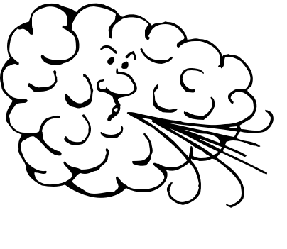
Large Scale Storminess
Generally proxied with surface wind, geostrophic wind or another variable proxied using in situ pressure measurements or reanalysis data
Quality/consistency varies for proxies
Measuring practices and changing instrumentation cause inconsistencies in records

Slide 58

Small Scale Storminess
Very few stations to observe local weather phenomena
Consistency among stations is questionable

Slide 59
2.7 Changes in Atmospheric Circulation and Patterns of Variability

Slide 60
likely
It is _______ that circulation features have moved poleward since the 1970s, involving a widening of the tropical belt, a poleward shift of storm tracks and jet streams, and a contraction of the northern polar vortex.

Slide 61
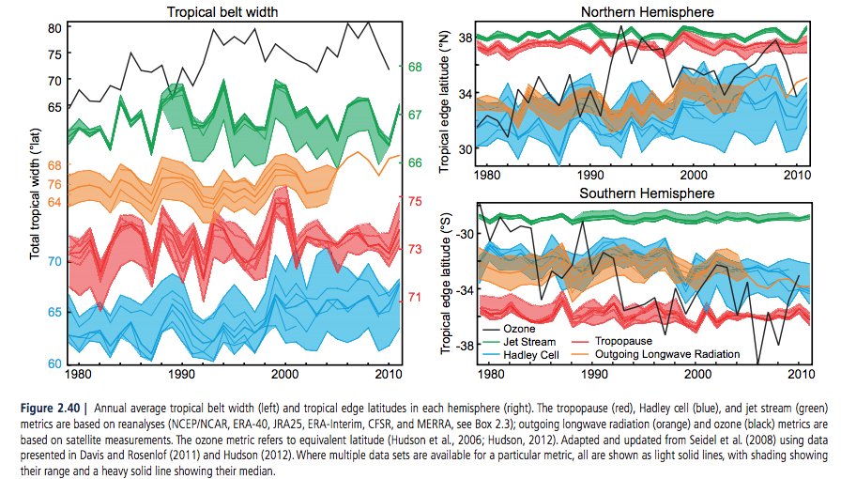
Tropical Belt Widening

Slide 62
Large variability on interannual to decadal time scales hampers robust conclusions on long-term changes in atmospheric circulation in many instances.
However, confidence is high that the NAO index has increased from the 1950s to the 1990s and that this increase has subsequently been offset by recent changes.

Slide 63
Confidence in the existence of long-term changes in remaining aspects of global circulation is _______ owing to the observational limitation or limited understanding.
low
Includes surface winds over land, East Asian summer monsoon circulation, the tropical cold-point tropopause temperature and the strength of the Brewer Dobson circulation among other things.

Slide 64
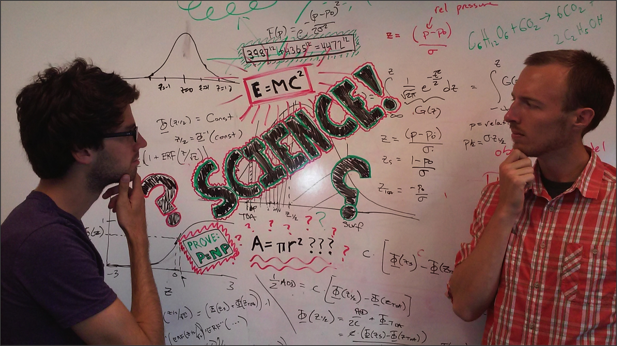
Questions?

