Slide 1
AT786 – Game plan & Overview
August 25, 2014

Slide 2
Overview for today
Basic overview – what is the AR5 WG1 Report? Context wrt WG2 and WG3.
Expectations of your jobs: presenter/discussion leader, and class participant. Expected format for each in-class meeting.
Course website.
Most useful info from Chapter 1.
Description of Chapters 2-14
Picking of dates / presenters.
Q/A time.

Slide 3
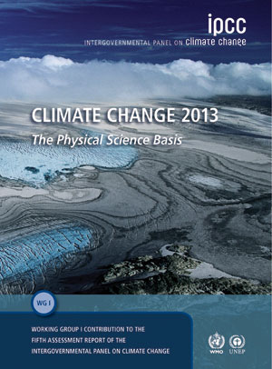
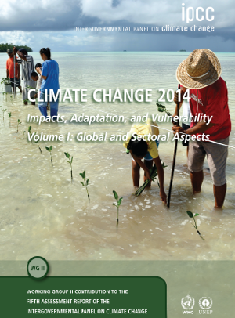
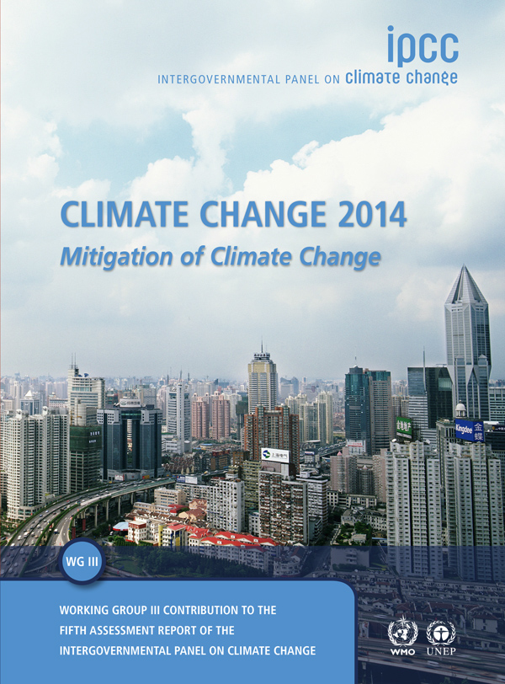
IPCC Working Groups
Each assess the literature at the present time
Hundreds of authors, thousands of pages.
NOT primary literature – simply a summary of the current research.

Slide 4
IPCC Working Groups
Global warming continues
Better understanding of processes
Extremes, near-term climate change
Already large risks
Risks increase with warming.
Poor countries hit harder.
2°C (even 1.5°C) still possible!
Delay is expensive

Slide 5
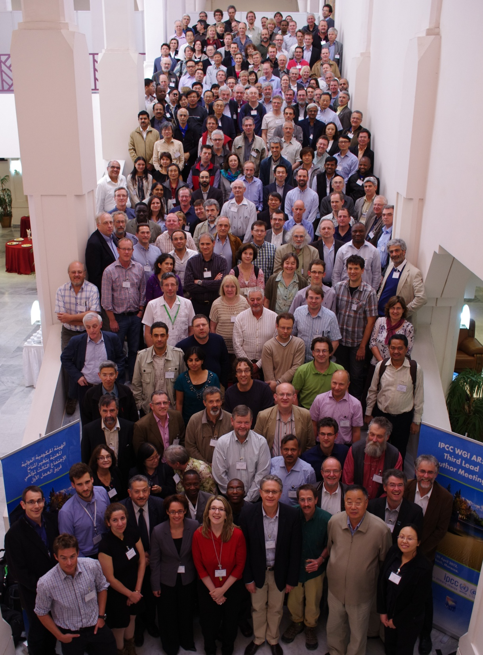
Key SPM Messages
19 Headlines
on less than 2 Pages
Summary for Policymakers
ca. 14,000 Words
14 Chapters
Atlas of Regional Projections
54,677 Review Comments
by 1089 Experts
2010: 259 Authors Selected
2009: WGI Outline Approved
3rd Lead Author Meeting, Marrakech, Morocco, April 2012
Notes:
More information available from the IPCC Working Group I website www.climatechange2013.org

Slide 6
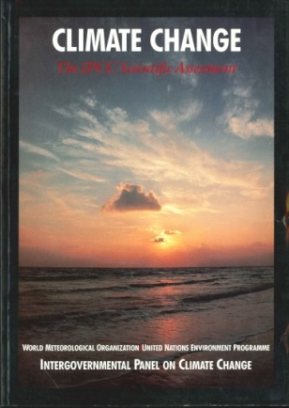
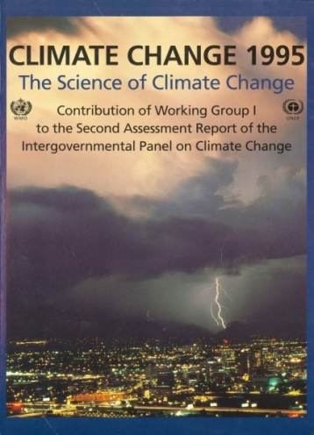
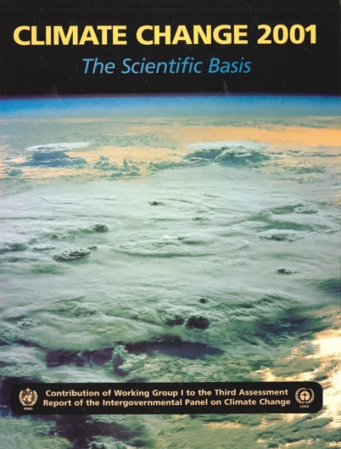
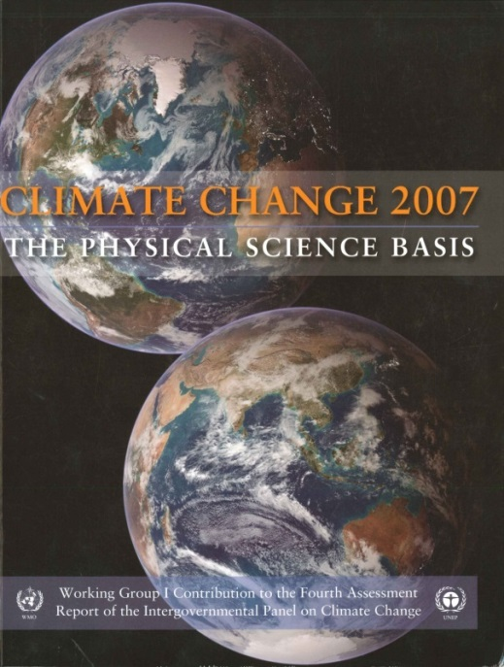
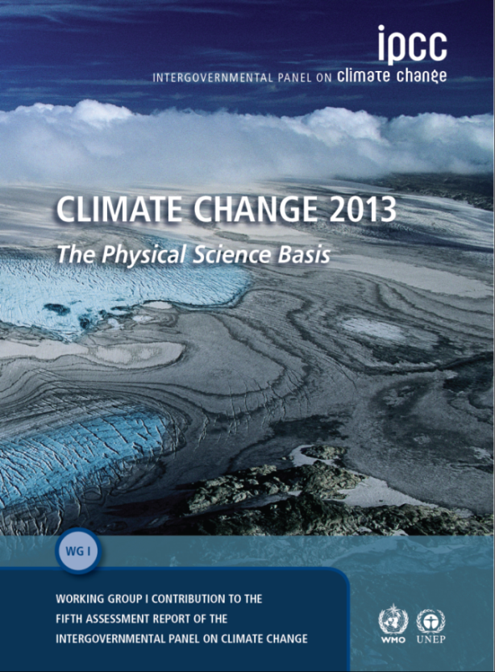
IPCC Assessment Reports since 1990: WGI Contribution
1990
1995
2001
2007
2013
Notes:
All IPCC Assessment Reports are available at www.ipcc.ch

Slide 7
Class Format
Students – skim/read the chapter in preparation for that class. Focus on interesting findings to you. Will take ~2 hrs/week.
Presenters –
  Read Entire Chapter
  Pick out what to present – of most general interest.
  You will really have to pick and choose!
  Presentation: 30-40 min; Discussion 20-30 min.
  May wish to have back-up slides OR stored PDF of the chapter for additional questions.
Driving themes:
  How do new findings affect my interests?
  How will the earth system change on different time scales (decades, centuries)
  How do new findings affect people’s lives over the next 1-2 centuries?
  …?

Slide 8
Schedule
Date Content Leader(s)
Aug 25 Intro + Chapter 1 O’Dell
Sep 1 Labor Day / No Class
Sep 8 Ch. 2, Observations: Atmosphere&Surface (96 pp) Rob & Andy
Sep 15 Ch. 3, Observations: Ocean (62 pp) Janice
Sep 22 Ch. 4, Observations: Cryosphere (66 pp) Veljko
Sep 29 Ch. 5, Paleoclimate (82 pp) Zitley & Brody
Oct 6 Ch. 6, Carbon & Biogeochemical Cycles (106 pp) Parker
Oct 13 Ch. 7, Clouds & Aerosols (88 pp) Ashley & Christina
Oct 20 Ch. 8, Radiative Forcing (82 pp) Dave D & Jianbo
Oct 27 Ch. 9, Evaluation of Climate Models (126 pp) Todd & Brandon
Nov 3 Ch. 10, Detection & Attribution of CC (86 pp) Brian C. & Sam
Nov 10 Ch. 11, Near-term Climate Change Projections (76 pp) Peter M.
Nov 17 Ch. 12, Long-term Climate Change Projections (108 pp) Marie M & Bryan M
Dec 1 Ch. 13, Sea Level Change (80 pp) Pat Keys
Dec 8 Ch. 14, Phenomena & Regional Climate Change (94 pp) Amanda
Finals Week AGU – No Class

Slide 9
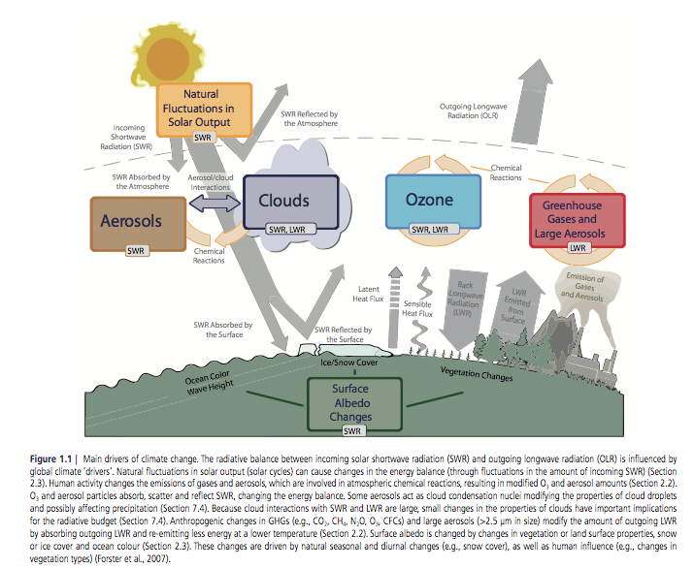
Main Drivers of Climate Change

Slide 10
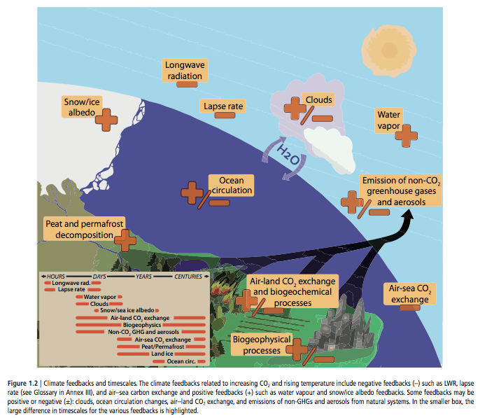
Feedbacks in the Climate system: Can be positive or negative.
(Overall they are positive ☹)

Slide 11
Multiple Lines of Evidence of Climate Change
Understanding of Basic Physics (radiative forcing by atmospheric gases & aerosols)
Current Observations of Climate Change (atmosphere, ocean, land, ice)
Paleoclimate Observations (Ice Cores, Tree rings, etc)
Paleoclimate reconstructions (help understand forcing agents)
Modeling of the past, present, and future climate
Statistical Detection and attribution of climate change

Slide 12
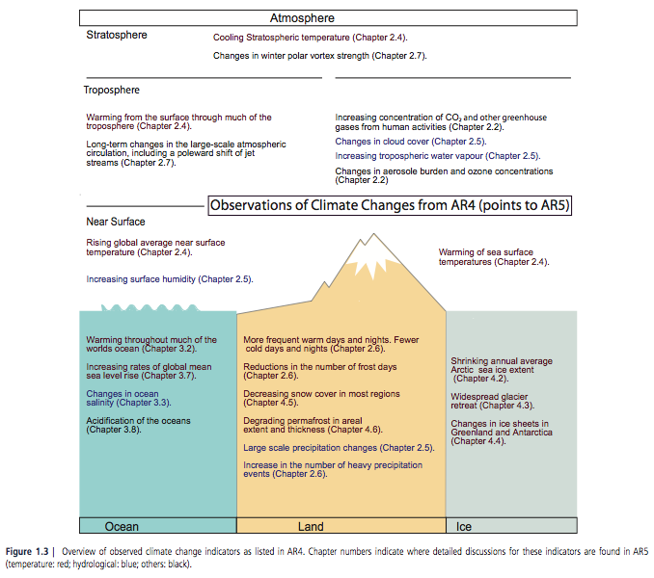
Observations of Current Climate Changes
Notes:
MULTIPLE LINES OF EVIDENCE OF CLIMATE CHANGE

Slide 13
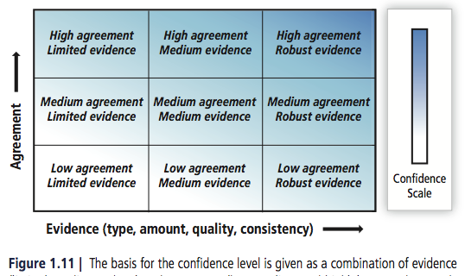
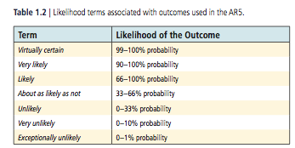
Treatment of Uncertainty
Qualitative Description
Quantitative Description
(where possible)
Notes:
Even this is rather subjective!!!

Slide 14
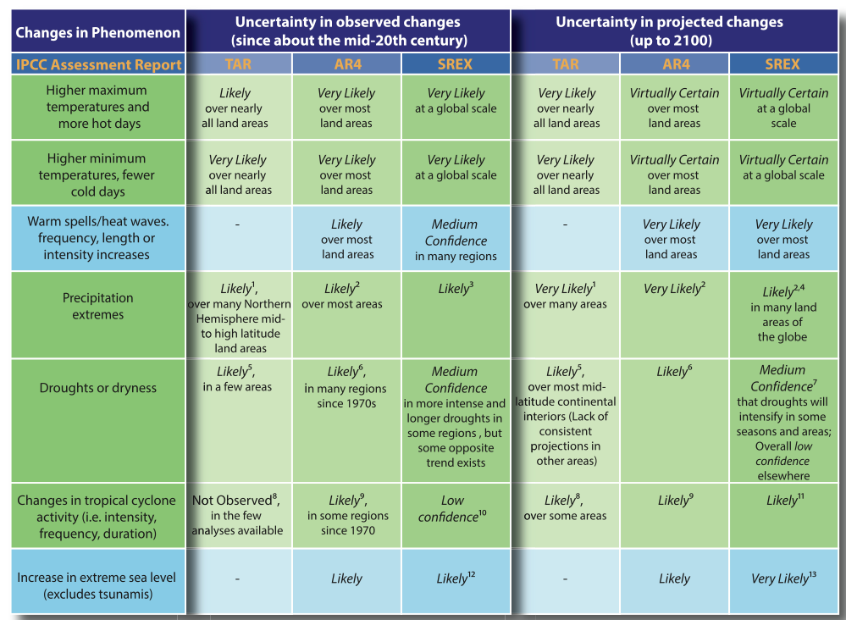
Even these probabilistic statements are somewhat subjective!
Notes:
1 More intense precipitation events
2 Heavy precipitation events. Frequency (or proportion of total rainfall from heavy falls) increases
3 Statistically significant trends in the number of heavy precipitation events in some regions. It is likely that more of these regions have experienced increases than decreases.
4 See SREX Table 3-3 for details on precipitation extremes for the different regions.
5 Increased summer continental drying and associated risk of drought
6 Area affected by droughts increases
7 Some areas include southern Europe and the Mediterranean region, central Europe, central North America and Mexico, northeast Brazil and southern Africa
8 Increase in tropical cyclone peak wind intensities
9 Increase in intense tropical cyclone activity
10 In any observed long-term (i.e., 40 years or more) after accounting for past changes in observing capabilities (see SREX, section 3.4.4)
11 Increase in average tropical cyclone maximum wind speed is, although not in all ocean basins; either decrease or no change in the global frequency of tropical cyclones
12 Increase in extreme coastal high water worldwide related to increases in mean sea level in the late 20th century
13 Mean sea level rise will contribute to upward trends in extreme coastal high water levels

Slide 15
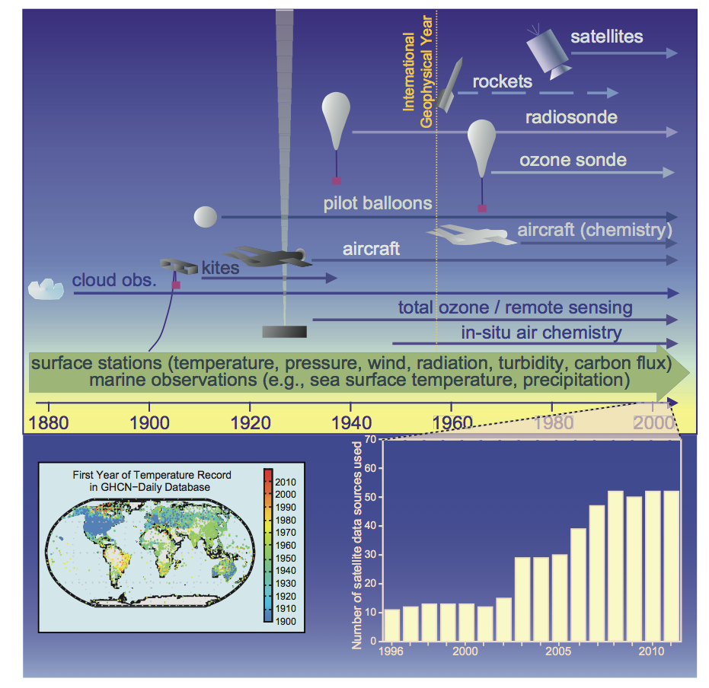
Better Measurement Capabilities
Notes:
Figure 1.12 | Development of capabilities of observations. Top: Changes in the mix and increasing diversity of observations over time create challenges for a consistent climate record (adapted from Brönnimann et al., 2008). Bottom left: First year of temperature data in Global Historical Climatology Network (GHCN) daily database (available at http:// www.ncdc.noaa.gov/oa/climate/ghcn-daily/; Menne et al., 2012). Bottom right: Number of satellite instruments from which data have been assimilated in the European Centre for Medium-Range Weather Forecasts production streams for each year from 1996 to 2010. This figure is used as an example to demonstrate the fivefold increase in the usage of satellite data over this time period.

Slide 16
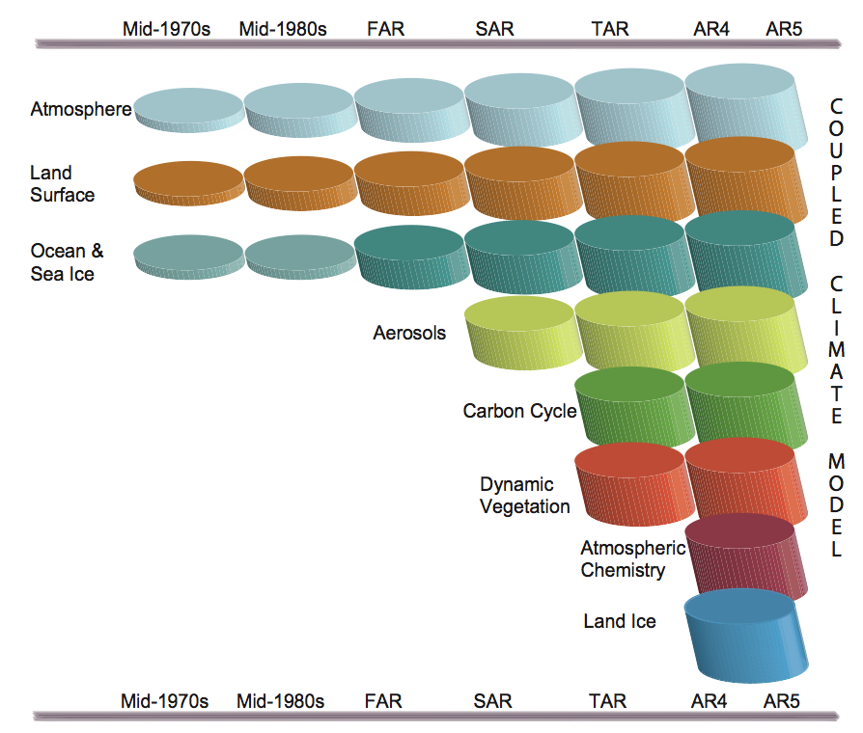
Better Modeling Capabilities
Notes:
Figure 1.13 | The development of climate models over the last 35 years showing how the different components were coupled into comprehensive climate models over time. In each aspect (e.g., the atmosphere, which comprises a wide range of atmospheric processes) the complexity and range of processes has increased over time (illustrated by growing cylinders). Note that during the same time the horizontal and vertical resolution has increased considerably e.g., for spectral models from T21L9 (roughly 500 km horizontal resolution and 9 vertical levels) in the 1970s to T95L95 (roughly 100 km horizontal resolution and 95 vertical levels) at present, and that now ensembles with at least three independent experiments can be considered as standard.

Slide 17
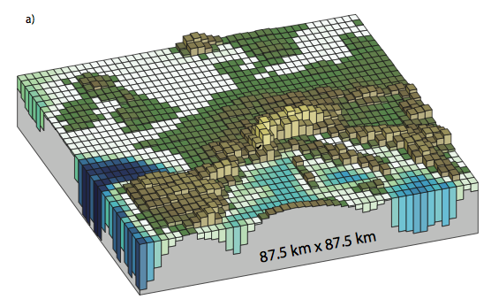
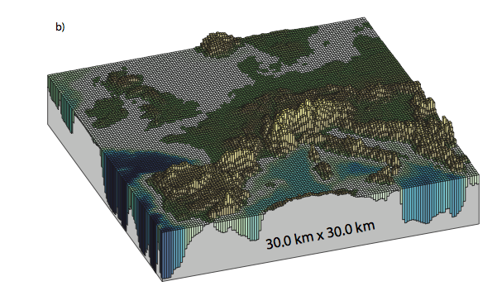
Increasing resolution allows better representation of processes
(Parameterize Less)
Typical Climate Model Resolution
Typical Forecast Model Resolution

Slide 18
Changing Emissions Scenarios
IS92A
SRES – Special Report on Emissions Scenarios
  A1B, B1, A1F1, A2
  All “plausible with no mitigation”
  The “no-mitigation” thing was a downside for many
RCP’s Representative Concentration Pathways
  All are “representative” and could include mitigation strategies
  2.6, 4.5, 6.0, 8.5 (Anthropogenic RF in 2100 in W/m² )
  Contain emission estimates, concentration estimates (using biogeochemical mdoels!), aerosol & air pollution emissions, etc. Very Detailed!

Slide 19
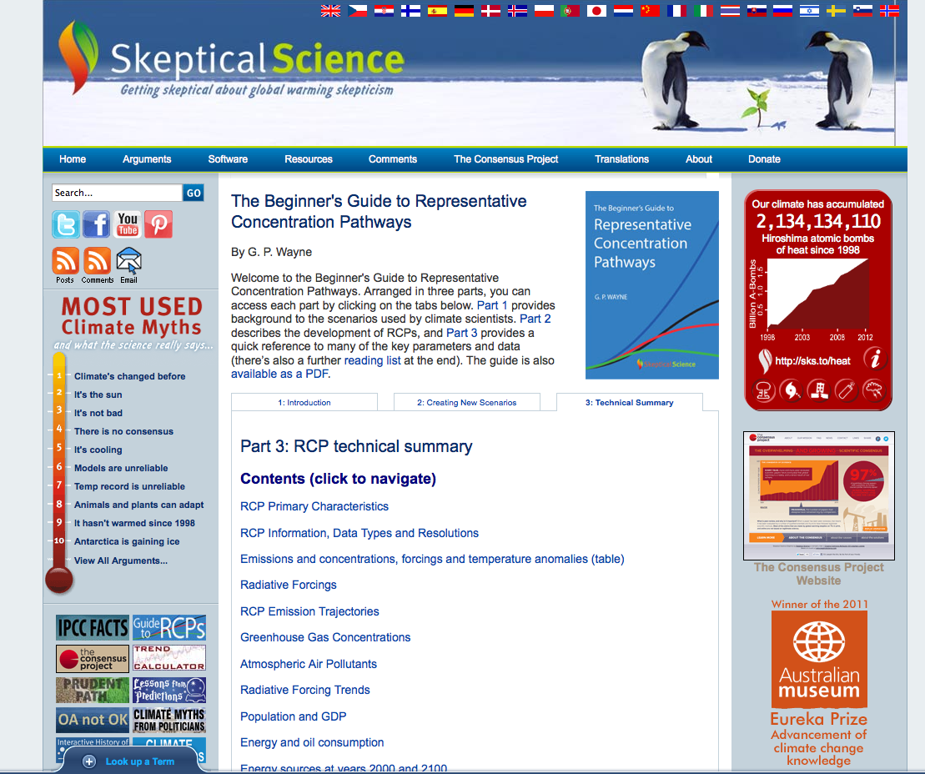
http://www.skepticalscience.com/rcp.php
Notes:
http://www.skepticalscience.com/rcp.php

Slide 20
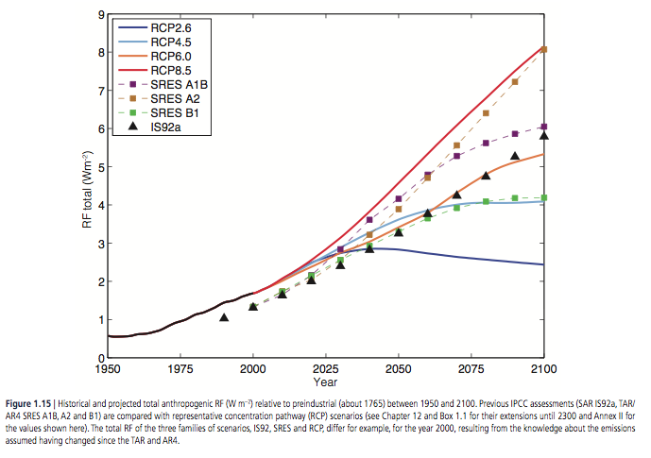
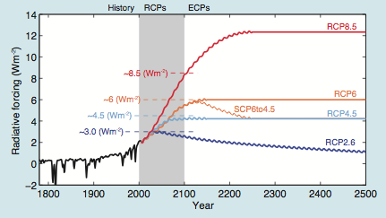
RCP Forcing Trajectories

Slide 21
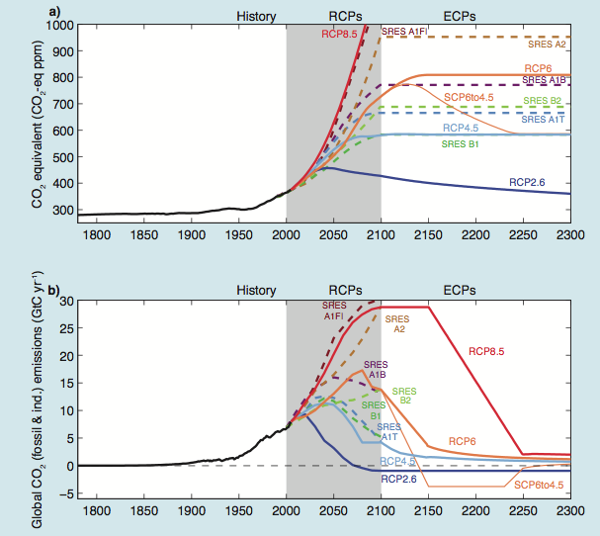
CO2-equivalent Trajectories

Slide 22
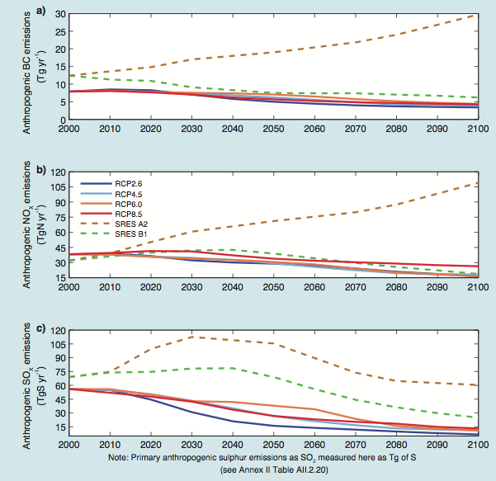
Atmospheric Air Pollutants Trajectories

Slide 23
WGI Summary for Policymakers
Summary for Policy Makers
Top-level results
Notes:
In order to facilitate the accessibility of the findings of the Working Group I assessment for a wide readership and to enhance their usability for stakeholders, each section and subsection of the Working Group I Summary for Policymakers has a highlighted headline statement. Taken together, these 19 headline statements provide an overarching summary in simple and quotable language that is supported by the scientists and approved by the member governments of the IPCC. The four headline statements in boxes are those summarizing the assessment in sections B, C, D and E of the Summary for Policymakers.

Slide 24
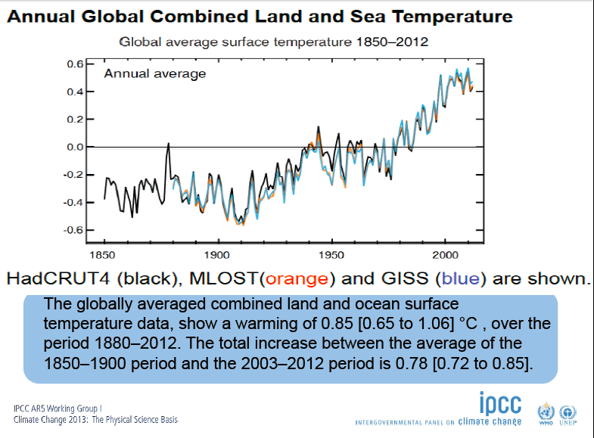
(IPCC 2013, Fig. SPM.1a)

Slide 25
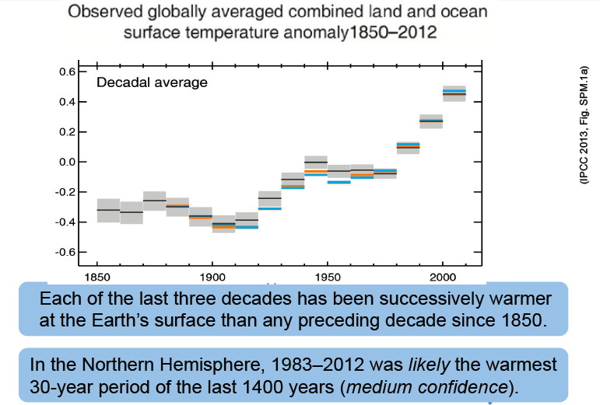

Slide 26
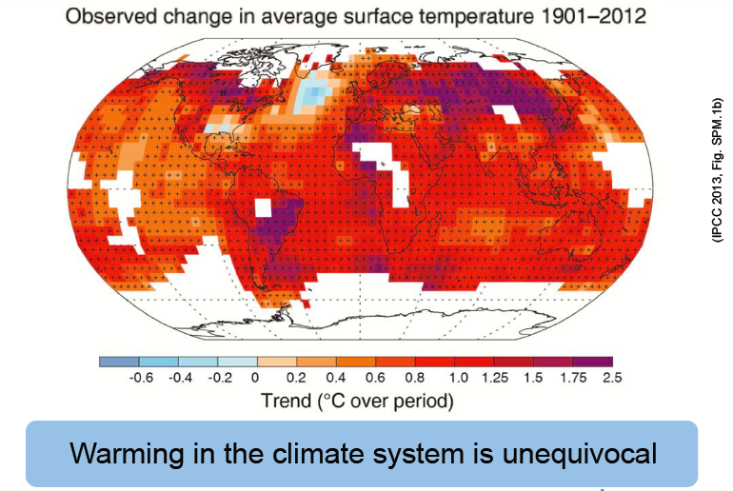

Slide 27
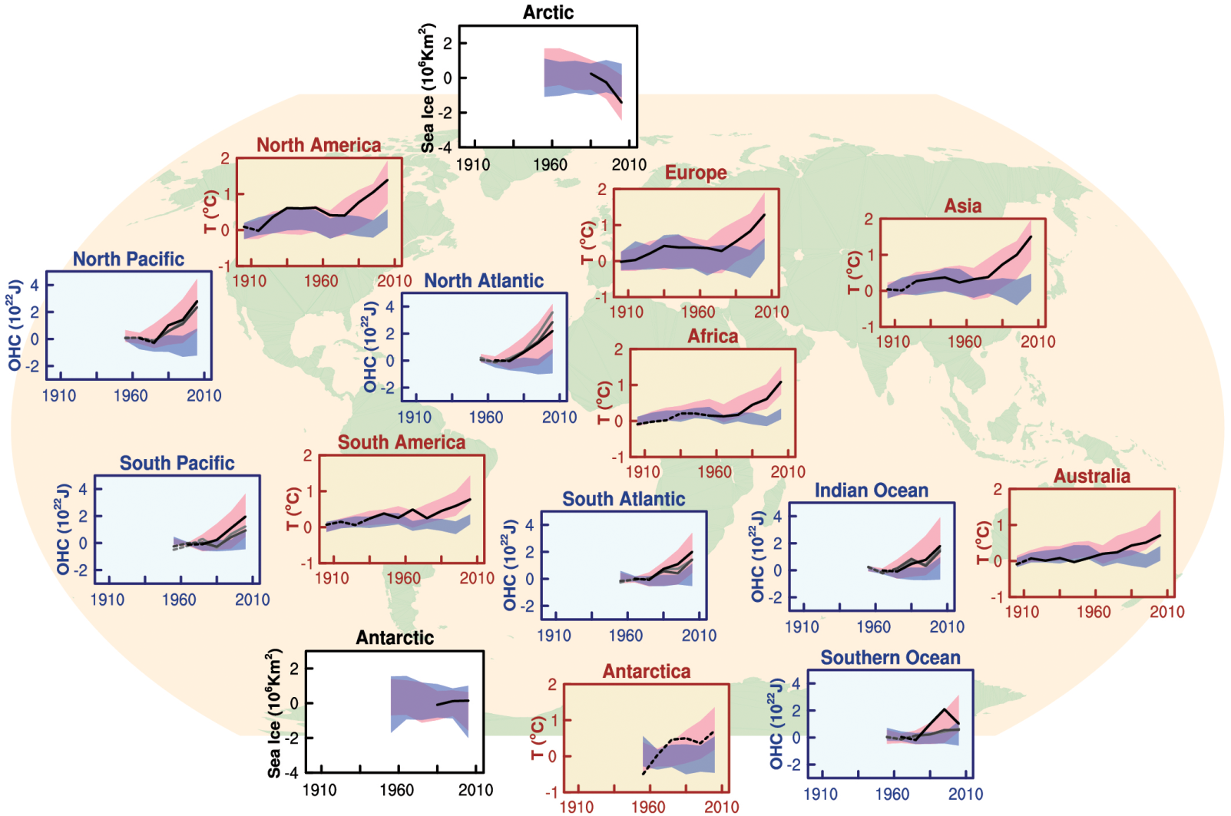

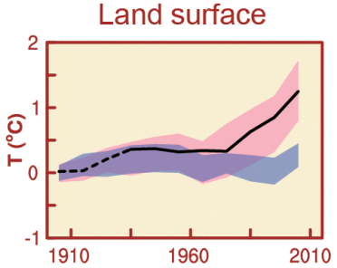
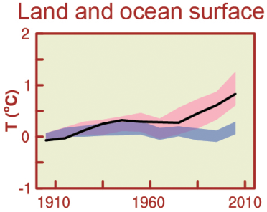
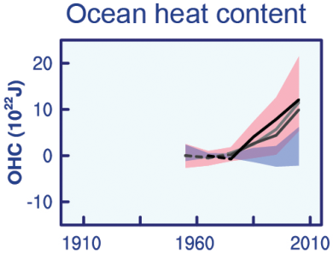
Figure SPM.6
Comparison of observed and simulated climate change
All Figures © IPCC 2013
Warming in the climate system is largely human-caused.
Notes:
Figure SPM.6 | Comparison of observed and simulated climate change based on three large-scale indicators in the atmosphere, the cryosphere and the ocean: change in continental land surface air temperatures (yellow panels), Arctic and Antarctic September sea ice extent (white panels), and upper ocean heat content in the major ocean basins (blue panels). Global average changes are also given. Anomalies are given relative to 1880–1919 for surface temperatures, 1960–1980 for ocean heat content and 1979–1999 for sea ice. All time-series are decadal averages, plotted at the centre of the decade. For temperature panels, observations are dashed lines if the spatial coverage of areas being examined is below 50%. For ocean heat content and sea ice panels the solid line is where the coverage of data is good and higher in quality, and the dashed line is where the data coverage is only adequate, and thus, uncertainty is larger. Model results shown are Coupled Model Intercomparison Project Phase 5 (CMIP5) multi-model ensemble ranges, with shaded bands indicating the 5 to 95% confidence intervals. For further technical details, including region definitions see the Technical Summary Supplementary Material. {Figure 10.21; Figure TS.12}

Slide 28
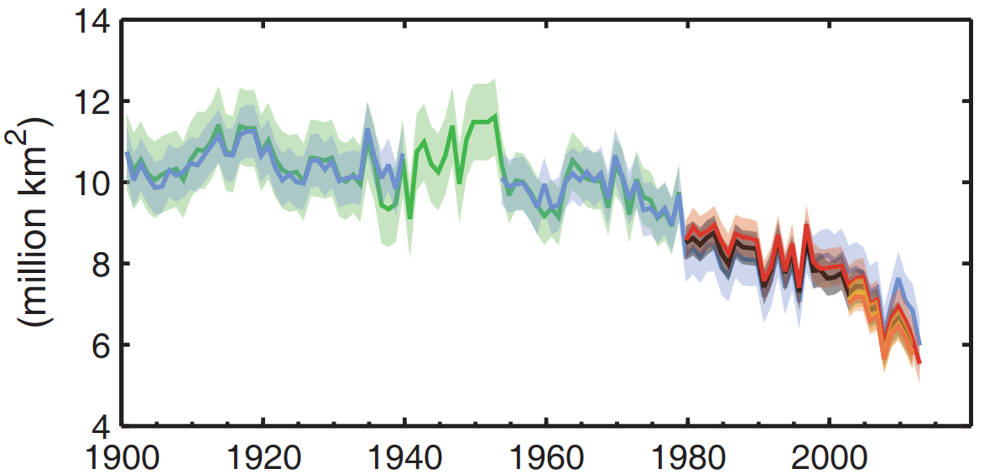
Annual mean Arctic summer sea ice
start of satellite data
(IPCC 2013, Fig. SPM.2)
Annual mean Arctic summer sea ice extent decreased
very likely with a rate of 3.5-4.1% per decade in 1979 – 2012
decrease was most rapid in summer (high confidence).
Data normalized to the satellite measured sea ice extent in 1979

Slide 29
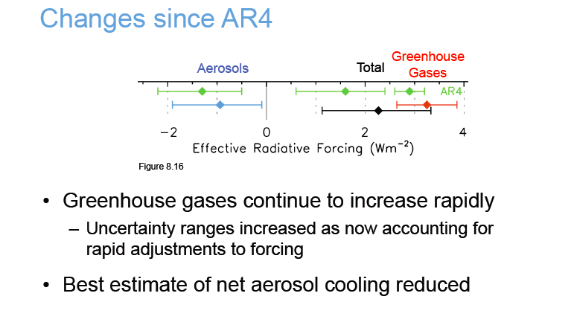

Slide 30
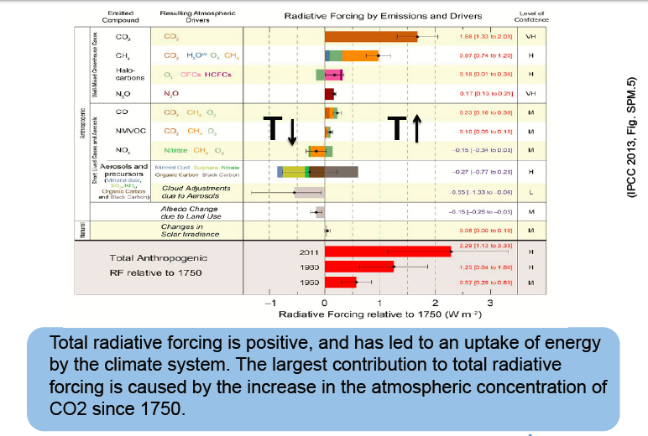

Slide 31
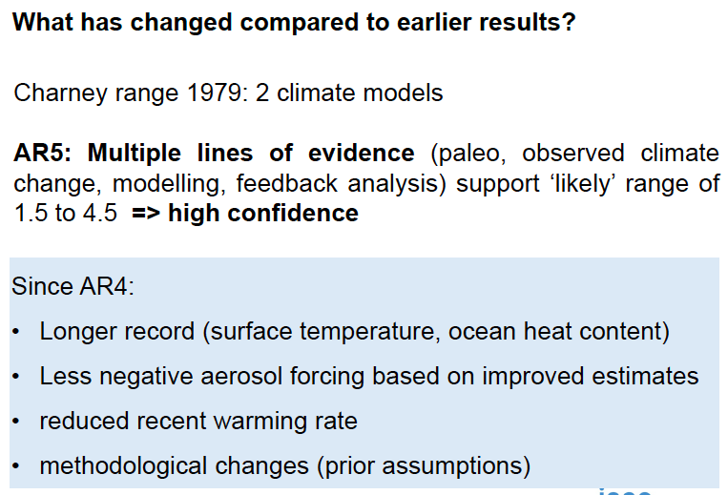

Slide 32
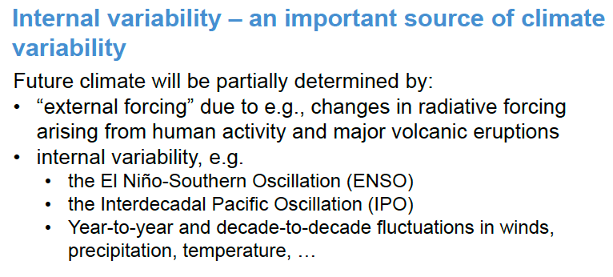

Slide 33
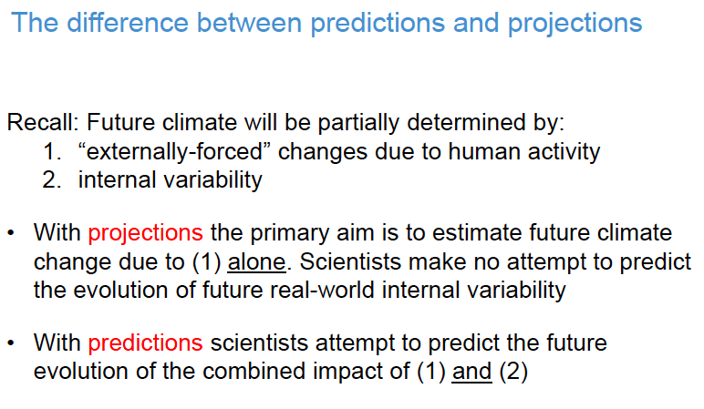

Slide 34
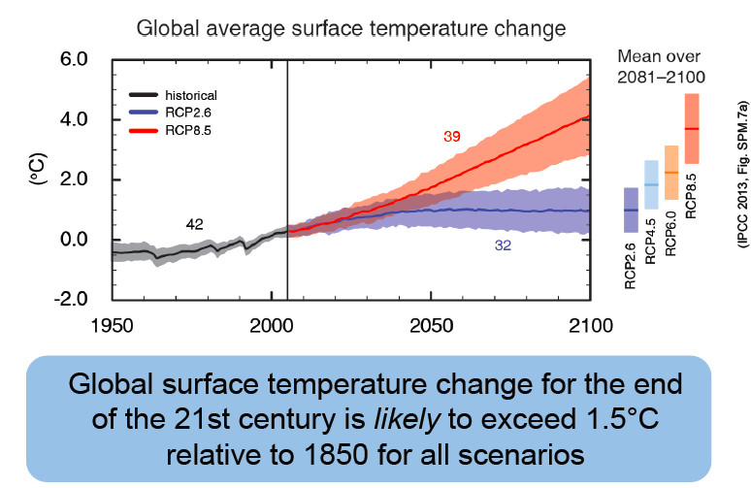

Slide 35
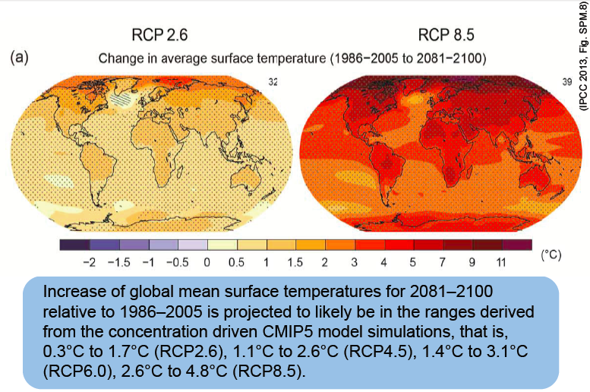

Slide 36
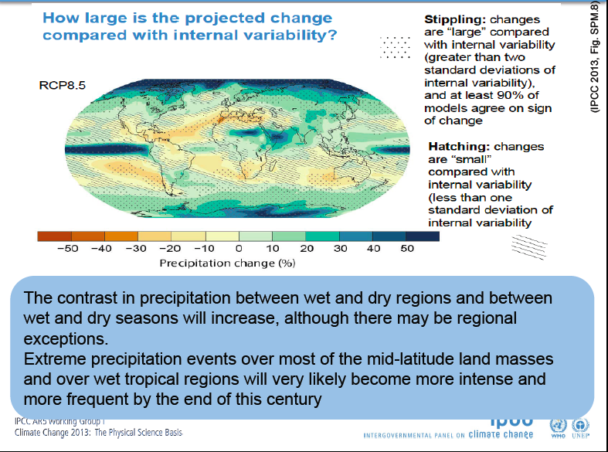

Slide 37
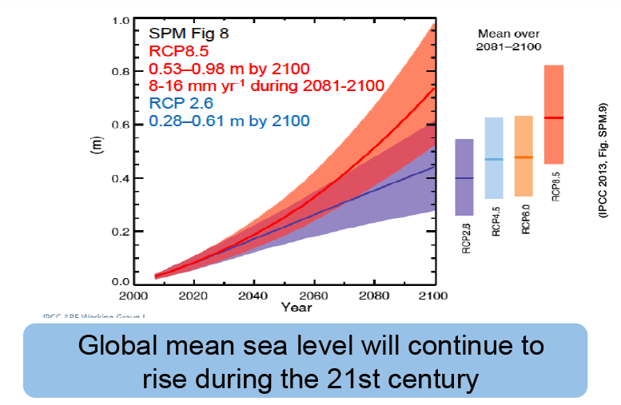

Slide 38
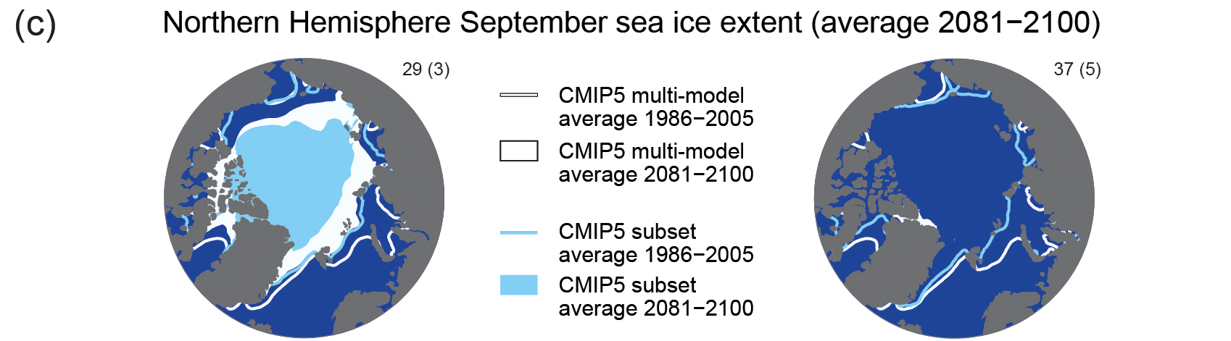
Figure SPM.8c
Maps of CMIP5 multi-model mean results
All Figures © IPCC 2013
RCP 2.6
RCP 8.5
Summer Arctic sea ice may survive in the low emissions scenario. Totally gone in the higher emissions scenario by 2100.
Notes:
Figure SPM.8, Panel c
Complete caption of Figure SPM.8:
Figure SPM.8 | Maps of CMIP5 multi-model mean results for the scenarios RCP2.6 and RCP8.5 in 2081–2100 of (a) annual mean surface temperature change, (b) average percent change in annual mean precipitation, (c) Northern Hemisphere September sea ice extent, and (d) change in ocean surface pH. Changes in panels (a), (b) and (d) are shown relative to 1986–2005. The number of CMIP5 models used to calculate the multi-model mean is indicated in the upper right corner of each panel. For panels (a) and (b), hatching indicates regions where the multi-model mean is small compared to natural internal variability (i.e., less than one standard deviation of natural internal variability in 20-year means). Stippling indicates regions where the multi-model mean is large compared to natural internal variability (i.e., greater than two standard deviations of natural internal variability in 20-year means) and where at least 90% of models agree on the sign of change (see Box 12.1). In panel (c), the lines are the modelled means for 1986−2005; the filled areas are for the end of the century. The CMIP5 multi-model mean is given in white colour, the projected mean sea ice extent of a subset of models (number of models given in brackets) that most closely reproduce the climatological mean state and 1979 to 2012 trend of the Arctic sea ice extent is given in light blue colour. For further technical details see the Technical Summary Supplementary Material. {Figures 6.28, 12.11, 12.22, and 12.29; Figures TS.15, TS.16, TS.17, and TS.20}

Slide 39
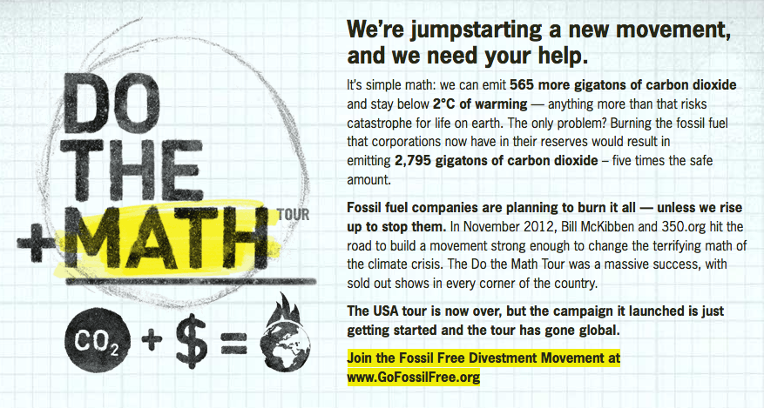
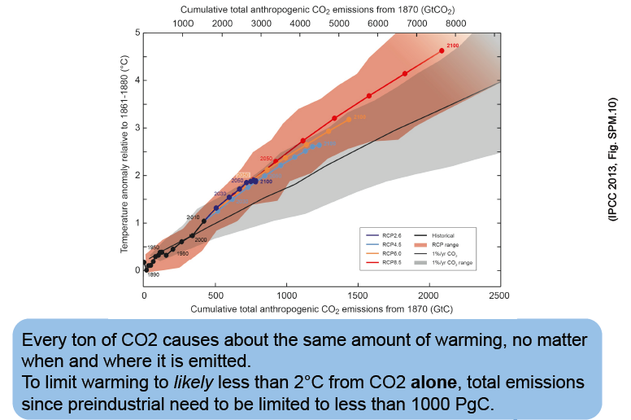

Slide 40
WGI Summary for Policymakers
Headline Statements
Notes:
In order to facilitate the accessibility of the findings of the Working Group I assessment for a wide readership and to enhance their usability for stakeholders, each section and subsection of the Working Group I Summary for Policymakers has a highlighted headline statement. Taken together, these 19 headline statements provide an overarching summary in simple and quotable language that is supported by the scientists and approved by the member governments of the IPCC. The four headline statements in boxes are those summarizing the assessment in sections B, C, D and E of the Summary for Policymakers.

Slide 41
Observed Changes in the Climate System (1/2)
Warming of the climate system is unequivocal, and since the 1950s, many of the observed changes are unprecedented over decades to millennia. The atmosphere and ocean have warmed, the amounts of snow and ice have diminished, sea level has risen, and the concentrations of greenhouse gases have increased.
Each of the last three decades has been successively warmer at the Earth’s surface than any preceding decade since 1850. In the Northern Hemisphere, 1983–2012 was likely the warmest 30-year period of the last 1400 years (medium confidence).
Ocean warming dominates the increase in energy stored in the climate system, accounting for more than 90% of the energy accumulated between 1971 and 2010 (high confidence). It is virtually certain that the upper ocean (0–700 m) warmed from 1971 to 2010, and it likely warmed between the 1870s and 1971.
Over the last two decades, the Greenland and Antarctic ice sheets have been losing mass, glaciers have continued to shrink almost worldwide, and Arctic sea ice and Northern Hemisphere spring snow cover have continued to decrease in extent (high confidence).
Notes:
In order to facilitate the accessibility of the findings of the Working Group I assessment for a wide readership and to enhance their usability for stakeholders, each section and subsection of the Working Group I Summary for Policymakers has a highlighted headline statement. Taken together, these 19 headline statements provide an overarching summary in simple and quotable language that is supported by the scientists and approved by the member governments of the IPCC. The four headline statements in boxes are those summarizing the assessment in sections B, C, D and E of the Summary for Policymakers.

Slide 42
Observed Changes in the Climate System (2/2)
The rate of sea level rise since the mid-19th century has been larger than the mean rate during the previous two millennia (high confidence). Over the period 1901 to 2010, global mean sea level rose by 0.19 [0.17 to 0.21] m.
The atmospheric concentrations of carbon dioxide, methane, and nitrous oxide have increased to levels unprecedented in at least the last 800,000 years. Carbon dioxide concentrations have increased by 40% since pre-industrial times, primarily from fossil fuel emissions and secondarily from net land use change emissions. The ocean has absorbed about 30% of the emitted anthropogenic carbon dioxide, causing ocean acidification.
Notes:
In order to facilitate the accessibility of the findings of the Working Group I assessment for a wide readership and to enhance their usability for stakeholders, each section and subsection of the Working Group I Summary for Policymakers has a highlighted headline statement. Taken together, these 19 headline statements provide an overarching summary in simple and quotable language that is supported by the scientists and approved by the member governments of the IPCC. The four headline statements in boxes are those summarizing the assessment in sections B, C, D and E of the Summary for Policymakers.

Slide 43
Understanding the Climate System and its Recent Changes (1/1)
Human influence on the climate system is clear. This is evident from the increasing greenhouse gas concentrations in the atmosphere, positive radiative forcing, observed warming, and understanding of the climate system.
Climate models have improved since the AR4. Models reproduce observed continental-scale surface temperature patterns and trends over many decades, including the more rapid warming since the mid-20th century and the cooling immediately following large volcanic eruptions (very high confidence).
Observational and model studies of temperature change, climate feedbacks and changes in the Earth’s energy budget together provide confidence in the magnitude of global warming in response to past and future forcing.
Human influence has been detected in warming of the atmosphere and the ocean, in changes in the global water cycle, in reductions in snow and ice, in global mean sea level rise, and in changes in some climate extremes. This evidence for human influence has grown since AR4. It is extremely likely that human influence has been the dominant cause of the observed warming since the mid-20th century.
Notes:
In order to facilitate the accessibility of the findings of the Working Group I assessment for a wide readership and to enhance their usability for stakeholders, each section and subsection of the Working Group I Summary for Policymakers has a highlighted headline statement. Taken together, these 19 headline statements provide an overarching summary in simple and quotable language that is supported by the scientists and approved by the member governments of the IPCC. The four headline statements in boxes are those summarizing the assessment in sections B, C, D and E of the Summary for Policymakers.

Slide 44
Future Global and Regional Climate Change (1/2)
Continued emissions of greenhouse gases will cause further warming and changes in all components of the climate system. Limiting climate change will require substantial and sustained reductions of greenhouse gas emissions.
Global surface temperature change for the end of the 21st century is likely to exceed 1.5°C relative to 1850 to 1900 for all RCP scenarios except RCP2.6. It is likely to exceed 2°C for RCP6.0 and RCP8.5, and more likely than not to exceed 2°C for RCP4.5. Warming will continue beyond 2100 under all RCP scenarios except RCP2.6. Warming will continue to exhibit interannual-to-decadal variability and will not be regionally uniform.
Changes in the global water cycle in response to the warming over the 21st century will not be uniform. The contrast in precipitation between wet and dry regions and between wet and dry seasons will increase, although there may be regional exceptions.
The global ocean will continue to warm during the 21st century. Heat will penetrate from the surface to the deep ocean and affect ocean circulation.
Notes:
In order to facilitate the accessibility of the findings of the Working Group I assessment for a wide readership and to enhance their usability for stakeholders, each section and subsection of the Working Group I Summary for Policymakers has a highlighted headline statement. Taken together, these 19 headline statements provide an overarching summary in simple and quotable language that is supported by the scientists and approved by the member governments of the IPCC. The four headline statements in boxes are those summarizing the assessment in sections B, C, D and E of the Summary for Policymakers.

Slide 45
Future Global and Regional Climate Change (2/2)
It is very likely that the Arctic sea ice cover will continue to shrink and thin and that Northern Hemisphere spring snow cover will decrease during the 21st century as global mean surface temperature rises. Global glacier volume will further decrease.
Global mean sea level will continue to rise during the 21st century. Under all RCP scenarios, the rate of sea level rise will very likely exceed that observed during 1971 to 2010 due to increased ocean warming and increased loss of mass from glaciers and ice sheets.
Climate change will affect carbon cycle processes in a way that will exacerbate the increase of CO₂ in the atmosphere (high confidence). Further uptake of carbon by the ocean will increase ocean acidification.
Cumulative emissions of CO₂ largely determine global mean surface warming by the late 21st century and beyond. Most aspects of climate change will persist for many centuries even if emissions of CO₂ are stopped. This represents a substantial multi-century climate change commitment created by past, present and future emissions of CO₂.
Notes:
In order to facilitate the accessibility of the findings of the Working Group I assessment for a wide readership and to enhance their usability for stakeholders, each section and subsection of the Working Group I Summary for Policymakers has a highlighted headline statement. Taken together, these 19 headline statements provide an overarching summary in simple and quotable language that is supported by the scientists and approved by the member governments of the IPCC. The four headline statements in boxes are those summarizing the assessment in sections B, C, D and E of the Summary for Policymakers.

Slide 46
WGI Summary for Policymakers
Figures
Notes:
All Figures from the IPCC Working Group I contribution to the IPCC 5th Assessment Report, including the Summary for Policymakers, are available as high-resolution JPEG files from the IPCC Working Group I website www.climatechange2013.org

Slide 47
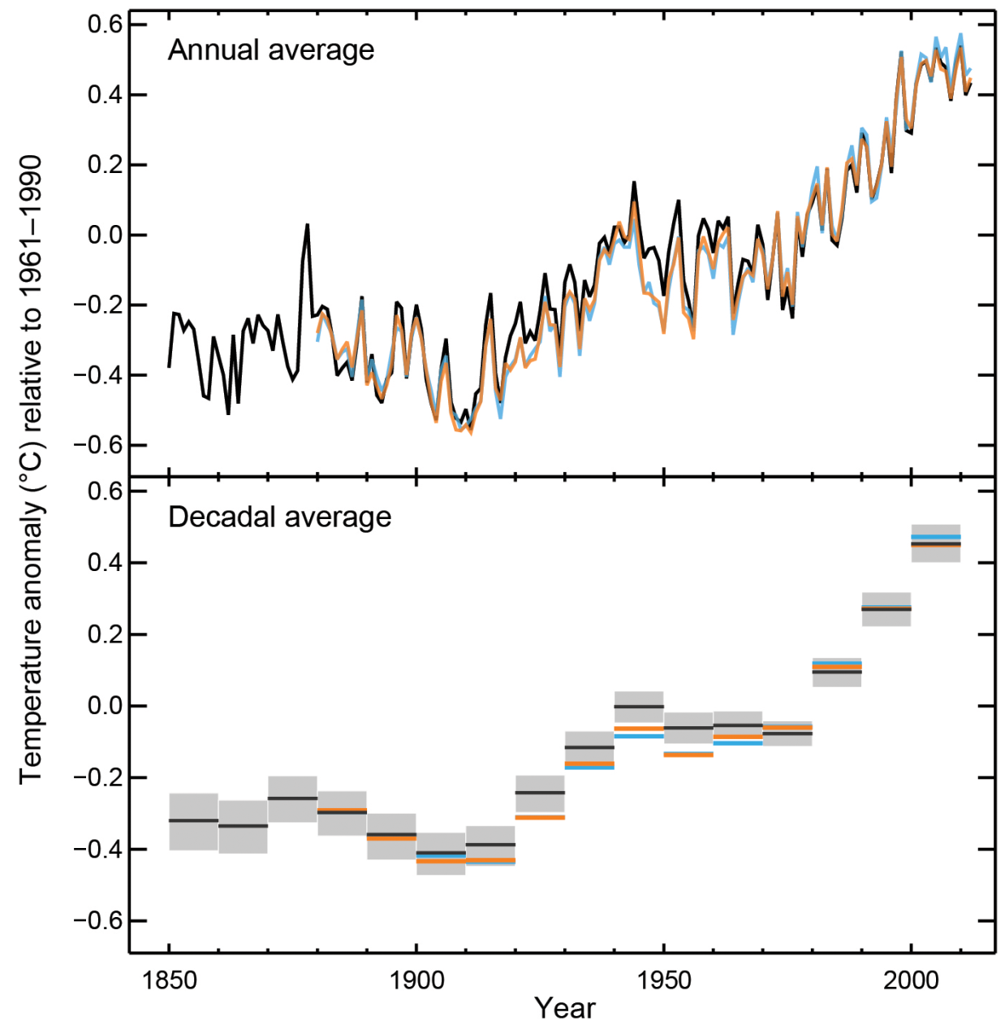
Figure SPM.1a
Observed globally averaged combined land and ocean surface temperature anomaly 1850-2012
All Figures © IPCC 2013
Notes:
Figure SPM.1, Panel a
Complete caption of Figure SPM.1:
Figure SPM.1 | (a) Observed global mean combined land and ocean surface temperature anomalies, from 1850 to 2012 from three data sets. Top panel: annual mean values. Bottom panel: decadal mean values including the estimate of uncertainty for one dataset (black). Anomalies are relative to the mean of 1961−1990. (b) Map of the observed surface temperature change from 1901 to 2012 derived from temperature trends determined by linear regression from one dataset (orange line in panel a). Trends have been calculated where data availability permits a robust estimate (i.e., only for grid boxes with greater than 70% complete records and more than 20% data availability in the first and last 10% of the time period). Other areas are white. Grid boxes where the trend is significant at the 10% level are indicated by a + sign. For a listing of the datasets and further technical details see the Technical Summary Supplementary Material. {Figures 2.19–2.21; Figure TS.2}

Slide 48
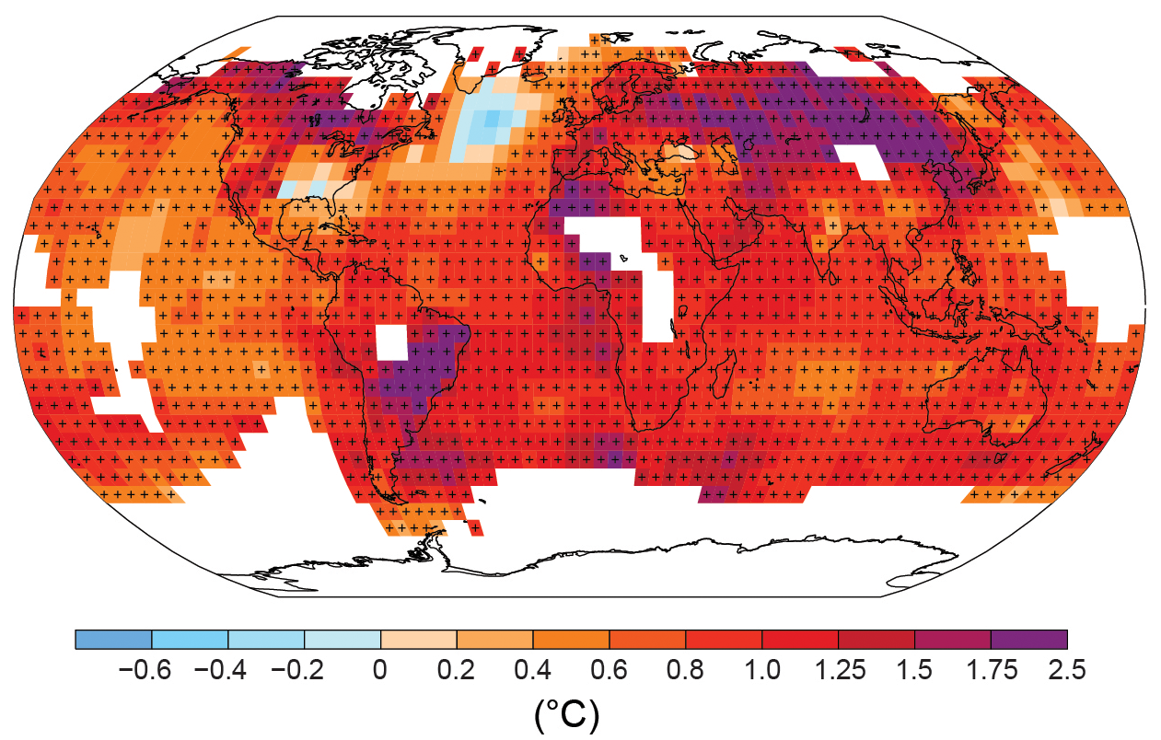
Figure SPM.1b
Observed change in surface temperature 1901-2012
All Figures © IPCC 2013
Notes:
Figure SPM.1, Panel b
Complete caption of Figure SPM.1:
Figure SPM.1 | (a) Observed global mean combined land and ocean surface temperature anomalies, from 1850 to 2012 from three data sets. Top panel: annual mean values. Bottom panel: decadal mean values including the estimate of uncertainty for one dataset (black). Anomalies are relative to the mean of 1961−1990. (b) Map of the observed surface temperature change from 1901 to 2012 derived from temperature trends determined by linear regression from one dataset (orange line in panel a). Trends have been calculated where data availability permits a robust estimate (i.e., only for grid boxes with greater than 70% complete records and more than 20% data availability in the first and last 10% of the time period). Other areas are white. Grid boxes where the trend is significant at the 10% level are indicated by a + sign. For a listing of the datasets and further technical details see the Technical Summary Supplementary Material. {Figures 2.19–2.21; Figure TS.2}

Slide 49
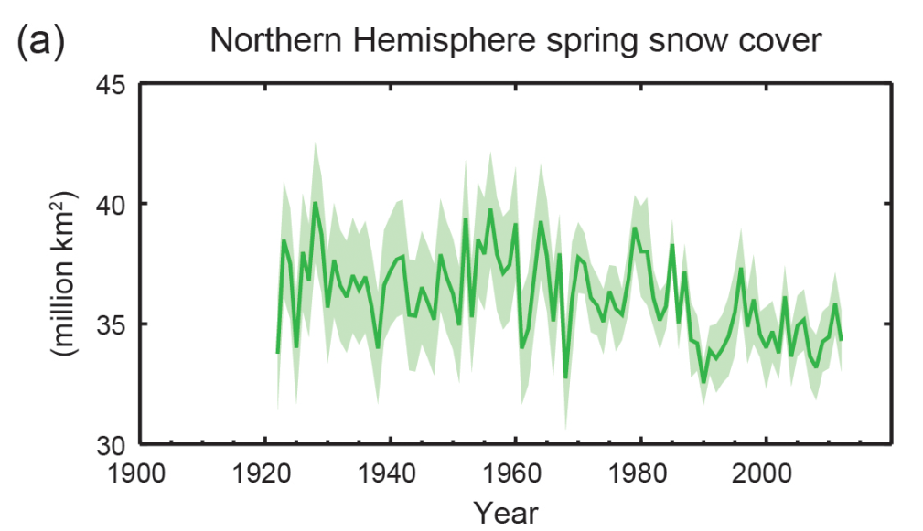
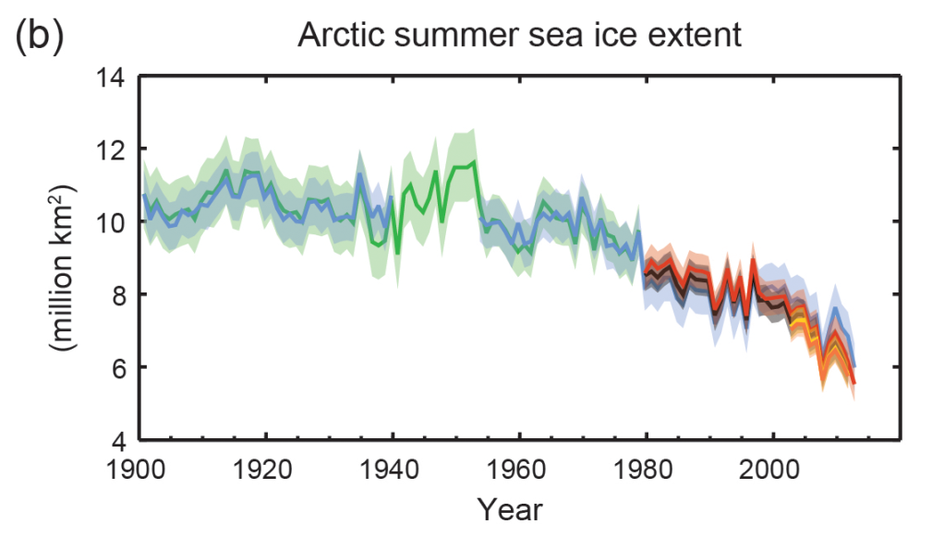
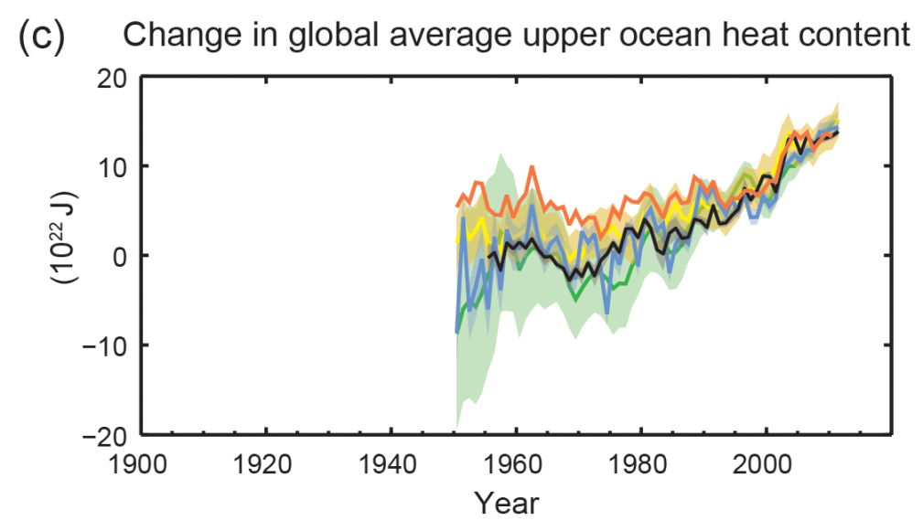
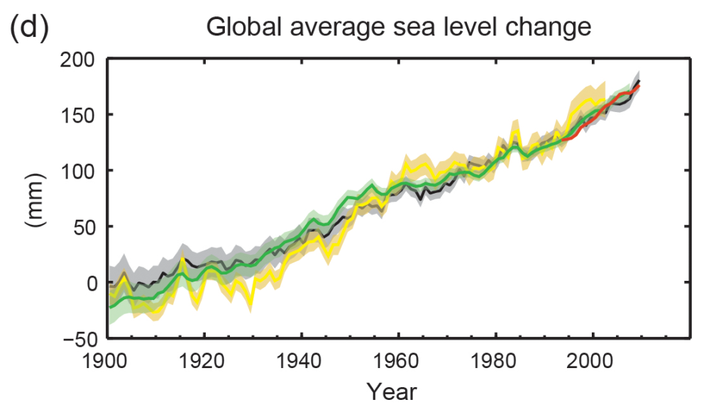
Figure SPM.3
Multiple observed indicators of a changing global climate
All Figures © IPCC 2013
Notes:
Figure SPM.3 | Multiple observed indicators of a changing global climate: (a) Extent of Northern Hemisphere March-April (spring) average snow cover; (b) extent of Arctic July-August-September (summer) average sea ice; (c) change in global mean upper ocean (0–700 m) heat content aligned to 2006−2010, and relative to the mean of all datasets for 1970; (d) global mean sea level relative to the 1900–1905 mean of the longest running dataset, and with all datasets aligned to have the same value in 1993, the first year of satellite altimetry data. All time-series (coloured lines indicating different data sets) show annual values, and where assessed, uncertainties are indicated by coloured shading. See Technical Summary Supplementary Material for a listing of the datasets. {Figures 3.2, 3.13, 4.19, and 4.3; FAQ 2.1, Figure 2; Figure TS.1}

Slide 50
Figure SPM.6
Comparison of observed and simulated climate change
All Figures © IPCC 2013
Notes:
Figure SPM.6 | Comparison of observed and simulated climate change based on three large-scale indicators in the atmosphere, the cryosphere and the ocean: change in continental land surface air temperatures (yellow panels), Arctic and Antarctic September sea ice extent (white panels), and upper ocean heat content in the major ocean basins (blue panels). Global average changes are also given. Anomalies are given relative to 1880–1919 for surface temperatures, 1960–1980 for ocean heat content and 1979–1999 for sea ice. All time-series are decadal averages, plotted at the centre of the decade. For temperature panels, observations are dashed lines if the spatial coverage of areas being examined is below 50%. For ocean heat content and sea ice panels the solid line is where the coverage of data is good and higher in quality, and the dashed line is where the data coverage is only adequate, and thus, uncertainty is larger. Model results shown are Coupled Model Intercomparison Project Phase 5 (CMIP5) multi-model ensemble ranges, with shaded bands indicating the 5 to 95% confidence intervals. For further technical details, including region definitions see the Technical Summary Supplementary Material. {Figure 10.21; Figure TS.12}

Slide 51

Figure SPM.8a,b
Maps of CMIP5 multi-model mean results
All Figures © IPCC 2013
Notes:
Figure SPM.8, Panels a and b
Complete caption of Figure SPM.8:
Figure SPM.8 | Maps of CMIP5 multi-model mean results for the scenarios RCP2.6 and RCP8.5 in 2081–2100 of (a) annual mean surface temperature change, (b) average percent change in annual mean precipitation, (c) Northern Hemisphere September sea ice extent, and (d) change in ocean surface pH. Changes in panels (a), (b) and (d) are shown relative to 1986–2005. The number of CMIP5 models used to calculate the multi-model mean is indicated in the upper right corner of each panel. For panels (a) and (b), hatching indicates regions where the multi-model mean is small compared to natural internal variability (i.e., less than one standard deviation of natural internal variability in 20-year means). Stippling indicates regions where the multi-model mean is large compared to natural internal variability (i.e., greater than two standard deviations of natural internal variability in 20-year means) and where at least 90% of models agree on the sign of change (see Box 12.1). In panel (c), the lines are the modelled means for 1986−2005; the filled areas are for the end of the century. The CMIP5 multi-model mean is given in white colour, the projected mean sea ice extent of a subset of models (number of models given in brackets) that most closely reproduce the climatological mean state and 1979 to 2012 trend of the Arctic sea ice extent is given in light blue colour. For further technical details see the Technical Summary Supplementary Material. {Figures 6.28, 12.11, 12.22, and 12.29; Figures TS.15, TS.16, TS.17, and TS.20}

Slide 52
Figure SPM.8c
Maps of CMIP5 multi-model mean results
All Figures © IPCC 2013
RCP 2.6
RCP 8.5
Notes:
Figure SPM.8, Panel c
Complete caption of Figure SPM.8:
Figure SPM.8 | Maps of CMIP5 multi-model mean results for the scenarios RCP2.6 and RCP8.5 in 2081–2100 of (a) annual mean surface temperature change, (b) average percent change in annual mean precipitation, (c) Northern Hemisphere September sea ice extent, and (d) change in ocean surface pH. Changes in panels (a), (b) and (d) are shown relative to 1986–2005. The number of CMIP5 models used to calculate the multi-model mean is indicated in the upper right corner of each panel. For panels (a) and (b), hatching indicates regions where the multi-model mean is small compared to natural internal variability (i.e., less than one standard deviation of natural internal variability in 20-year means). Stippling indicates regions where the multi-model mean is large compared to natural internal variability (i.e., greater than two standard deviations of natural internal variability in 20-year means) and where at least 90% of models agree on the sign of change (see Box 12.1). In panel (c), the lines are the modelled means for 1986−2005; the filled areas are for the end of the century. The CMIP5 multi-model mean is given in white colour, the projected mean sea ice extent of a subset of models (number of models given in brackets) that most closely reproduce the climatological mean state and 1979 to 2012 trend of the Arctic sea ice extent is given in light blue colour. For further technical details see the Technical Summary Supplementary Material. {Figures 6.28, 12.11, 12.22, and 12.29; Figures TS.15, TS.16, TS.17, and TS.20}

Slide 53

Figure SPM.10
Temperature increase and cumulative carbon emissions
All Figures © IPCC 2013
Notes:
Figure SPM.10 | Global mean surface temperature increase as a function of cumulative total global CO2 emissions from various lines of evidence. Multi-model results from a hierarchy of climate-carbon cycle models for each RCP until 2100 are shown with coloured lines and decadal means (dots). Some decadal means are labeled for clarity (e.g., 2050 indicating the decade 2040−2049). Model results over the historical period (1860 to 2010) are indicated in black. The coloured plume illustrates the multi-model spread over the four RCP scenarios and fades with the decreasing number of available models in RCP8.5. The multi-model mean and range simulated by CMIP5 models, forced by a CO2 increase of 1% per year (1% yr–1 CO2 simulations), is given by the thin black line and grey area. For a specific amount of cumulative CO2 emissions, the 1% per year CO2 simulations exhibit lower warming than those driven by RCPs, which include additional non-CO2 forcings. Temperature values are given relative to the 1861−1880 base period, emissions relative to 1870. Decadal averages are connected by straight lines. For further technical details see the Technical Summary Supplementary Material. {Figure 12.45; TS TFE.8, Figure 1}

