Slide 1
IPCC Report Chapter 11 Near-Term Climate Change: Predictions and Projections
ATS786
11/11/2014

Slide 2
Overview
Introduction to Near-term predictions
Terminology
Predictability
Near-term projections
Atmospheric and Land Surface
Ocean
Cryosphere
Atmospheric Composition and Air Quality
Uncertainties in Near-term projections
Intro.
Prediction
Projection
Weather
Ocean
Cryosphere
Atm. Comp.
Uncertain.

Slide 3
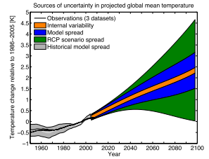
What is near-term?
Defined as period from current to 2050
Emphasis on “core” period: 2016 – 2035
Relatively small uncertainty → high S/N ratio (models, emissions)
Decision makers
Compares most results to benchmark period (1986 – 2005)
Atmospheric composition section looks out to 2100
Figure 11.8
Near Term
Intro.
Prediction
Projection
Weather
Ocean
Cryosphere
Atm. Comp.
Uncertain.

Slide 4
The Big Picture
In order to see how well models predict the future (projections), we need to understand how well they have predicted the past (predictions)
Decadal Predictions are a relatively new focus of IPCC
Methodologies are still being tested
Intro.
Prediction
Projection
Weather
Ocean
Cryosphere
Atm. Comp.
Uncertain.

Slide 5
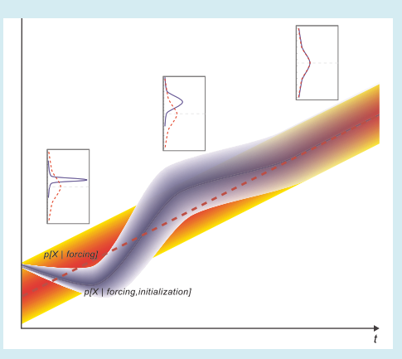
Terminology
Internally generated (chaos) vs. externally forced (both anthropogenic and natural) variability
Climate projection vs. prediction
Box 11.1 Figure 3
Prediction/forecast
Initialized based on observations
Initial value and boundary value problems
Use of Ensemble Analysis
Hindcasts
Projection
Uses emission scenarios
“NoInit” / Uninitialized
Intro.
Prediction
Projection
Weather
Ocean
Cryosphere
Atm. Comp.
Uncertain.
Notes:
Purple – prediction / uncertainty increases with time
Red – projection – unitialized (unitialized – started from historic simulations from pre-industrial times)
After time, lose predictability associated with initial values

Slide 6
Terminology
Initialized Predictions are valuable in short-term, but lose value in long-term
Predictability – a feature of the system
Ability to be predicted (potential skill)
not ability to predict (prediction)
A great deal of recent research on climate predictability / statistical methods
Temperature Avg’s Box 11.1 Figure 4
Intro.
Prediction
Projection
Weather
Ocean
Cryosphere
Atm. Comp.
Uncertain.

Slide 7
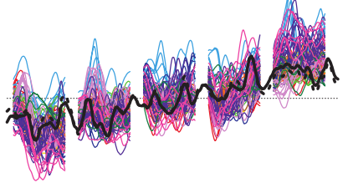
Predictability
Notes:
Small errors in initial conditions and run
Statistical analysis on observations or model output
Literature Review (p962) of different regions and variables and relatively predictability scales

Slide 8
Climate Predictability Studies
How well can models predict known state
Tell us the current limits (time ranges) for predicting different variables and different regions using hindcasts
Prognostic vs. Diagnostic Studies
Generally, both types of studies are generally in-line
Dependent on trust of model
Variable | Predictability
ENSO / PDO | 1 – 5 years
AMOC | 5 – 10 years
SST | 5 – 10 years
Temperature | Multi-year
Precipitation | Long-term
In general, shorter time frames predictability is based on initial conditions, longer time frames is based on external forcing
Intro.
Prediction
Projection
Weather
Ocean
Cryosphere
Atm. Comp.
Uncertain.
Notes:
Small errors in initial conditions and run
Statistical analysis on observations or model output
Literature Review (p962) of different regions and variables and relatively predictability scales

Slide 9
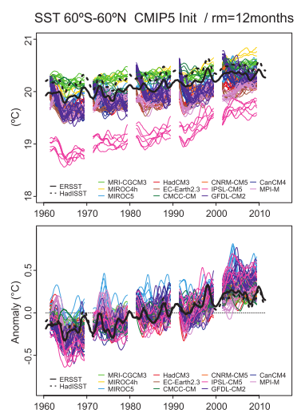
Climate Predictability Studies
CMIP5 (Coupled Model Intercomparison Project)
Multi-model
Each model initialized differently (Table 11.1)
Use of ensemble analysis
Perturbed parameter
Drifts / bias shifts to model preferred climate state
Many methods to fix
Projections typically do not have these issues
Figure 11.2
Intro.
Prediction
Projection
Weather
Ocean
Cryosphere
Atm. Comp.
Uncertain.
Notes:
Ensemble Analysis – predicts changes in

Slide 10
Quality Assessment
Forecast quality depends on hindcast
Accuracy – how close to observations
Skill – compared to a benchmark forecast (e.g. climatology)
Reliability – comparison of probability distribution / variance
Frequency of outcome
Intro.
Prediction
Projection
Weather
Ocean
Cryosphere
Atm. Comp.
Uncertain.

Slide 11
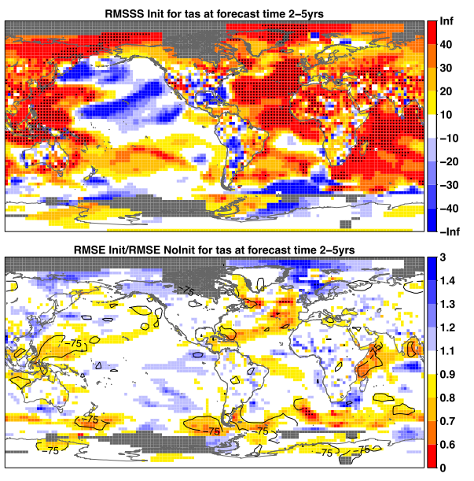
Is Prediction Accurate / Skillful?
Figure 11.4
Temperature
Generally, skillful over oceans (except Pacific)
Initialization improves skill in some regions
Root Mean Square Skill Score (Relative to Climatology)
Root Mean Square Error
Intro.
Prediction
Projection
Weather
Ocean
Cryosphere
Atm. Comp.
Uncertain.
Notes:
Root Mean Square Skill Score – RMSE of prediction compared to RMSE of climatology, such that a higher value represents more skillful than a climatology RMSE INIT / RMSE NoINIT – close to zero means initalizing model with observations improves prediction

Slide 12
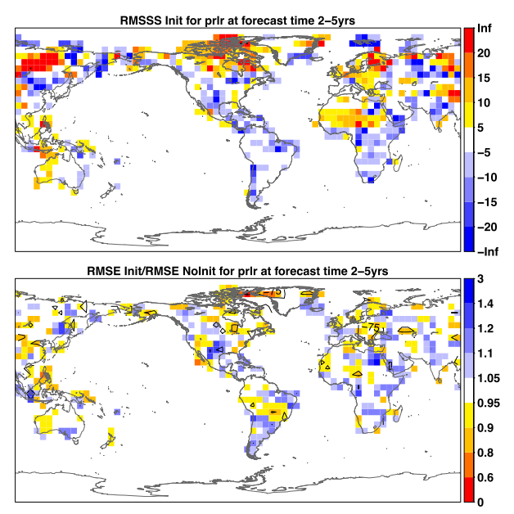
Is Prediction Accurate / Skillful?
Figure 11.6
Precipitation
Less skillful than temperature (high confidence)
Skill that is present likely comes from RF (Not from initialization)
AMOC
Low confidence
Model differences
Intro.
Prediction
Projection
Weather
Ocean
Cryosphere
Atm. Comp.
Uncertain.
Notes:
R

Slide 13
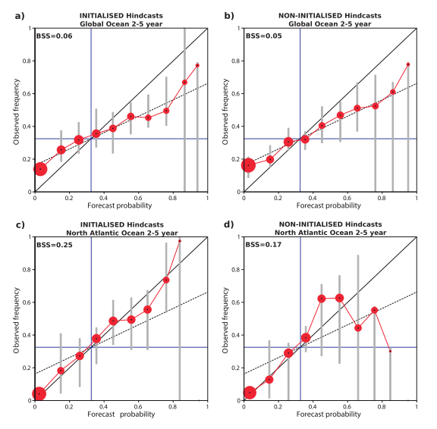
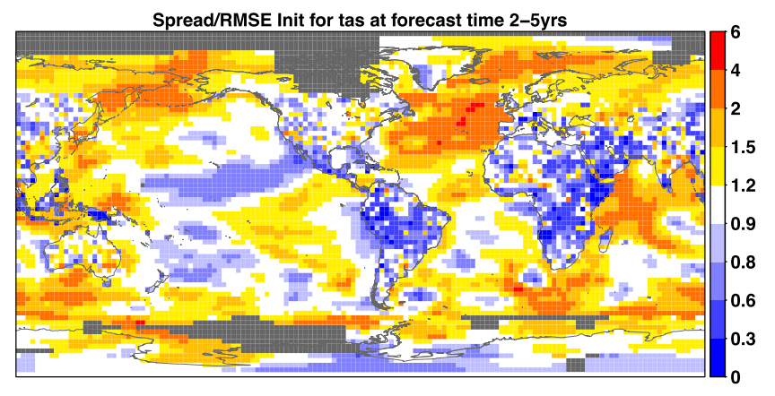
Is Prediction Reliable?
Surface temperatures of North Atlantic more reliable than global oceans
Regionally Dependent
Surface Temperatures
Figure 11.5
Figure 11.7
Intro.
Prediction
Projection
Weather
Ocean
Cryosphere
Atm. Comp.
Uncertain.
Notes:
Values close to 1, mean a well-calibrated/ reliable system

Slide 14
Summary of Predictability
While high prediction is potentially possible, there are many hurdles in assessing the quality of current predictions
Limited data for initialization and verification
Initialization and assimilation techniques
Dynamical model responses in order to produce similar variability
Intro.
Prediction
Projection
Weather
Ocean
Cryosphere
Atm. Comp.
Uncertain.

Slide 15
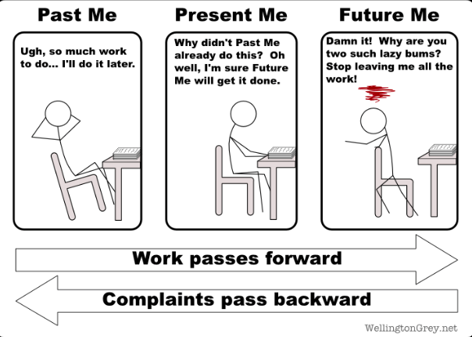
Near-Term Projections

Slide 16
Near-Term Projections
Initialized from historical simulations of the evolution of climate from pre-industrial conditions
Testing how much of near-term climate signal is forced from internal vs. external forcings
In near-term, different emission scenarios generally cause similar results
RCP4.5 is used in this study
Intro.
Prediction
Projection
Weather
Ocean
Cryosphere
Atm. Comp.
Uncertain.

Slide 17
Near-Term Projections
Uncertainties in Near-term projections
Natural Internal Variability
External Forcings / Scenarios
Climate Model Responses
Difficult to gauge uncertainties in regional trends
Figure 11.8
Near Term
Intro.
Prediction
Projection
Weather
Ocean
Cryosphere
Atm. Comp.
Uncertain.

Slide 18
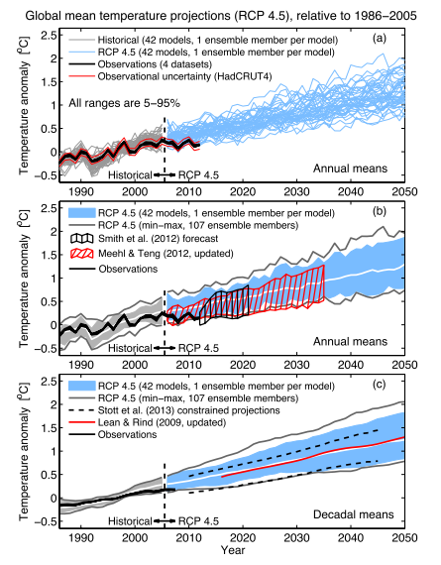
Caveat
Figure 11.9
Forecast improvements may demonstrate that actual results fall outside projected RCP range
Initializing models with observations
Weighting better-performing models (ASK method)
Climate system models may have too high a transient response to anthropogenic forcing (medium confidence)
May not fall within range of projections
Intro.
Prediction
Projection
Weather
Ocean
Cryosphere
Atm. Comp.
Uncertain.
Notes:
Top is temperature projections
Middle is temperature projections overlaid with tests where models where intiialized in 2006 and 2011 with observations

Slide 19
Weather Projections
http://www.brisbanetimes.com.au/queensland/heatwave-set-to-hit-queensland-20140101-3066m.html

Slide 20
Figure
Stippled
Where change is > 2 standard deviations of internal variability
90% of models agree on sign
Thus, forcing signal
Hatched
Where changes is < 1 standard deviation of internal variability
Low signal/noise ratio
Changes represent 2016-2035 mean vs. 1986-2005 mean
Intro.
Prediction
Projection
Weather
Ocean
Cryosphere
Atm. Comp.
Uncertain.

Slide 21
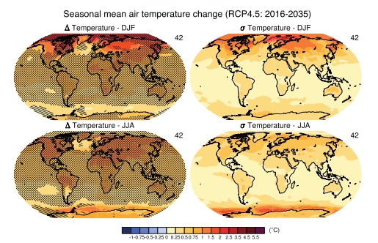
Temperature Projections
Very Likely that more rapid temperature increases will occur over land than over ocean
Very Likely that polar warming amplification will occur in winter (largely due to changes in sea ice)
Figure 11.10
Intro.
Prediction
Projection
Weather
Ocean
Cryosphere
Atm. Comp.
Uncertain.
Notes:
Standard devaition measures internal variability

Slide 22
Temperature Projections
“Time of Emergence”
Climate change signal is emerging against background of internal variability
Subjective analysis methods – therefore more useful in understanding regional and seasonal trends as opposed to absolutes
High Confidence that warming signal will occur more rapidly in tropics and subtropics (relative to internal variability)
Figure 11.11
Intro.
Prediction
Projection
Weather
Ocean
Cryosphere
Atm. Comp.
Uncertain.
Notes:
User-defined choice of variable, space, time-scale, baseline, threshold of emergence, models

Slide 23
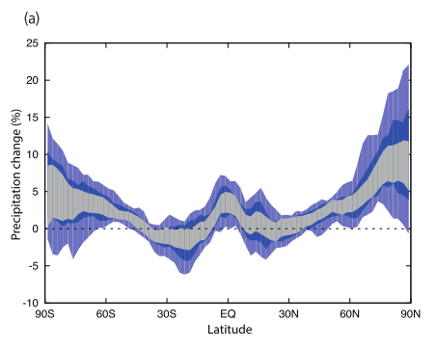
Water Cycle Projections
Generally consistent with AR4
“wet get wetter, dry get dryer”
Changes within the large internal variability
Some studies have shown that precip. changes may be underestimated in CMIP5 models
Very Likely increase in high / mid-latitudes
More Likely Than Not decrease in subtropics
Figure 11.13
Gray - 1σ of natural variability
Blue – 5-95% and 17-83% range, respectively, of CMIP5 models
Intro.
Prediction
Projection
Weather
Ocean
Cryosphere
Atm. Comp.
Uncertain.

Slide 24
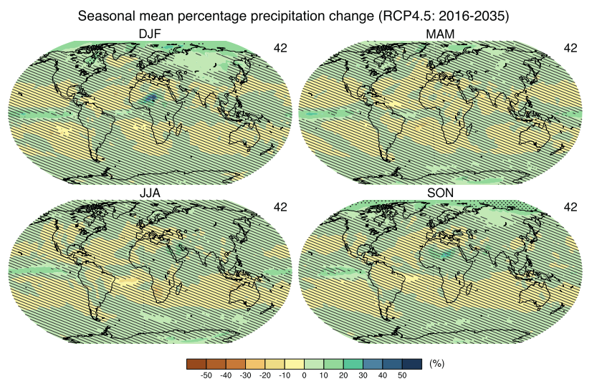
Water Cycle Projections
Generally consistent with AR4
“wet get wetter, dry get dryer”
Changes within the large internal variability
Some studies have shown that precip. changes may be underestimated in CMIP5 models
Very Likely increase in high / mid-latitudes
More Likely Than Not decrease in subtropics
Figure 11.12
Intro.
Prediction
Projection
Weather
Ocean
Cryosphere
Atm. Comp.
Uncertain.

Slide 25
Water Cycle Projections
Changes in evaporation are generally positive over land and oceans
Changes larger than standard deviation in internal variability over tropical oceans and high latitudes
Likely increases in evaporation over many land regions
Figure 11.14
Intro.
Prediction
Projection
Weather
Ocean
Cryosphere
Atm. Comp.
Uncertain.

Slide 26
Water Cycle Projections
Decreases in soil moisture in sub-tropical regions and Europe / increases in northern mid-high latitudes
Changes generally smaller than internal variability
Large uncertainty given simplified hydrological models → Low Confidence
Figure 11.14
Intro.
Prediction
Projection
Weather
Ocean
Cryosphere
Atm. Comp.
Uncertain.

Slide 27
Water Cycle Projections
Very Likely projected increases in near surface specific humidity
Consistent with temperature increases
Strongest increase in northern high-latitudes
Figure 11.14
Intro.
Prediction
Projection
Weather
Ocean
Cryosphere
Atm. Comp.
Uncertain.

Slide 28
Atmospheric Circulation Projections
Poleward shift in NH storm track and increase in NAO
Medium confidence
Large model response uncertainty and large internal variability
Poleward shift in SH storm track, though rate of shifting rate will decrease with recovery of stratospheric ozone
Likely
Increase poleward extent of Hadley Cell, though less in SH
Likely
Structure/Nature of NH Hadley Circulation Change
Low Confidence due to model inconsistency
Walker Circulation
Low confidence in projected changes
Very likely to have both strengthened and weakened circulation due to internal variability
Intro.
Prediction
Projection
Weather
Ocean
Cryosphere
Atm. Comp.
Uncertain.

Slide 29
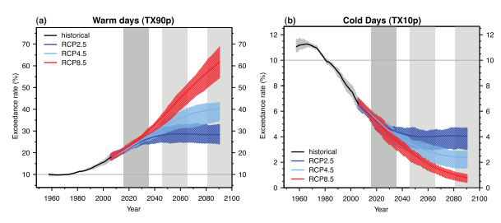
Extreme Temperature Projections
Frequency of warm days/nights will increase (likely)
Frequency of cold days/nights will decrease (likely)
Minimal sensitivity to emission scenario in near-term
Figure 11.17
Intro.
Prediction
Projection
Weather
Ocean
Cryosphere
Atm. Comp.
Uncertain.

Slide 30
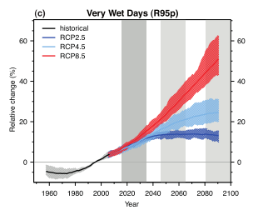
Extreme Precipitation Projections
Frequency and intensity of heavy precipitation events to increase over many land areas (likely)
Though, not apparent in all regions due to large internal variability and local forcings
Figure 11.20
Intro.
Prediction
Projection
Weather
Ocean
Cryosphere
Atm. Comp.
Uncertain.

Slide 31
Tropical Cyclone Projections
Low Confidence in basin-scale and global projections in tropical cyclone frquency
Larger internal climate variability, model uncertainty and limited studies
Low Confidence in TC intensity projections
Though some studies report near-term increases in intensity due to reduction of NA tropospheric aerosol
Very Likely that TC activity will vary from basin to basin, year to year, and decade to decade
Due to influences from climate variability modes
Intro.
Prediction
Projection
Weather
Ocean
Cryosphere
Atm. Comp.
Uncertain.

Slide 32
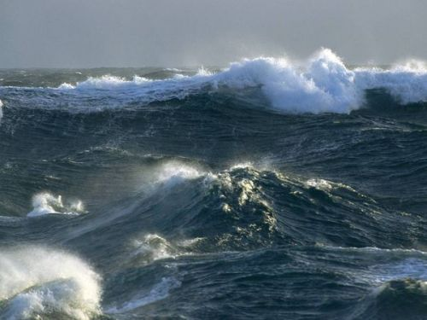
Ocean Projections

Slide 33
Ocean Temperature Projections
Warmer SST and depth-averaged Temperatures
Very likely
Larger internal variability in ocean temperatures in midlatitudes than tropics
IndoPacific thermal structure linked to the Walker Circulation → thus, driven by internal variability
Figure 11.20
Intro.
Prediction
Projection
Weather
Ocean
Cryosphere
Atm. Comp.
Uncertain.

Slide 34
Ocean Salinity Projections
Response to changes in precipitation, evaporation, run-off, and ocean circulation
In general, “salty becomes saltier” / “fresh becomes fresher”
Increased freshwater flux into Arctic Ocean
Likely increases in salinity in subtropical N. Atlantic and decreases in western Pacific
Figure 11.20
Intro.
Prediction
Projection
Weather
Ocean
Cryosphere
Atm. Comp.
Uncertain.

Slide 35
Ocean Circulation Projections
AMOC projected to weaken (likely)
Though there may be decades when it strengthens
Similar to previous reports
Rate and magnitude of weakening is very uncertain
Internal variability in AMOC is poorly known/understood
Low confidence in anthropogenic ToE
Indo-Pacific circulation depends on Walker Circulation (which has low confidence)
Medium confidence in weakening of equatorial Pacific Circulation, including upwelling and shallow overturning
Intro.
Prediction
Projection
Weather
Ocean
Cryosphere
Atm. Comp.
Uncertain.
Notes:
Despite low confidence of walker Circulation, they say have medium confidence in weakening of equatorial Pacific circulation

Slide 36
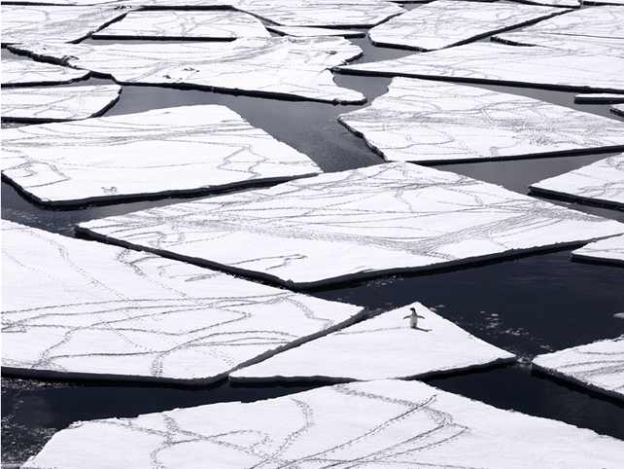
Cryosphere Projections
http://voices.nationalgeographic.com//files/2013/02/Adélie-Penguin-on-Pack-Ice.jpg

Slide 37
Sea Ice Projections
Further Discussed in Chapter 12
Arctic Sea Ice
Continued shrinking trend (very likely)
Reach ice-free September by 2050 in high GHG emission scenarios (likely, medium confidence)
Antarctic Sea Ice
Low confidence in decreasing projections
Due to model uncertainty, model spread, and model inability to reproduce variability and current observations
Intro.
Prediction
Projection
Weather
Ocean
Cryosphere
Atm. Comp.
Uncertain.
Notes:
Despite low confidence of walker Circulation, they say have medium confidence in weakening of equatorial Pacific circulation

Slide 38
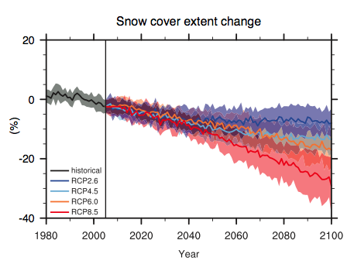
Snow Cover & Permafrost Projections
Snow Cover
Related to precipitation, temperature, and sea ice extent (source of moisture)
Projected to decline
Permafrost
Most near-term projections show substantial degradation of permafrost
Current models better reflect permafrost
No broad statement on global or regional trends or confidence
Further Discussed in Chapter 12
Figure 12.32
Northern Hemisphere ice-free land
Near- Term
Intro.
Prediction
Projection
Weather
Ocean
Cryosphere
Atm. Comp.
Uncertain.
Notes:
Despite low confidence of walker Circulation, they say have medium confidence in weakening of equatorial Pacific circulation

Slide 39
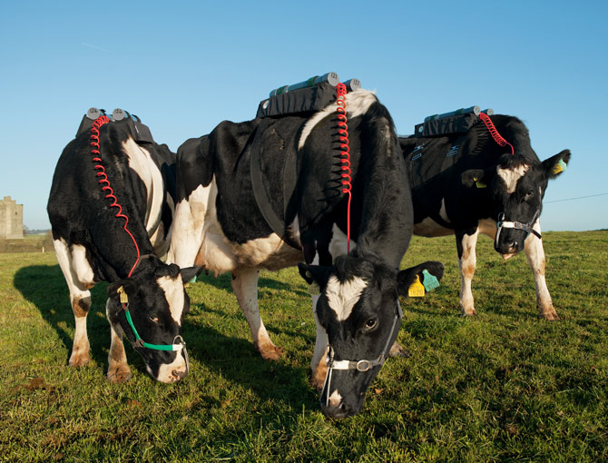
Atmospheric Composition Projections
http://ngm.nationalgeographic.com/2012/12/methane/thiessen-photography#/11-cows-at-food-research-center-670.jpg

Slide 40
Background
RCP (CMIP5) vs. SRES (CMIP3) Scenarios
CMIP3 simulations had about 40% more aerosol in 2000 than the CMIP5 simulations
On average, RCP aerosols decrease by 5% per decade, while SRES aerosol increase by 9% per decade
RCP assume continuation of current trends
RCP uses a simplified chemistry model than predecessors
Uncertainties from this simplification are generally smaller than range in RCP scenarios
Projections in this section use CMIP5 models that include Atmospheric Chemistry (ACCMIP)
Intro.
Prediction
Projection
Weather
Ocean
Cryosphere
Atm. Comp.
Uncertain.

Slide 41
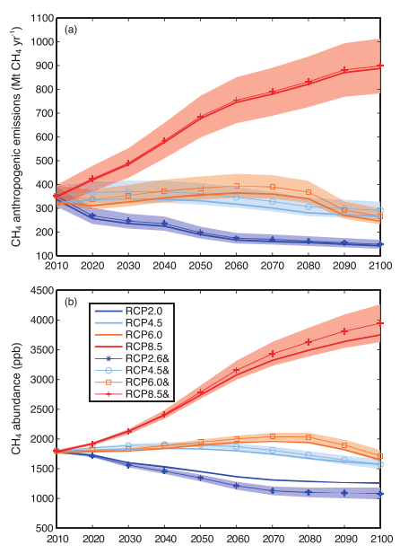
Reactive GHG and Aerosol
Figure 11.21
Methane, Nitrous Oxide, and Fluorinated Gases
In general, projections match RCP scenarios well
New understanding of lifetime / feedbacks
Annex II has the projections of various gas species and abundances
Intro.
Prediction
Projection
Weather
Ocean
Cryosphere
Atm. Comp.
Uncertain.

Slide 42
Reactive GHG and Aerosol
Tropospheric Ozone
Near-term small increases to 2040 (+2 DU) and continued increase up to 2100
Driven by changes in methane
High confidence
Stratospheric Ozone
Expected to increase in near-term
By 2100, 5-7% increase in all RCPs
Aerosol
Total aerosol loadings from anthropogenic components drop by 5-12% at 2030 and 24-39% at 2100
Due to decreasing emissions
Intro.
Prediction
Projection
Weather
Ocean
Cryosphere
Atm. Comp.
Uncertain.

Slide 43
Air Quality Projections
Very Difficult to Assess
Feedbacks between biosphere
Large scale synoptic changes
Focus of this section
O3 and PM2.5
Changes due to climate and local emissions
Intro.
Prediction
Projection
Weather
Ocean
Cryosphere
Atm. Comp.
Uncertain.

Slide 44
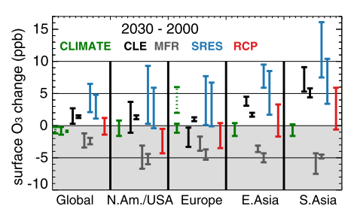
Ozone
Higher temperatures and water vapor enhance surface O₃ destruction in unpolluted areas
High confidence
In some polluted regions (e.g. Europe), O₃ shown to increase
Exact mechanism that drives this is unknown
Medium confidence
Changes driven by emissions scenarios, not climate
Figure 11.22
Intro.
Prediction
Projection
Weather
Ocean
Cryosphere
Atm. Comp.
Uncertain.
Notes:
Green dashed bar shows summer only range from one model

Slide 45
Aerosols
Difficult to assess given a wide range of opposing processes
Increasing temperatures (e.g. wildfires, dust)
Increasing precipitation (e.g. scavenging)
No Confidence in aerosol projections due to climate changes
Intro.
Prediction
Projection
Weather
Ocean
Cryosphere
Atm. Comp.
Uncertain.

Slide 46
Air Quality
Lower air pollution levels are projected following RCP emissions compared to SRES
High Confidence
Range in projections of air quality are driven by emissions, as opposed to driven my climate change processes
Medium Confidence
Extreme pollution events
All else equal, increased temperatures will trigger regional feedbacks that increases peak pollution
Medium Confidence
In reality, regional dependence on local events / feedbacks
Intro.
Prediction
Projection
Weather
Ocean
Cryosphere
Atm. Comp.
Uncertain.

Slide 47
Additional Uncertainties in Near-Term Projections
http://education.nationalgeographic.com/education/topics/volcanoes/?ar_a=1

Slide 48
Uncertainties in Anthropogenic Forcing
Near-term Climate Projections overall are not very sensitive to range of anthropogenic emissions of CO₂ or WMGHG
Aerosol conditions similar to SRES could increase warming in CMIP5 by 0.2 ºC
Medium Confidence
CH₄ and BC reduction strategies could decrease warming by a few tenths of a degree in near-term
Medium Confidence
Land Use Change has a small ERF in near-term
Intro.
Prediction
Projection
Weather
Ocean
Cryosphere
Atm. Comp.
Uncertain.

Slide 49
Uncertainties in Natural Forcing
Volcanic eruptions
Several tenths of a degree cooling
Persists for a few years
Eruption time / amount of SO₂ emitted is currently unpredictable
Solar forcing
Changes in incoming solar radiation has a small influence to surface temperatures compared to increasing GHG concentrations
High Confidence
Intro.
Prediction
Projection
Weather
Ocean
Cryosphere
Atm. Comp.
Uncertain.

Slide 50
Summary
Predictability
CMIP5 models are able to predict some variables in various areas with some skill / reliability for near-term time scales
More work to be done to assess this
Projections
Temperatures and feedbacks are likely
Expert opinion: 0.3-0.7 ºC increase in GMST from reference period
Precipitation Less Predictable
Circulations / Tropical Cyclones – Low confidence

Slide 51
Questions / Discussion

