Slide 1
Other Techniques:
What can they do?
Some solve much harder problems:
  3D methods – Can deal with horizontal inhomogeneity.
    Independent Pixel Approximation
    Slant Methods
    Full 3D with horizontal photon transport.
  Vector calculations: Include effects of polarization, calculate Stokes vectors.
    Matrices generally becomes (4n, 4n) instead of (n,n)
    Calculations become ~ 100x slower typically!
  Curvature of Atmosphere
    Important for very oblique or limb observations. (>80 deg)
    “Pseudo-spherical” approximation is typical.

Slide 2
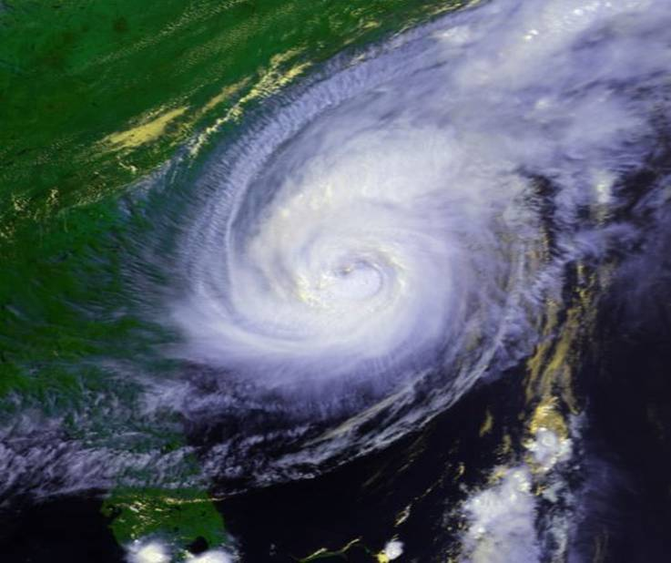
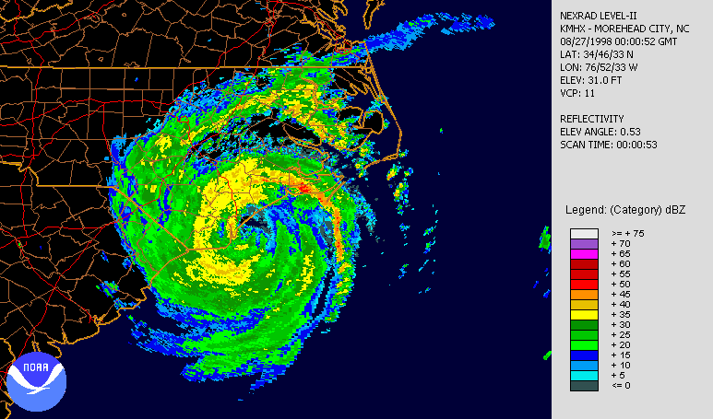
3D effects example:
Hurricane Bonnie (1998)

Slide 3
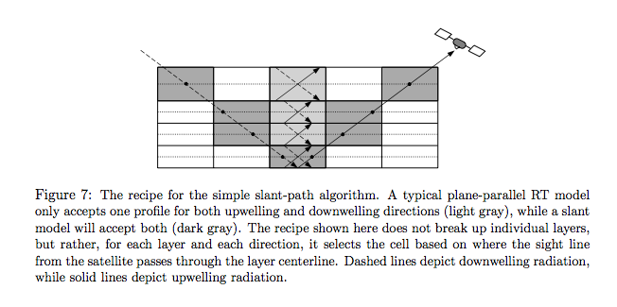
3D effects in the microwave

Slide 4
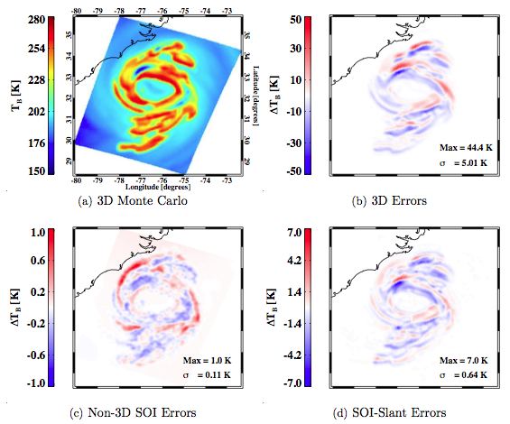
3D effects Example:
Hurricane Bonnie
Notes:
TB’s of a Hurricane Bonnie simulation from the UWNMS mesoscale model at 36.5 GHz, using four different radiative transfer models. All domains have been convolved with a 12 km FWHM beam footprint, corresponding to a good instrument resolution at this frequency. Top left: “truth” (3D Monte Carlo) model. Top right: Errors in plane-parallel SOI model as compared with the 3D Monte Carlo. Bottom left: Errors in 1D SOI model as compared with 1D (plane parallel) Monte Carlo. Bottom right: Errors in SOI-Slant as compared with the 3D Monte Carlo. It can be seen that the 3D errors are reduced by ∼ 85% by the SOI-Slant model.

Slide 5
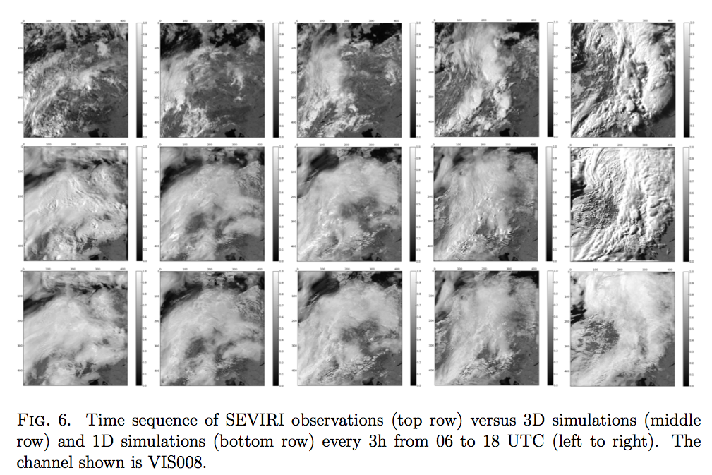
3D Effects in the Vis/NIR
06 UTC
09 UTC
12 UTC
15 UTC
18 UTC
Courtesy P.M. Kostka

Slide 6
Partial Cloudiness
How do we simulate a “partially cloud” field of view? This happens a lot in satellite observations which take place over larger regions (>~ 1 km). The larger the FOV, the more likely that horizontal variability in the atmosphere could matter.
This affects retrievals as well as data assimilation.

Slide 7
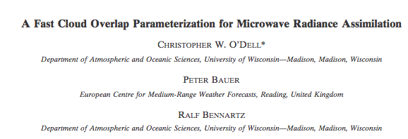
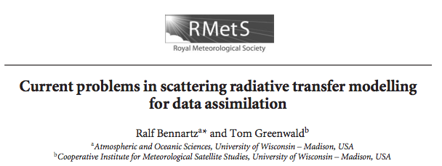

Slide 8
Horizontal Cloud Variability: Levels of Complexity
Cloud Overlap
  A single column with mean grid-box properties
  Two columns: Cloudy & Clear
  Independent Column Approximation
    Each layer has a cloud fraction.
    But you must decide how to distribute the clouds in each layer!

Slide 9
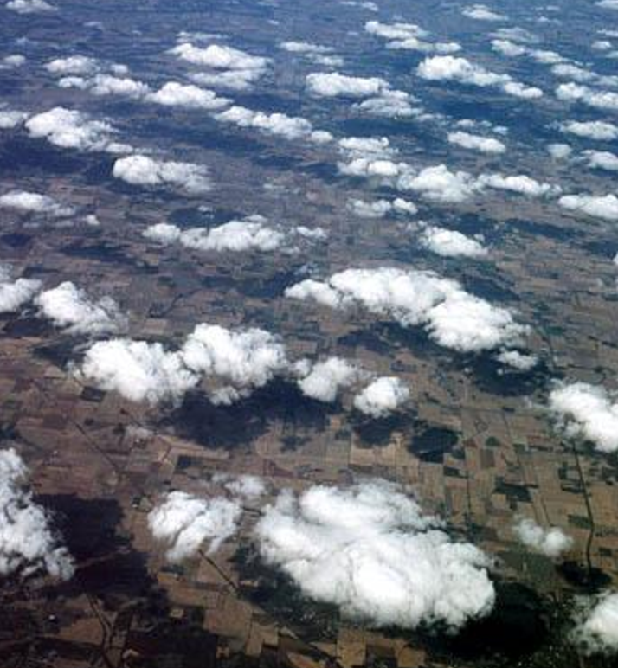
Equation of radiative transfer: 3-D effects

Slide 10
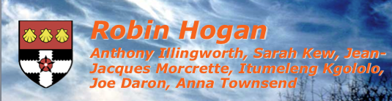
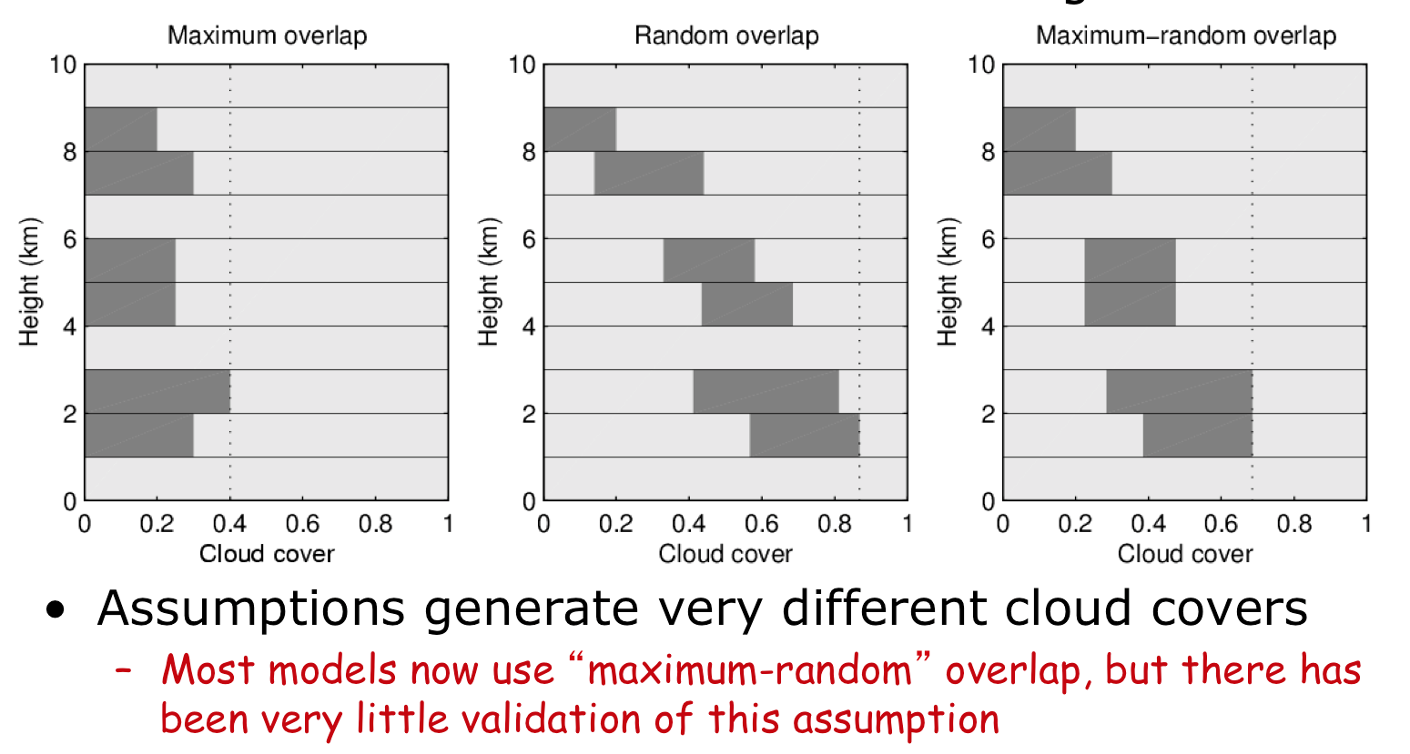

Slide 11
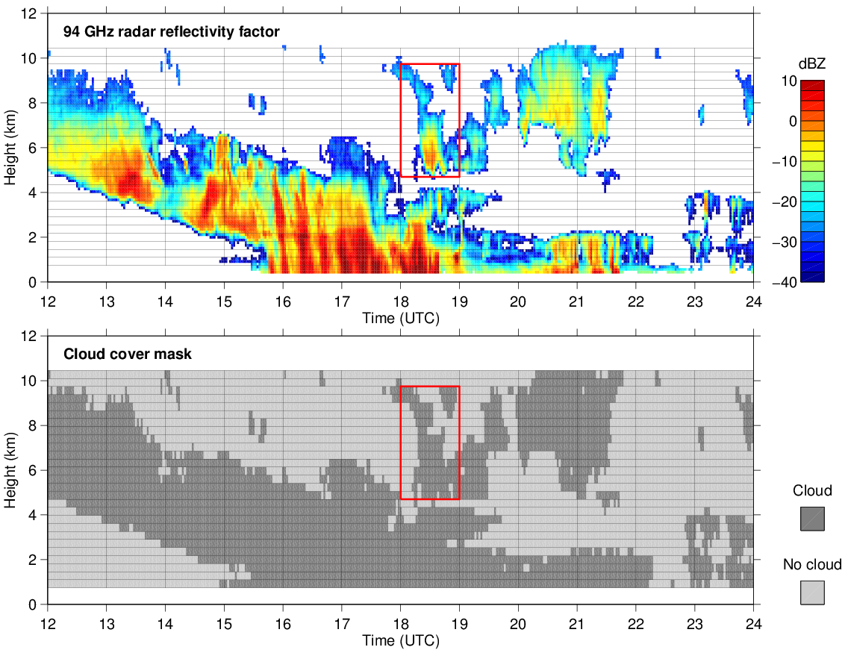
Cloud overlap from radar: example
Radar can observe the actual overlap of clouds
We next quantify the overlap from 3 months of data

Slide 12
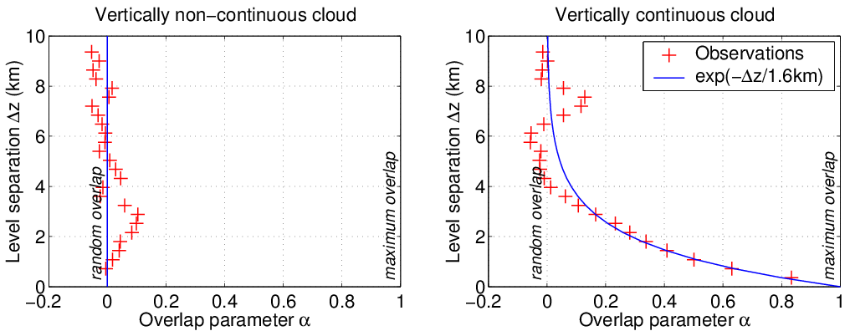
“Exponential-random” overlap
Overlap of vertically continuous clouds becomes random with increasing thickness as an inverse exponential
Vertically isolated clouds are randomly overlapped
Higher total cloud cover than maximum-random overlap
Hogan and Illingworth (QJ 2000), Mace and Benson-Troth (2002)

Slide 13
In the microwave…
EARLY ECMWF SCHEME (a):
Maximum Cloud Overlap
Precipitation “follows” the clouds
Precipitation does not “fall out” of clouds
MORE PHYSICAL SCHEME (b):
Maximum-Random Cloud Overlap
Precipitation in a layer is based both upon the clouds in that layer as well as the precipitation in the adjacent higher layer.
Precipitation thus can “fall out” of clouds.

Slide 14
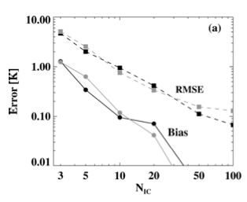
What is a reference “truth” approach?
IC errors relative to 3D approach
Use 100 ICs. 100 independent, plane-parallel radiative transfers performed & averaged. Errors as compared to the more accurate 3D approach are highly dependent on the spatial resolution of the model.

Slide 15
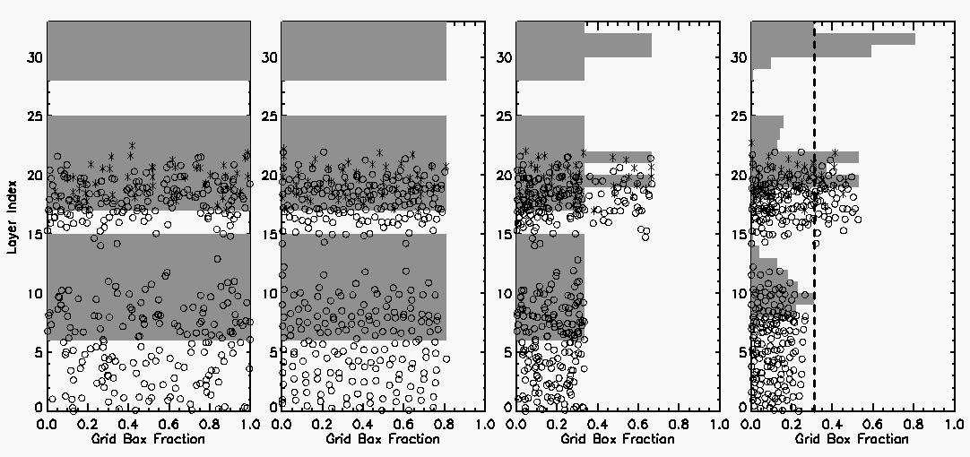
Grid-box averages
More accurate schemes from O’Dell et al (2007)
1 clear, 1 cloudy
Challenge is to create a scheme that is accurate yet computationally feasible.
Errors for the simplistic schemes are occasionally large!

Slide 16
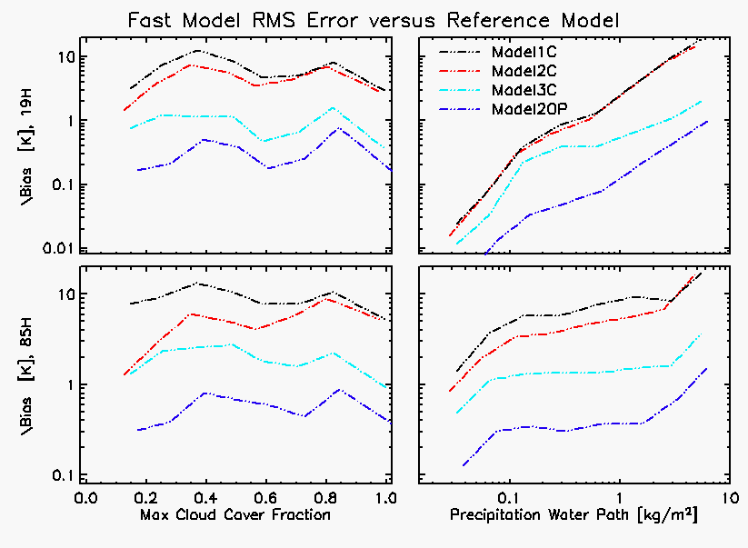

Slide 17
Rest of Class
March 31 – April 30 : 5 weeks, 10 classes.
  Finish up RT stuff.
  Detailed overview of retrieval/inverse theory.
  1 -2 homeworks
Week of May 12-16. Need 2-hour block for final project presentations. Nominal final is Thursday May 15, 11:50-1:50pm. All are expected to attend.

Slide 18
Lit-Review Presentation
Choose a class-related topic to do a literature review on, and present to class. 15-20 min per presentation. Some Possibilities:
  Modeling shortwave fluxes and associated biases (long-standing difficulties here).
  3D RT effects associated with clouds & precip
  RT effects associated with non-spherical particles
  Effects of oriented cirrus particles on vis/IR radiances
  Polarization effects from aerosols, precipitation, ice, land surfaces, etc– observations and/or modeling (any waveband).
  Correlated-k distributions / modeling scattering over large wavelength ranges for weather/climate models.

