Slide 1
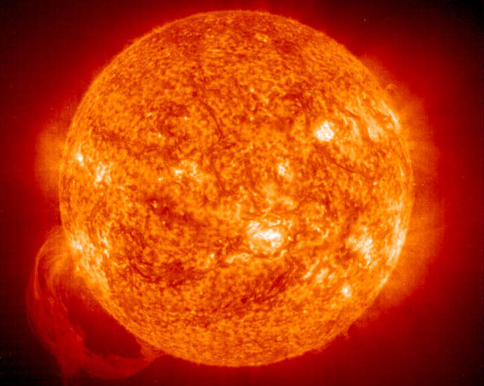
Sol: The Sun
Fun facts
The solar “constant”
Spectrum of sunlight
Distribution of sunlight on the Earth
Milankovitch theory of ice ages

Slide 2
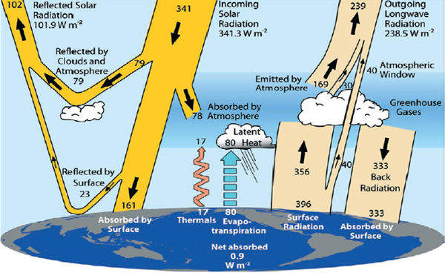
Back to the Big Picture
Radiant energy from the Sun accounts for practically all the energy received by Earth, and represents the basic driver of all atmospheric and ocean circulations.

Slide 3
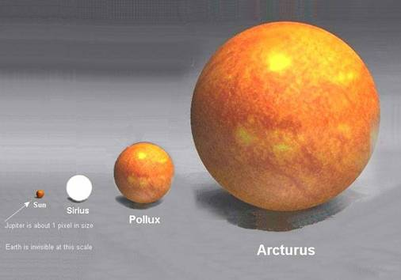
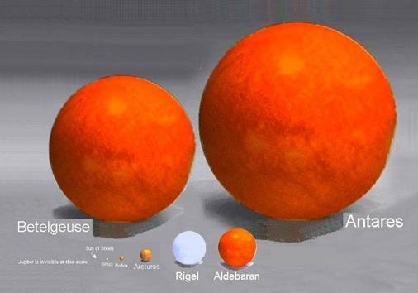
Solar Factoids
Our Sun is one of about 100 billion in our galaxy (Milky Way); a normal “G2” star having average luminosity.
Its average radius (696,000 km) is about 109 times that of Earth, and its mass is 1.989e+30 kg.
Our Sun
→ The Sun is by far the largest object in the solar system. It contains more than 99.8% of the total mass of the Solar System (Jupiter contains most of the rest).

Slide 4
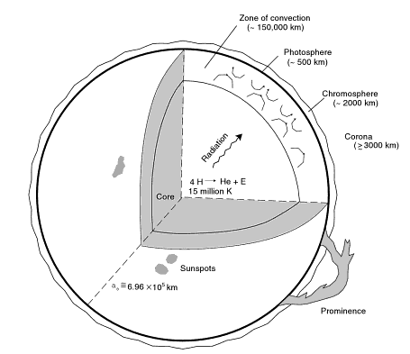
Nuclear fusion happens in the hot dense core, burning hydrogen into helium.
Takes 1 million years for photons to escape to the surface!

Slide 5
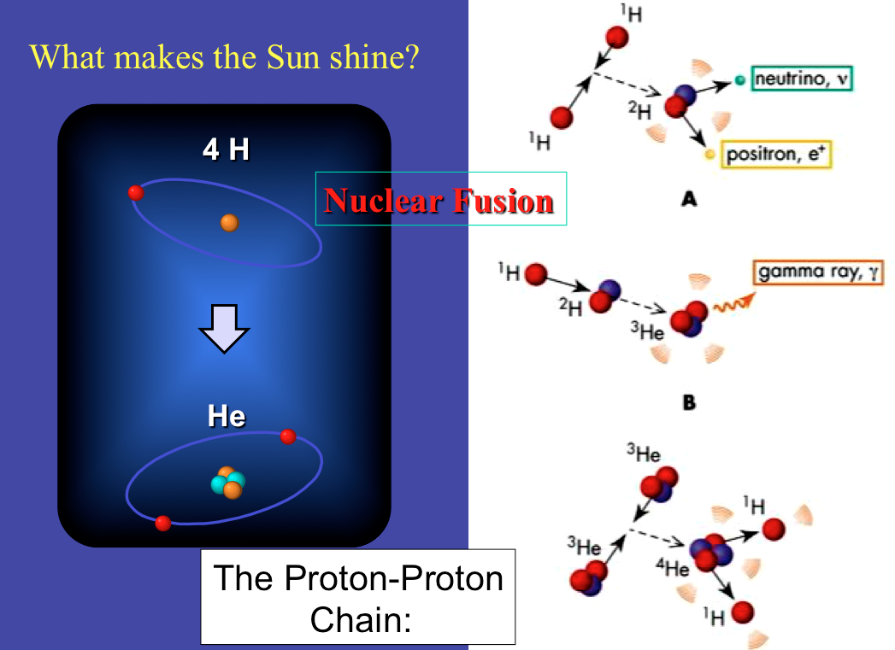

Slide 6
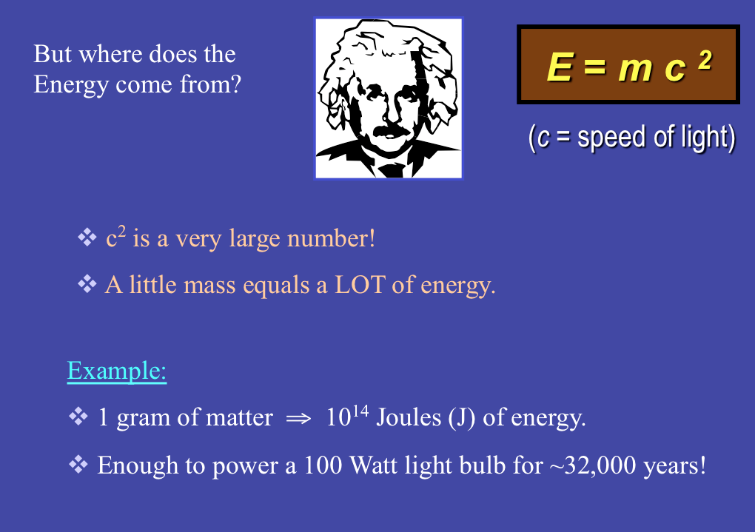

Slide 7
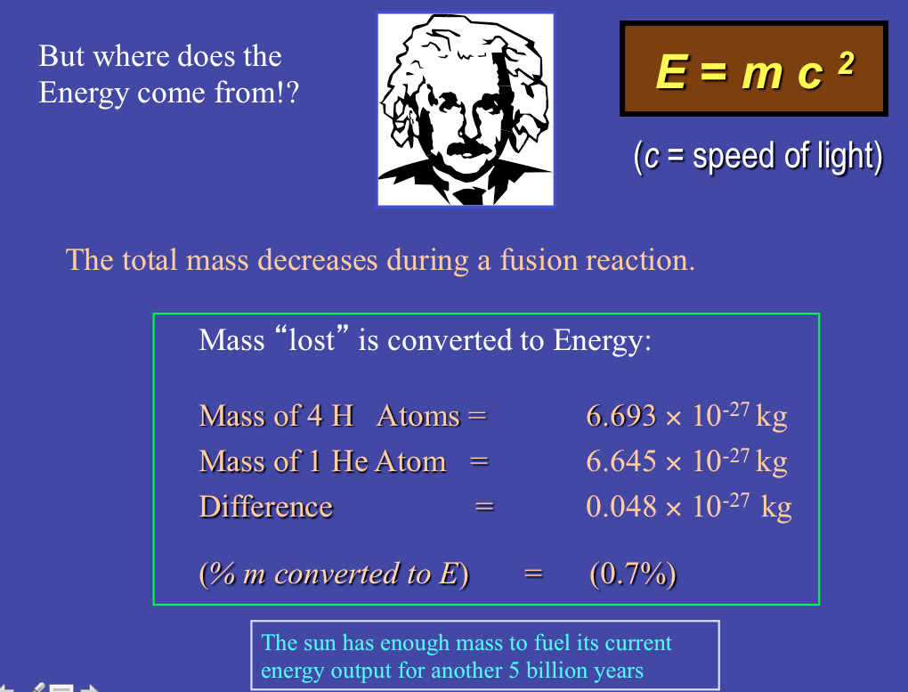

Slide 8
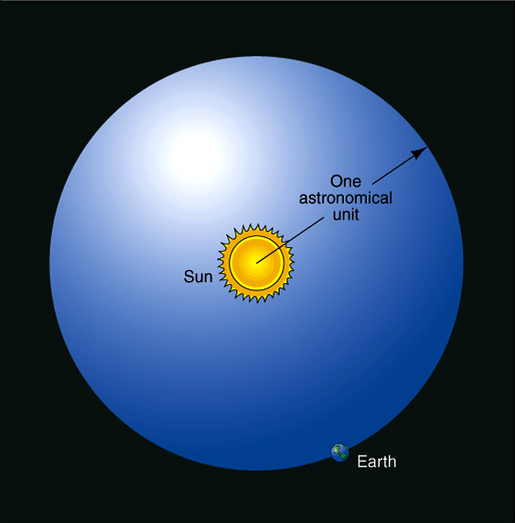
Luminosity of the Sun
= L_{SUN}
(Total light energy emitted per second)
~ 4 x 10²⁶ W
100 billion one-megaton nuclear bombs every second!
Solar constant:
L_{SUN} / 4πR²
(energy/second/area at the radius of Earth’s orbit)

Slide 9
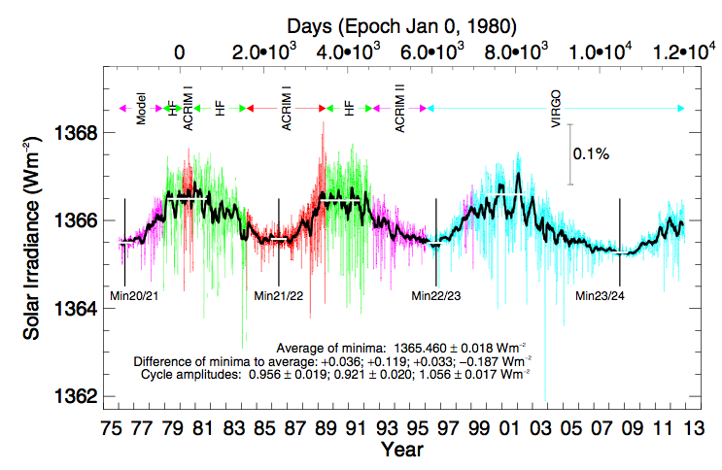
The “Solar Constant”, S0 ~ 1366 W/m²
(at mean earth-sun distance = 1 AU)

Slide 10
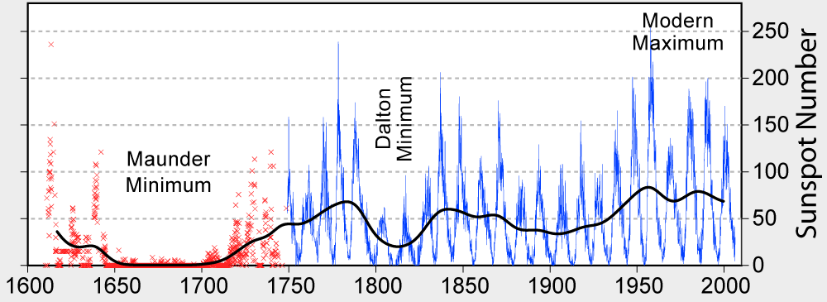
Historical Observatory Record of Sunspot Count
More sunspots = More Solar Irradiance
Correlates with “Little Ice Age” but still open questions about causation here.

Slide 11
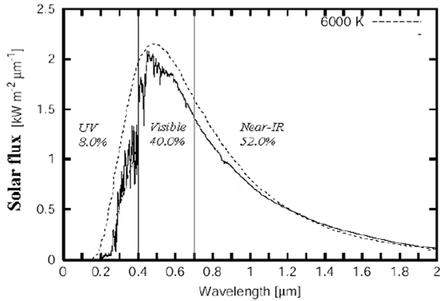
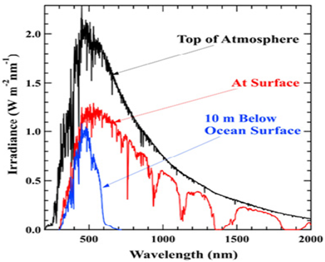
Partitioning of Solar Energy
As we have seen before, sunlight is distributed across the UV, visible, and Near IR, with most significant atmospheric attenuation occurring in the UV.

Slide 12
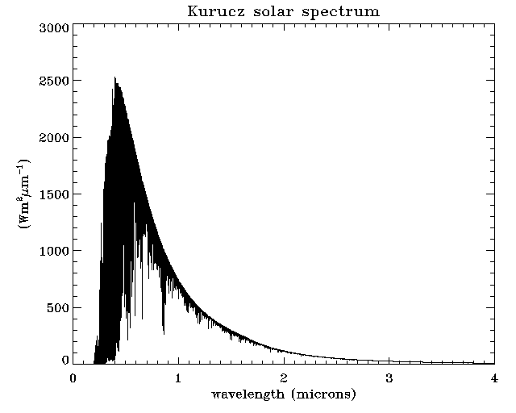
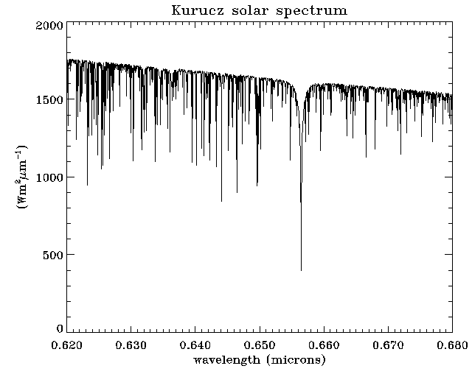
Detailed Spectral Structure of Sunlight
Kurucz, R.L., 1992; Synthetic IR spectra, in Infrared Solar Physics, IAU Symp., 154,
Ed D.M. Sabin and J.T. Jefferies, Kluwer, Acad
→ The emission spectrum of the sun is rich in spectral structure and the black-body assumption is really only a convenient one useful in our broad-band considerations

Slide 13
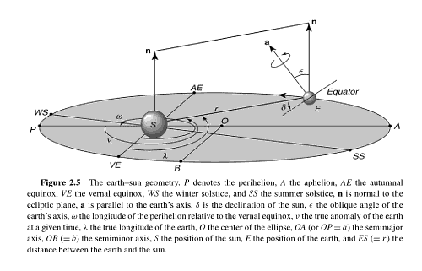
Earth’s Orbit Determines Distribution of Sunlight!
Winter
Solstice
Dec 21
(shortest day)
Autumnal Equinox
Equal Day/Night
Autumn
Summer
Aphelion
July 4
Perihelion
January 3
Winter
Spring
Summer
Solstice
June 21
(longest day)
Vernal Equinox
Equal Day/Night
= “Cardinal Points” of Earth’s Orbit
O = Center of Ellipse
AP = Major Axis
OB = Minor Axis
OA = 1 Astronomical Unit = 1.5*10⁸ km
Perihelion Distance = 1.471*10⁸ km
Aphelion Distance = 1.522*10⁸ km

Slide 14
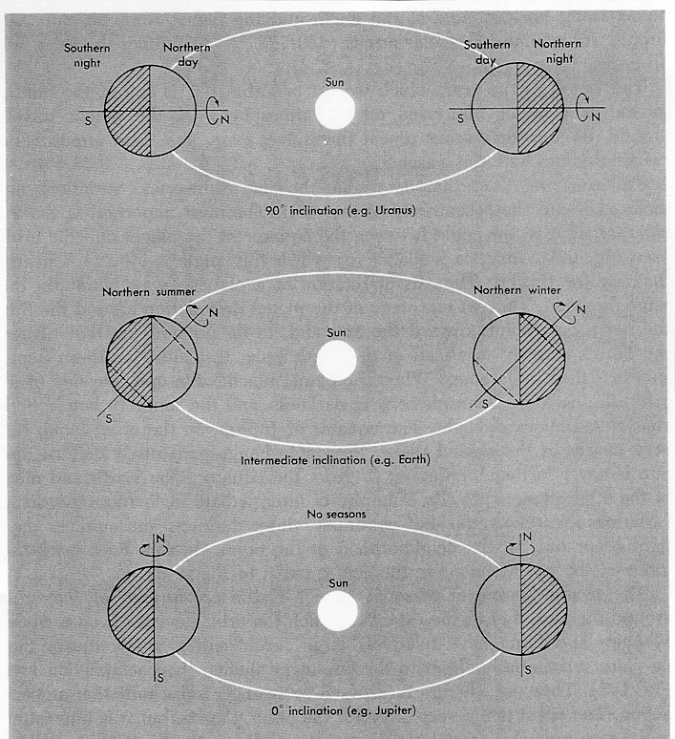
Geometry: Declination Angle
Consequence
Declination Angle (δ)
= the angle between the Earth’s equator and the incoming rays of sunlight
=latitude where sun is overhead at local noon
“sub-solar latitude”
Extreme
to sun
δ
Moderate
Rotation
No Seasons
→ -23.45° when JD=355, or Dec 21st (Winter Solstice)

Slide 15
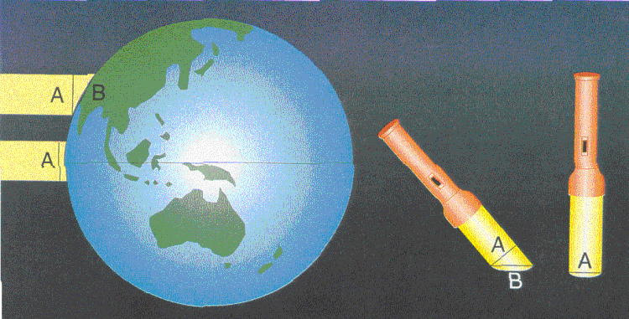
Solar Zenith Angle
The solar zenith angle determines how much dilution of the incoming sunlight occurs as a function of date, time, and latitude.
F_{SOLAR} = S₀ (D₀/D)² cos(θ₀)
Calculating the solar zenith angle (θ₀) is CRITICAL to knowing the solar insolation (=irradiance in W/m²)

Slide 16
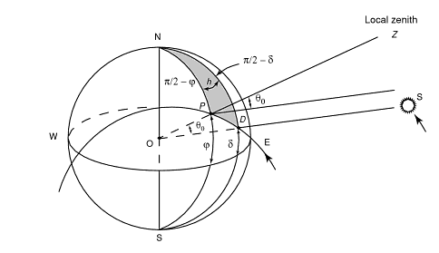
θ_{o} = solar zenith angle
φ = latitude (position on the globe)
δ = declination angle (time of year)
h = hour angle (time of day)
h > 0° before solar noon
h = 0° at solar noon (=sun @ highest point in the sky)
h < 0° after solar noon
dh/dt = 15° per hour (360 deg/day)

Slide 17
Examples: One “Day” and One “Night” Per Year
At the Earth’s poles, cos(φ = ± 90°) = 0, sin (φ = ± 90°) = ± 1
→
And since
→
This is just the elevation angle of the Sun, and we see that the value of μ_{o} for this special case is independent of the time of day. Since -23.5° < δ < 23.5°, the Sun will never exceed this elevation angle at the poles (and will just circle the sky at this fixed angle.
Recall that θ_{o} = 0° corresponds to the Sun directly overhead, and that θ_{o} = 90° corresponds to the Sun on the horizon. Transition from day to night, and night to day, occurs at the Autumnal and Vernal equinoxes, respectively.

Slide 18
Examples: Maximum Altitude Angle of the Sun
At solar noon, the hour angle h = 0°, so cos(h) =1, and:
Since -23.5° < δ < 23.5°, the Sun can never be directly overhead (θ_{o} = 0°) for latitudes that exceed the maximum value of declination angle.
These latitudinal limits define the Tropics of Cancer (north) and Capricorn (south), which define the northern and southern boundaries of the equatorial zone.

Slide 19
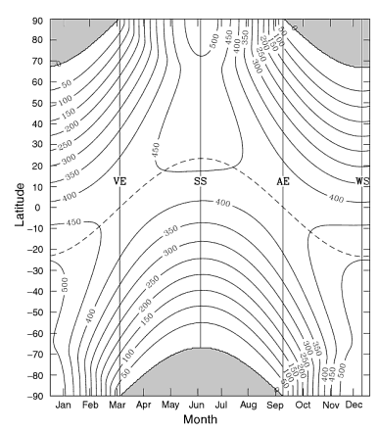
Distribution of Earth’s Solar Insolation
Night
Night
Night

Slide 20
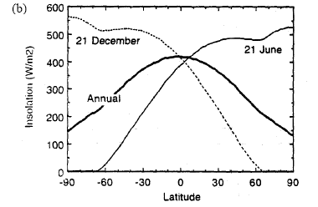
Mean Daily Insolation Over Zonal Bands
Asymmetry between the SH and NH summers is due to orbital eccentricity (& position of perihelion)

Slide 21
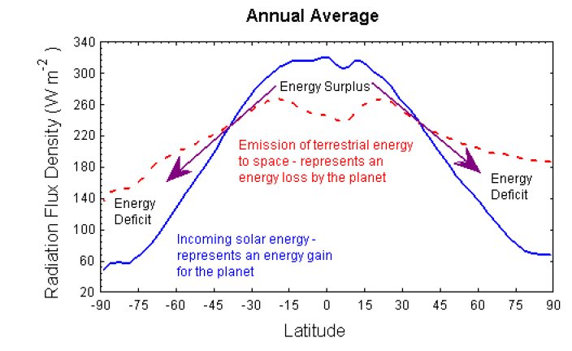
Zonal Radiation Budget

Slide 22
Question: Is there any relationship between when the earth is CLOSEST to the sun (Perihelion) and northern hemisphere winter?

Slide 23
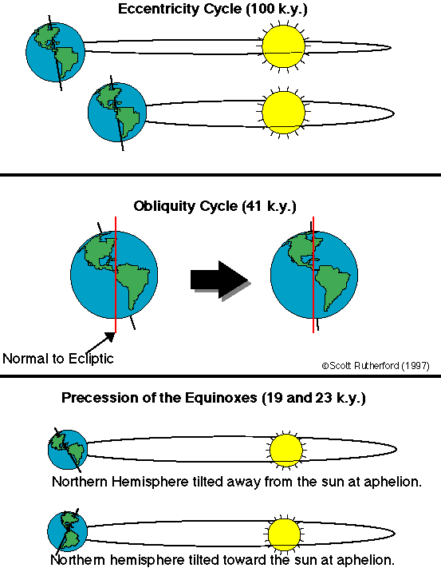
Milankovitch Theory
Short term variability is
associated with activity
of the Sun (changing solar
constant→ the solar cycle).
Longer term activity is
associated with changing
eccentricity, obliquity (+/- 1.5º) and precession of perihelion.
These do not affect
the averaged net energy at
TOA over the year but do affect the distribution of that energy in latitude and time of year.

Slide 24
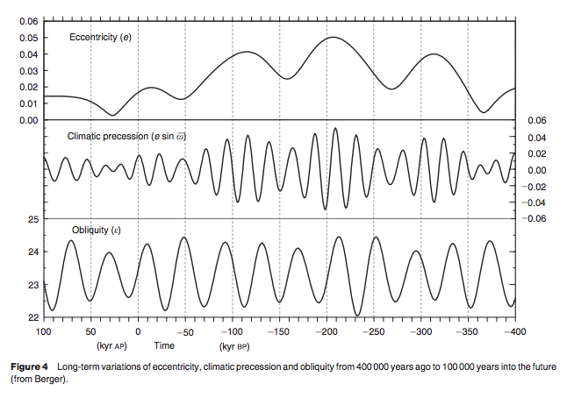

Slide 25
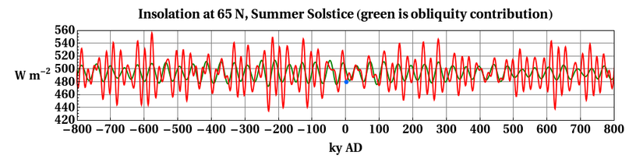
“Trigger Hypthesis” for the Ice Ages.
Solar Insolation at ~ 65N is well correlated with the onset of ice ages.
Gets low enough, ice sheets can grow in a positive feedback loop. Has approximately the correct periodicity to explain the ice ages.

