Slide 1
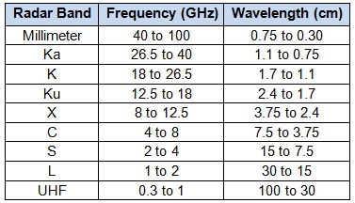
Radar Bands
Letters chosen during WWII. X-band so-named b/c it was kept secret during the war.

Slide 2

Multiple scattering in cloud or aerosol layers
REFLECTED
τ=0
ABSORBED
τ=τ*
TRANSMITTED
Fraction absorbed + fraction transmitted + fraction reflected = 1

Slide 3
Direct & diffuse transmission
REFLECTED
ABSORBED
τ=0
DIRECT Transmission:
Not scattered at all
τ=τ*
DIFFUSE Transmission:
Scattered at least once
Fraction absorbed + fraction transmitted + fraction reflected = 1

Slide 4
Monte-Carlo
Can simulate each individual photon from sun.
Chance of making it through cloud: t*=e^{–τ*/μ}
Chance of being scattered or absorbed: 1-t*
Chance of being scattered:
Chance of being absorbed:

Slide 5
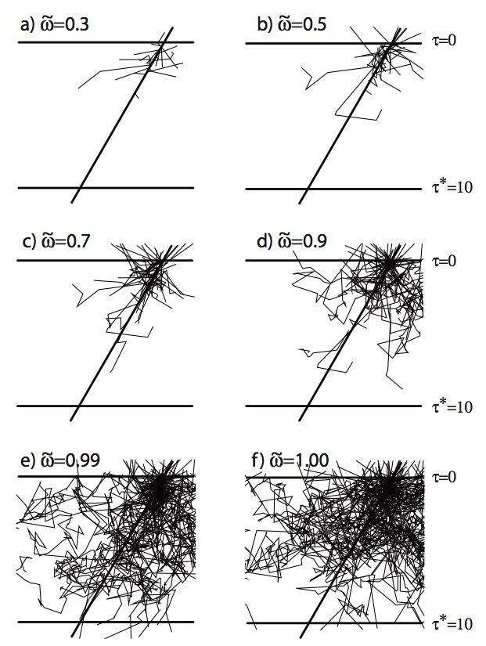

Low SSA: most absorbed
Higher SSA: many still absorbed (multiple scattering means many chances to be absorbed!)
Many photons reflected than transmitted (optically thick)
A bit unrealistic because g=0 (would be the case for smaller particles or longer wavelengths)

Slide 6
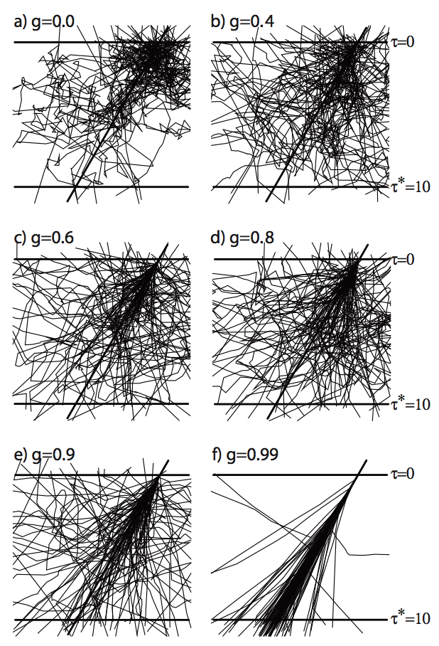
Now SSA = 1 (conservative scattering). No photon absorption.
Higher g, more photons make it through rather than being reflected back.
g=0.99 is quite unrealistic. g=0.8 to 0.9 for most clouds in the visible.

Slide 7
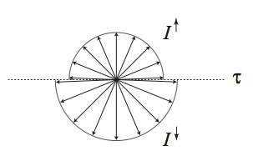
Two-Stream Approximation
Azimuthally averaged radiance field
Radiance is constant within a hemisphere. Can be different between upward & downward hemispheres.
Phase function is parameterized by g only.
Can determine r, t, a from three variables:

Slide 8
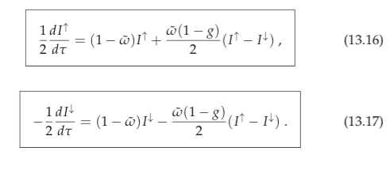

Solving these equations:
…leads to the general solution:

Slide 9

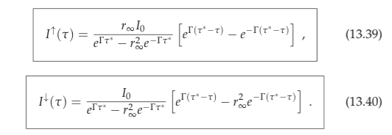
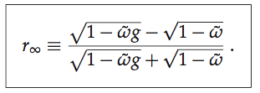

Next apply boundary conditions
ie., the underlying surface is black.
A known intensity is downwelling upon the TOA (e.g., from the sun)
where

Slide 10
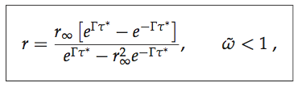
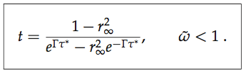
General 2-stream equations
where
Assumptions:
Incoming flux is diffuse. Amazingly, works okay with solar illumination as well!
Initially do derivation assumng a black underlying surface.
Straightforward to add a nonzero surface albedo later.

Slide 11
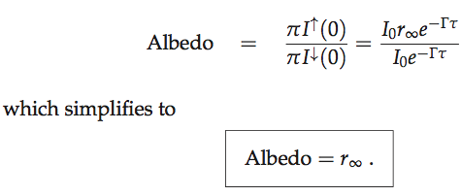
Limiting Case: Semi-Infinite Cloud
Limit when cloud is VERY optically thick (τ* >~ 100)
Transmittance t → 0. So only absorption and reflectance.
Absorption = 1 – reflectance in this case

Slide 12
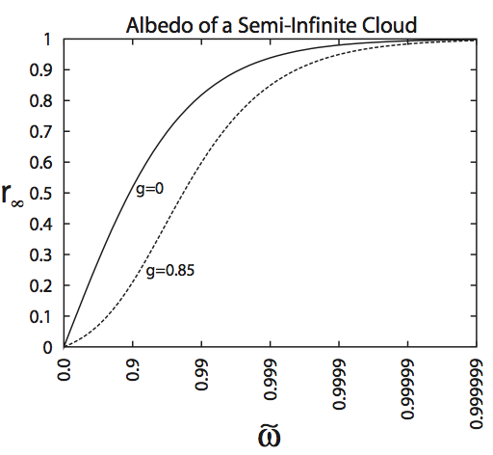
Limiting Case: Semi-Infinite Cloud
Asymmetry parameter g of 0.85 is harder to get back out, so reflectance is lower.
Note that reflectance is not super high even for ssa =0.999! Implies that MANY scattering events are happening. How many?

Slide 13
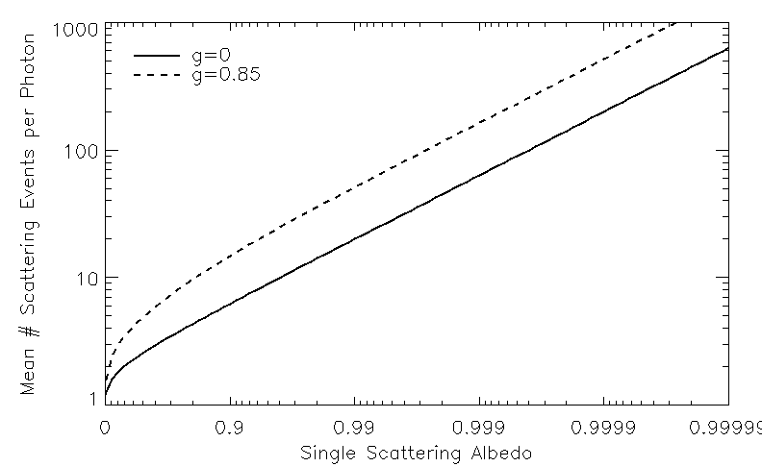
Limiting Case: Semi-Infinite Cloud
Asymmetry parameter g of 0.85 is harder to get back out, so reflectance is lower.
Note that reflectance is not super high even for ssa =0.999! Implies that MANY scattering events are happening. How many?

Slide 14
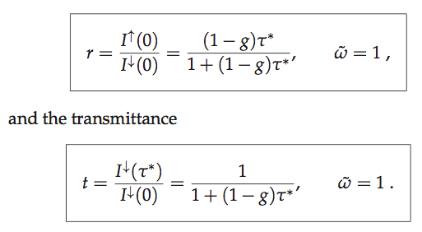
Limiting Case: Non-absorbing cloud
Useful for clouds in the visible, where imaginary part of index of refraction of water & ice is essentially 0 (pure scattering)
Reflectance (r) & tramittance (t) only.
a=0 ; t=1-r

Slide 15
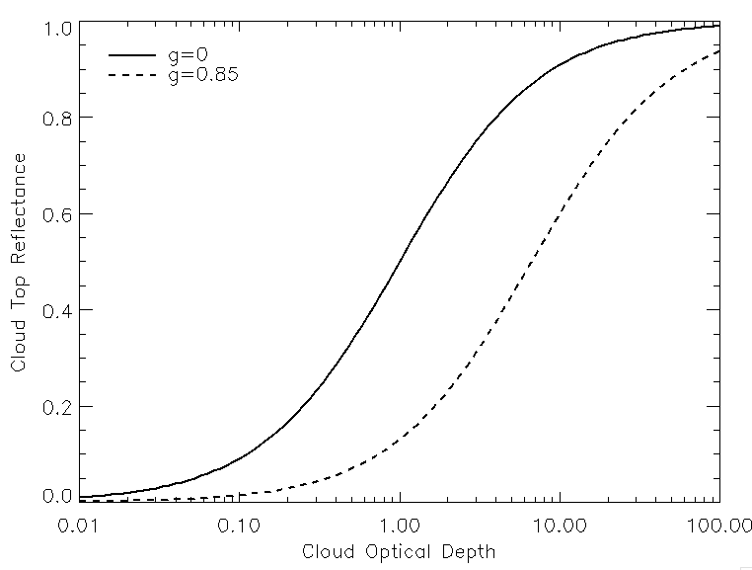
Limiting Case: Non-absorbing cloud
Thicker water cloud
Typical Cirrus Cloud
As we saw in Cloud Radiative forcing, the cloud albedo ( = reflectance) is important in determining cloud radiative forcing.
Even optical depth of 1 still has low reflectance, due to high asymmetry parameter.

Slide 16
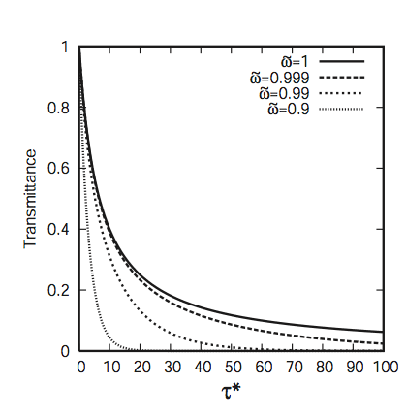
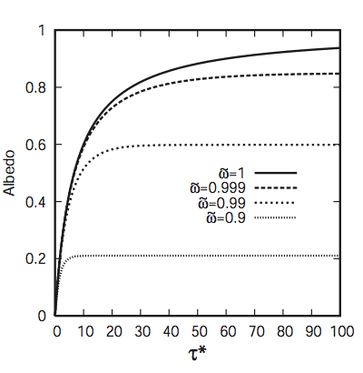
General Case: Reflectance & Transmittance
g=0.85
g=0.85
Reflectance not very high even for ssa =~ 0.9 (tops out due to strong absorption).

Slide 17
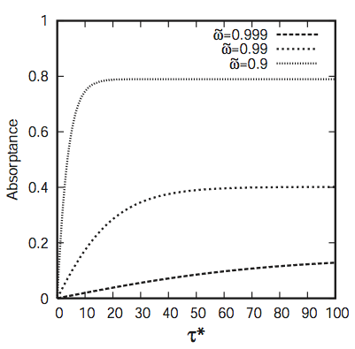
General Case: Absorption
g=0.85
Strong absorption for ssa <~ 0.99 !

Slide 18



Final notes
Can calculate (monochromatic) fluxes & heating rates using the fact that
Can add a non black surface.
Can partition the flux transmittance into diffuse & direct components, using

Slide 19
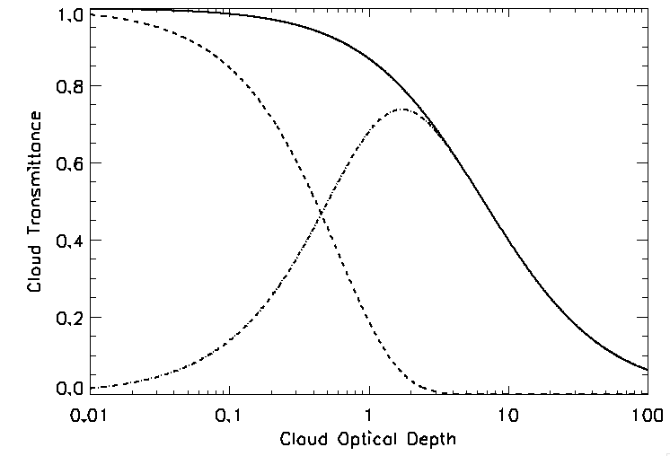
Diffuse & Direct Cloud Transmittance
Non-Absorbing cloud (ie cloud in visible); g=0.85
Direct
Total
Diffuse

Slide 20


Adding in a reflecting surface
REFLECTED
τ=0
ABSORBED
τ=τ*
TRANSMITTED
surf
r_{sfc}
We already did this!!

