Slide 1
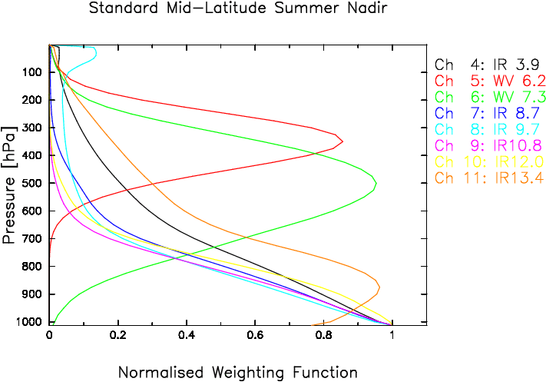
Example for a Satellite: Meteosat Second Generation
The combination of these two “competing effects” results in a profile that peaks at some level in the atmosphere, depending on the strength of the absorbing gases at the current wavelength.
This forms the physical basis for our ability to derive temperature and moisture soundings from satellite observations, using measurements in the various atmospheric absorption bands.
EUMETSAT

Slide 2
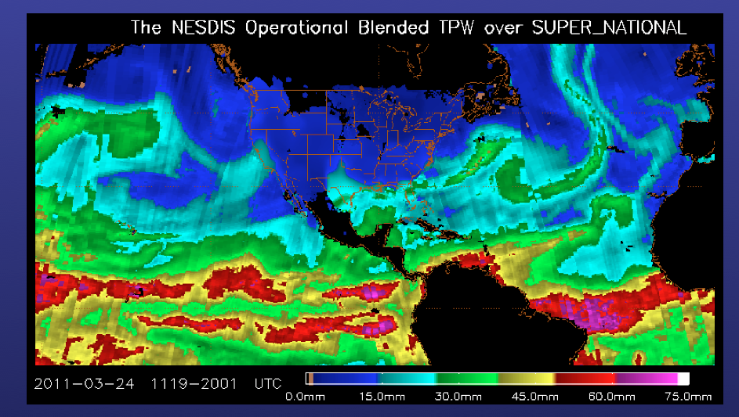

Slide 3
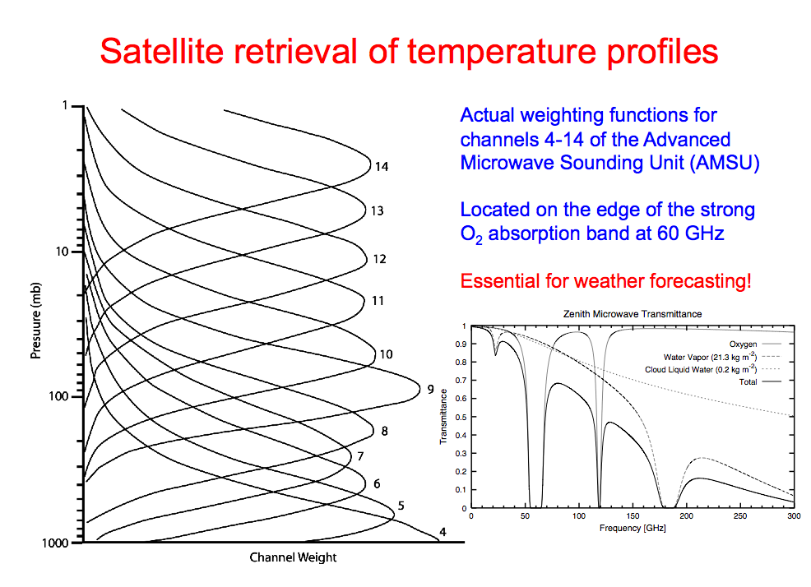
57.29 GHz
52.8 GHz

Slide 4
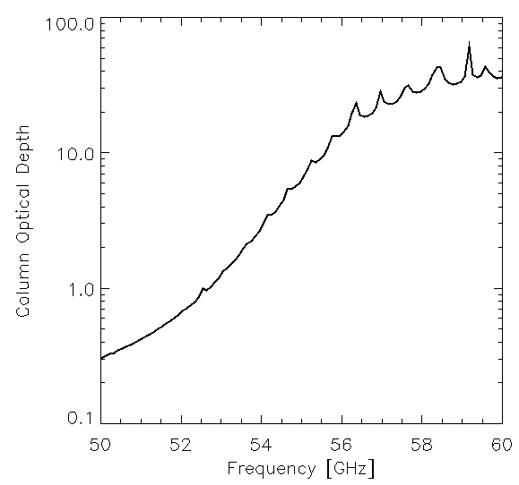
57.29 GHz
52.8 GHz

Slide 5
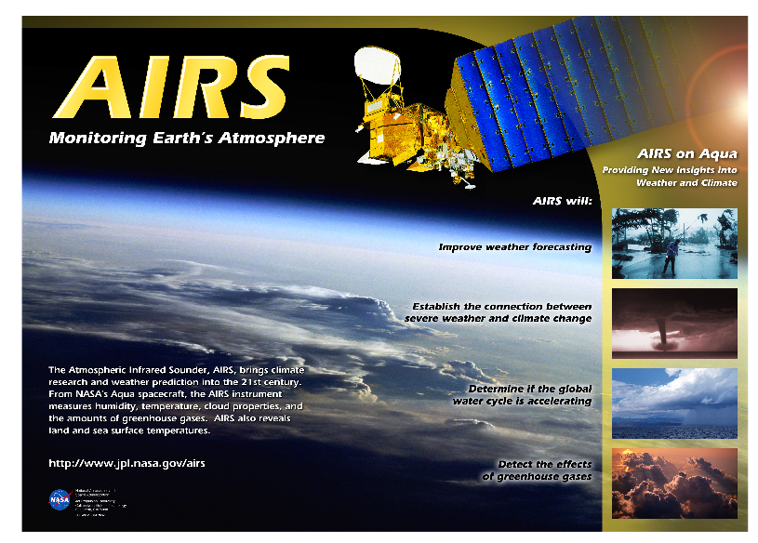
Thermal IR Sounder; > 2000 channels!
T, H2O, CO2, O3, N20…
Launched in 2002 on Aqua with several other sensors

Slide 6
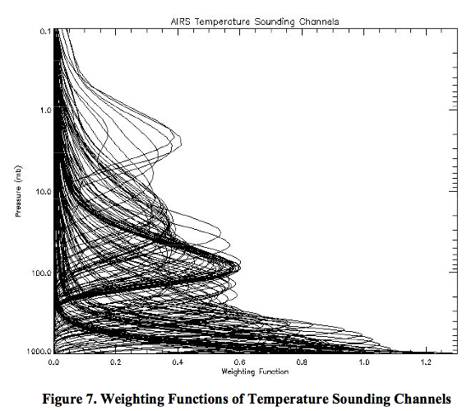
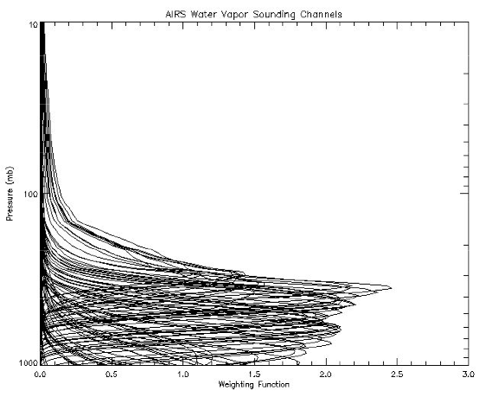
AIRS Weighting Functions
Temperature Weighting Functions
H2O Weighting Functions
Used all the time in Numerical Weather Prediction (NWP) via data assimilation! (at least for clear-sky observations)

Slide 7
Thermal IR Spectra
From surface (looking up) OR TOA (looking down)
Gases that matter most: O3, CO2, H2O
Will enable us to visually deduce: surface temperature, atmospheric inversions, wet vs. dry atmosphere
With a computer, you can get O3 profiles, H2O profile, T profile!

Slide 8
IR Spectra Lookup UP from Surface

Slide 9
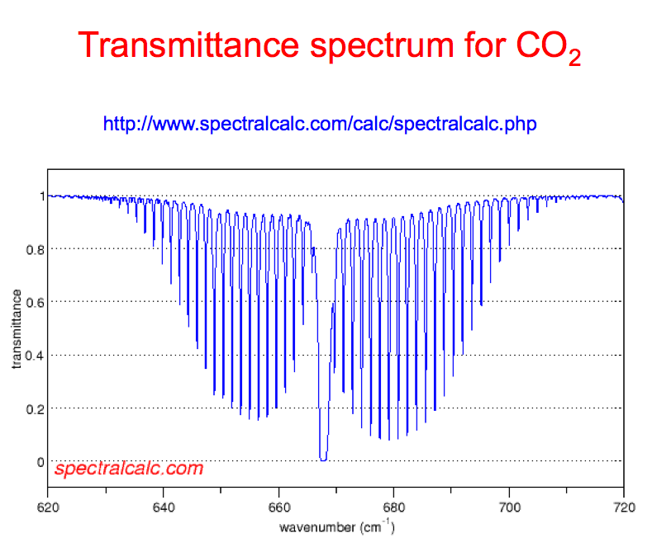

Slide 10
Polar Ice Sheet Observations
(Dave Tobin, UW-Madison/CIMSS)

Slide 12
The Earth’s Radiation Budget (ERB)
Earth’s
Shadow
Sunlight intercepted by the Earth =
Energy reflected back to space =
Net solar energy absorbed by the =
planet
Radiation emitted from the planet =
Planetary albedo
Outgoing longwave
radiation (OLR)
So, the balance between incoming and outgoing radiation is:

Slide 13
Planetary Temperature
Suppose the radiation budget R =0, (annual, global mean) and that we can represent the radiation emitted to space in terms of equivalent blackbody radiation and a characteristic planetary temperature.
Note: T_{p} depends on α - compare
the values of Venus and Earth
(Overbar -global/annual mean)
Important Point: the surface temperatures of Venus and Earth are much greater than their blackbody-equivalent planetary temperatures….why is this?

Slide 14
Revisiting the Radiative Transfer Equation
Q_{o} (1-α)/4
F∞
T₁
T₂
τ*
σT_{s}⁴
T₃
T_{s}
Basic Question: what temperature profile is required to sustain
an energy balance (i.e. a radiative equilibrium) at the TOA, surface and for each layer of atmosphere)?

Slide 15
Solution to the Gray-Gas Model
Discontinuity at surface, F_{SOL}/2
F_{SOL}
0
F⬆
Optical depth ←
F⬇
τ*
σT⁴
A “tropopause” (skin) temperature for our simple model

Slide 16
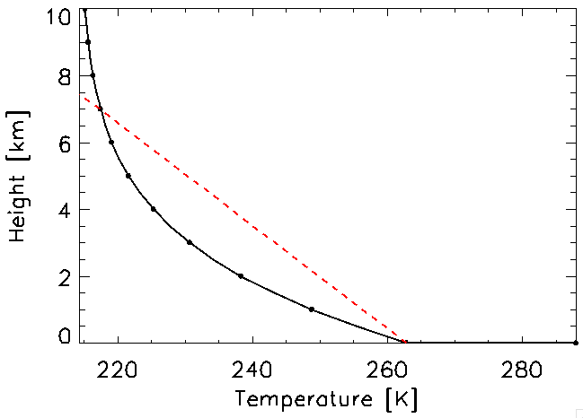
Solutions to the Gray Gas Model
This reduces to:
Hypothesize that:
τ(z)→ρ_{h2o}(z) (which decays
exponentially in height)
τ(z) → τ*exp(-z/H)
Scale height of H₂O, ~2.3 km
6.5 K/km lapse rate
Gray body model for the atmospheric temperature profile:

Slide 17
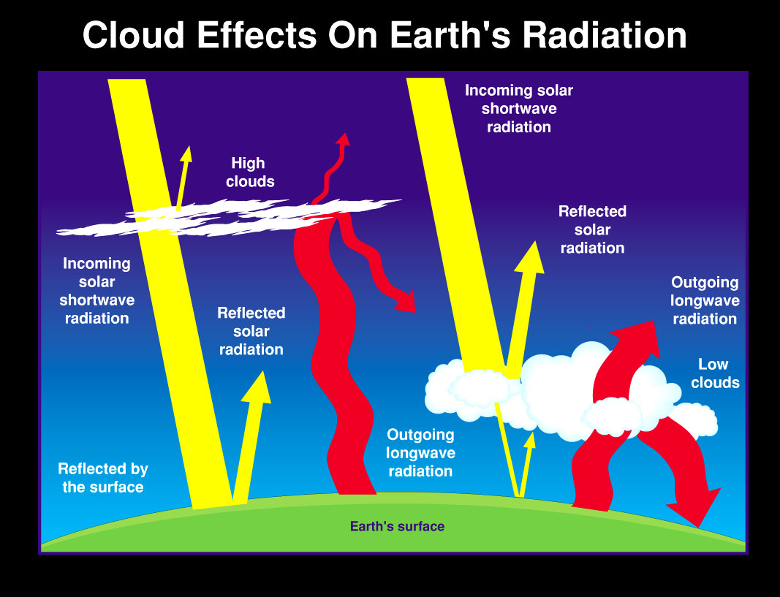
Clouds have been classified as the highest priority in climate change by the U.S. climate change research initiative because they are one of the largest sources of uncertainty in predicting potential future climate change

Slide 18
Cloud Radiative Forcing
The effect of clouds on the Earth's radiation balance is measured as the difference between clear-sky and all-sky radiation results
CRF_{X} = F_{X}(all-sky) - F_{X}(clear)
F_{X}^{net} = F_{X}^{down} – F_{x}^{up}
where X= SW or LW
Total or Net CRF = CRF_{LW} + CRF_{SW}
Negative CRF => Clouds have a cooling effect on Climate
Positive CRF => Clouds have a warming effect on Climate

Slide 19
TOA Cloud Radiative Forcing (CRF)
➔Since cloud-base temperature is typically greater than the clear-sky effective atmospheric radiating temperature, CRF_{LW} is generally positive.
The magnititude of CRF_{LW} is strongly dependent on cloud-base height (i.e., cloud-base temperature) and emissivity.
➔Conversely, clouds reflect more insolation than clear sky, therefore, CRF_{SW} is always negative over long time averages or large spatial domains. The magnititude of CRF_{SW} cooling strongly depends on the cloud optical properties and fraction, and varies with season.
Notes:
Remember, this is for surface CRF, not TOA CRF

Slide 20
285 W m⁻² (LW out)
239 W m⁻²
341 W m⁻²
56 W m⁻²
341 W m⁻²
102 W m⁻²
Albedo=16%
(surface + Rayleigh)
285 W m⁻²
239 W m⁻²
Earth (No Clouds)
Earth (With Clouds)
F_{SW} (cloud) =-50 W m⁻²
F_{LW} (cloud)= 30 W m⁻²
=> Net Effect of Clouds = -20 W m⁻²

Slide 21
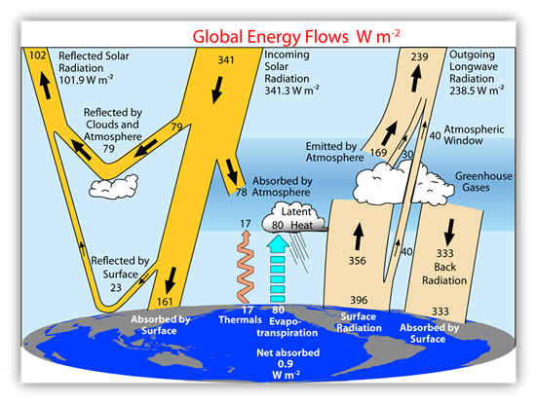
Earth Energy Budget (Trenberth 2009)
TOA
Incoming = Outgoing
341 = 102 + 239
ATMOSPHERE
Absorbs: 78 (SW)+356 (LW)
= 434 W/m²
Emits: 199 up + 333 down
= 532 W/m²
Atmosphere is losing:
98 W/m² from radiation!
Gains it back from sensible heat (thermals) =~ 17 W/m²
Latent Heat =~ 80 W/m² makes up the difference
→ due to radiation imbalance, it must rain 3 mm/day on average everywhere on the planet!

Slide 22
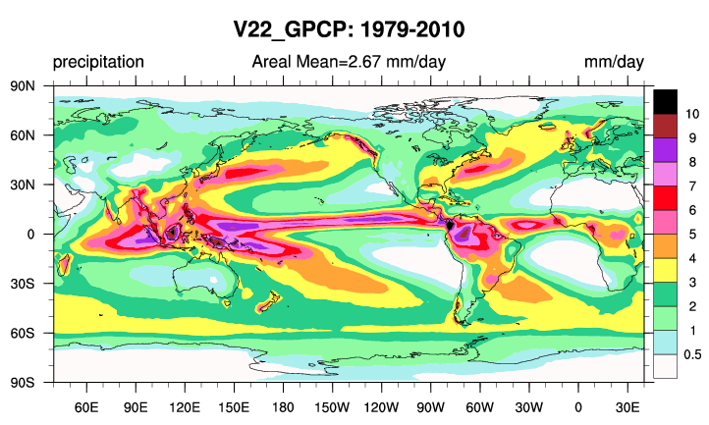
Global Precipitation Climatology Project

Slide 23
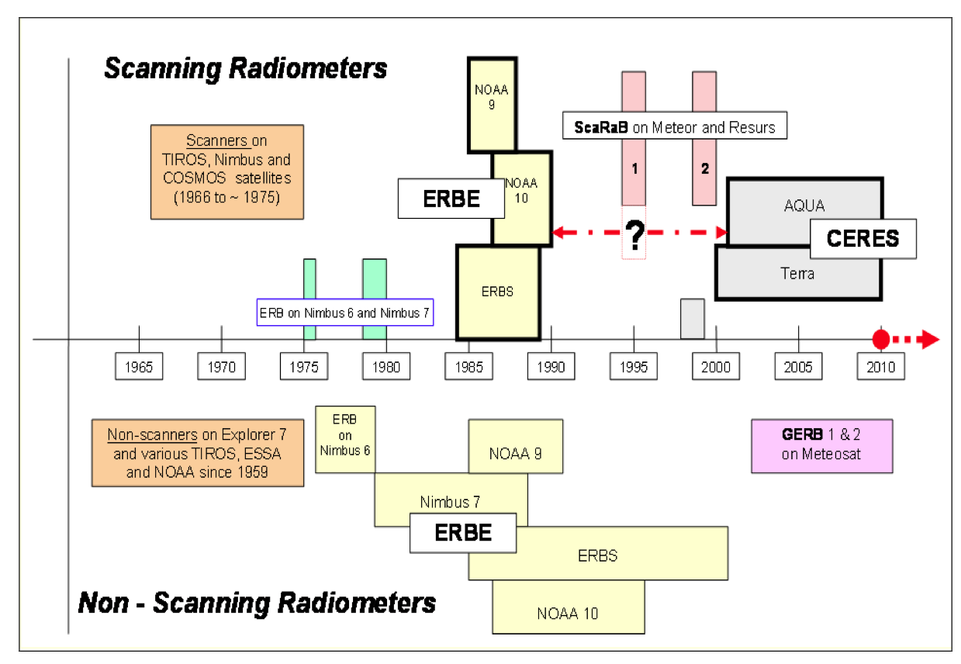
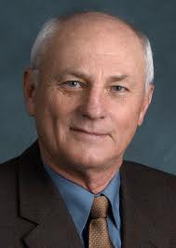
Radiation Budget Sensors
ERBE PI!

Slide 24
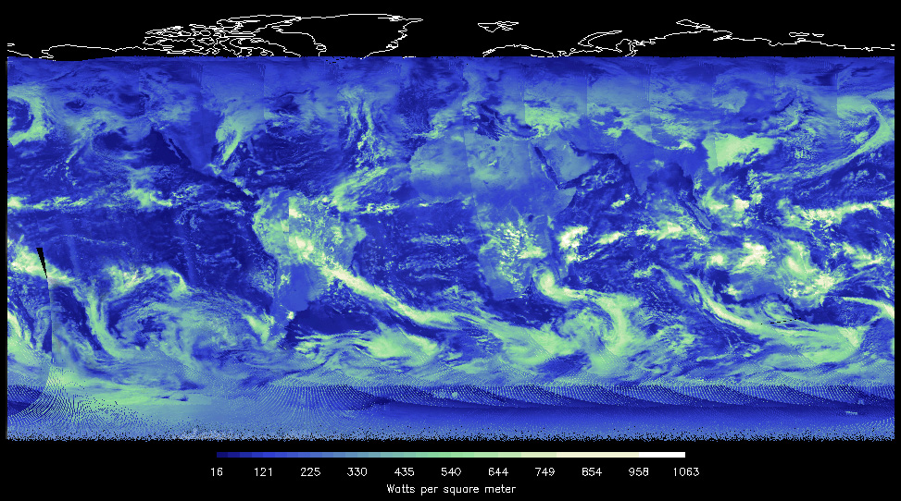
Suomi NPP: CERES First Light: 2/1/2012
Outgoing Shortwave Radiation = OSR

Slide 25
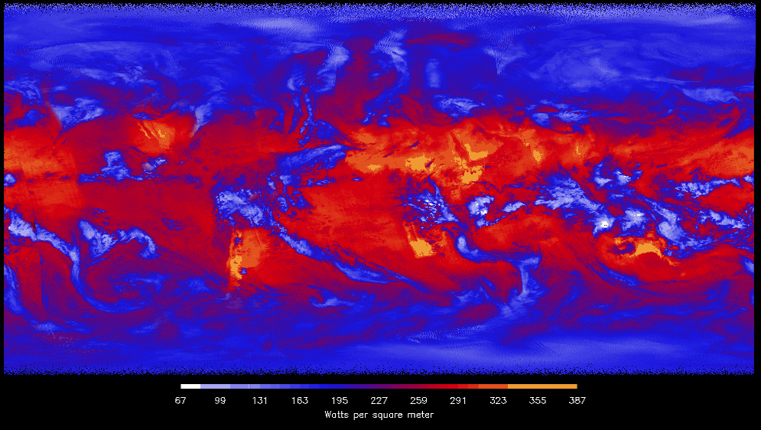
Suomi NPP: CERES First Light
Long Wave TOA Upwelling = Outgoing Longwave Radiation (OLR)

Slide 26
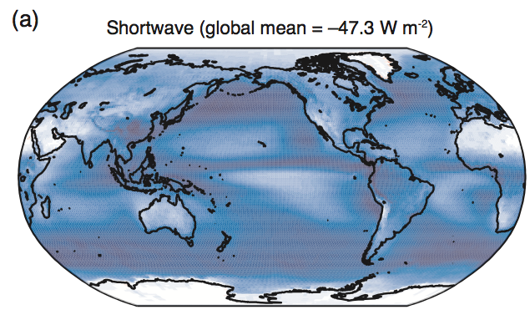
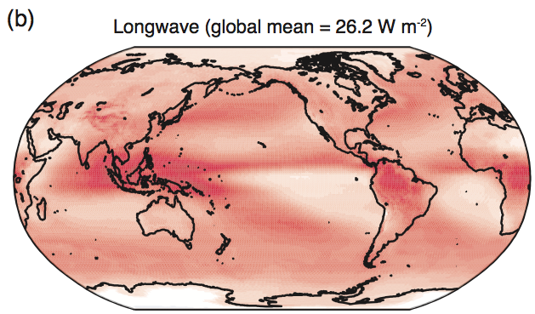
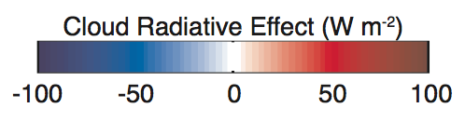
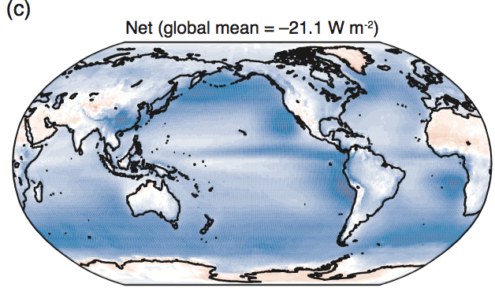
Mean TOA Cloud Radiative Forcing
Shortwave is generally negative – larger where clouds are thicker and surface is darker.
Longwave is positive – larger where clouds are thicker.
Net is generally negative: SW>LW. Slightly positive over higher albedo or drier regions.

Slide 27
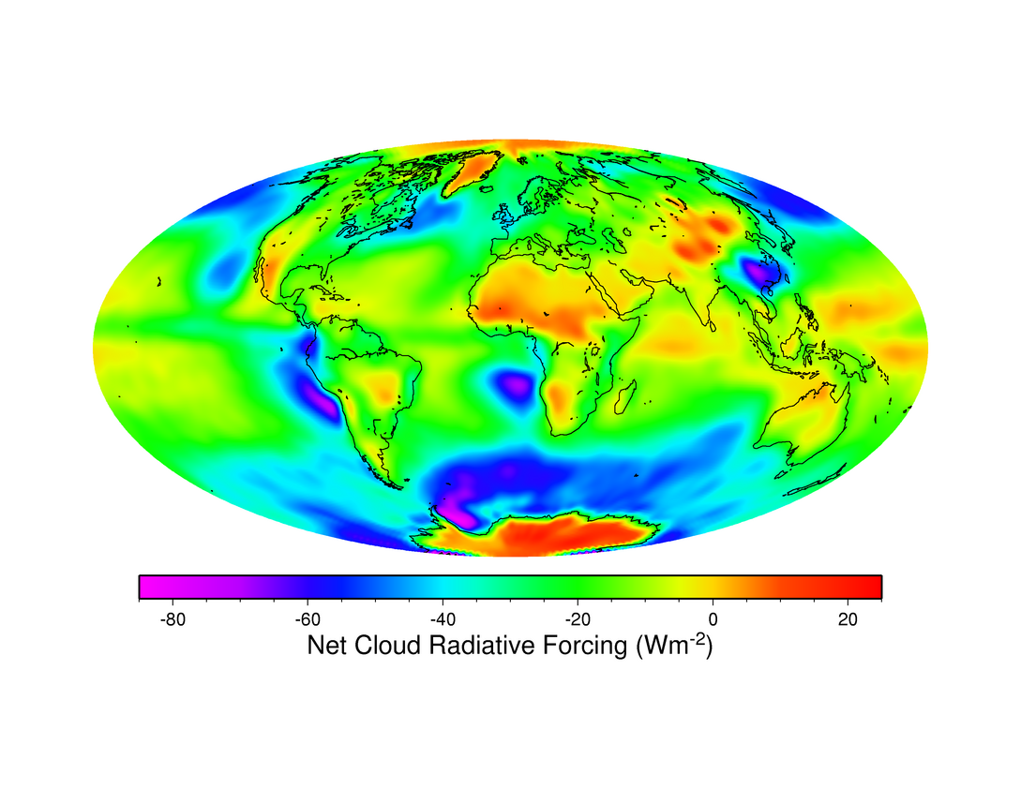
CERES Cloud Radiative Forcing (annual average)
MEAN =~ -20 W/m²

Slide 28
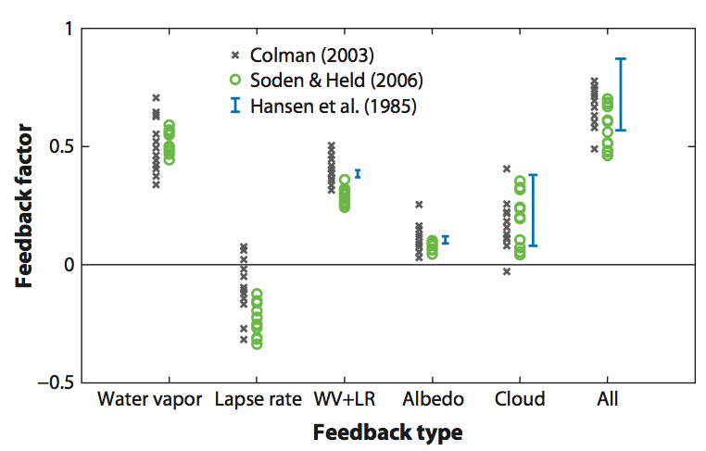
Uncertainties in Long-term climate change: Fast Feedbacks
Roe (2009)
Feedbacks mostly positive; thought to amplify baseline warming by factor of 2-5.
Aerosol forcing uncertainty + feedback uncertainty → large uncertainty in climate change.
1.5-4.5 K range for doubled CO₂
Clouds Contribute the largest contribution to the uncertainty in the fast feedbacks.

Slide 29
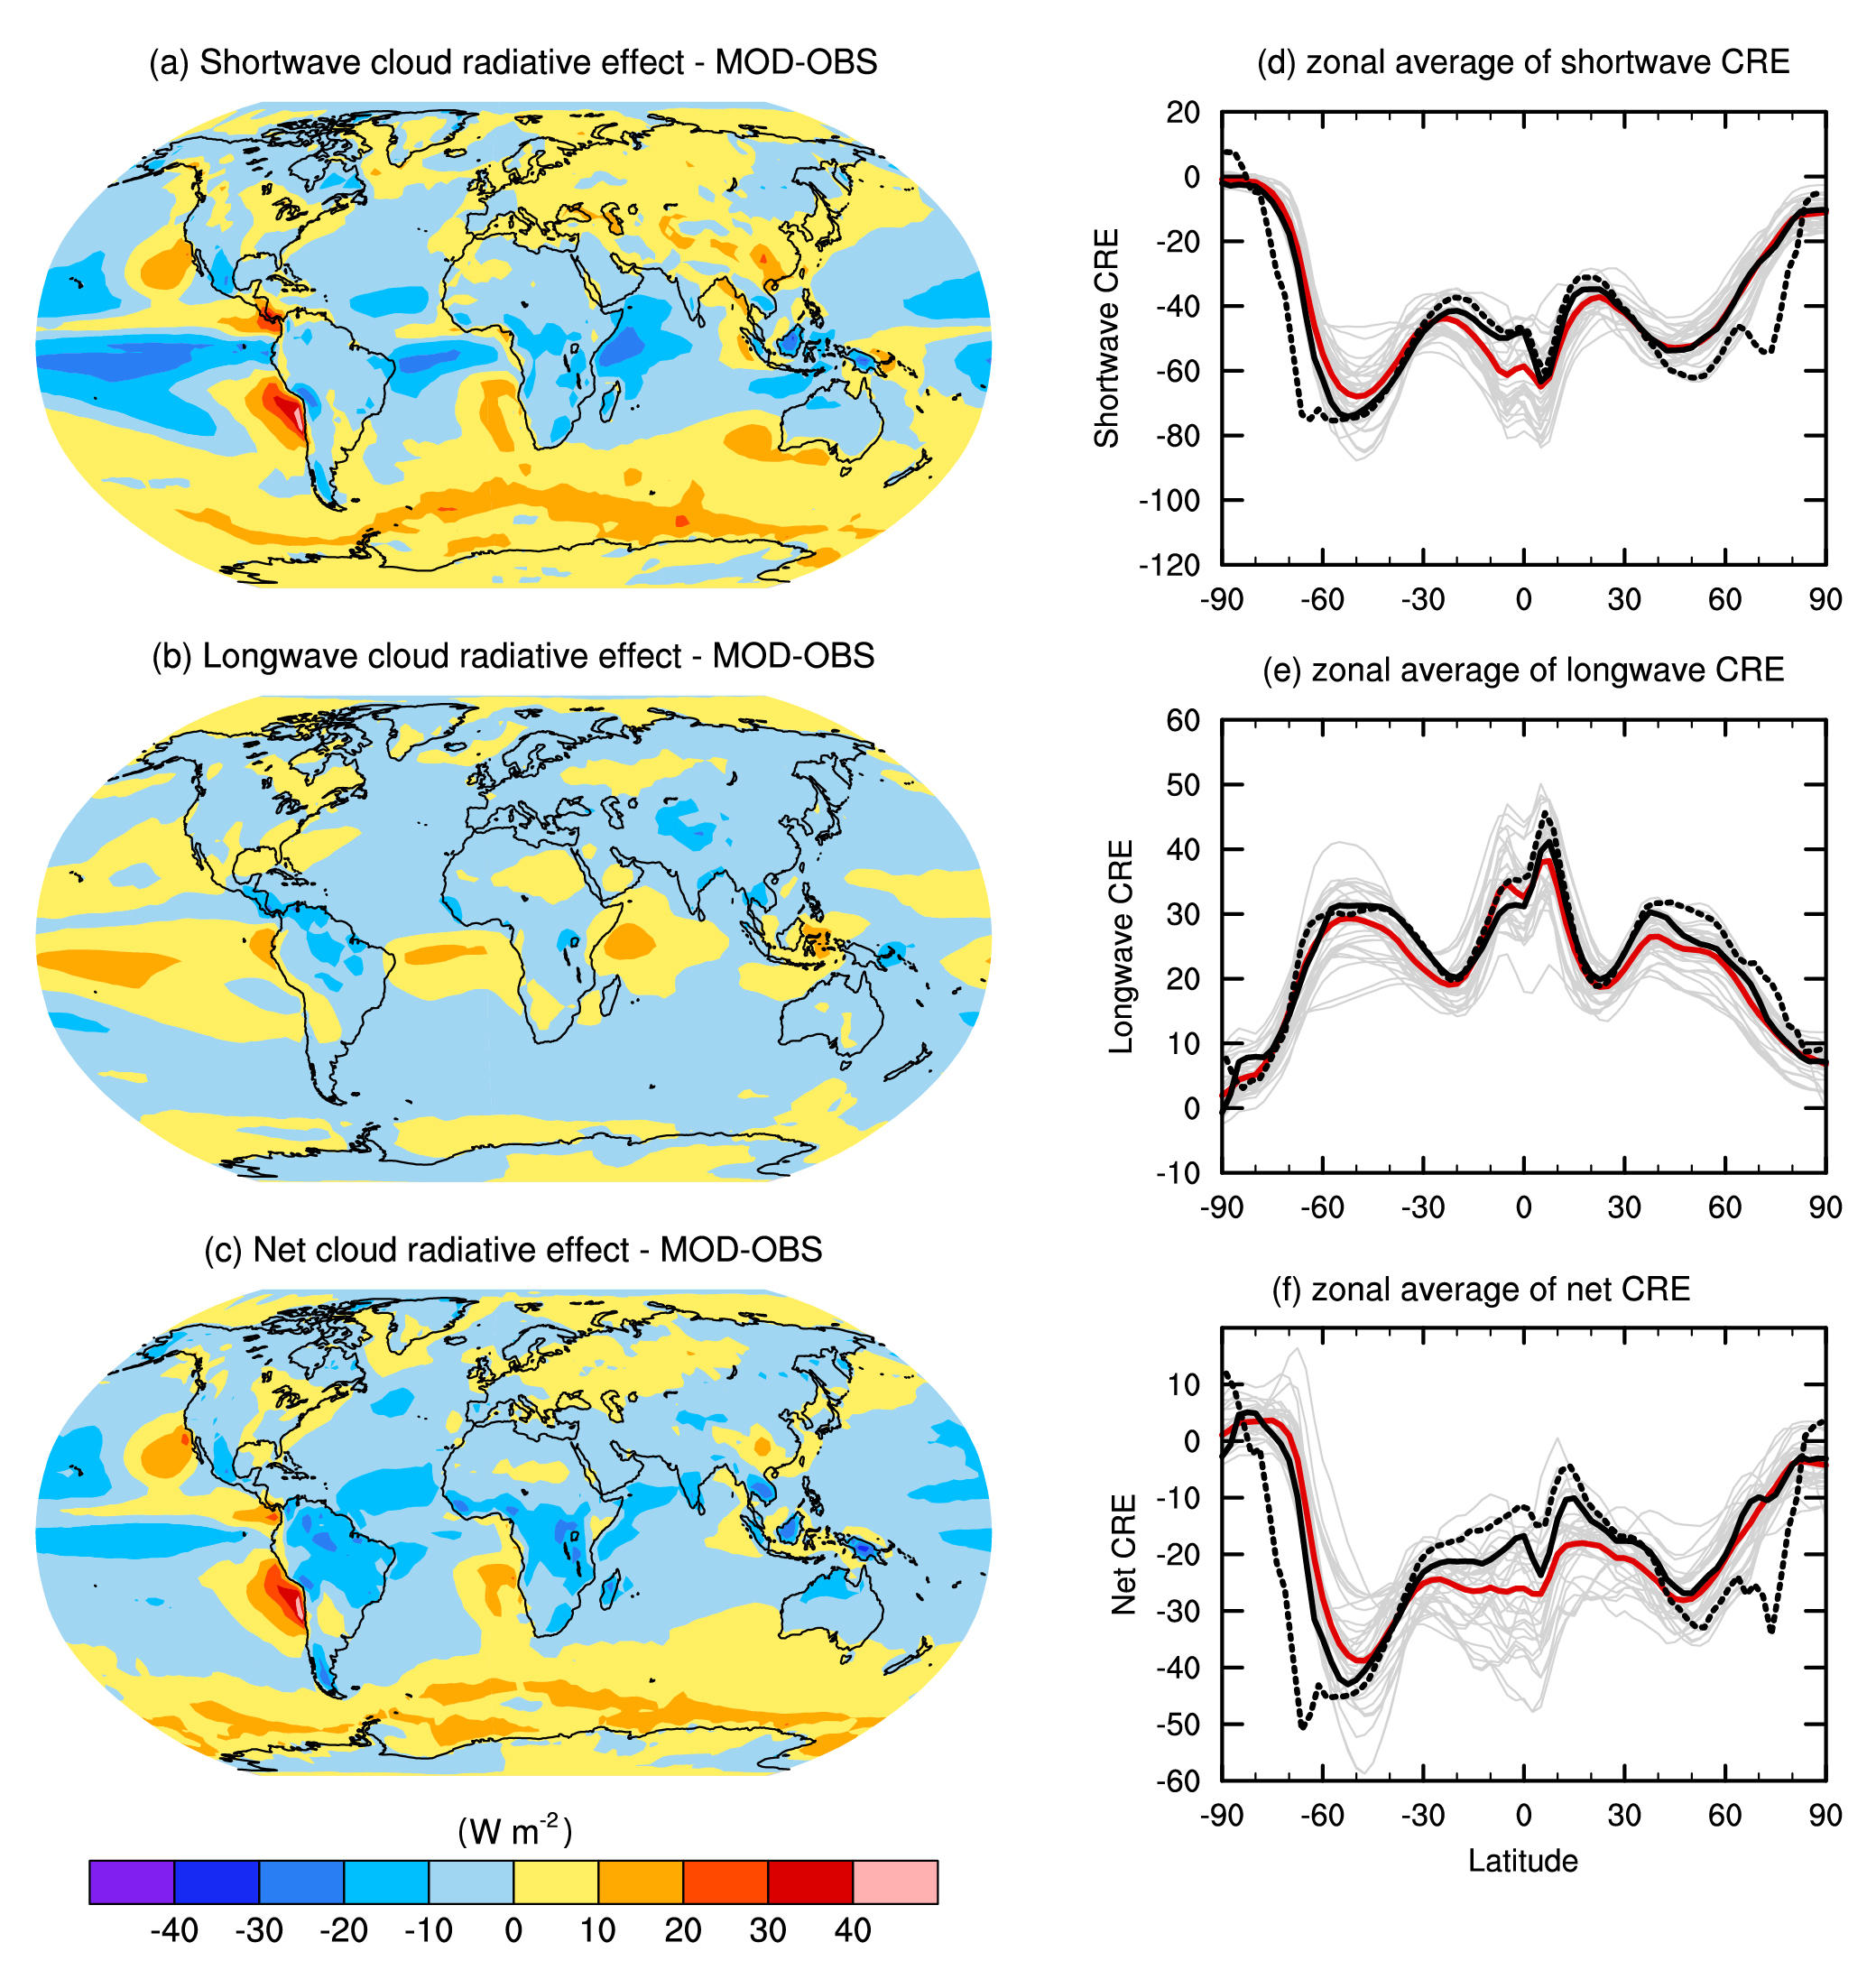

Intergovernmental Panel on Climate Change (IPCC) Fifth Assessment Report (AR5)
Clouds/cloud feedbacks still remain a critical source of uncertainty in climate projections.
What will happen with clouds? With over 25 years of data, we are approaching period where trends/variability can be quantified more robustly.
But, observational products still need “work” (e.g. discrepancies between different data sets).
Notes:
Clouds and the Earth’s Radiant Energy System (CERES) dataset for clouds; GPCP for precip. See 2013sept_odellgroup_presentation.pptx, Odell_microwave_LWP.ppt and MEASURES_2012_technical.pdf for text/talking points.

Slide 30
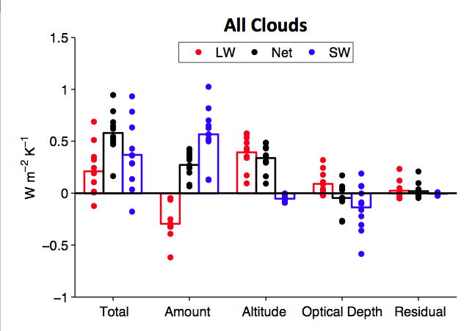
Cloud Feedback Components (CFMIP1)
2. Cloud Altitude Increasing!
1. Cloud Fraction Decreasing!
Courtesy Mark Zelinka, LBNL

