Slide 1
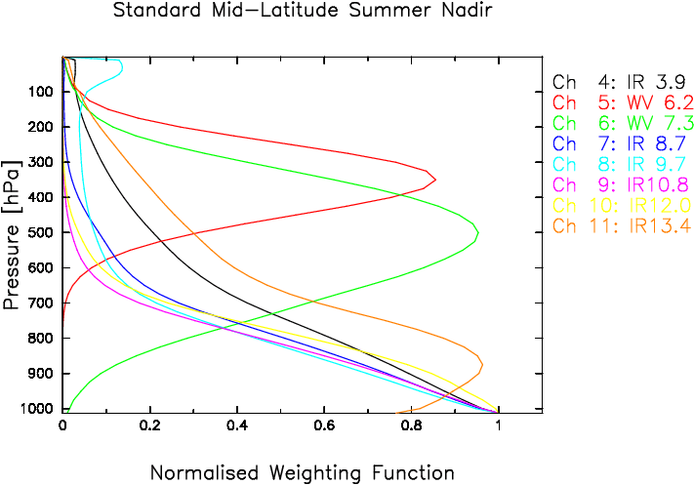
Example for a Satellite: Meteosat Second Generation
The combination of these two “competing effects” results in a profile that peaks at some level in the atmosphere, depending on the strength of the absorbing gases at the current wavelength.
This forms the physical basis for our ability to derive temperature and moisture soundings from satellite observations, using measurements in the various atmospheric absorption bands.
EUMETSAT

Slide 2
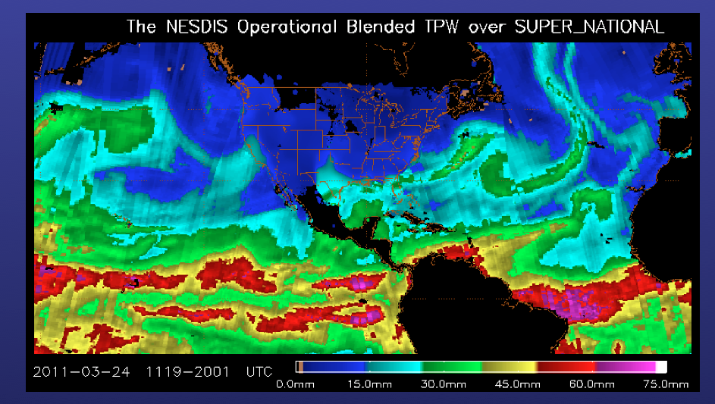

Slide 3
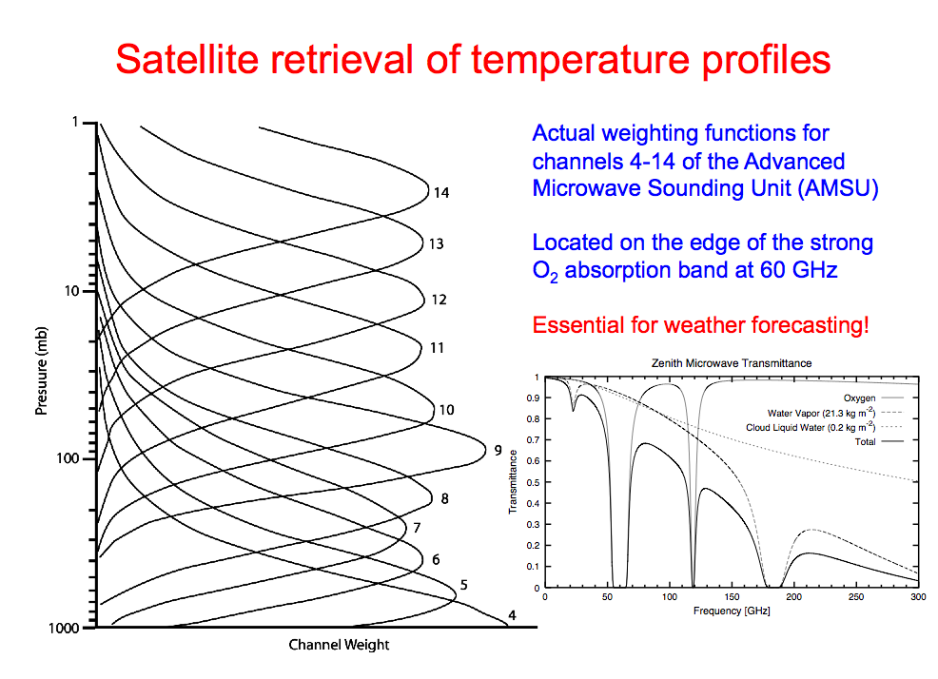
57.29 GHz
52.8 GHz

Slide 4
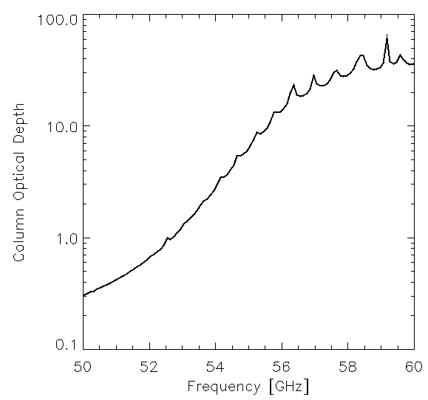
57.29 GHz
52.8 GHz

Slide 5
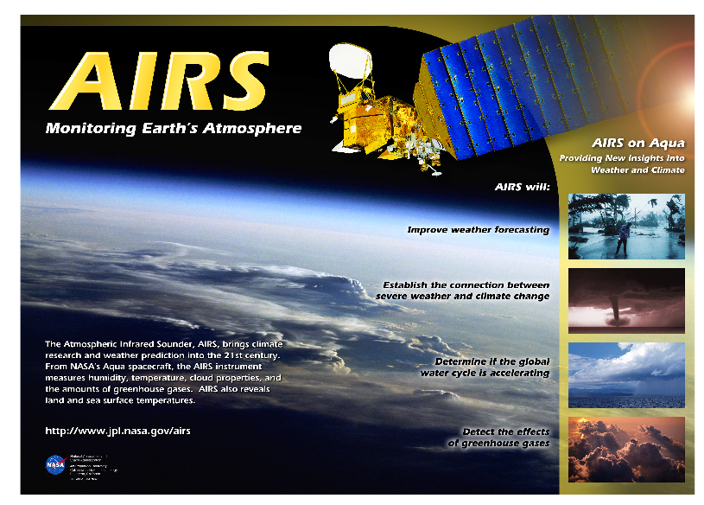
Thermal IR Sounder; > 2000 channels!
T, H2O, CO2, O3, N20…
Launched in 2002 on Aqua with several other sensors

Slide 6
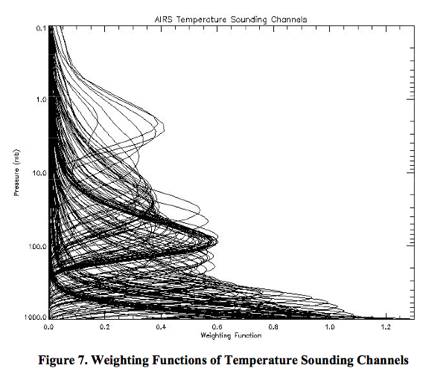
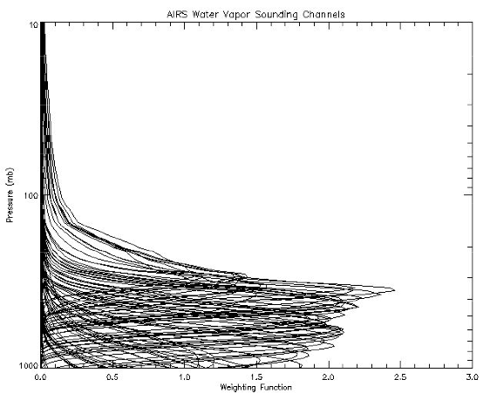
AIRS Weighting Functions
Temperature Weighting Functions
H2O Weighting Functions
Used all the time in Numerical Weather Prediction (NWP) via data assimilation! (at least for clear-sky observations)

Slide 7
Thermal IR Spectra
From surface (looking up) OR TOA (looking down)
Gases that matter most: O3, CO2, H2O
Will enable us to visually deduce: surface temperature, atmospheric inversions, wet vs. dry atmosphere
With a computer, you can get O3 profiles, H2O profile, T profile!

Slide 8
IR Spectra Lookup UP from Surface

Slide 9
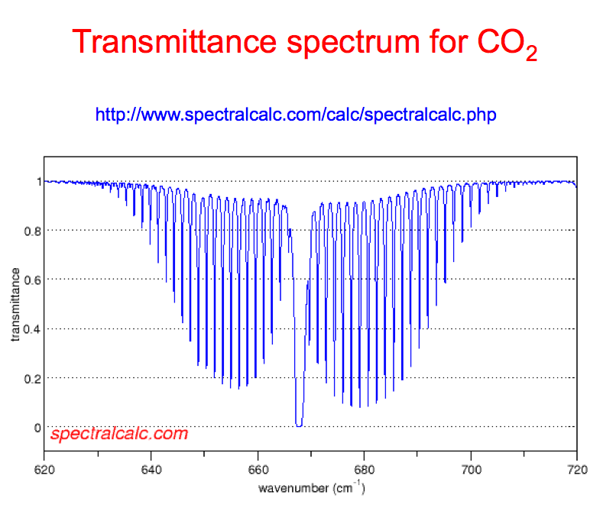

Slide 10
Polar Ice Sheet Observations
(Dave Tobin, UW-Madison/CIMSS)

