Slide 1
Reminder of radiance quantities
I_{λ} Radiance W m⁻² μm⁻¹ sr⁻¹
Intensity
(Monochromatic)
F_{λ} Spectral Irradiance W m⁻² μm⁻¹
Monochromatic Flux
F (Broadband) Flux W m⁻²

Slide 2
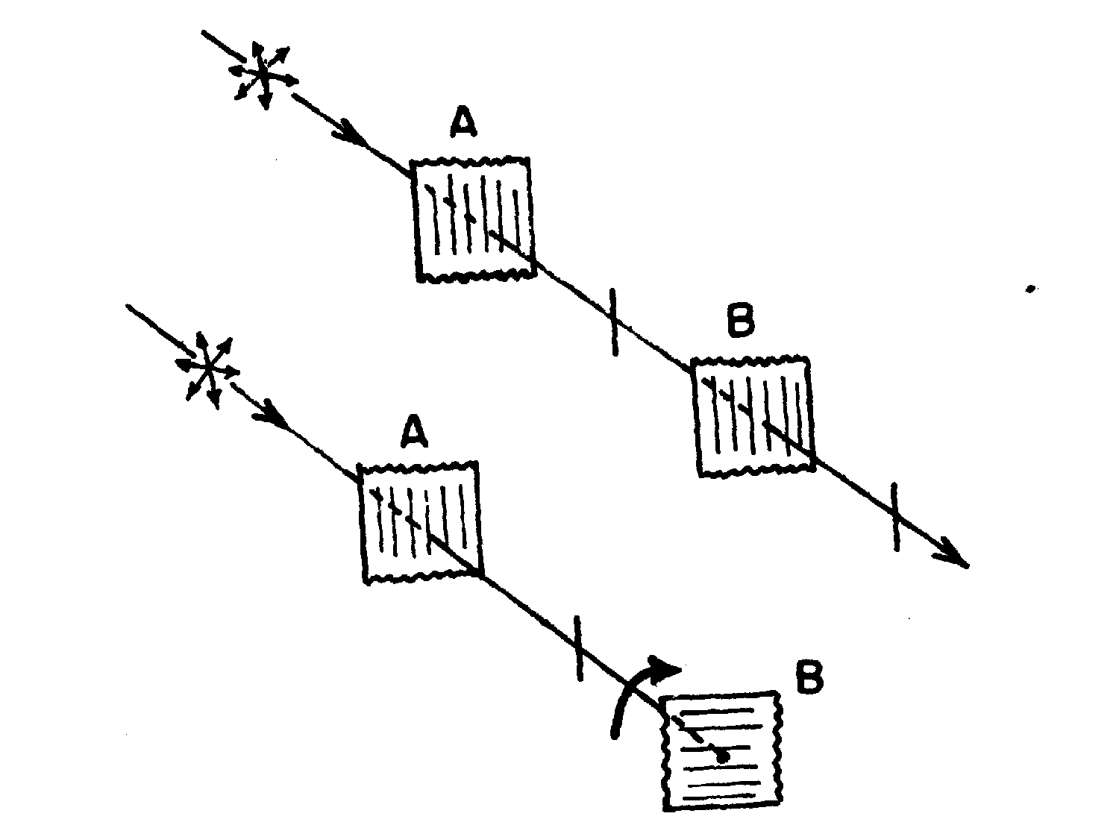
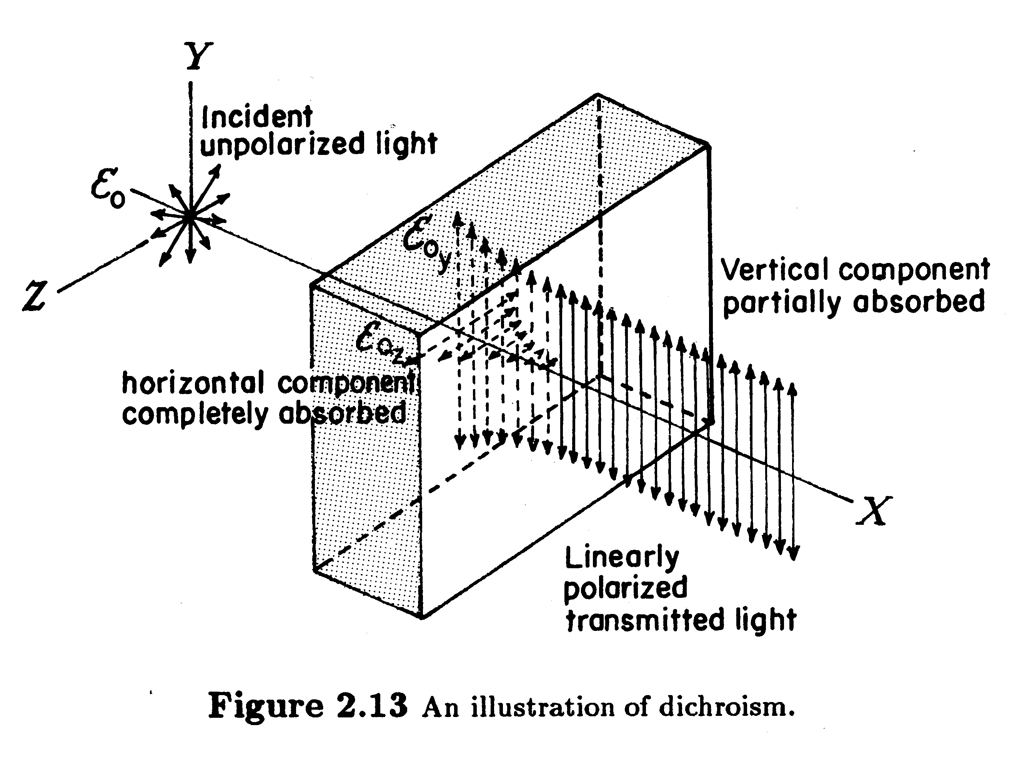
Polarization – a property of the
transverse nature of EM radiation-
doesn’t affect energy transfer but
it is altered by the way radiation
interacts with matter
Simple illustration
of the effects of
two pieces of polarizing
material (polarizers)
Polarization is widely used in remote sensing:
‘multi-parameter’ radar → particle characteristics
microwave emission → cloud water and precipitation
aerosol
sea-ice extent
design of instruments

Slide 3
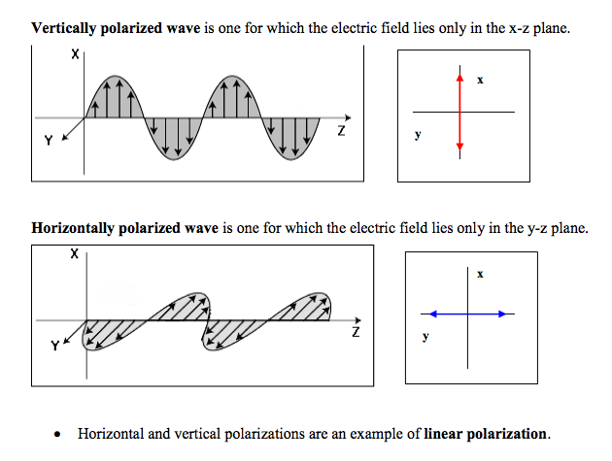

Slide 4
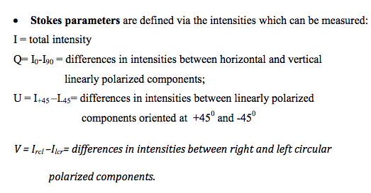
Stokes Parameters – an alternate set of 4
intensity (i.e. energy based) parameters that
derive directly from experiments: can be
Measured!

Slide 5
Stokes Parameters – an alternate set of 4
intensity (i.e. energy based) parameters that
derive directly from experiments: can be
Measured!
Total Intensity
Linear polarization
Linear pol at 45°
Circular Polarization
For a monochromatic wave:
I_{perp}
I_{par}
(in general)

Slide 6
NOTE:
Measurements of polarization are actively used in remote sensing in the solar and microwave regions.
Polarization in the microwave–mainly due to reflection from the surface.
Polarization in the solar –reflection from the surface and scattering by molecules and particulates.
Active remote sensing (e.g., radar) commonly uses polarized radiation.

Slide 7
Region | Spectral Range | Fraction of solar output | Remarks
X-rays | λ < 0.01 μm |  | Photoionizes all species; absorbed in upper atmosphere.
Extreme UV | 0.01 < λ < 0.1 μm |  | Photoionizes O₂ and N₂ ; absorbed above 90 km
Far UV | 0.1 < λ < 0.2 μm | 0.15% | Photodissociates O₂; absorbed above 50 km
UV-C | 0.2 < λ < 0.28 μm | 2% | Photodissociates O₂ and O₃; absorbed above 30 km
UV-B | 0.28 < λ < 0.32 μm | 2% | Mostly absorbed by O₃ in stratosphere; sunburn!
UV-A | 0.32 < λ < 0.4 μm | 8% | Reaches surface
Visible | 0.4 < λ < 0.7 μm | 37% | Atmosphere mostly transparent
Near IR | 0.7 < λ < 4 μm | 50% | Partially absorbed, H₂O, some useful RS lines (methane, CO₂, O₂)
Thermal IR | 4 < λ < 50 μm | 1% | Absorbed & emitted by wv, co2, ozone, other trace gases
Far IR | 50 μm < λ < 1 mm |  | Absorbed by water vapor
Microwave | 50 μm < λ < 30 cm |  | Clouds & rain; semi transparent; o2 & h2o lines
Radio | λ > 30 cm

Slide 10
Glowing wires in labs, when heated to high temperatures,
Had intensity that followed a characteristic shape!
Further, found that the total flux emitted (integrate over
all wavelengths) depended ONLY on temperature.
∼

Slide 11
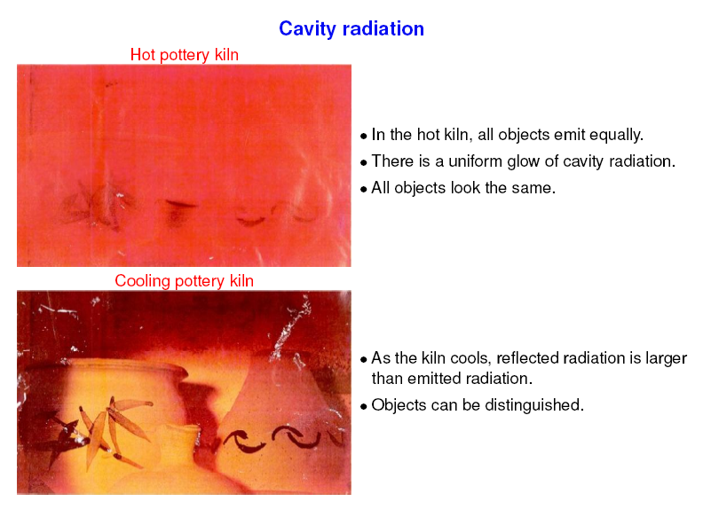

Slide 12
Basic Laws of Emission
Consider an ‘isolated cavity’ and a hypothetical radiating body within it
at temperature T.
An equilibrium will exist between the
radiation emitted from the body and
the radiation that body receives from
the walls of the cavity.
The ‘equilibrium’ radiation inside the cavity is determined solely
by the temperature of the body. This radiation is referred to as
black-body radiation. Two black-bodies of the same temperature
emit precisely the same amount of radiation - proof 2nd law

Slide 13
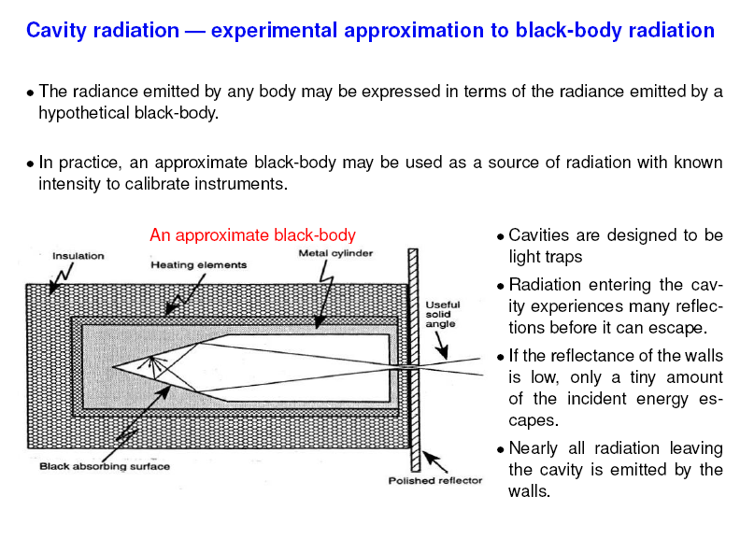
We can very closely approximate blackbody radiation by carefully
constructing a cavity and observing the radiation within it.

Slide 14
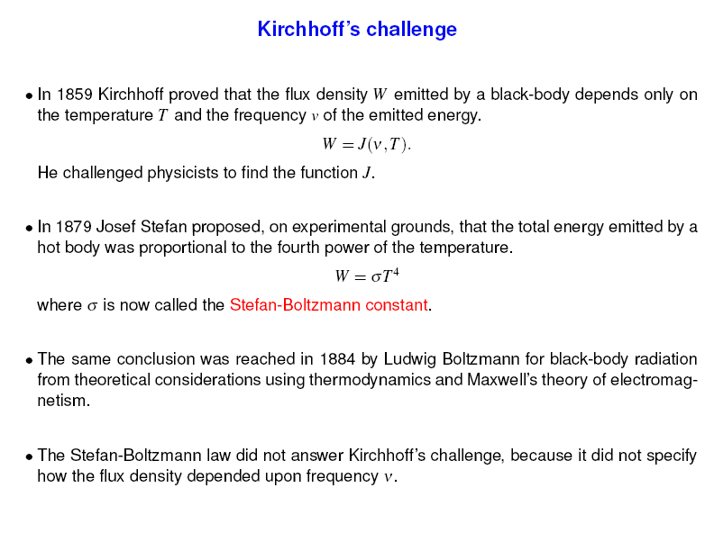

Slide 15
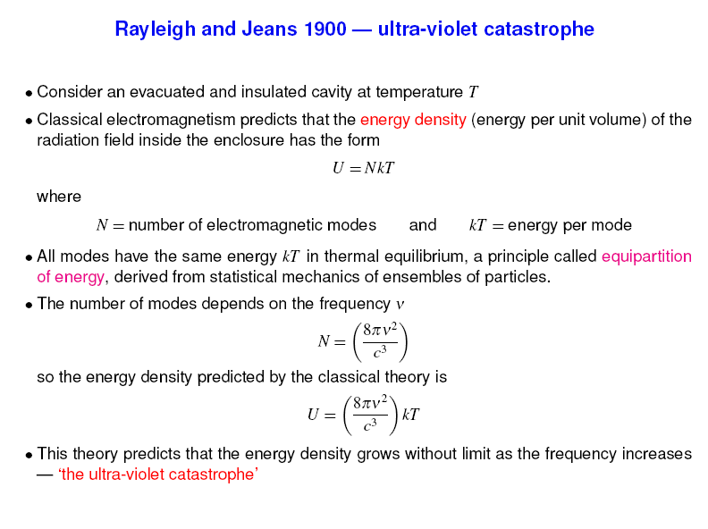

Slide 16
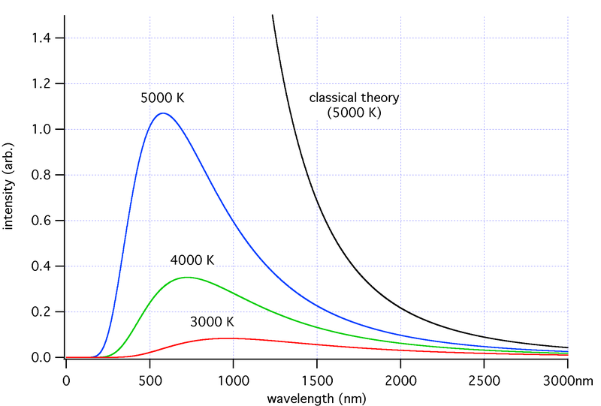

Slide 17
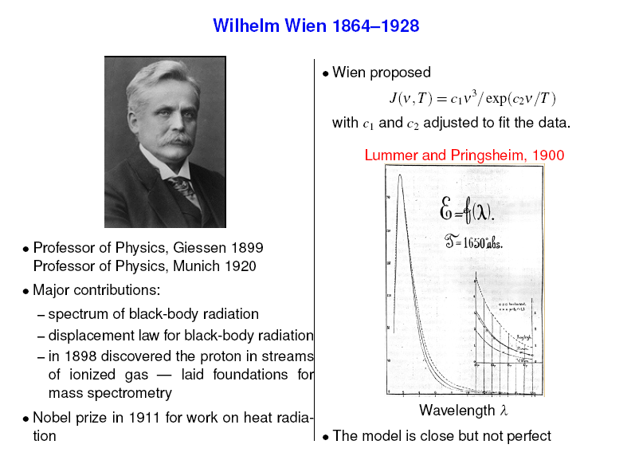

Slide 18
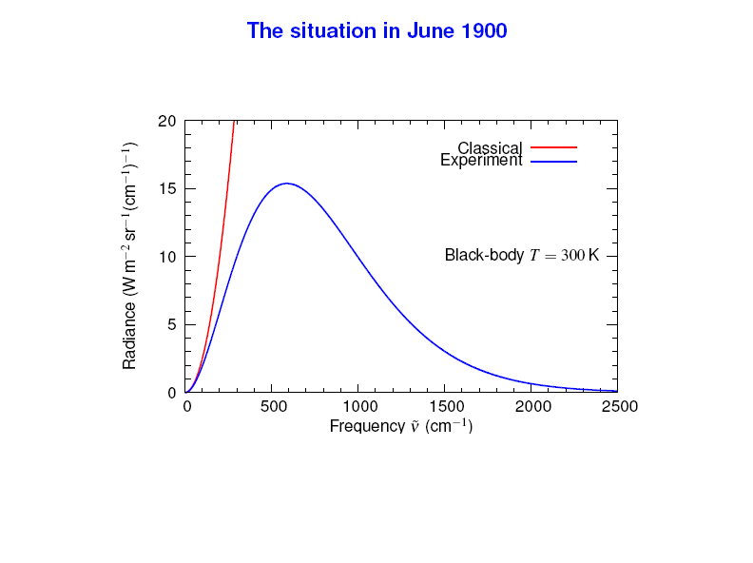

Slide 19
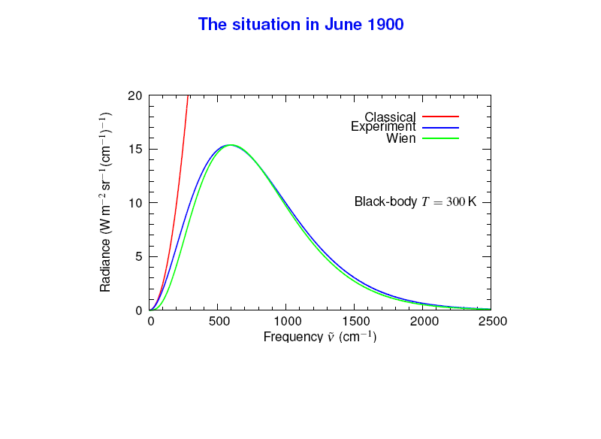

Slide 20
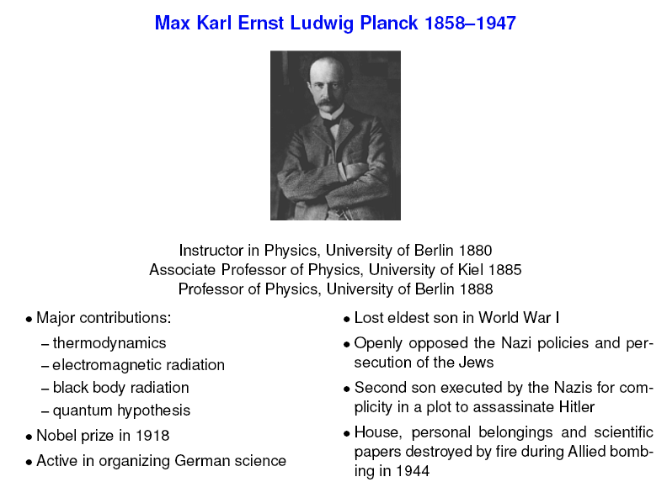

Slide 21
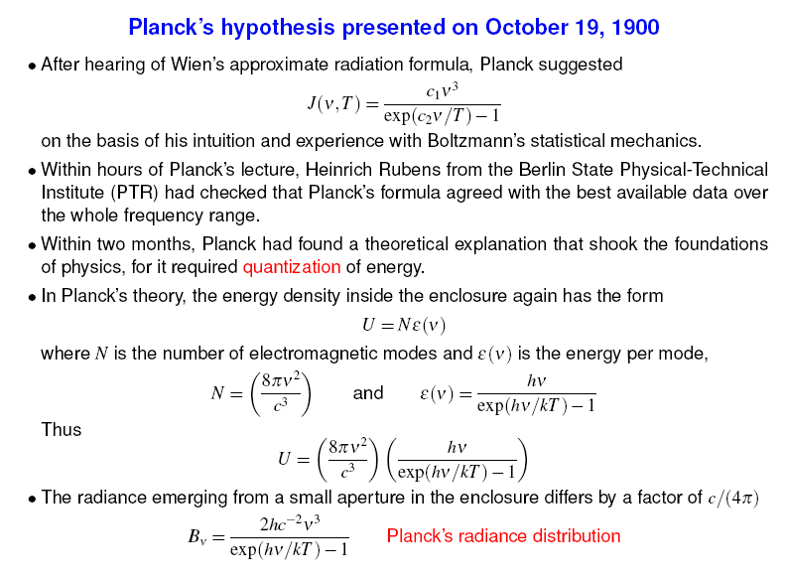
(in units of frequency, ν = c/λ)

Slide 22
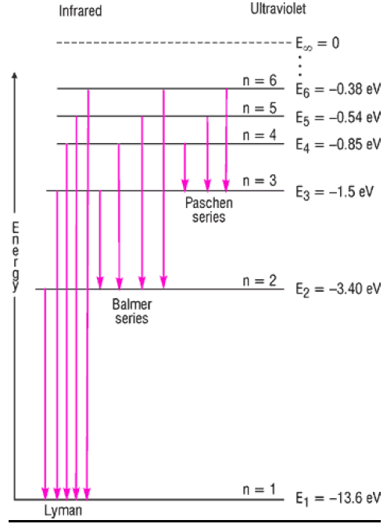
Planck’s “Quantum Leap” of Faith
Max Planck discovered via hypothesis that there is a discrete number of permitted energy levels for an oscillator.
Classical physics would suggest a that there should exist a smooth continuum of possible energy values.
Planck’s Constant (h) is a proportionality constant relating the permitted energy levels to the frequency of the oscillator (ν= c/λ).
The discrete energy levels can then be expressed as: E = n h ν
Above: discrete energy levels of the hydrogen atom

Slide 23
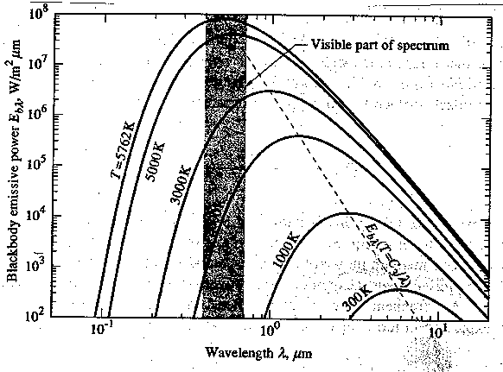
Planck’s Blackbody Function
The nature of B_{λ}(T) was one of the great findings of the latter part
of the 19th century and led to entirely new ways of thinking about
energy and matter.
Insert fig 3.1
There are 4 ‘laws’ or properties of the Planck function that have important consequences: (i) Wien displacement law; (ii) Stefan-Boltzmanm Law; (iii) Rayleigh-Jeans law and (iv) Wein radiation law

Slide 24
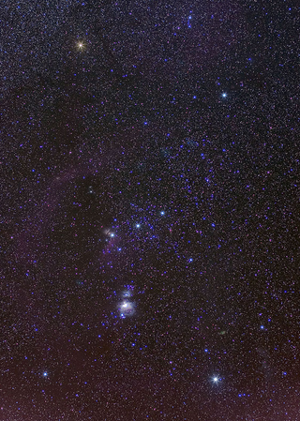
Wien’s Displacement Law
Betelgeuse 3300 K 880 nm
Rigel 12100K 240 nm

Slide 25
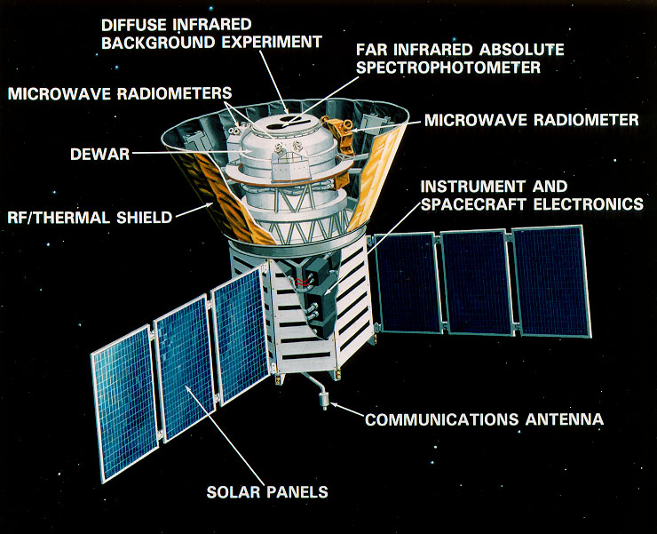
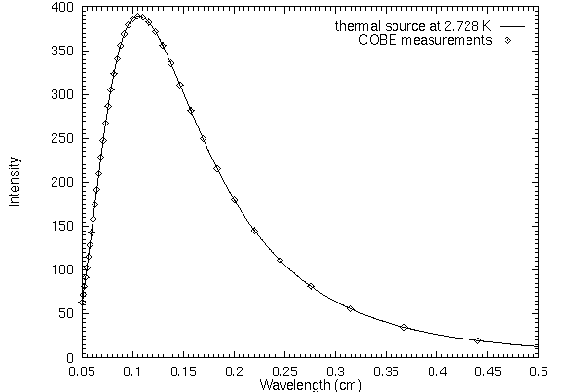
COLD SPACE – THE MOST PERFECT BLACKBODY EVER MEASURED:

Slide 26
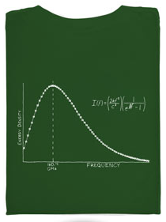


Slide 27
Higher temperature blackbodies are higher at EVERY wavelength.

Slide 28
The solar spectrum is a near blackbody at 5762K.

Slide 30
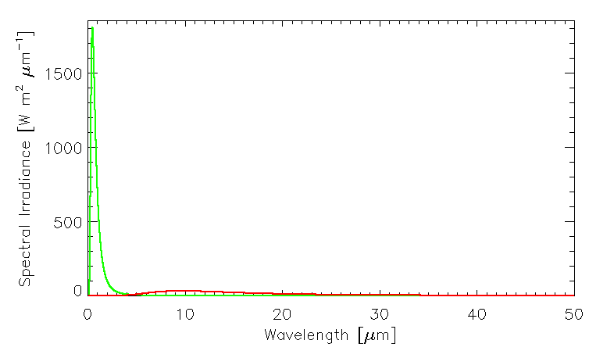
The sun & earth’s spectra do not overlap much!
Overhead Sun, T= 5800K
Flux Down = 1370 W m⁻²
Earth, T=300 K
Flux Up = 457 W m⁻²

Slide 31
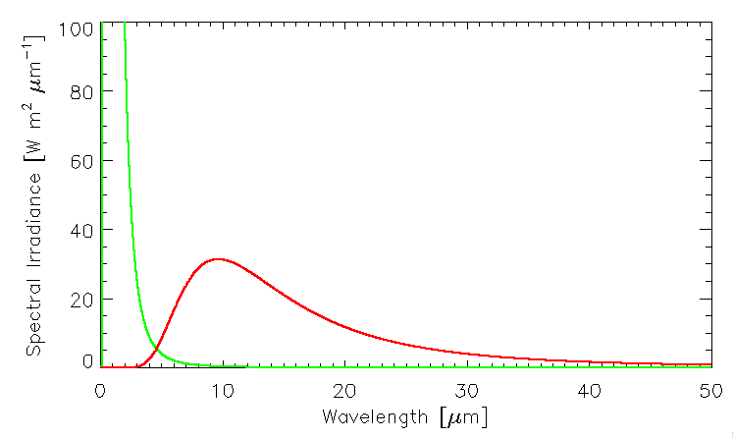
The sun & earth’s spectra do not overlap much!
~1800
Overhead Sun, T= 5800K
Flux Down = 1370 W m⁻²
Earth, T=300 K
Flux Up = 457 W m⁻²

Slide 32
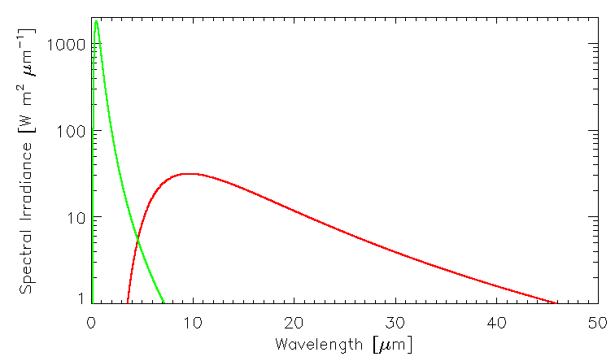
The sun & earth’s spectra do not overlap much!
Overhead Sun, T= 5800K
Flux Down = 1370 W m⁻²
Earth, T=300 K
Flux Up = 457 W m⁻²

Slide 33
Another perspective: normalized area under BB curves

Slide 34
Next
Kirchoff’s Law
Limits: Wien & Rayleigh-Jeans
Brightness Temperature

Slide 35
Brightness Temperature
Radiometers measure the quantity radiance. A perfect blackbody (with unit emissivity) emits a radiance B_{λ}(T) uniformly in all directions. Suppose a radiometer measures some radiance I_{λ} at a wavelength λ. Then it is possible to define the brightness temperature T_{B} that corresponds to this radiance, by finding the temperature that a perfect blackbody would have to have to yield that radiance; i.e., . To find this, one must invert the Planck formula for temperature. That is, solve for T_{B} in the above equation. Doing so yields the following:

Slide 36
Satellite spectrum over tropical Pacific.

Slide 37
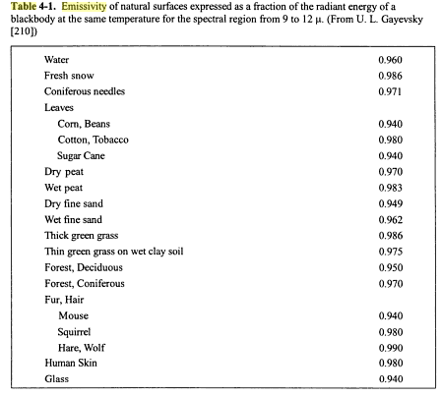
From The Climate Near the Ground (Geiger, Aron, and Todhunter)

Slide 38
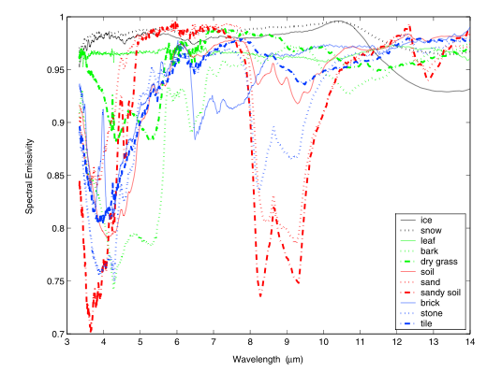
Some Longwave Emissivities vs. Wavelength

