Slide 1
Feb 18, 2015
Petty Chapter 4 & 5

Slide 2
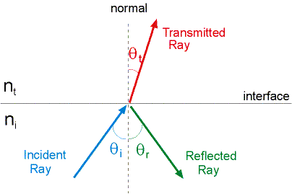
Snell’s Law
(direction of transmitted light)

Slide 3
Fresnel Equations
(fraction of reflected power)
And T_{S} = 1 – R_{S}
T_{P} = 1 - R_{P}

Slide 4
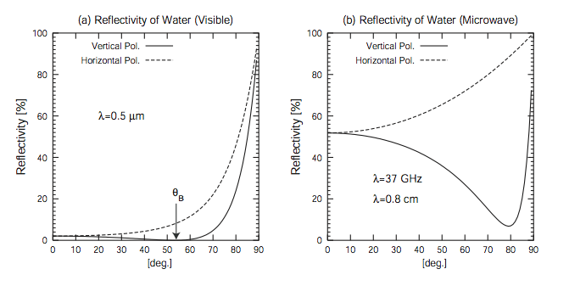
No Brewster’s angle in microwave because of high imaginary component of N

Slide 5
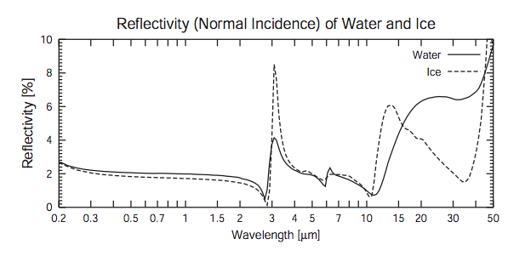
Reflectivity of water & ice remarkably similar over the visible & NIR.
Can become rather different in the Thermal IR & Microwave

Slide 6
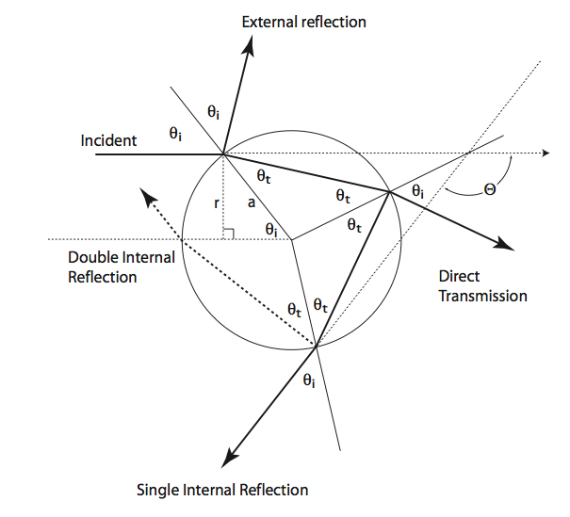
Rainbow Geometry

Slide 7
Minimum 138° Scattering angle

Slide 8
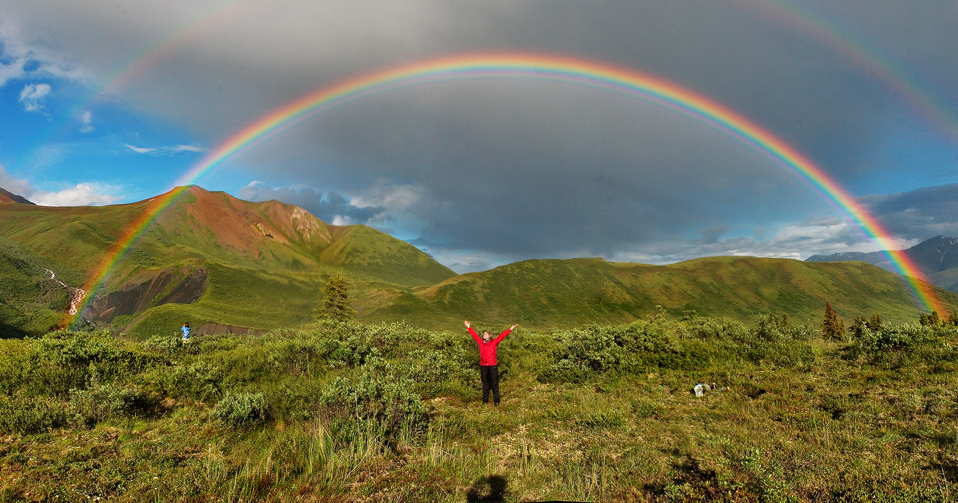

Slide 9
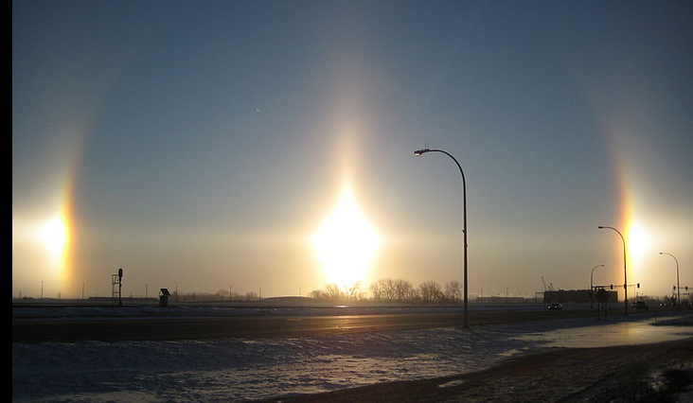
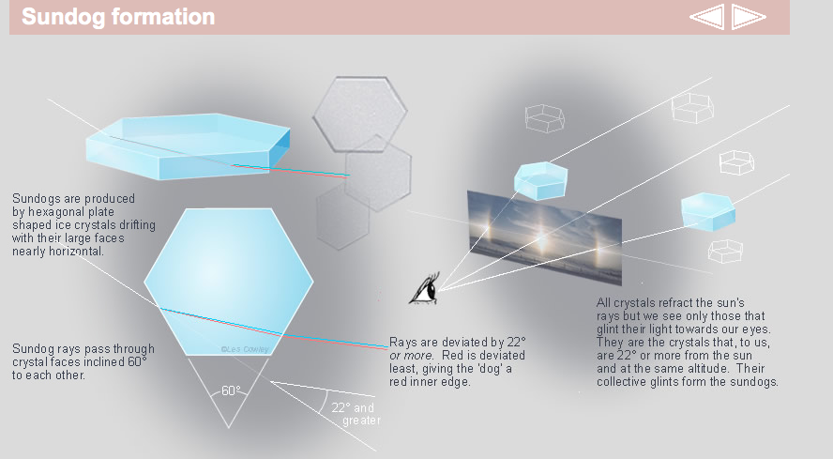

Slide 10
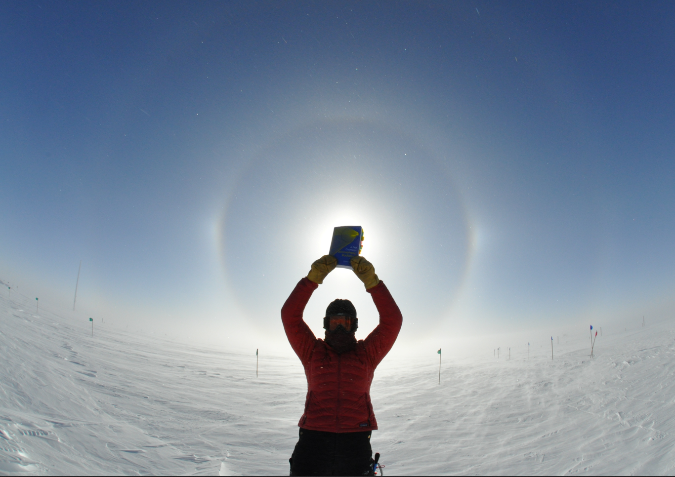


Slide 11
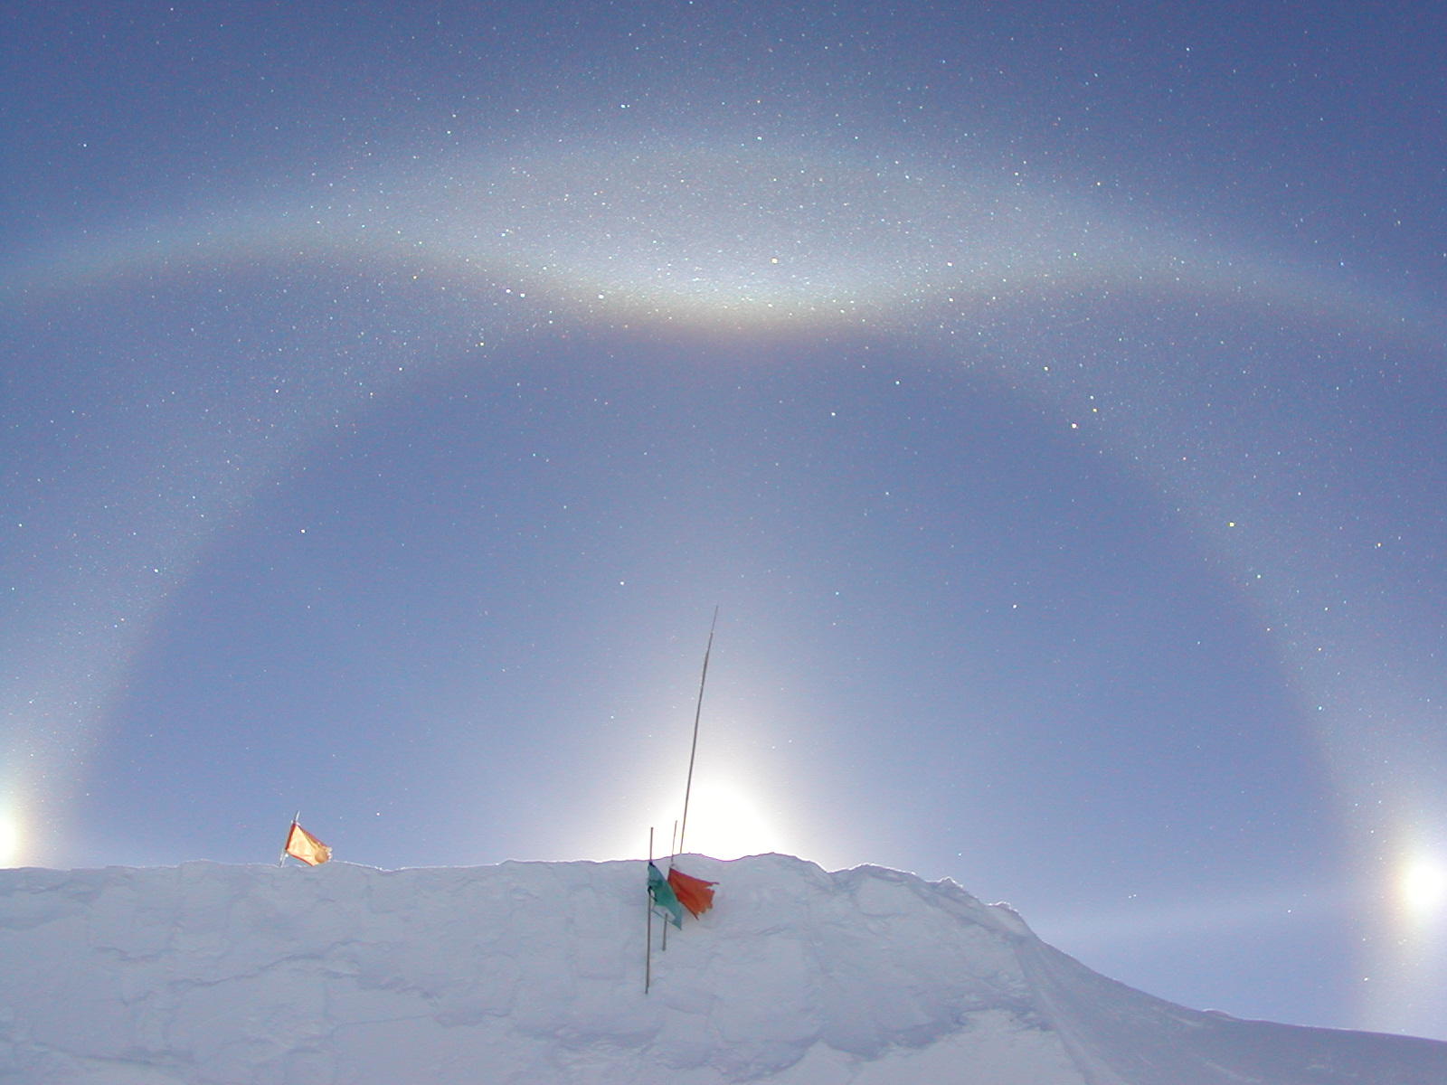

Slide 12
Review of Petty Ch 4:
Reflection & Refraction
Light may encounter boundaries of nearly homogeneous materials in the atmosphere: e.g., incidence on smooth water surface, ice surface, snow surface.
Require that wavelength of light << dimensions of boundary.
Important in remote sensing (determining albedo / emissivity of ocean & land surface)
Important in many optical phenomena such as rainbows.

Slide 13
Review of Petty Ch 4:
Reflection & Refraction
Relative index of refraction (m=N2/N1) and angle of incidence θ_{i} govern both the direction of reflected (R) and transmitted (T) radiation at a boundary (Snell’s Law), as well as the fraction of light transmitted versus reflected (Fresnel Equations).
By conservation of energy, R + T = 1
The index of refraction has a real and imaginary part, and is the square root of the dielectric constant for non-magnetic materials.

Slide 14
Review of Petty Ch 4:
Reflection & Refraction
When N2<N1, light experiences Total Internal Reflection for angles greater than the critical angle θ_{crit} = ArcSin(N2/N1)
When N2>N1, light polarized perpendicular to the plane of incidence (S-pol or V-pol) may be completely transmitted at the Brewster Angle θ_{B} = ArcTan(N2/N1)
Reflection of light from such a boundary can POLARIZE the light.
For unpolarized incident light, R = (R_{P}+R_{S})/2

Slide 15
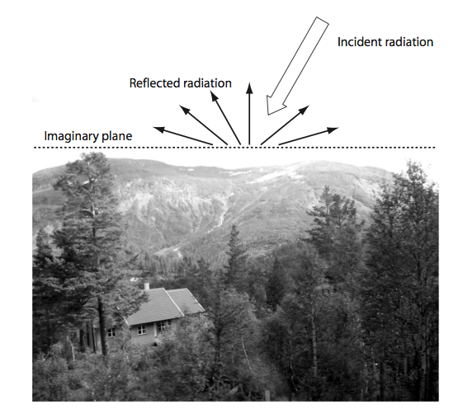
Real surfaces aren’t usually smooth planes!

Slide 16
Surface characteristics
(all wavelength-dependent!)
Absorptivity (may be internally transmitted)
Emissivity (=Absorptivity)
Reflectivity = Albedo = 1 – Emissivity
Bidirectional Reflectance Distribution Function (BRDF) How light incident on surface can be reflected differently into ALL outgoing angles!

Slide 17
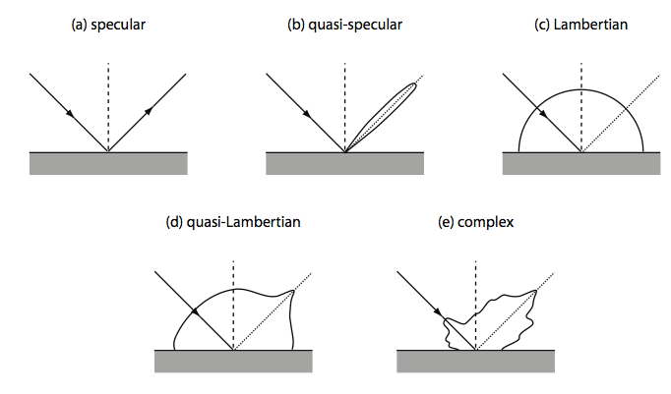
Rough surfaces: Specular vs. Lambertian incident radiation can be reflected into any direction, but amount depends on surface

Slide 18
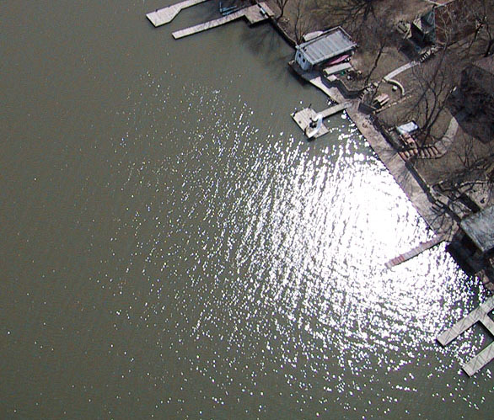
Sunglint from VIIRS

Slide 19
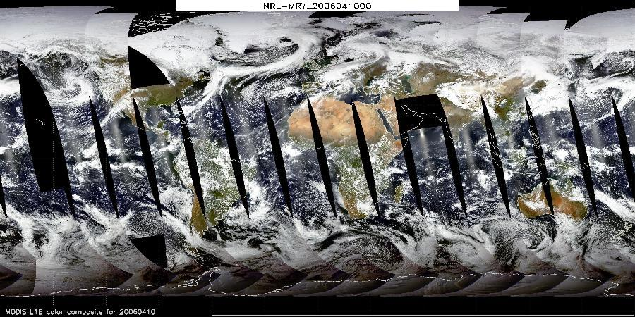
MODIS day-side collage

Slide 20
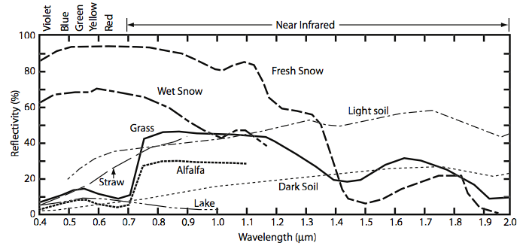
Shortwave Albedo
Water is very dark throughout SW
Snow is bright to about 1.4 um, then becomes very absorbing!
Plants have a “Red Edge” – absorbing to about 0.7 um, then more reflective! (this is how “greenness” or vegetation is measured from satellite

Slide 21
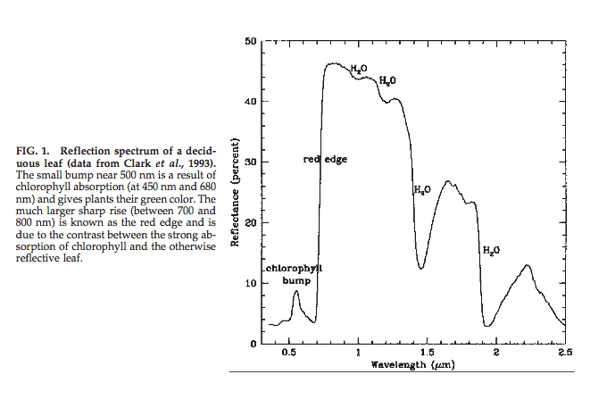

Chlorophyll’s “Red Edge”

Slide 22
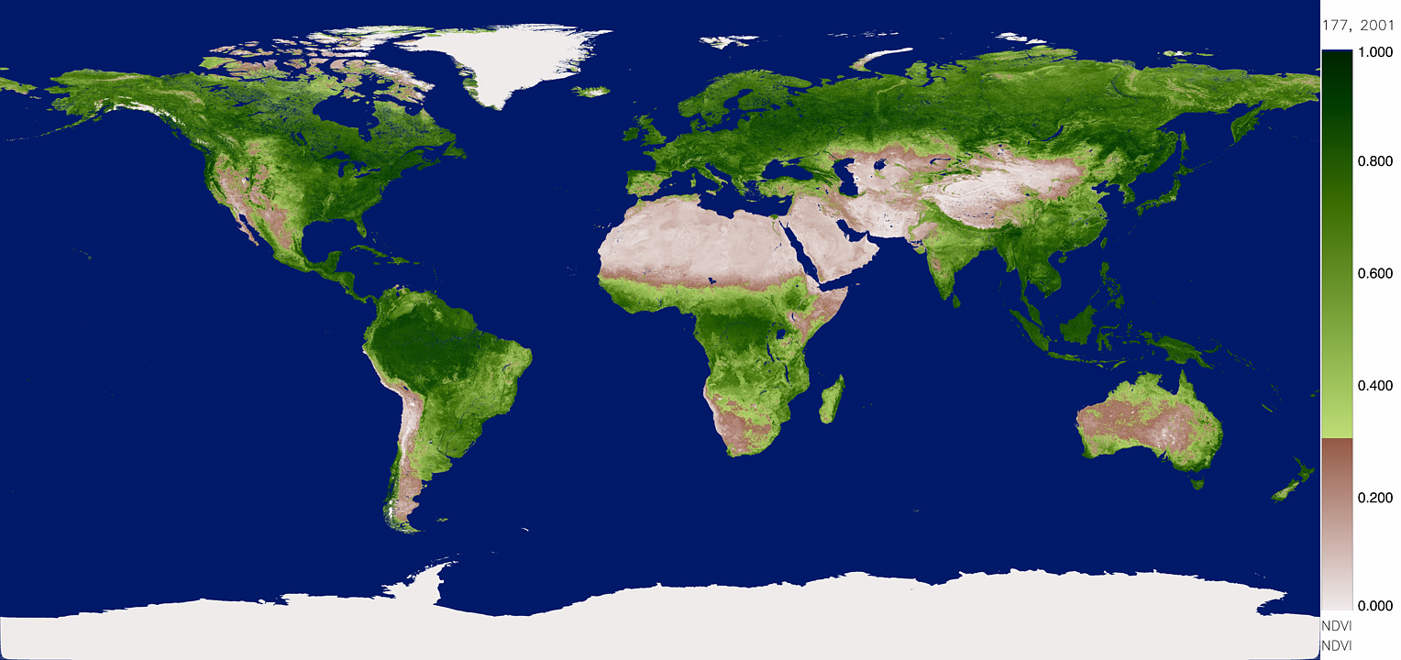
MODIS NDVI

Slide 23
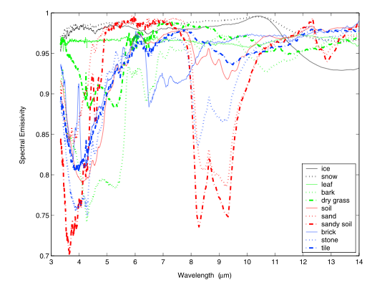
Longwave Emissivity

Slide 24
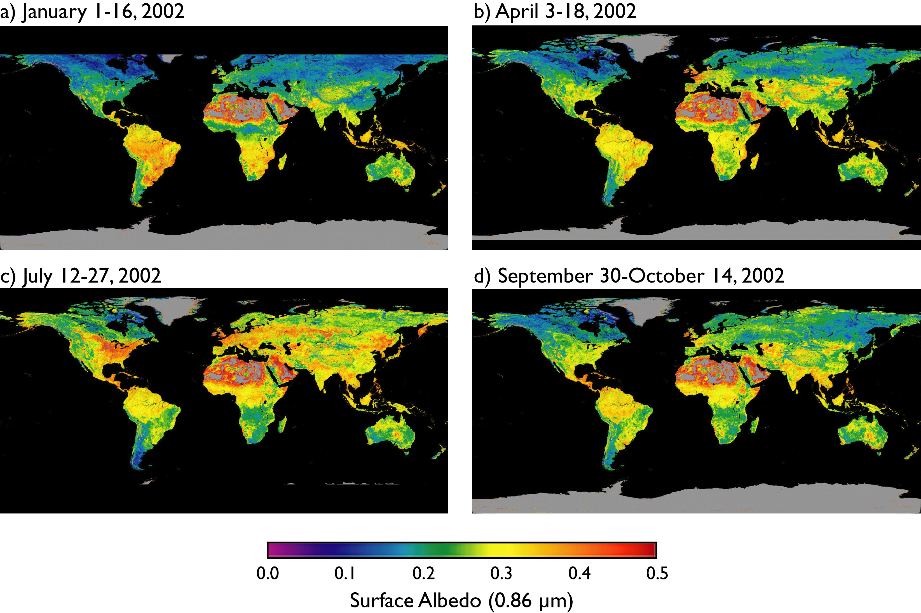

Slide 25
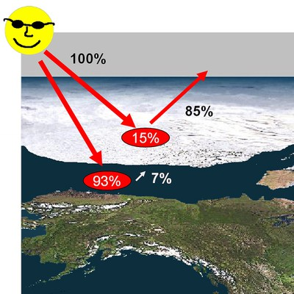
Ice-albedo Feedback

