Slide 1
Feb 16, 2015
Milankovitch Cycles – Brief
Petty Chapter 4

Slide 2
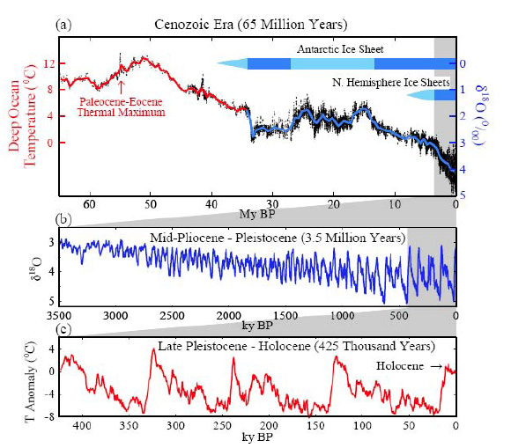

Slide 3
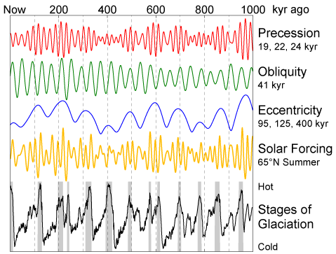

Slide 4
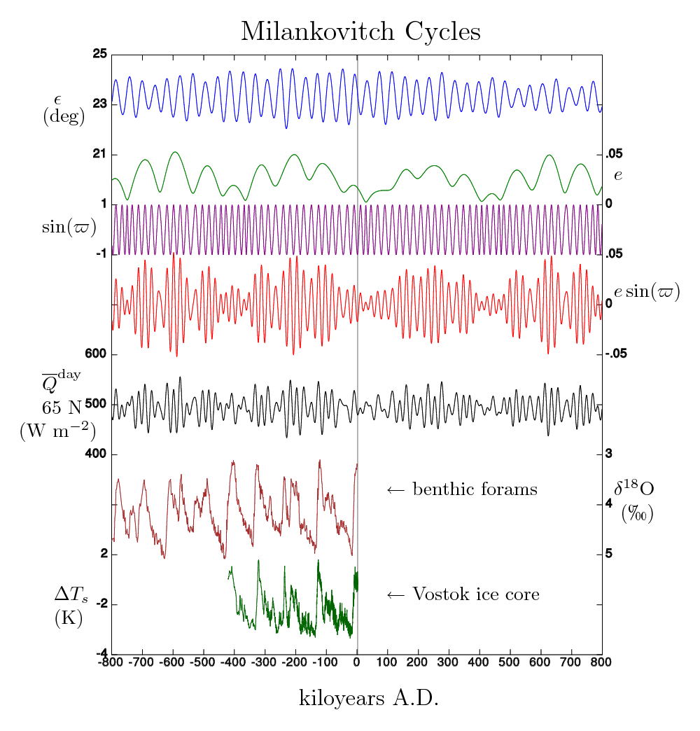

Slide 5
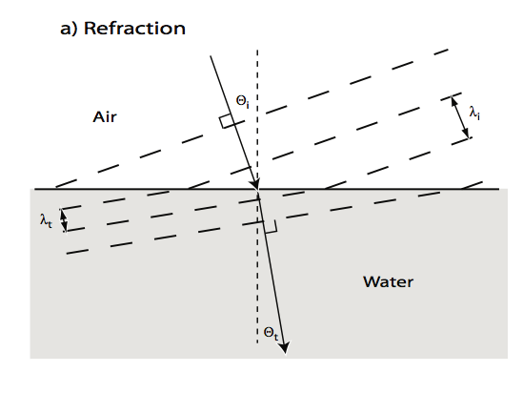

Slide 6
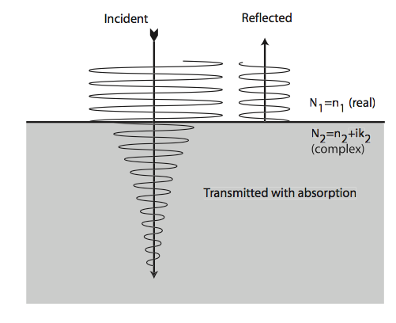
Exponentially Decays according to β_{a} = 4πN_{i}/λ

Slide 7
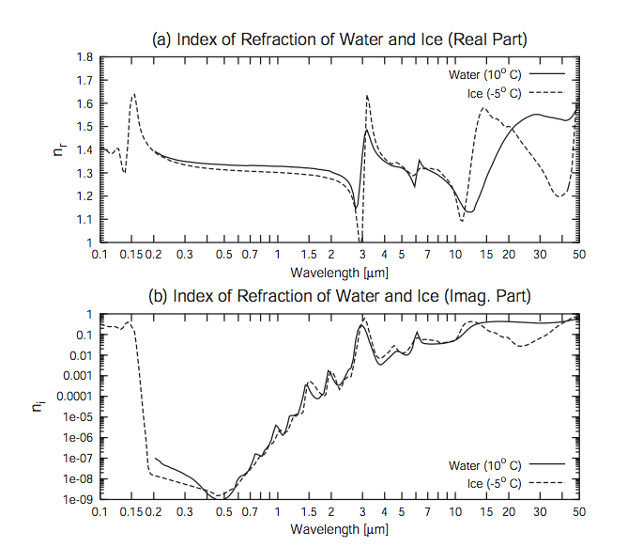
PD = 3-30 m
PD ~ 10 um
PD ~ 100s um

Slide 8
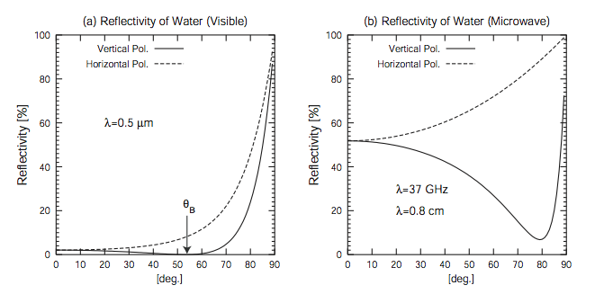
No Brewster’s angle in microwave because of high imaginary component of N

Slide 9
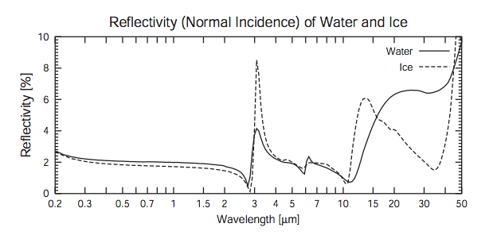
Reflectivity of water & ice remarkably similar over the visible & NIR.
Can become rather different in the Thermal IR & Microwave

Slide 10
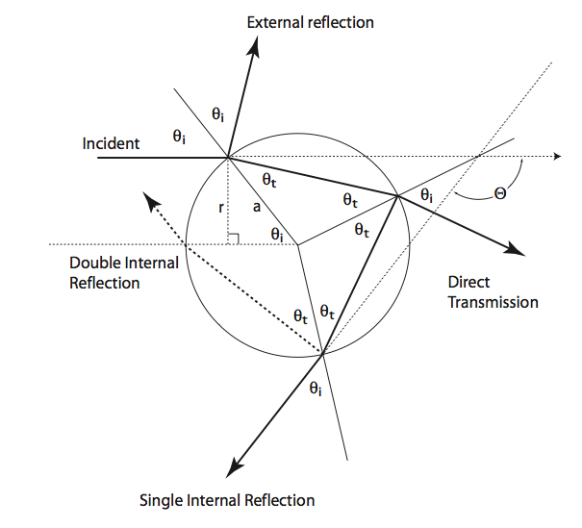
Rainbow Geometry

Slide 11
Minimum 138° Scattering angle

Slide 12
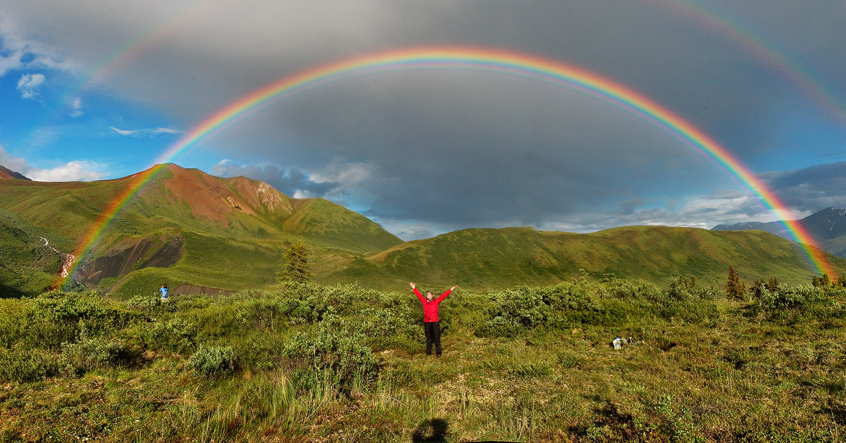

Slide 13
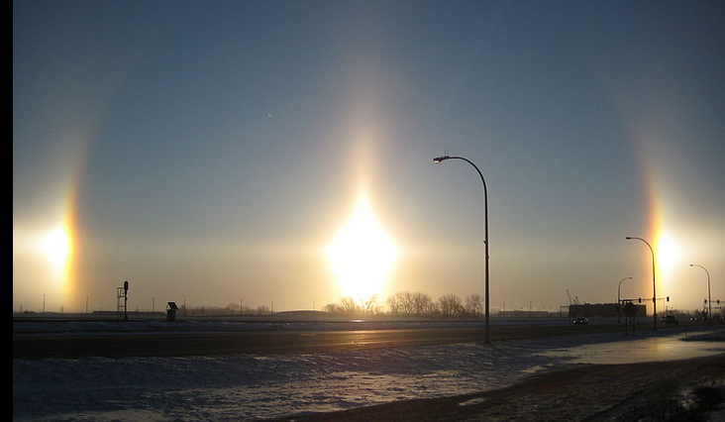
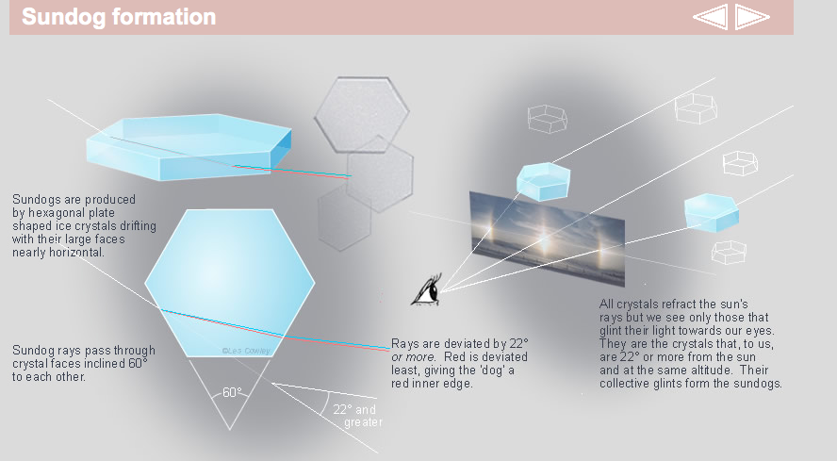

Slide 14
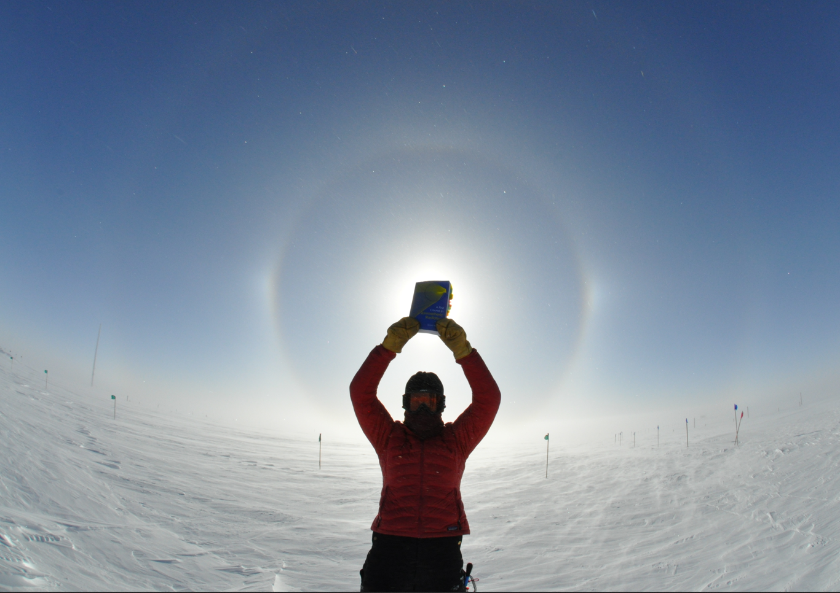


Slide 15
