Slide 1
Single-Scattering Stuff + petty chap 12 intro
April 27-29, 2015

Slide 2
Reminders
Project 2 due this Friday – Rob laid up but will answer emails, or come see me! (email first)
Homework 4 will be handed out soon, due Friday May 8.
Course evals likely Friday may 8 also.
Final Thursday May 14

Slide 3
Singly-scattered radiance
Downwelling Radiance at Surface:
direct beam
Upwelling Radiance At TOA:
Singly-scattered radiance
direct beam
In the limit of τ* << 1:
Singly-scattered radiance
direct beam

Slide 4
Limits of the approximation?
Thin aerosol layers, rayleigh atmosphere, optically thin clouds.
If the sun is too low on horizon, it will break.
If the view angle is too close to horizon, it will break.
If ωτ* >~ 0.5, it will break: i.e., most cloudy situations.

Slide 5
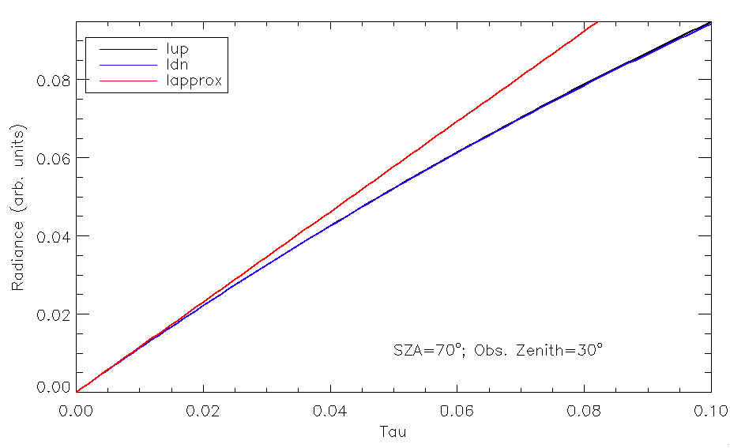
Single-Scattering Approximation: Behavior vs. Optical depth of scattering layer

Slide 6
Application
Let’s attempt to determine the clear-sky flux reflectivity of the atmosphere, due to Rayleigh-scattering of gas molecules in the atmopshere.
Result will depend strongly on wavelength, but we can solve it generally…
Will not worry about photons scattered off surface (just atmosphere).

Slide 7
Pieces to think about
How is F defined?: integral over a hemisphere of F mu.
How is flux reflectivity defined?: Fout/Fin

Slide 8
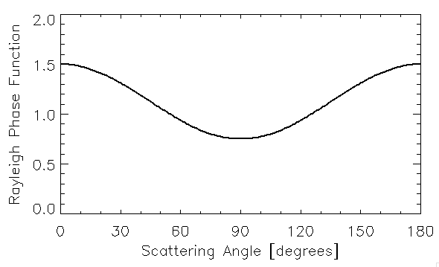

Back to Phase Function
“Asymmetry Parameter”
Equivalent to:

Slide 9

Useful phase function:
“Henyey-Greenstein Phase Function”
Function of g only
Not a “real” phase function – but can be useful in certain applications when the real phase function is too hard to deal with

Slide 10
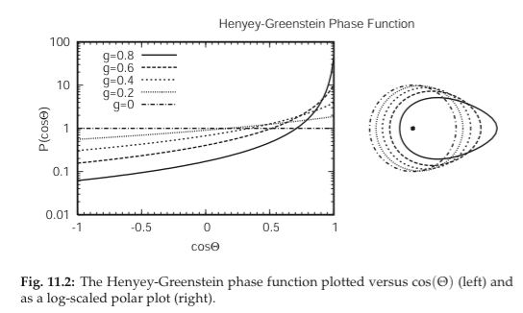
Useful phase function:
“Henyey-Greenstein Phase Function”
Function of g only
Not a “real” phase function – but can be useful in certain applications when the real phase function is too hard to deal with
Backward Scattering
Forward Scattering

Slide 11
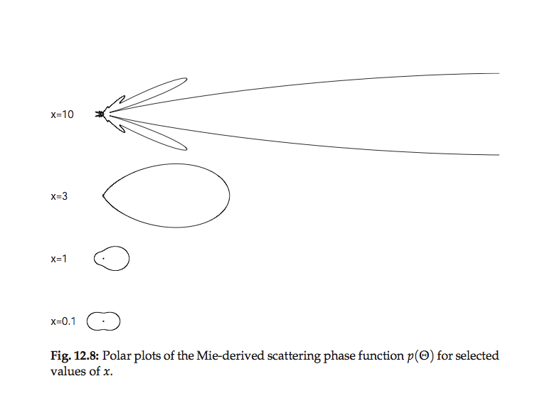

Slide 12
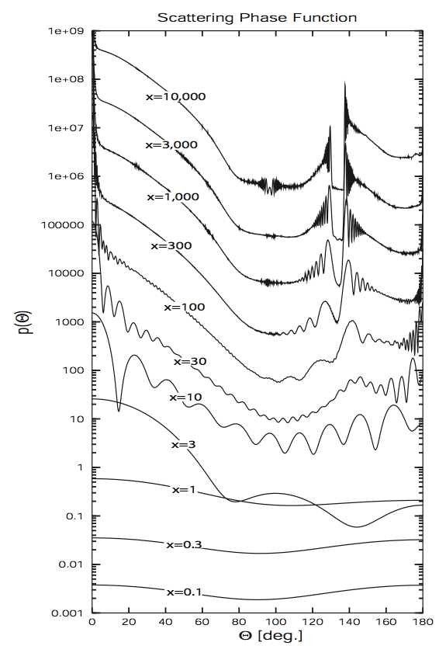
Phase Function of water spheres
(Mie theory)
High Asymmetry Parameter
Low Asymmetry Parameter

Slide 13
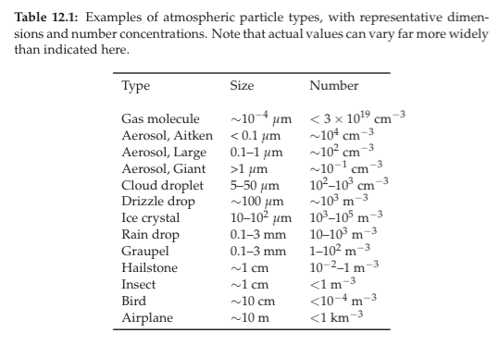
The range of atmospheric scatterers

Slide 14
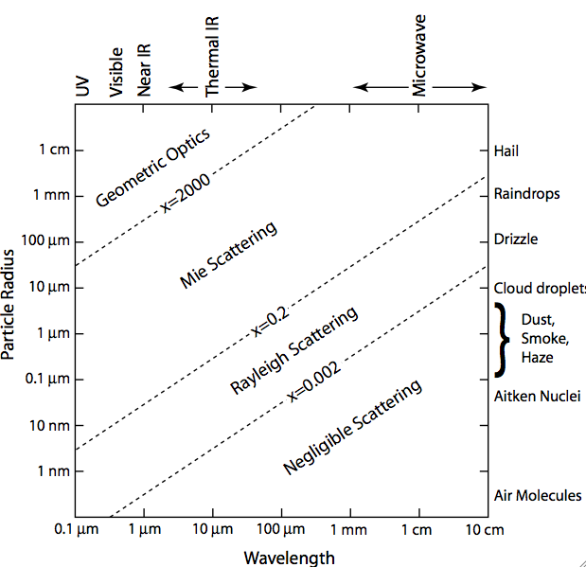
Scattering by particles: clouds, precip, aerosols, air
Intrinsic properties:
  Extinction efficiency
  single scattering albedo
  phase function
Extrinsic properties:
  Scattering optical depth
  Emissivity
  Spherical albedo
  Transmissivity

Slide 15
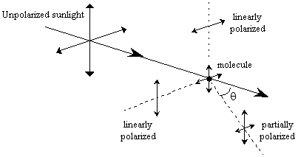
Rayleigh Scattering: Geometry & Polarization
Very small scatterer acts like a pure dipole!

Slide 16
Scattered electric field (polar plot)
Vertical Incoming Polarization
Horizontal Incoming Polarization
Incoming Light Unpolarized

Slide 17
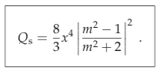

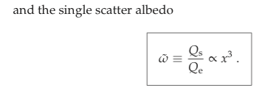
Rayleigh Optical Properties of a small sphere (x<<1)
(slightly more accurate equation in book)

Slide 18
The Rayleigh-regime Single Scattering Albedo
If imag(m) > 0, then there will be almost no scattering.
However, if imag(m) is tiny (<~ 1e-7), then there can be appreciable scattering.
For molecular (rayleigh scattering), it is in the “window” regime by definition – absorption is treated separated because they have such different wavelength-dependence – so ssa=1.

Slide 19
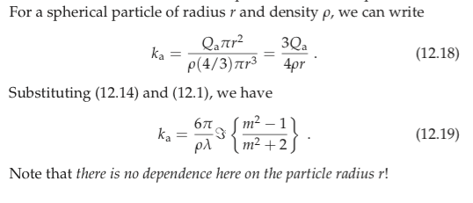
“Absorbing Rayleigh”
(e.g., cloud droplets in the microwave)
Cloud droplet radii: r = 10 μm (4-25 μm)
Microwave Wavelength: λ = 1 cm (0.2 – 5 cm)
x = 2πr/λ= 0.007
So τ_{cloud} = k_{a} • (Cloud Liquid water Path in kg m⁻²)

Slide 20
Mie Theory
Input
  Size parameter x of particle
  Relative index of refraction m (real, imaginary)
Output
  Qe, Qs, Qa, single-scattering Albedo
  6x6 “Phase Matrix” with 4 independent elements
  P(1,1) function is the Intensity phase function P(Θ)

Slide 22
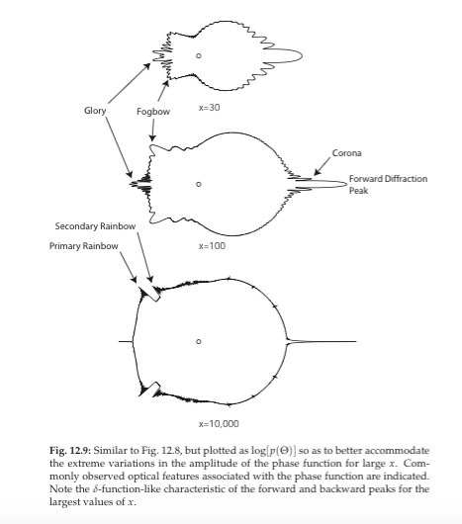

Slide 23
Phase Function of water spheres
(Mie theory)
High Asymmetry Parameter
Low Asymmetry Parameter

Slide 24
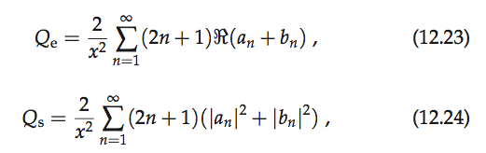
Mie Theory Results
Exact Qs, Qa for spheres of some x, m.
a, b coefficients are called “Mie Scattering coefficients”, functions of x & m. Easy to program up.
“bhmie” is a standard code to calculate Q-values in Mie theory.
Need to keep approximately x + 4x^{1/3} + 2 terms for convergence

Slide 25
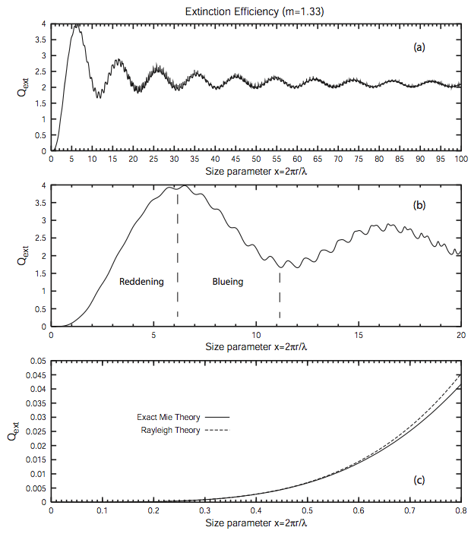
Q_{e} for NON-ABSORBING SPHERES

Slide 26
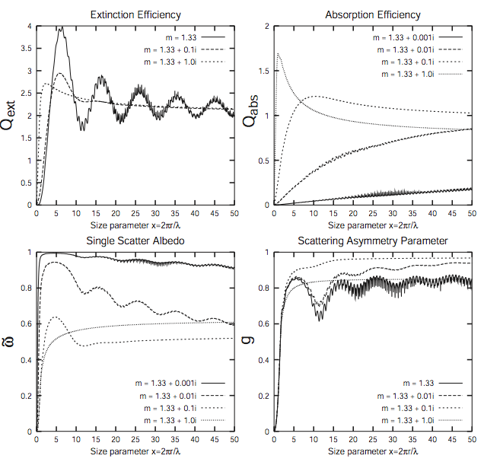
Mie Theory Results for ABSORBING SPHERES

Slide 27
Variations of SSA with wavelength
Somewhat Absorbing
Non-Absorbing!

Slide 28
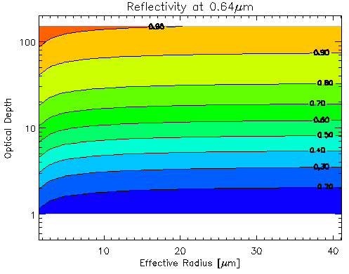
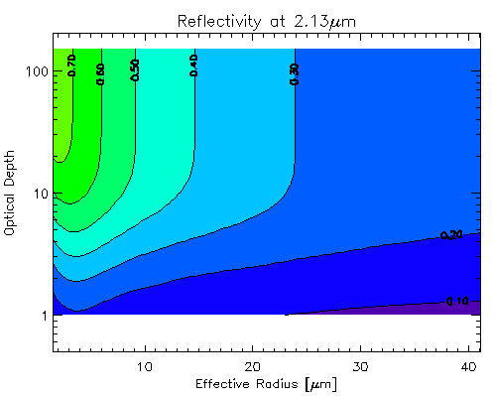
Satellite retrieve of cloud optical depth & effective radius
Non-absorbing Wavelength (SSA~1):
Reflectivity is mainly a function of optical depth.
Absorbing Wavelength (SSA < 1):
Reflectivity is mainly a function of cloud droplet size (for thicker clouds).

Slide 29
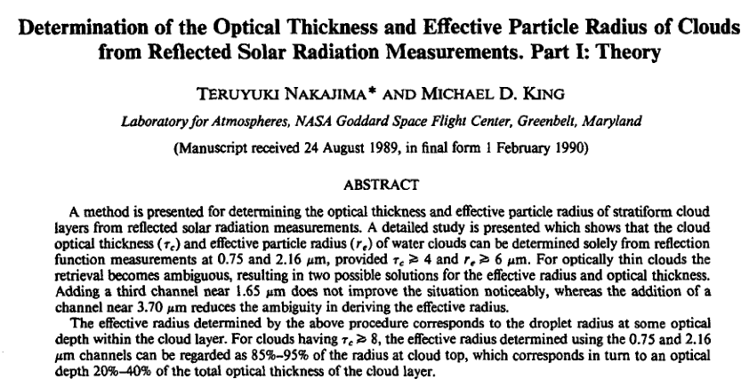
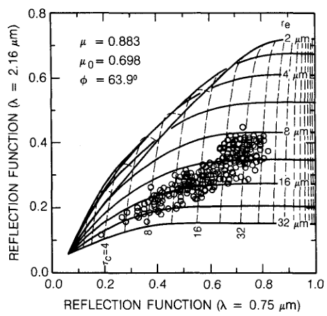

Slide 30
Distributions of Particles

Slide 31
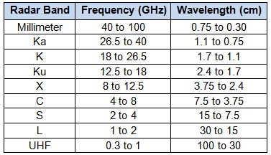
Radar Bands
Letters chosen during WWII. X-band so-named b/c it was kept secret during the war.

