Slide 1
Cloud Radiative Forcing equations

Slide 2
SHORTWAVE CRF: ~ Same for low & high clouds, at all locations:
where
LONGWAVE CRF: ~ Depends on Cloud Top Height & TOA vs. Surface

Slide 3
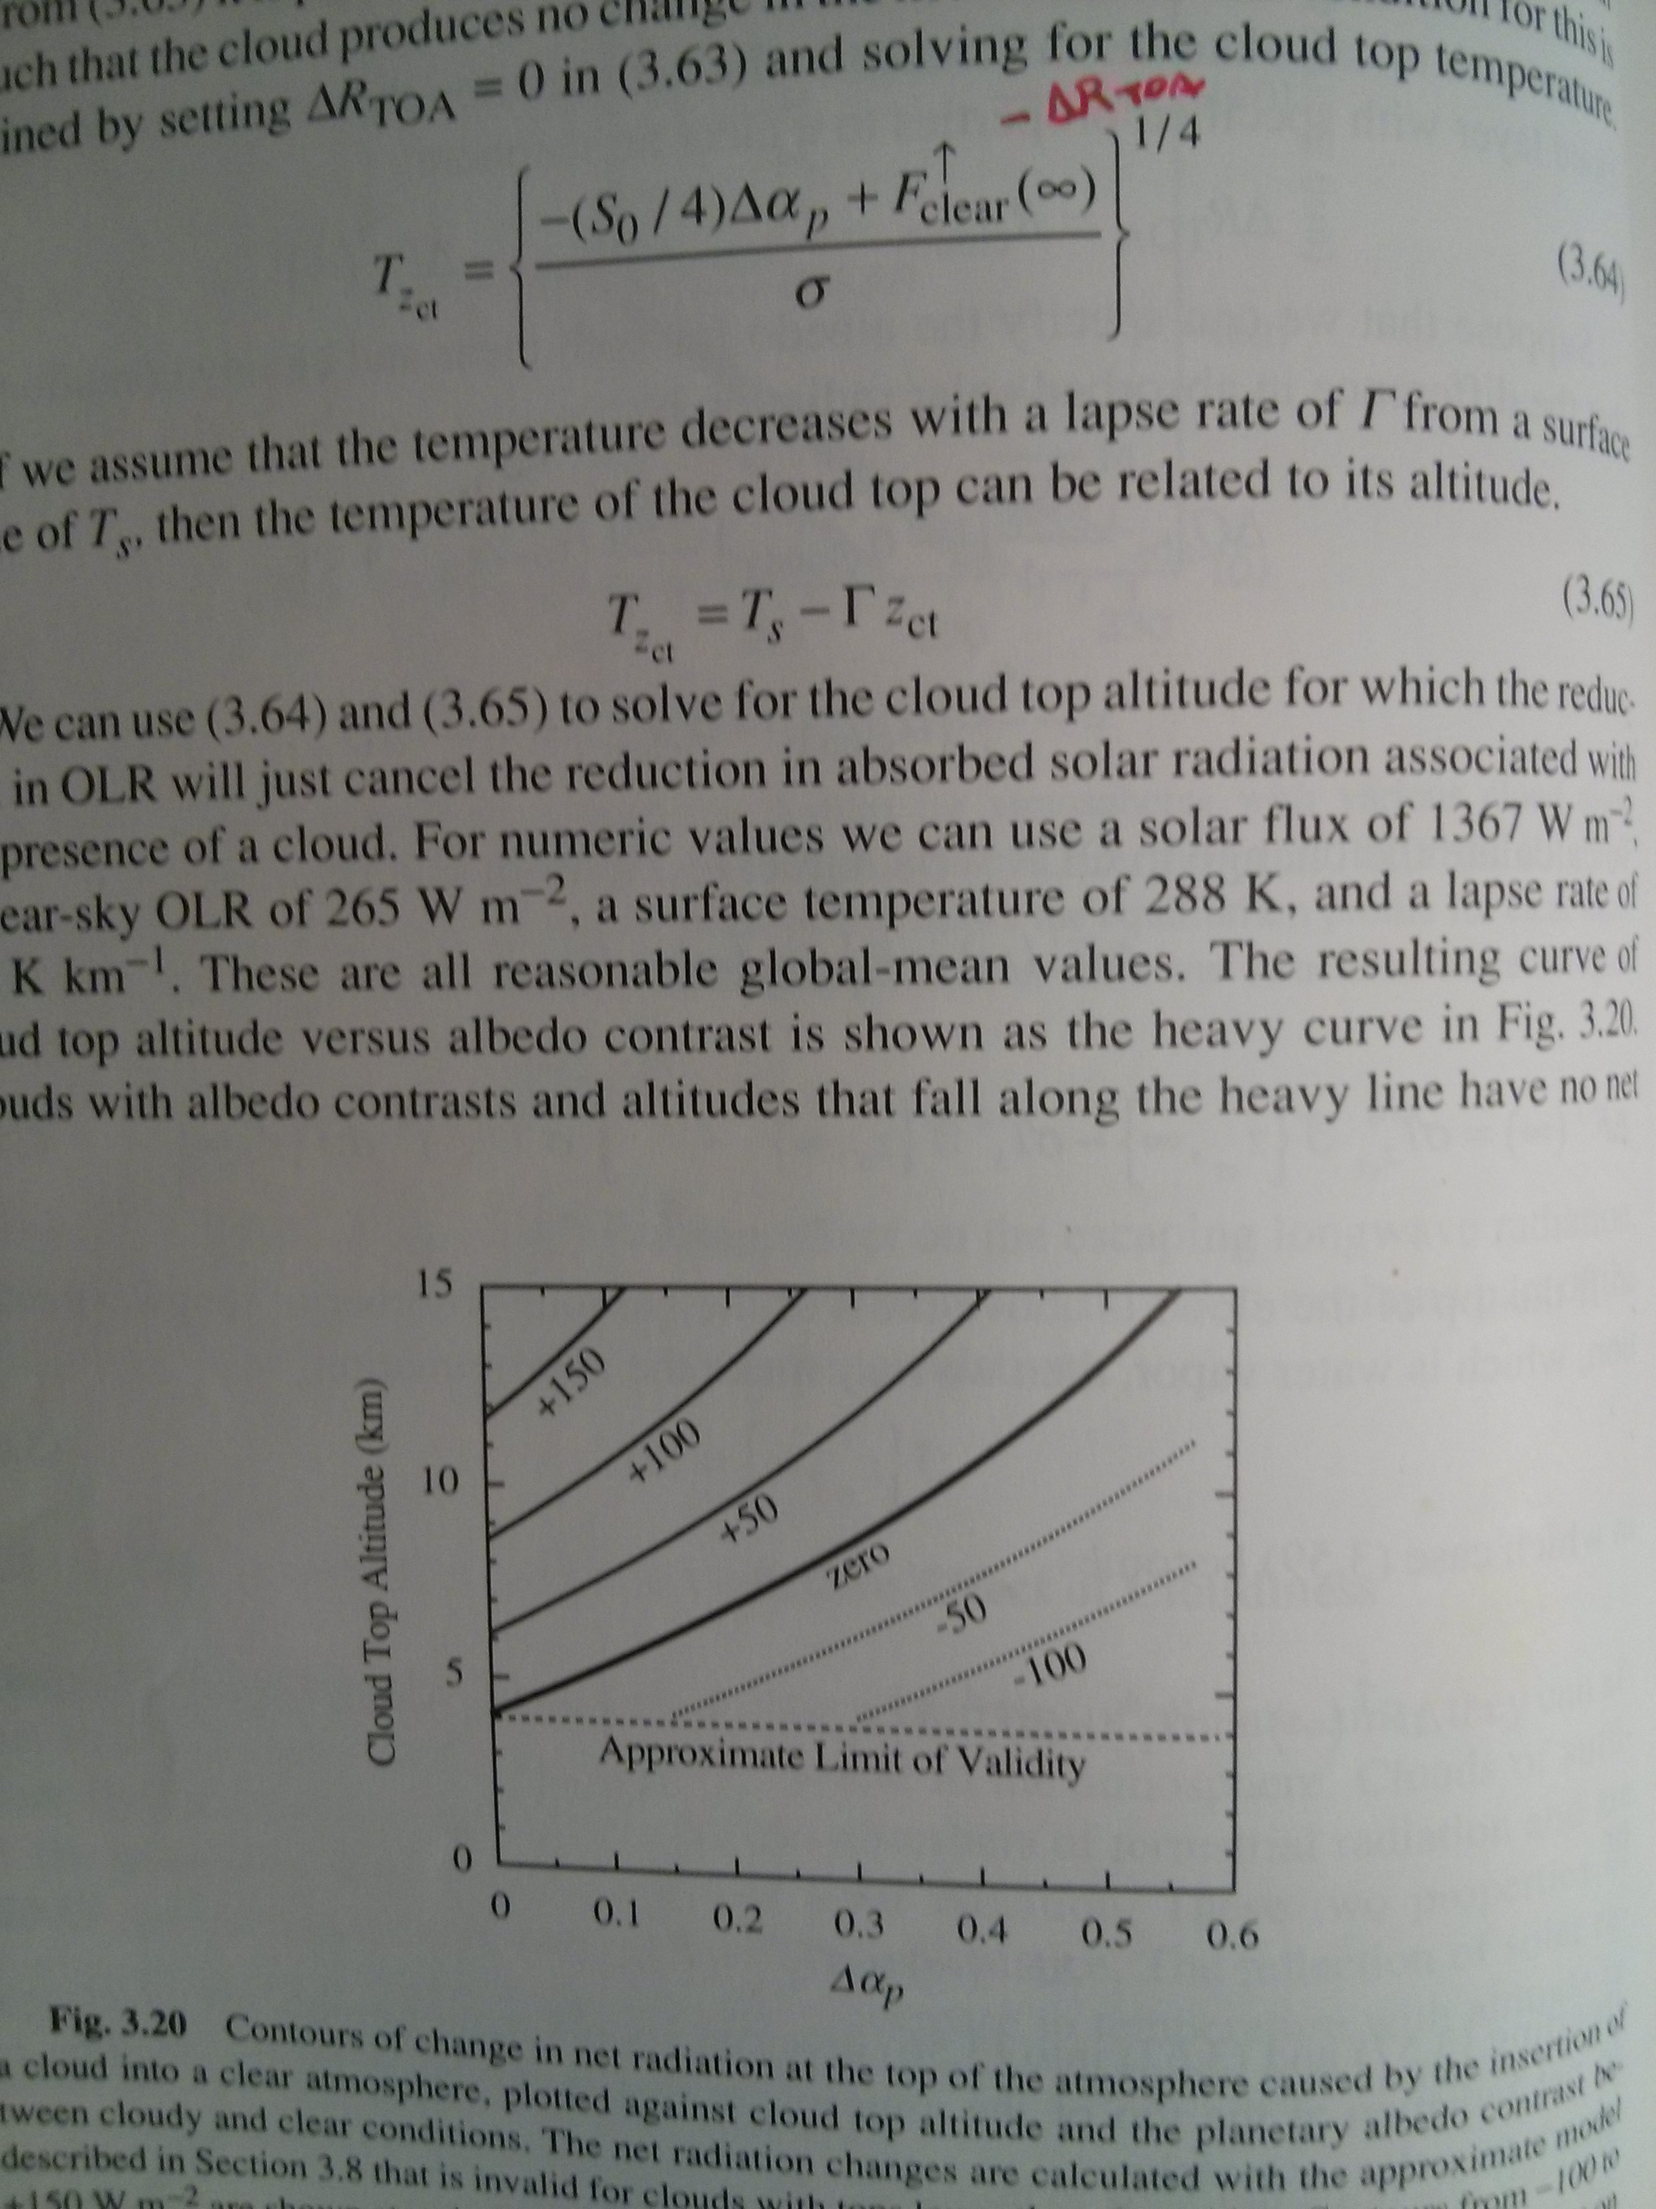

Slide 4
Two examples
Atmosphere
Ra = 0; ε=0.8; T=255 K
High Cloud:
Rc = 0.2; ε=1; T=220 K
Low Cloud:
Rc = 0.5; ε=1; T=280 K
Forcing SW: -36 W/m² LW: +137 W/m² NET: +101 W/m²
TOA
Surface
Surface:
Rg = 0.3; ε=1; T=288 K

Slide 5
Two examples
Atmosphere
Ra = 0; ε=0.8; T=255 K
High Cloud:
Rc = 0.2; ε=1; T=220 K
Low Cloud:
Rc = 0.5; ε=1; T=280 K
Forcing SW: -36 W/m² LW: +137 W/m² NET: +101 W/m²
Forcing SW: -36 W/m² LW: +27 W/m² NET: -9 W/m²
TOA
Surface
Surface:
Rg = 0.3; ε=1; T=288 K

Slide 6
Two examples
Atmosphere
Ra = 0; ε=0.8; T=255 K
High Cloud:
Rc = 0.2; ε=1; T=220 K
Low Cloud:
Rc = 0.5; ε=1; T=280 K
Forcing SW: -36 W/m² LW: +137 W/m² NET: +101 W/m² | Forcing SW: -99 W/m² LW: +8 W/m² NET: -90 W/m²
Forcing SW: -36 W/m² LW: +27 W/m² NET: -9 W/m²
TOA
Surface
Surface:
Rg = 0.3; ε=1; T=288 K

Slide 7
Two examples
Atmosphere
Ra = 0; ε=0.8; T=255 K
High Cloud:
Rc = 0.2; ε=1; T=220 K
Low Cloud:
Rc = 0.5; ε=1; T=280 K
Forcing SW: -36 W/m² LW: +137 W/m² NET: +101 W/m² | Forcing SW: -99 W/m² LW: +8 W/m² NET: -90 W/m²
Forcing SW: -36 W/m² LW: +27 W/m² NET: -9 W/m² | Forcing SW: -99 W/m² LW: +157 W/m² NET: +58 W/m²
TOA
Surface
Surface:
Rg = 0.3; ε=1; T=288 K

Slide 8
To be more realistic
SW forcing will depend on solar zenith angle
Clouds absorb some SW radiation (NIR)
Clear atmosphere absorbs some shortwave radiation
Atmospheric emission temp is different in downwelling vs. upwelling direction

