Slide 1
AT622 Introduction
Jan 23, 2013

Slide 2
Nearly all energy on earth ultimately comes from sun.
There is an approximate equilibrium between absorbed solar radiation, keeping the earth’s temperature (approximately) constant.
Radiation is emitted in the longwave – we’ll discuss why.

Slide 3
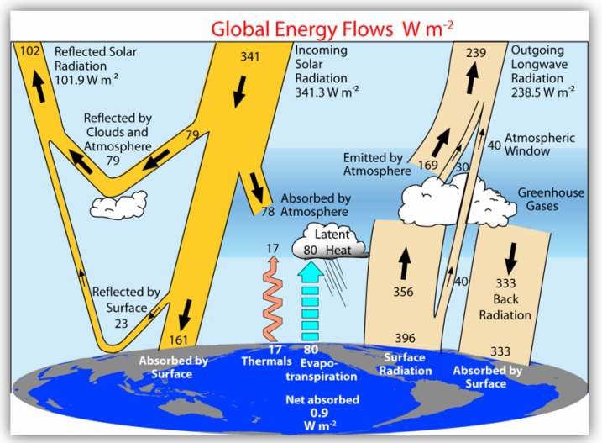
Earth’s Energy Balance
At the surface, the energy balance is :
+161 absorbed solar
-396 emitted longwave
+333 absorbed “back-radiation”
- 17 Thermals (sensible heat)
- 80 Evapotranpsiration (latent heat)
80 W/m² evaporated into h2o vapor
Because E ≈ P, 80 W/m² released by precip.
→ 3 mm/day global average precip.
Can learn about the hydrologic cycle directly from radiation budgets!

Slide 4
Earth’s Energy Balance
At TOA: 341.3-101.9-238.5 = +0.9 W/m²
→ Driving Global warming!

Slide 5
Latitudinal distribution of radiation

Slide 6
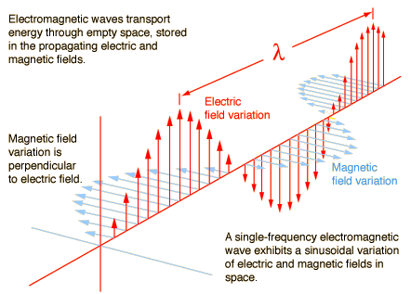
The nature of radiation
Maxwell’s equations
Wave equations
Energy quantization
Particles vs. Waves
The E-M spectrum
Polarization

Slide 7
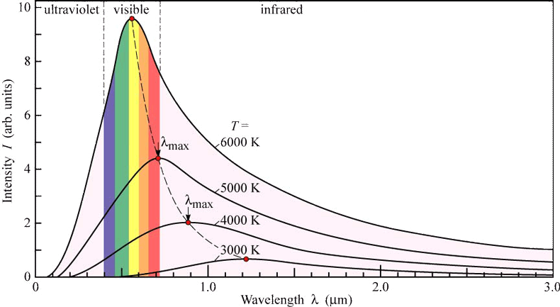

Blackbody radiation

Slide 8
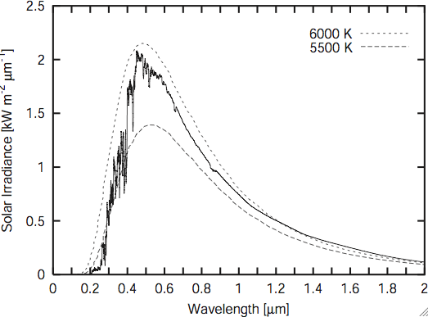
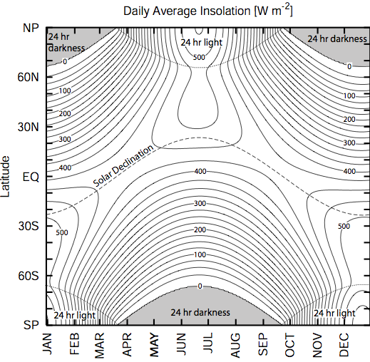
The Sun
Solar Spectrum
Solar Flux Distribution

Slide 9
The Greenhouse Effect
Simple energy balance calculations to show that forcing → ~ 1 K for every 4 W/m² of forcing in the absence of feedbacks
LATER: How doubling CO₂ increases forcing by ~ 4/m² .

Slide 10
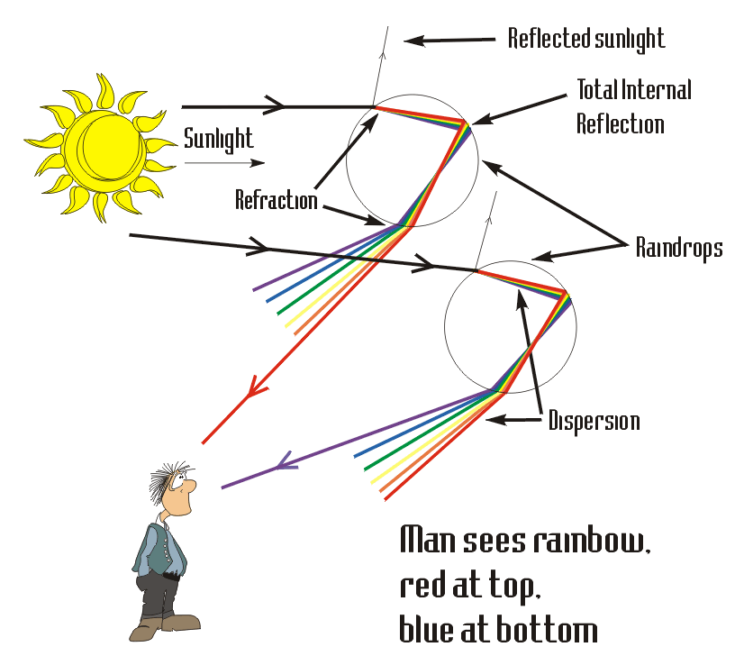
EM Radiation in Matter
Reflection & Refraction at a boundary
Absorption / Emission (by gases & particles)
Scattering of radiation by particles

Slide 11
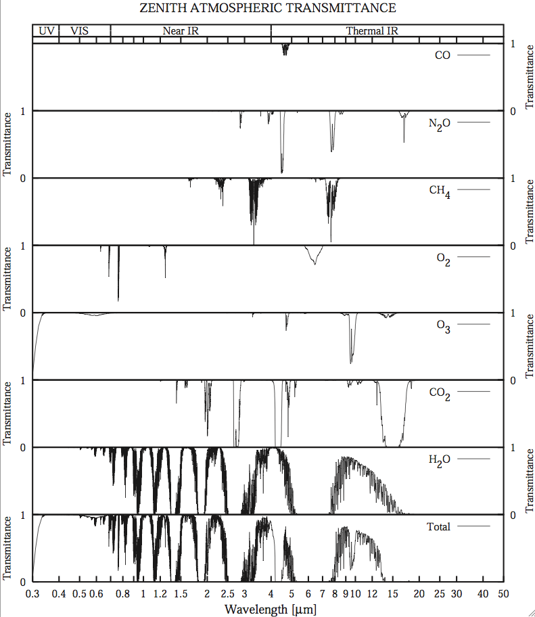
Absorption by Gases
Absorption lines in gases – how does this work?
Line broadening (pressure & doppler)
Global warming potentials
The Gray-body approximation
Use of Line-by-line approaches such as MODTRAN, HITRAN

Slide 12
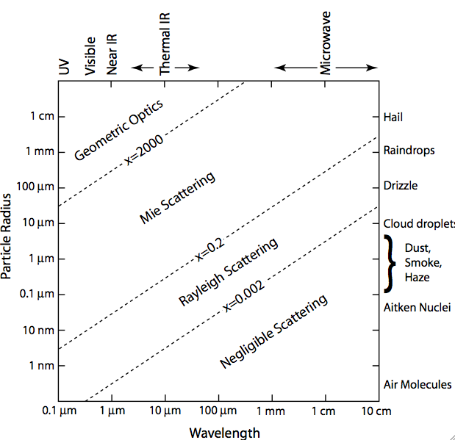
Scattering by particles: clouds, precip, aerosols, air
Intrinsic properties:
  Extinction efficiency
  single scattering albedo
  phase function
Extrinsic properties:
  Scattering optical depth
  Emissivity
  Spherical albedo
  Transmissivity

Slide 13
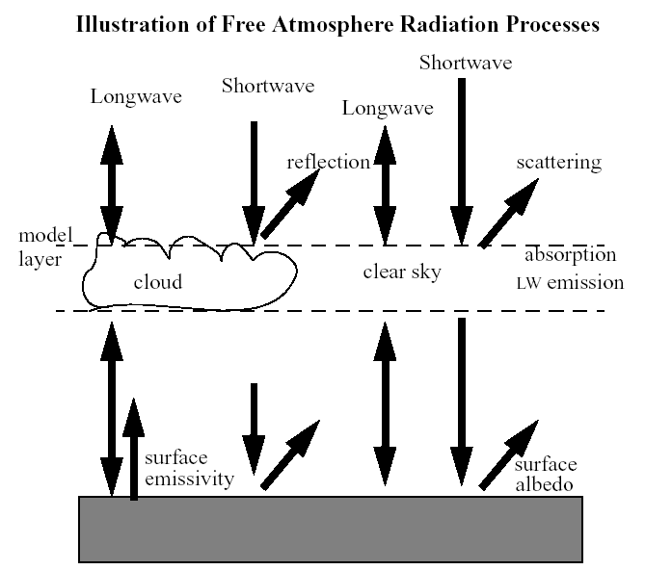
Radiative Transfer
Transmission-only
With emission sources (infrared, Microwave): EASY
With solar source ( UV/Visible/Near-IR)
With scattering (HARD)

Slide 14
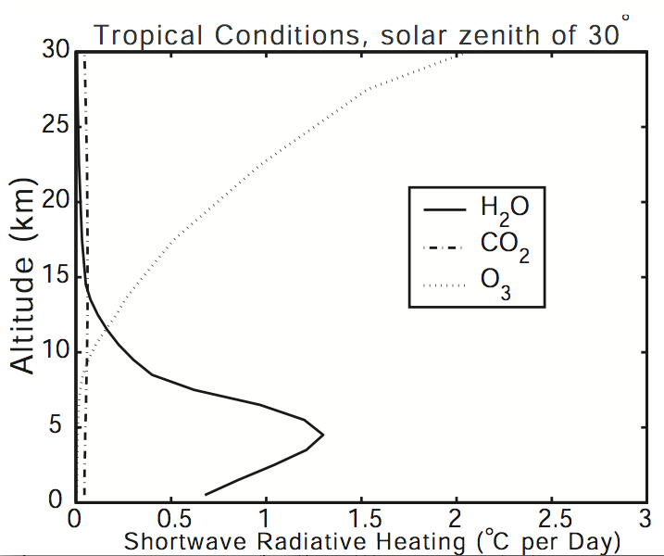
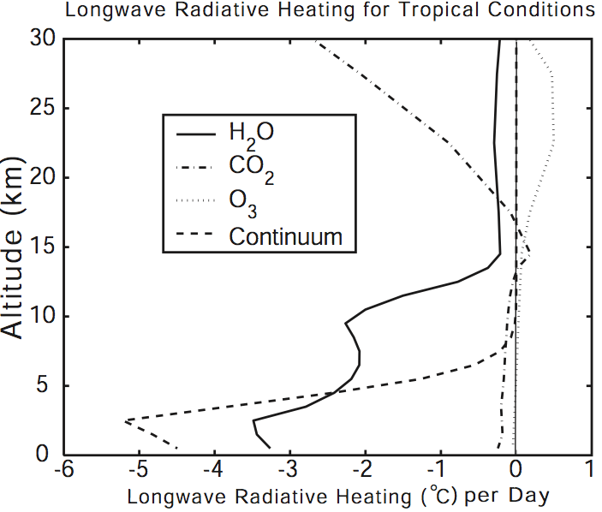
Fluxes & heating rates

Slide 15
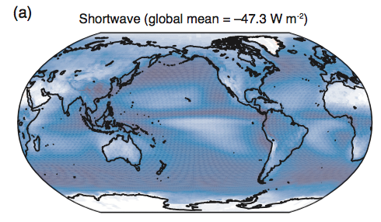
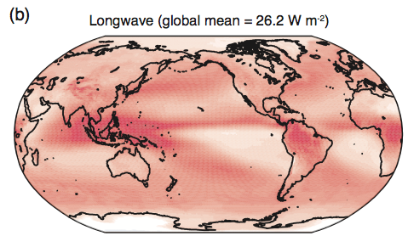
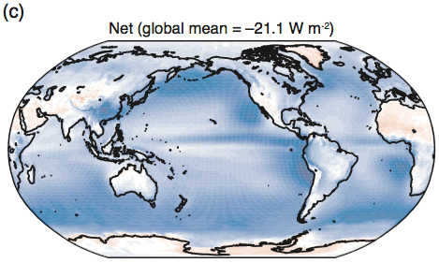

Cloud Forcing
Clouds mostly reflect shortwave (cooling), and trap longwave (warming).
Balance between these due to height and properties of the cloud, and of the surface underneath!
Large impacts on both short timescales (weather) and long timescales (climate)

Slide 16
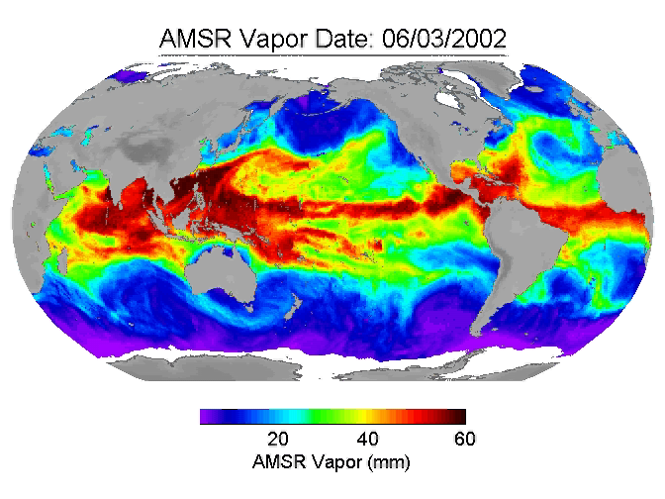
Applications to remote sensing

Slide 17
This class is for you!
If you would like to learn about something that is not listed, ask me and we can talk about it!
ATS652: Introduction to remote sensing
ATS721 : Advanced remote sensing & radiative transfer techniques
ATS753 : Global Hydrologic Cycle

Slide 18
Logistics
Website: http://reef.atmos.colostate.edu/~odell/at622
TA’s : Rob Nelson (course) & Alex Goodman (programming)
Grading: 25% homework (x4), projects (x2), mid-terms (x2), final.
Work through Petty’s book, supplement with Stephens’ original 622 notes.
Tests: 8:30am or 2pm of same day (vote).
Missed classes either filled in by others or made up. Make-up Preference? (8:35am start or Friday afternoons 2pm).
Names / advisors / thoughts.

