Slide 1
RT solution methods

Slide 2
Review: What are we doing again?
Divide vertical, plane-parallel atmosphere up into approximately homogeneous sections.
Calculate (composite) optical properties of each layer: τ, ϖ, PF(Θ) at some wavelength λ. Monochhromatic!!
Goal: Calculate Total Intensities in any direction (θ,ϕ) at any τ(z). Typically τ=0, and τ=τ* (surface & TOA).
Sum over mu-weighted intensities to calculate (monochromatic) fluxes if desired.
I⁺_{TOA}(θ,ϕ)
τ₁, ϖ₁, PF₁(Θ)
τ₂, ϖ₂, PF₂(Θ)
…
…
τ_{n}, ϖ_{n}, PF_{n}(Θ)

Slide 3
Review: What are we doing again?
Divide vertical, plane-parallel atmosphere up into approximately homogeneous sections.
Calculate (composite) optical properties of each layer: τ, ϖ, PF(Θ) at some wavelength λ. Monochhromatic!!
Goal: Calculate Total Intensities in any direction (θ,ϕ) at any τ(z). Typically τ=0, and τ=τ* (surface & TOA).
Sum over mu-weighted intensities to calculate (monochromatic) fluxes if desired.
I⁺_{TOA}(θ,ϕ)
τ₁, ϖ₁, PF₁(Θ)
τ₂, ϖ₂, PF₂(Θ)
…
…
τ_{n}, ϖ_{n}, PF_{n}(Θ)

Slide 4
How do we do it? “Adding-Doubling”
STEPS
(for a given azimuthal moment m)
Use Doubling to calculate the properties R,T,s⁺,s⁻ from the optical properties τ₁, ϖ₁, PF₁(Θ) of each homogeneous layer.
Note: The source terms s⁺, s⁻ can include both thermal and solar contributions.
Use Adding to calculate R_{ab}, R_{ba}, T_{ab}, T_{ba}, s⁺,s⁻ of the full atmosphere.
Calculate the surface reflectance matrix R_{g} and source s⁺_{g} (thermal+solar).
Combine the atmosphere & surface to calculate I_{m}(μ) upwelling at TOA and downwelling at surface.
Calculate I in any direction upwelling@TOA, downwelling@surf:

Slide 5
So what did we calculate?
Monochromatic Intensity I_{λ} at chosen observation angles (θ,ϕ) at surface (upwelling) or TOA (downwelling)
Easily extended to calculate at any level in atmosphere.
Can easily calculate fluxes from I_{m=0} quantities.
Would need to repeat this for multiple wavelengths.
We assumed Plane-Parallel!
We only calculated Total Intensity I, not polarization!!

Slide 6
DISORT : 1988
First really stable, easily available full scattering code (in Fortran 77)
Many codes are derivatives of this in one way or another since then.
And some people still use it!

Slide 7
Wiscombe RT contributions
DISORT - first publicly available N-stream multiple-scattering solar+thermal code.
Delta-Eddington for climate calculations
Fast, Stable Mie calculations, especially for large size parameter x (100-1000).
Delta-M phase function similarity transformation for large particle scattering (large forward scattering peak)
Adding-doubling and doubling initialization
Now he studies climate and exoplanets at NASA-Goddard.

Slide 8
Wiscombe RT contributions
DISORT - first publicly available N-stream multiple-scattering solar+thermal code.
Delta-Eddington for climate calculations
Fast, Stable Mie calculations, especially for large size parameter x (100-1000).
Delta-M phase function similarity transformation for large particle scattering (large forward scattering peak)
General doubling rules for variable temperature and solar sources.
Thin-layer initialization for doubling
Now he studies climate and exoplanets at NASA-Goddard.

Slide 9
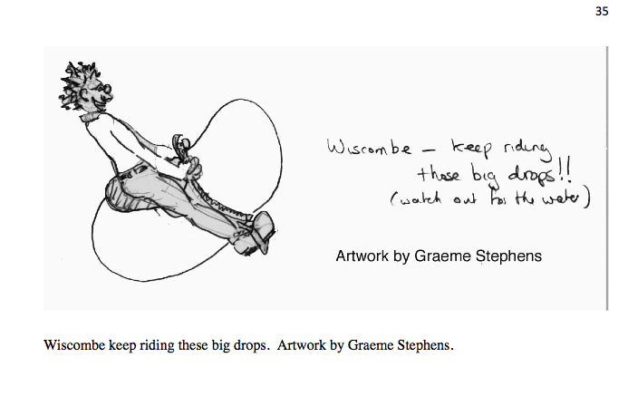

Slide 10
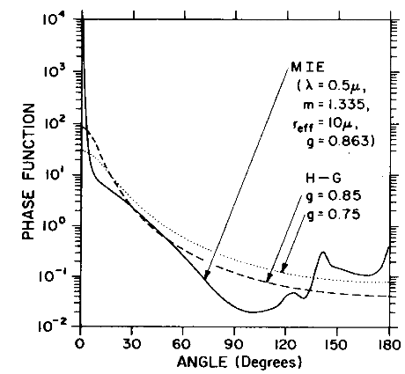
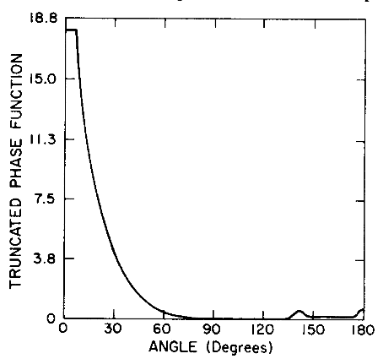
Similarity Transformations: “Delta scaling”
For Highly forward-peaked phase functions (i.e., large size parameter x)
Water cloud phase function, 500 nm
“Truncation and renormalization”

Slide 11
Similarity Transformations: “Delta scaling”
Delta-M scaling introduced by Wiscombe much more robust.
* Notes taken from K.F. Evans, http://nit.colorado.edu/atoc5560/

Slide 12
Similarity Transformations: “Delta scaling”
*Note that these χ_{l} values are in the “Wiscombe” convention, where:

Slide 13
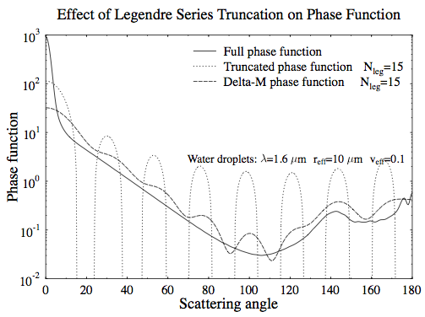
Similarity Transformations: “Delta scaling”

Slide 14
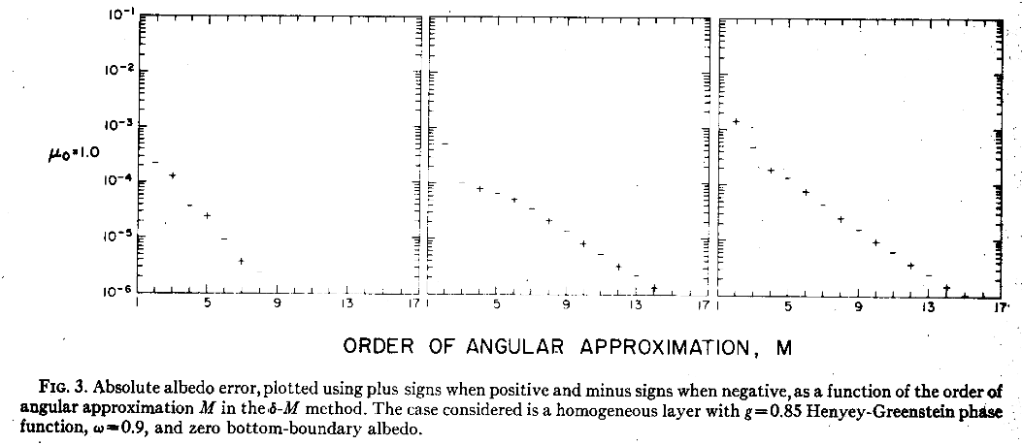
Similarity Transformations: “Delta scaling”
Can have nontrivial (few %) errors for solar radiances, but is very accurate for fluxes.
Still the errors are almost always much larger when you don’t use it!
An simple improvement introduced by Najakima & Tanaka (1988) reduces the intensity errors to ~0.1%.

Slide 15
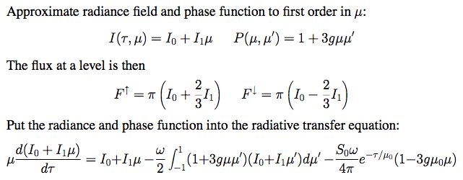
The Eddington Approximation
This is analytically solvable for I₀ and I₁. Solutions look like:

Slide 16
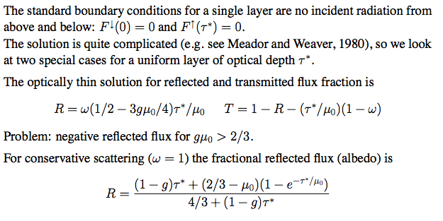
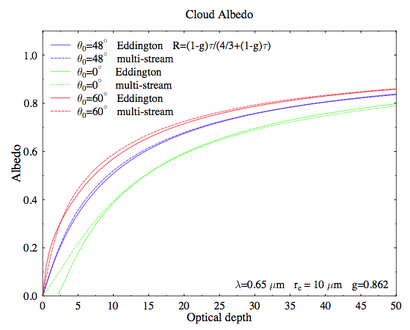

Slide 17
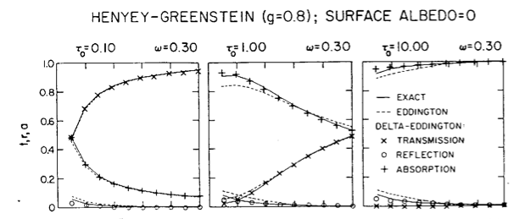
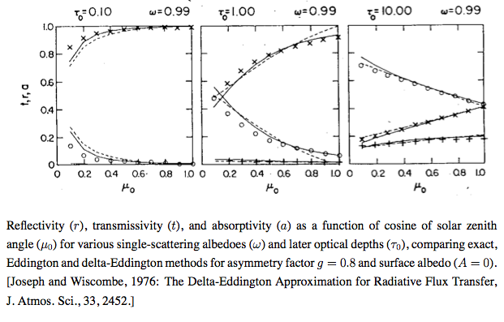
The Delta-Eddington approximation is exactly this but using Delta-Scaling for f=g².

Slide 18
“Successive Orders of Scattering” aka
Neumann’s iterative solution

Slide 19
“Successive Orders of Scattering”
Keep track of # of times a stream is scattered.
Usually cut off after radiance at some location and angle has stopped changed.
For small amounts of scattering, will be small.
For large amounts of scattering, may have to keep track of 100s of scattering “orders”
IMPLEMENTATION
Divide layers into small enough layers so the source function of each layer does NOT require multiple scattering.
Use principle of interaction to propagate radiation.
Often is slow, especially for highly scattering atmospheres.

Slide 20
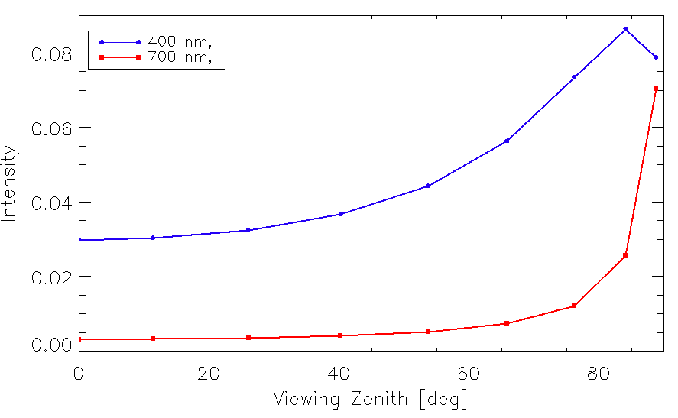
Rayleigh scattering
How many times is light scattered in a clear sky that reaches our eye?

Slide 21
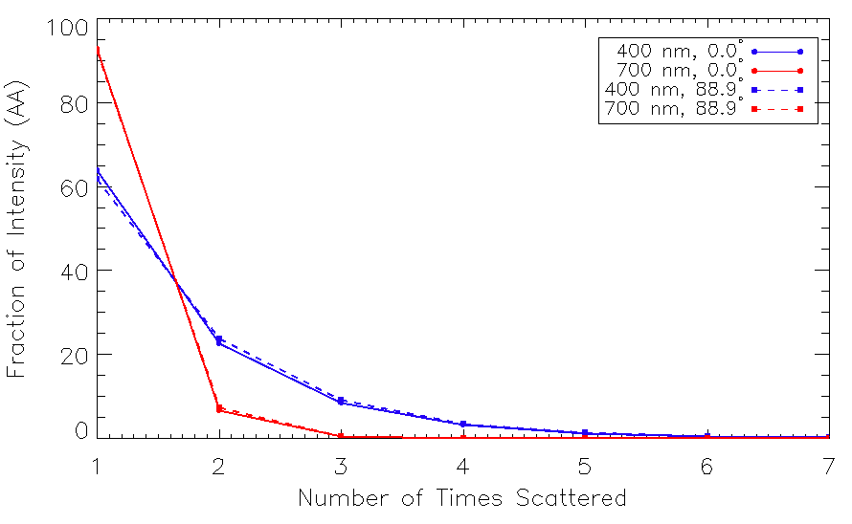
Rayleigh scattering
How many times is light scattered in a clear sky that reaches our eye?

Slide 22
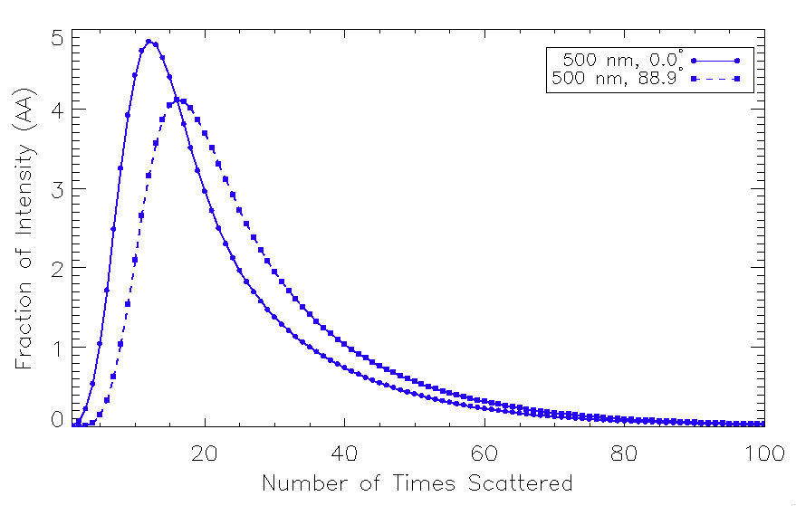
Cloud Scattering
Cloud with Optical Depth = 10, ϖ=1, g=0.85.
Downwelling Intensity (aziumthally-aveaged)

Slide 23
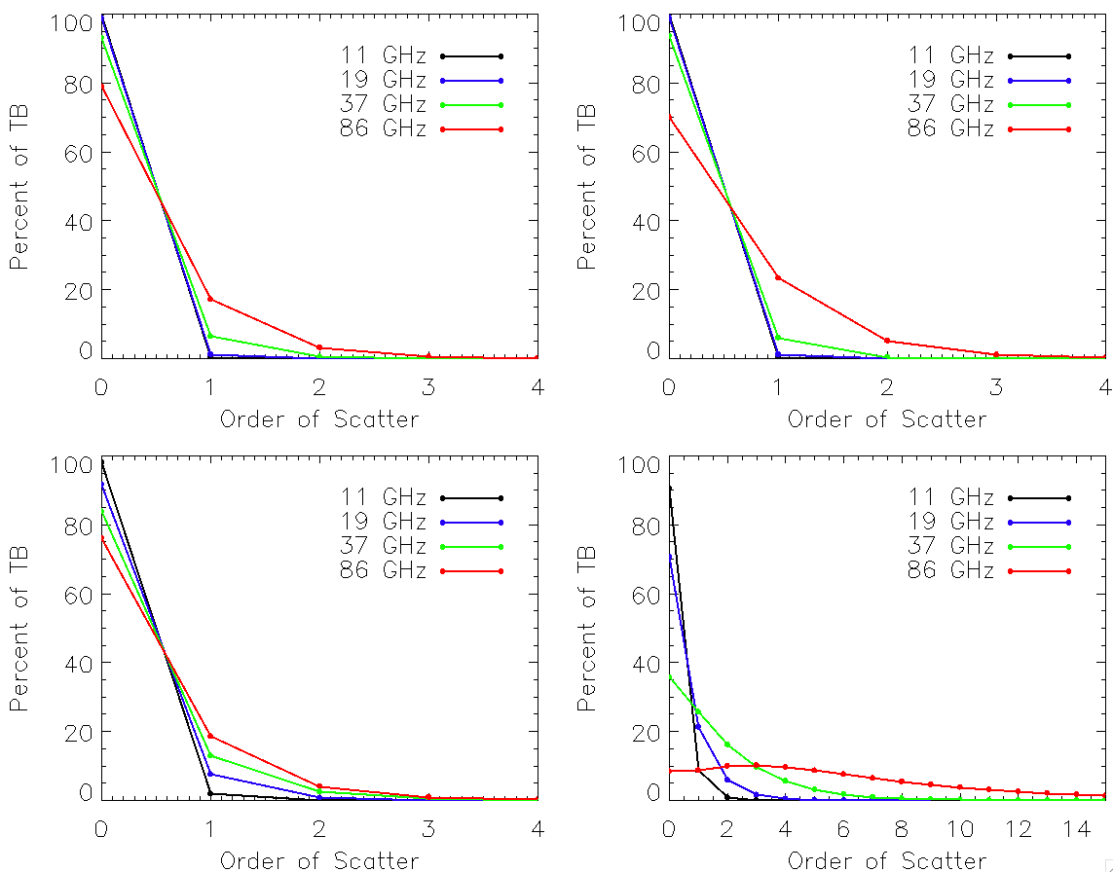
Microwave Rain Cases (Smith et al 2002, IEEE)
Case 1:
Low water, low ice
~ 1 mm/hr
Case 2:
Low water, high ice
~ 0.3 mm/hr
Case 3:
High water, low ice
~ 10 mm/hr
Case 4:
High water,High ice
~ 90 mm/hr
* Note that surface reflection does NOT change the order of scattering in this case; only atmospheric scattering does.

Slide 24
Other Techniques: What can they do?
Some are 1D plane-parallel, quadrature-type methods simply to speed up the calculations:
“Eigenmatrix” Approach to find R, T of a homogeneous layer with larger optical depth (much faster than doubling)
Analytic solution available for 4-stream methods (Liou, 1980s)
Work here to speed up the eigenmatrix technique with “Pade Approximants” (McGarragh & Gabriel, 2010, 2013)
Delta-Eddington / Analytic 2-stream : very, very fast!
Some give you derivatives as well
“Tangent-Linear”: Change of the output with a given set of small input changes.
“Adjoint” : How much would each input need to change to yield a prescribed change in the output?
These are needed typically in many retrieval algorithms as well as data assimilation.

Slide 25
Other Techniques: What can they do?
Some provide additional insights:
Successive order of scattering provides how the radiance is distributed vs. scattering order.
Some codes give you radiances at intermediate levels- useful for varying aircraft observations.
Some codes are optimized for (spectral) fluxes rather than radiances.
1D Monte-Carlo codes calculate the same quantities but are excellent as “truth” or a benchmark. Can make very pretty pictures of scattering as well!!

Slide 26
Monte-Carlo Techniques
Forward methods (generally solar only) launch photons from the sun and track them wherever they go.
If a photon makes it through a layer. If so, keep going.
If not, did it get absorbed or scattered? A new r.
r < ϖ : scattered. r > ϖ : absorbed.
If scattered, which direction did it go? Must know the Cumulative Probability of scattering less than a certain angle, based on the layer’s scattering phase function.
Can spin the emergent direction arbitrarily on (0,2π) about the incoming direction. So select a relative azimuth on (0, 2π)
Repeat until photon absorbed, or makes it out.
If made it out, record direction
Number of photons per unit solid angle emerging in a given direction is proportional to intensity.
Can also be used for 3D calculations.
Output error is proportional to 1/sqrt(N), where N is the number of photons launched.

Slide 27
Reverse Monte-Carlo
Forward Monte-Carlo: most of the photons we launched are not interesting to us as they would not have made it to our detector. But if we care about the distribution of all photons – this is the way to go!
Reverse Monte-Carlo launches photons from the sensor rather than the sun, so needs far fewer photons to calculate the intensity in a given observation direction.
Works well in the thermal IR / microwave (azimuthal symmetry simplifies some of the calculations).
Can also be extended into the solar.

Slide 28
Reverse Monte-Carlo
Uses “time-reversal symmetry” of photons / RT equation: Photons travelling backwards in time act exactly the same as travelling forwards!
Launch photons from a sensor in the direction of observation.
Do everything pretty much the same, but this way only the photons you care about count.
For thermal: when it is absorbed at the atmosphere or surface, we know “where that photon came from” and assign it B_{λ}(T), for the temperature where it got absorbed.
Works well for 3D!

Slide 29
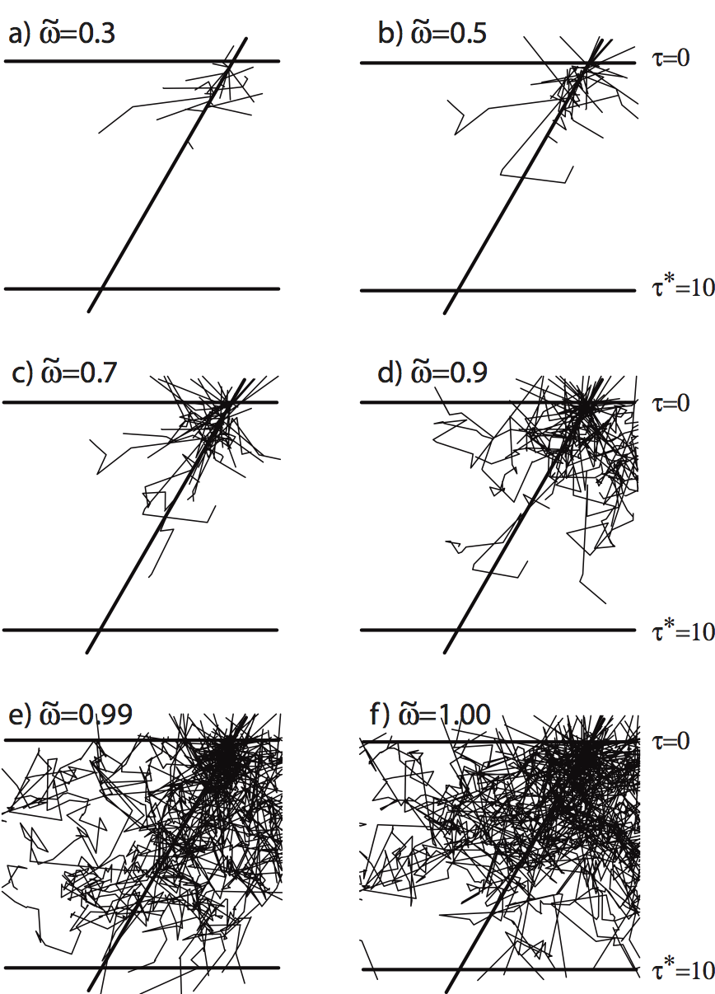
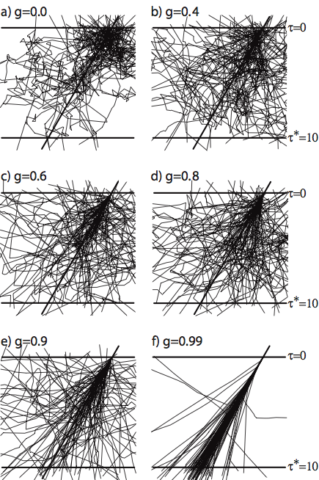
Monte-Carlo depictions of photons incident on an optical depth cloud layer

Slide 30
Other Techniques: What can they do?
Some solve much harder problems:
3D methods – Can deal with horizontal inhomogeneity.
Independent Pixel Approximation
Slant Methods
Full 3D with horizontal photon transport.
Vector calculations: Include effects of polarization, calculate Stokes vectors.
Matrices generally becomes (4n, 4n) instead of (n,n)
Calculations become ~ 100x slower typically!
Curvature of Atmosphere
Important for very oblique or limb observations. (>80 deg)
“Pseudo-spherical” approximation is typical.

Slide 31
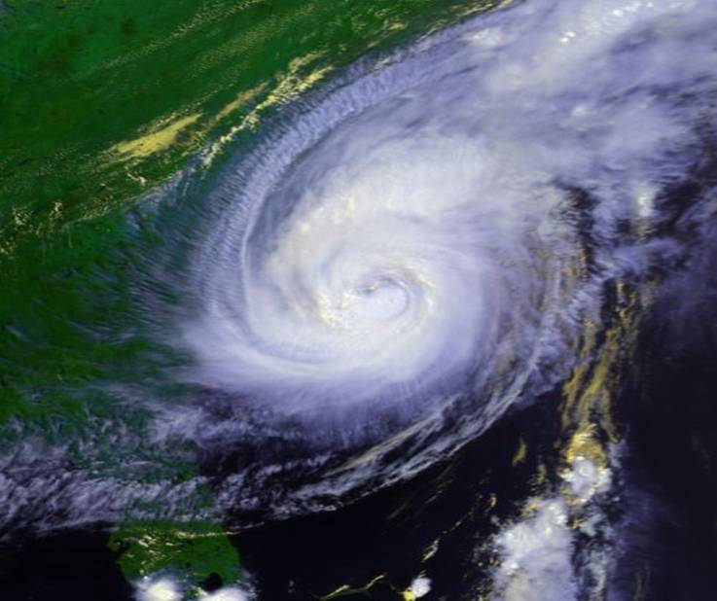
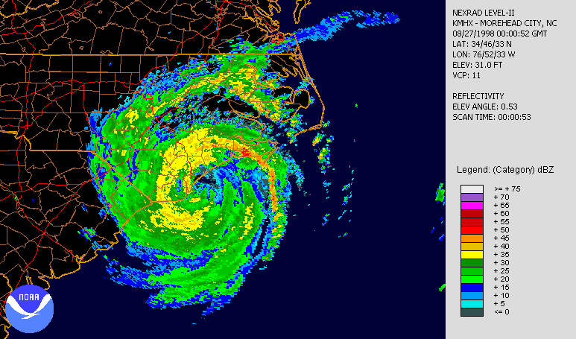
3D effects example: Hurricane Bonnie (1998)

Slide 32
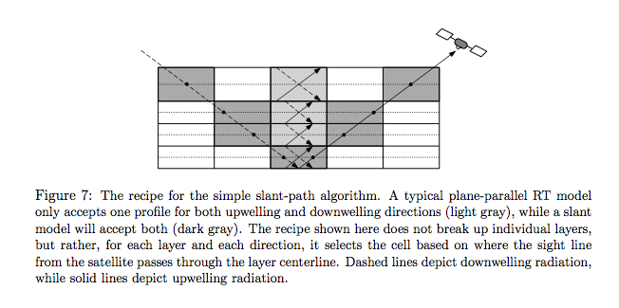
3D effects in the microwave

Slide 33
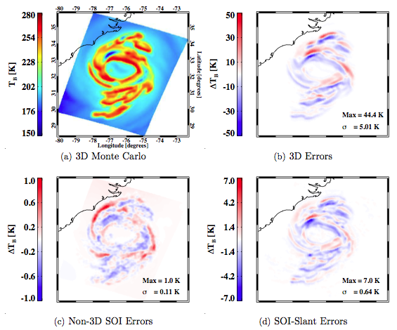
3D effects Example: Hurricane Bonnie
Notes:
TB’s of a Hurricane Bonnie simulation from the UWNMS mesoscale model at 36.5 GHz, using four different radiative transfer models. All domains have been convolved with a 12 km FWHM beam footprint, corresponding to a good instrument resolution at this frequency. Top left: “truth” (3D Monte Carlo) model. Top right: Errors in plane-parallel SOI model as compared with the 3D Monte Carlo. Bottom left: Errors in 1D SOI model as compared with 1D (plane parallel) Monte Carlo. Bottom right: Errors in SOI-Slant as compared with the 3D Monte Carlo. It can be seen that the 3D errors are reduced by ∼ 85% by the SOI-Slant model.

Slide 34
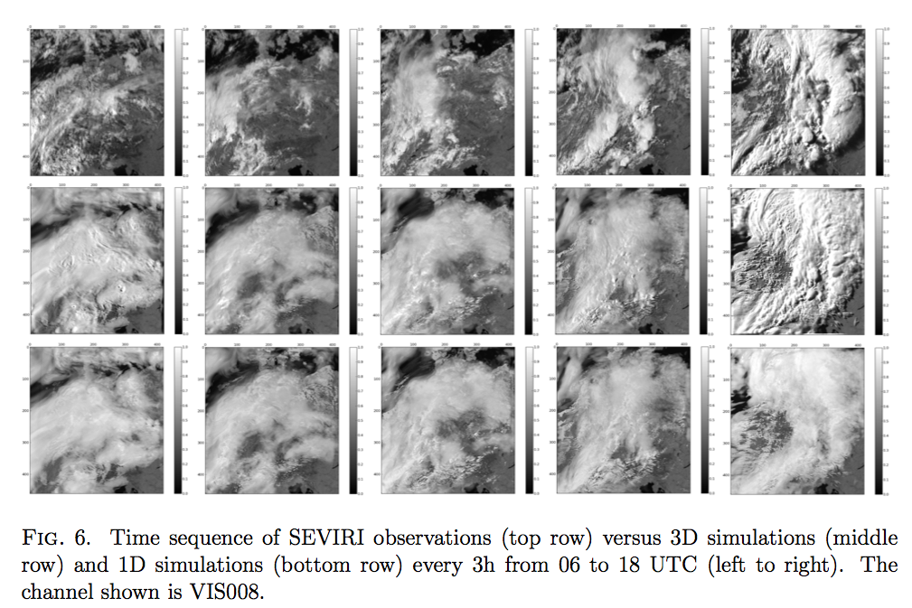
3D Effects in the Vis/NIR
06 UTC
09 UTC
12 UTC
15 UTC
18 UTC
Courtesy P.M. Kostka

